Slide 1
Making Web Interactive
Sajid Rabbani
Senior Software Engineer
Nascenia

Slide 2
What is Javascript
First of all, it has nothing to do with Java!
It is a dynamic programming language
Commonly used as a part of web browsers
Syntax is derived from C

Slide 3
What does Javascript do?
Helps to interact with the user
Controls the browser
Communicates asynchronously (AJAX)
Alters the document content
Provides client side validation

Slide 4
Lets See some javascript action!!

Slide 5
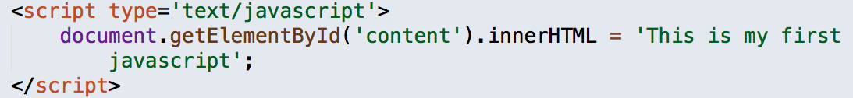
<script> Tag

Slide 6
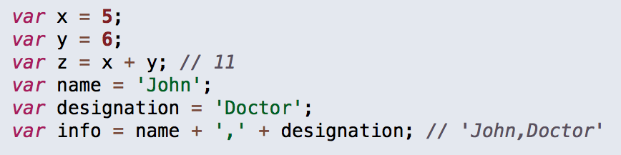
Javascript variables & statements

Slide 7
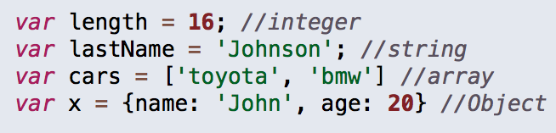
Javascript Data Types

Slide 8
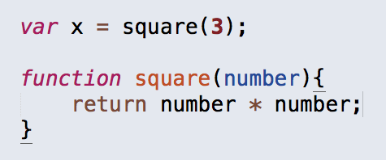
Functions

Slide 9
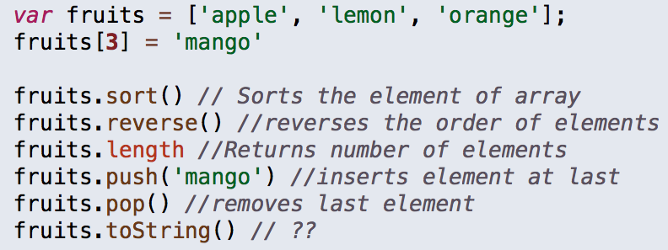
Arrays & Some Methods

Slide 10
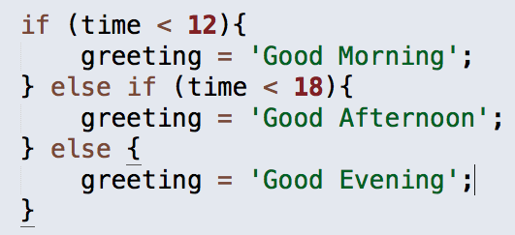
Conditions

Slide 11
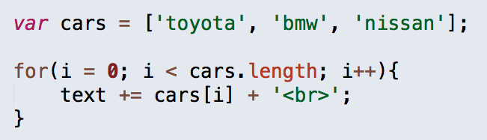
Loops

Slide 12
Events

Slide 13
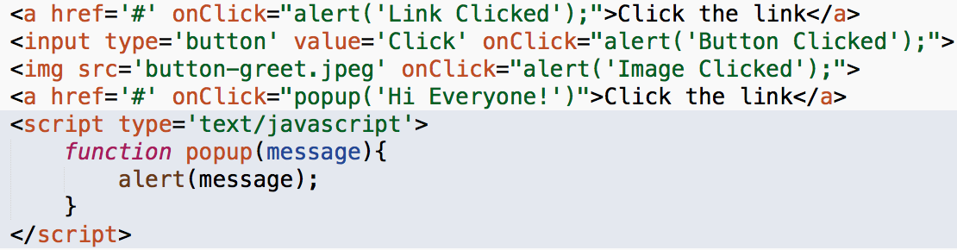
onClick Event

Slide 14
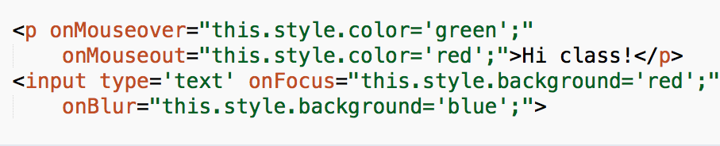
Some more events!

Slide 15
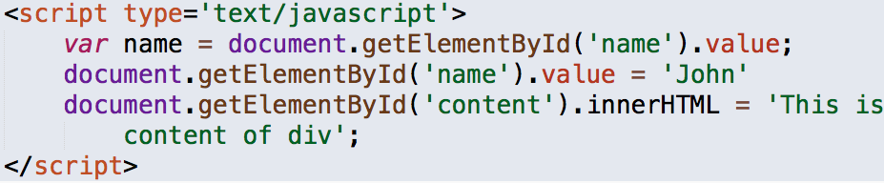
Getting & Setting Values

Slide 16
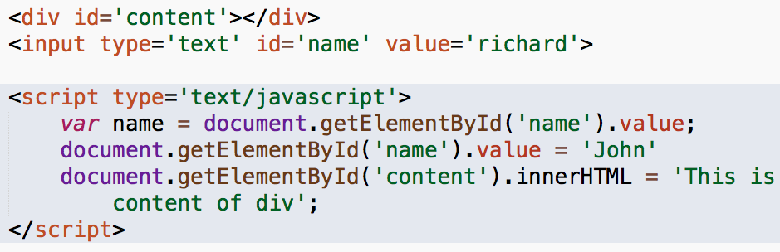
Getting & Setting Values

Slide 17
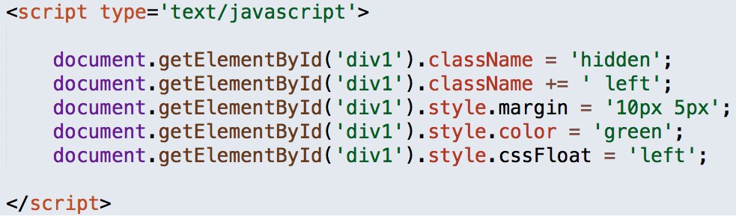
Manipulating CSS Styles

Slide 18
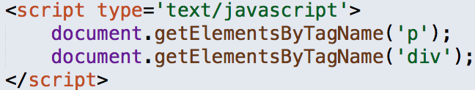
Target elements by Tag name

