Slide 1
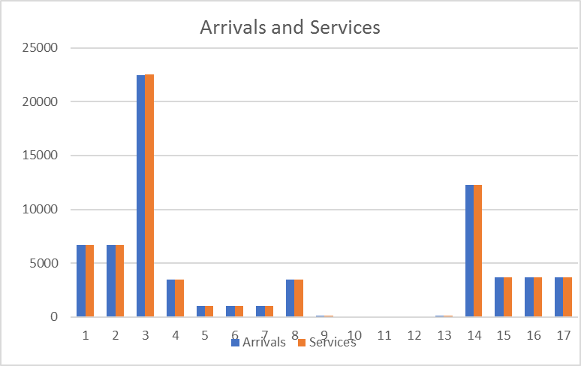
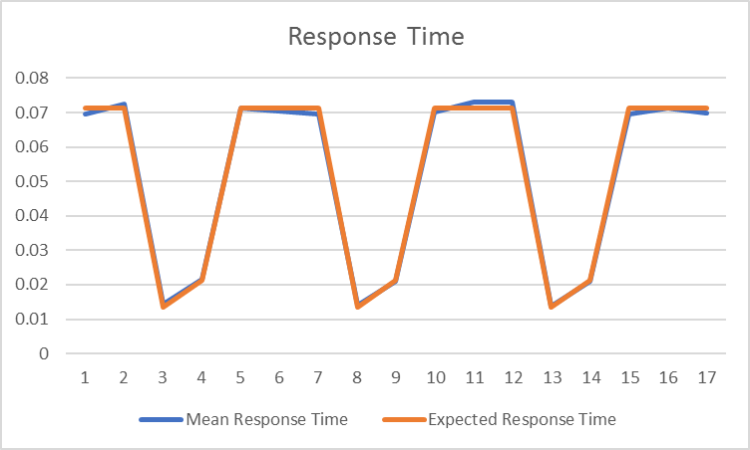
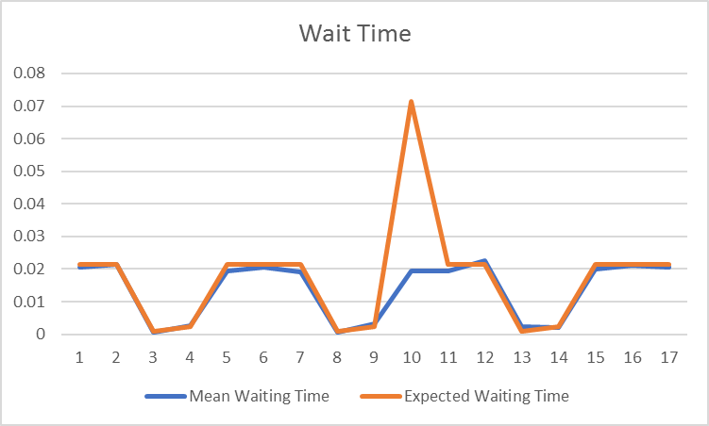
Arrivals | Services | Mean Response Time | Expected Response Time | Mean Waiting Time | Expected Waiting Time | Mean Queue Length | Expected Queue Length | Mean Number of Customers | Expected Number of Customers | Server Utilization | Expected Server Utilization | Server Idle | Expected Server Idle
6701 | 6698 | 0.069429 | 0.071429 | 0.020546 | 0.021429 | 0.123394 | 0.128571 | 0.416597 | 0.428571 | 0.293203 | 0.3 | 0.709745 | 0.7
6701 | 6700 | 0.072395 | 0.071429 | 0.02149 | 0.021429 | 0.128853 | 0.128571 | 0.434088 | 0.428571 | 0.305234 | 0.3 | 0.696463 | 0.7
22488 | 22506 | 0.01443 | 0.013514 | 0.000619 | 0.001014 | 0.002276 | 0.006081 | 0.0491949 | 0.0810811 | 0.046919 | 0.075 | 0.950996 | 0.925
3480 | 3479 | 0.021704 | 0.021277 | 0.002664 | 0.002409 | 0.016149 | 0.014452 | 0.131548 | 0.12766 | 0.1154 | 0.113208 | 0.887644 | 0.886792
1028 | 1026 | 0.071186 | 0.071429 | 0.01932 | 0.021429 | 0.113461 | 0.128571 | 0.418402 | 0.428571 | 0.30494 | 0.3 | 0.695525 | 0.7
1028 | 1027 | 0.070398 | 0.071429 | 0.020452 | 0.021429 | 0.120222 | 0.128571 | 0.413822 | 0.428571 | 0.2936 | 0.3 | 0.713035 | 0.7
1028 | 1028 | 0.069534 | 0.071429 | 0.019009 | 0.021429 | 0.111705 | 0.128571 | 0.408612 | 0.428571 | 0.296907 | 0.3 | 0.706226 | 0.7
3479 | 3480 | 0.014045 | 0.013514 | 0.000576 | 0.001014 | 0.002139 | 0.006081 | 0.0483392 | 0.0810811 | 0.0462 | 0.075 | 0.95286 | 0.925
159 | 157 | 0.020918 | 0.021277 | 0.003271 | 0.002409 | 0.017544 | 0.014452 | 0.112206 | 0.12766 | 0.094662 | 0.113208 | 0.886792 | 0.886792
45 | 44 | 0.070199 | 0.071429 | 0.019546 | 0.071429 | 0.116274 | 0.128571 | 0.417594 | 0.428571 | 0.30132 | 0.3 | 0.733333 | 0.7
46 | 45 | 0.073034 | 0.071429 | 0.019305 | 0.021429 | 0.112696 | 0.128571 | 0.426353 | 0.428571 | 0.313656 | 0.3 | 0.717391 | 0.7
45 | 45 | 0.073134 | 0.071429 | 0.022627 | 0.021429 | 0.137278 | 0.071429 | 0.443697 | 0.428571 | 0.306419 | 0.3 | 0.777778 | 0.7
159 | 157 | 0.013676 | 0.013514 | 0.002427 | 0.001014 | 0.008339 | 0.006081 | 0.046996 | 0.0810811 | 0.038657 | 0.075 | 0.930818 | 0.925
12291 | 12289 | 0.020922 | 0.021277 | 0.002216 | 0.002409 | 0.013229 | 0.014452 | 0.124932 | 0.12766 | 0.111703 | 0.113208 | 0.893987 | 0.886792
3661 | 3660 | 0.069439 | 0.071429 | 0.019859 | 0.021429 | 0.120311 | 0.128571 | 0.42093 | 0.428571 | 0.300619 | 0.3 | 0.702813 | 0.7
3661 | 3660 | 0.071144 | 0.071429 | 0.02112 | 0.021429 | 0.127985 | 0.128571] | 0.43112 | 0.428571 | 0.303135 | 0.3 | 0.700355 | 0.7
3661 | 3660 | 0.069874 | 0.071429 | 0.020598 | 0.021429 | 0.124821 | 0.128571 | 0.423423 | 0.428571 | 0.298602 | 0.3 | 0.706364 | 0.7
…

