Slide 1
A Neural Network for
Skin Cancer Detection
Sarah Dutton, Jack Thomas, Jamey Yadon

Slide 2
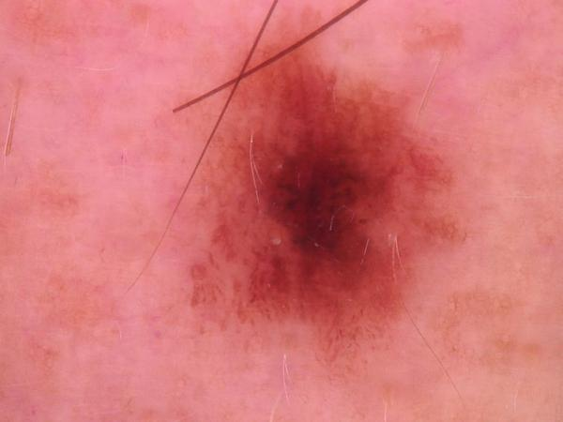
Introducing the Problem
Time is of the essence in skin cancer diagnosis. Image recognition technology can assist in early diagnoses by providing a recommendation regarding whether to seek medical attention.
Notes:
Jamey will introduce the problem and discuss the issues with hardware limitations.

Slide 3
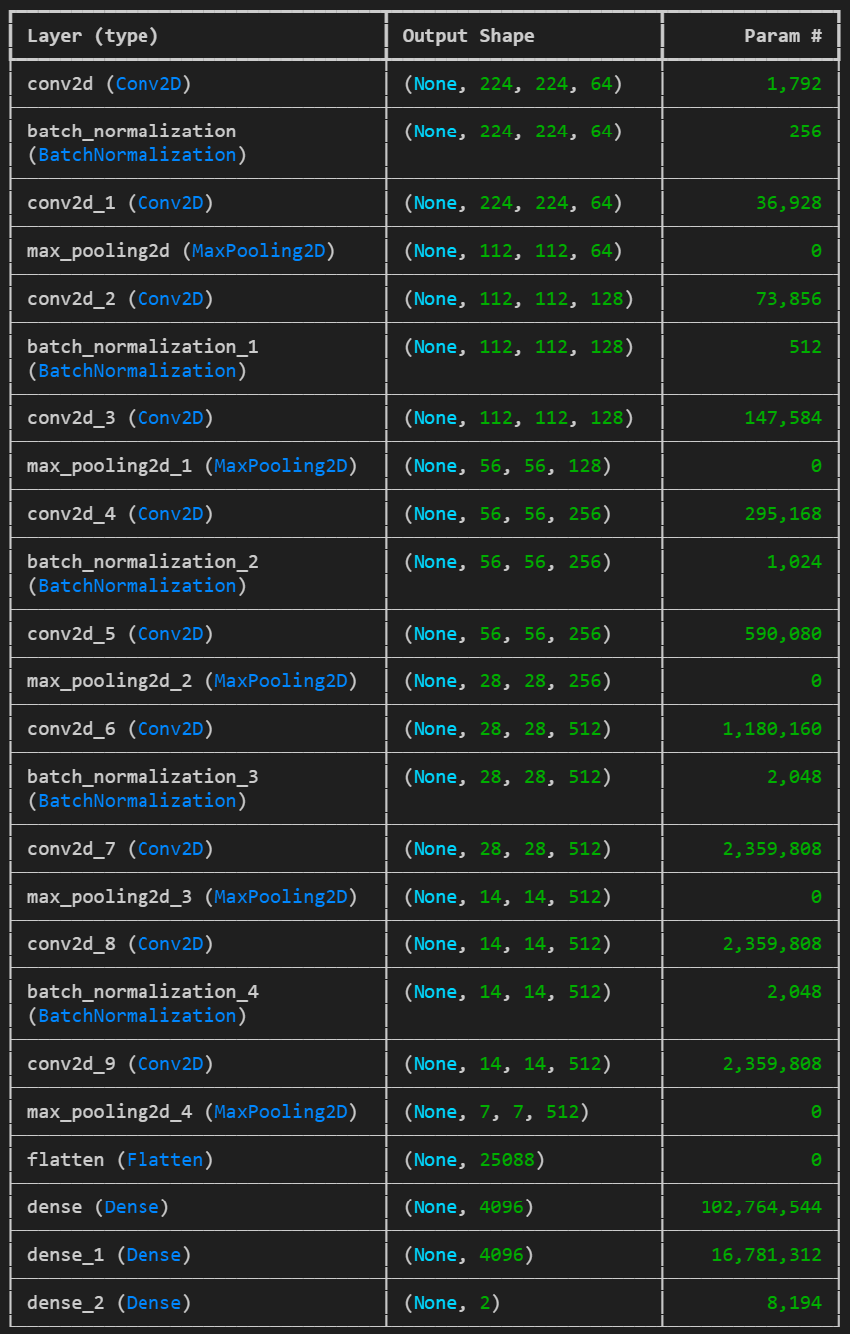
First Model
25 layers
129,000,000 parameters
10 training epochs
96.79% training accuracy
Notes:
Jack will discuss the problems getting the images loaded into a database and discuss the first model.

Slide 4
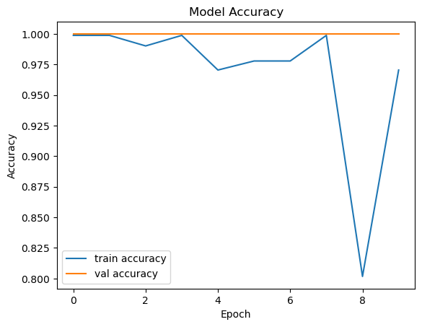
Problems with the First Model
The accuracy seems higher than one would expect from 10 epochs through such a large dataset.
There is an unexplained drop in accuracy at the ninth epoch.
Notes:
Jack will cover the ‘red flags’ we ran into with the first model.

Slide 5
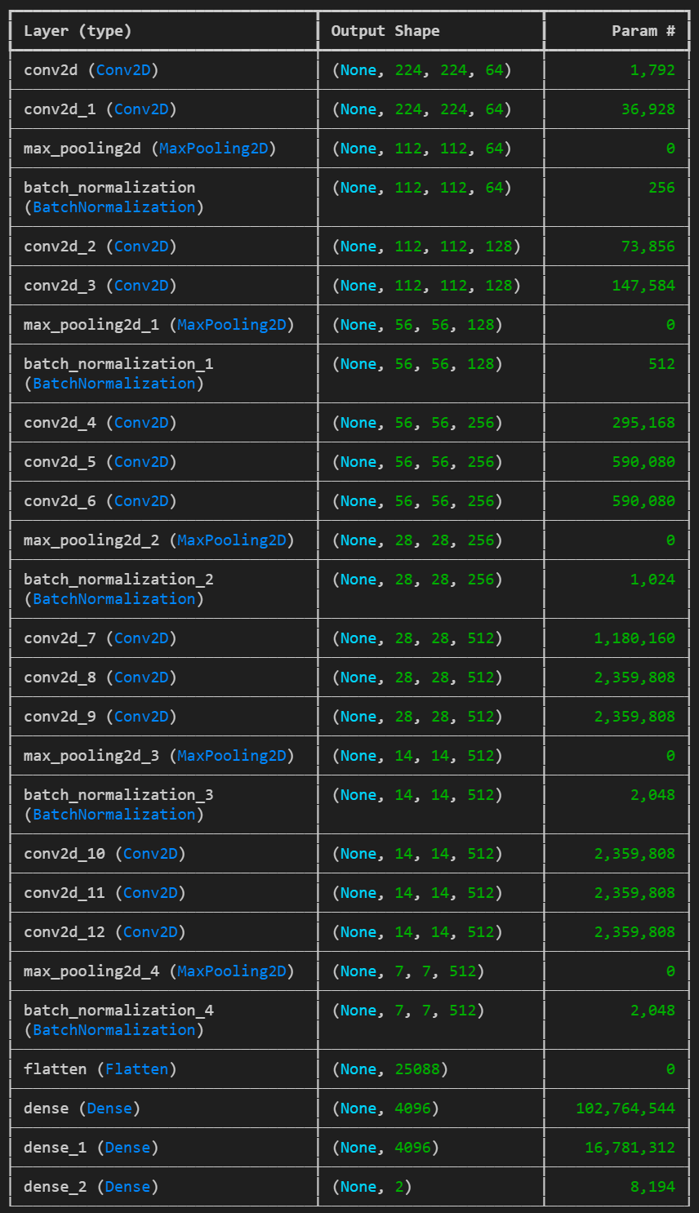
Second Model
27 layers
134,000,000 parameters
50 training epochs
Notes:
Sarah will cover training her model.

Slide 6
Next Steps for Further Improvement
Expand to a categorical model to sort into all seven categories
Train two neural networks to work in conjunction: one on the tabular data, one on the images
Include age, sex, and localization data
Notes:
Jamey will discuss ways to improve the models if we had more time.

