Slide 1
External Validity of Experimental Social Preferences Games
By Sarah Xu

Slide 2
Roadmap
Motivation
Literature
Design
Analysis
Importance

Slide 3
Motivation
Social preferences: outcomes or beliefs of others affect an agents’ utility in any way
Altruism, social welfare, inequality aversion, reciprocity
Experiments in a laboratory setting
Dictator game, ultimatum game, etc…
Fehr and Schmidt (1999); Berg et al (1995); Hermann, Thoni, Gachter (2008)
Important question: can these results be generalized to real world situations?
Scrutiny/anonymity: Benz and Meier (2006)
Context: Ross and Ward (1996)
Stakes: Carpenter, Verhoogen, and Burks (2005)

Slide 4
Literature Review
Baran et al (2010): MBA alumni donations to their university vs. reciprocity behavior in trust game
Franzen and Pointner (2013): standard dictator games vs. misdirected mail containing money
In-lab behavior related to field behavior
Hill and Gurven (2000): ultimatum games vs. food production and sharing patterns
Goeschl et al (2015): public goods game vs. contributions to directly reduce CO2 emissions
No significant relationship

Slide 5
Literature Review
Galizzi and Navarro-Martinez (2017): crucial to conduct more systematic research
Self-reported social behaviors performed in the past
Decisions in seven experimental social preference games
Behaviors in five naturalistic field situations

Slide 6
Design
Wesleyan University seniors and recent alumni
Subjects complete two sets of tasks:
Self-reported survey questions
Various experimental games (dictator, ultimatum, trust, public goods games)
Donations data
Donating: altruism, reciprocity
Donating to Financial Aid: inequality aversion
Far-removed

Slide 7
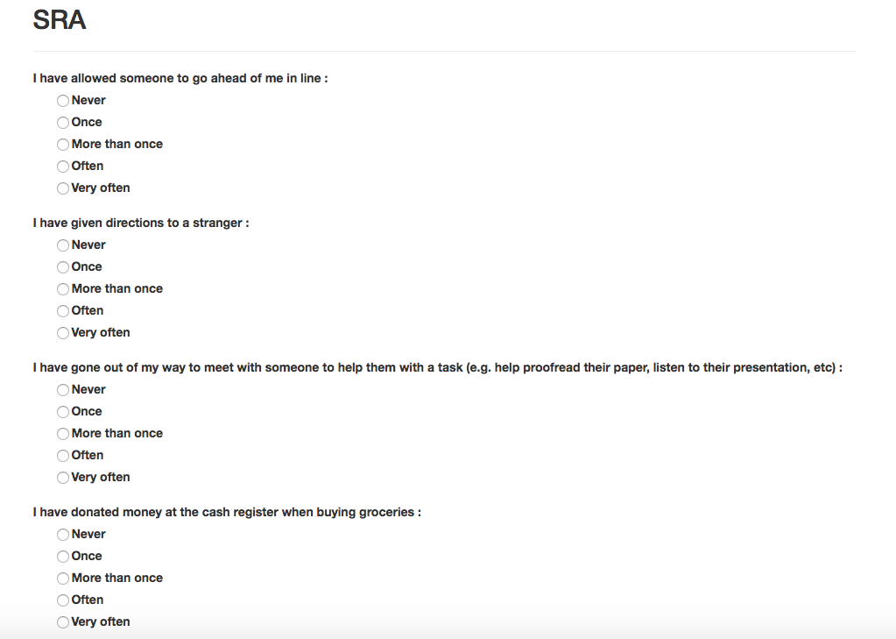

Slide 8
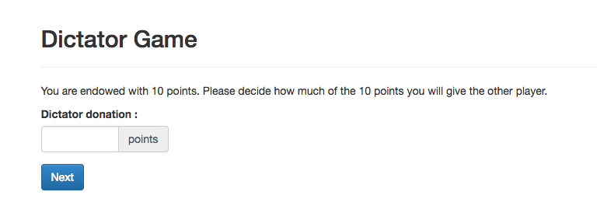
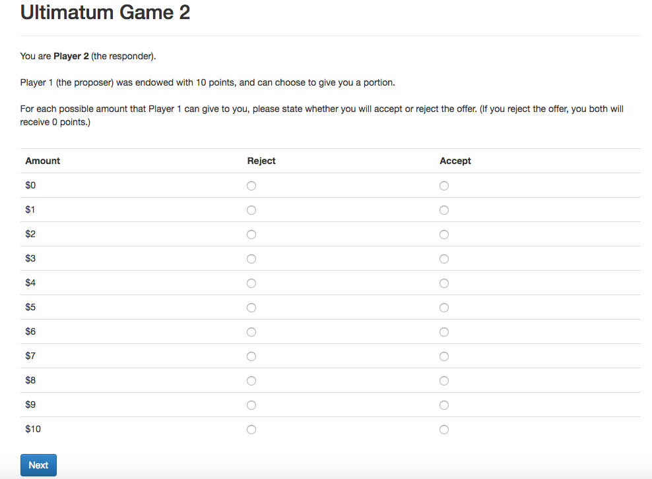

Slide 9
Analysis
Donations = ß₀ + ß₁DG + ß₂UG1 + ß₃UG2 + ß₄TG1 + ß₅TG2 + ß₆PGG
Pass rates and return ratio
Donations = ß₀ + ß₁SRA
Do experimental games or non-incentivized self-report questions better predict field measures?
Prediction errors

Slide 10
So What?
Add to the growing literature -- are experimental games a useful tool to examine social preferences?
Experimental games are costly
Payments
Time
Spark interest into future studies into the external validity of other behavioral economics topics where lab experiments are commonly used

