Slide 1
External Validity of Experimental Social Preferences Games
By Sarah Xu

Slide 2
Motivation
Social preferences: outcomes or beliefs of others affect an agents’ utility in any way
Altruism, social welfare, inequality aversion, reciprocity
Experiments in a laboratory setting
Dictator game, ultimatum game, etc…
Fehr and Schmidt (1999); Berg et al (1995); Hermann, Thoni, Gachter (2008)
Notes:
The standard economic model assumes actions are motivated purely by self-interest. However, it’s clear from simple observation that people actually care about the wellbeing of others: social programs exist, people volunteer, and people donate.
We say that a person has social preferences if the outcomes/beliefs of others affect their utility
different aspects such as altruism, inequality aversion, and reciprocity.
When researchers examine people’s social preferences, they typically use experiments in a laboratory setting

Slide 3
Games
Dictator Game: Players divide m dollars between themselves and another player so that π_{s} + π_{o} = m
Ultimatum Game: Similar to Dictator Game, except the second player chooses to either accept or reject the proposal. If the second player rejects, neither player receives any money.
Trust Game: Similar to Dictator Game, except the second player receives 3π_{o} and can return any amount back.
Public Goods Game: N-player game where each player receives m dollars, and chooses how much to put into a public fund. The total money in the public fund is multiplied by k, where 1 ≤ k ≤ N, and this “public good” is evenly divided among players.

Slide 4
Motivation
Can these results be generalized to real world situations?
Scrutiny/anonymity: Hoffman et al (1994)
Context: Ross and Ward (1996)
Stakes: Carpenter, Verhoogen, and Burks (2005) vs. Cherry, Frykblom, Shogren (2002)
Notes:
However, an important question is the extent to which the experimental games approach can be generalized to real world situations
Possible complications can arise when experimental findings are extrapolated to outside the lab
In practical scenarios, human behavior may be sensitive to a variety of factors not present in a lab setting
Scrutiny and anonymity may exaggerate pro-social behaviors
Hoffman et al (1994) found that almost 50% subjects donated at at least $3/$10 under a normal dictator game, but when subject-experimenter anonymity was added, only 16% gave at least $3.
Ross and Ward find that slightly changing the context of the scenario really matters -
Rates of defection in prisoner dilemma games swing wildly depending on whether subjects are playing a “community” or “wall street” game.
Varying the stakes may lead to significantly different results.
Inc in stakes from $10 to $100 causes median offer to drop from 40% to 20% of endowment, but interestingly Cherry, Frykblom, Shogren (2002) find no differences in offes across a $10 and $40 dictator game.

Slide 5
Literature Review
Baran et al (2010): MBA alumni donations to their university vs. reciprocity behavior in trust game
Franzen and Pointner (2013): standard dictator games vs. misdirected mail containing money
In-lab behavior related to field behavior
Hill and Gurven (2000): ultimatum games vs. food production and sharing patterns
Goeschl et al (2015): public goods game vs. contributions to directly reduce CO2 emissions
No significant relationship
Notes:
This has led to a surge in literature that examines people’s behavior in both lab setting and field situation, and comparing the two
Baran et al compare MBA alumni donations to their university with reciprocity behavior when playing trust games, and find that in-lab behavior is related to field behavior. On the other hand, Hill and Gurven use Paragay Indians and compare their behavior when playing ultimatum games with food-production and sharing patterns. They find no significant relationship. Along with other papers, the currently accumulated evidence is ambiguous, indicating that further research is needed.

Slide 6
Literature Review
Galizzi and Navarro-Martinez (2017): crucial to conduct more systematic research
Decisions in seven experimental social preference games
Behaviors in five naturalistic field situations
Notes:
However, Galizzi and Navarro-Martinez argue that these studies only look at one social preference game with one specific field measure, and that it is crucial to conduct more systematic research. For their design, they have participants answer a set of questions about social behaviors exhibited in the past, play a variety of social preference games in a laboratory, and also encounter naturalistic situations in the field. Examples of field situations include asking for help carrying boxes, or asking for donations to a children’s charity. Their overarching conclusion is that the games do a poor job explaining both the self-report measures and the field behaviors, although more systemic studies are needed to draw a definite conclusion.

Slide 7
Design
Generalized Dictator Game: Each participant makes a series of choices about how to divide points between themselves and Player 2. Every point that Player 1 earns will be worth 10, 20, 30 or 40 cents. Similarly for the earnings of Player 2.
Ultimatum Game:
Player 1: Each participant is endowed with 10 points, decide how much to send Player 2. They are told Player 2 may accept or reject the offer.
Player 2: Each participant is now the responder. They are given a list from 0 points to 10 points (in 1-point increments), and are asked whether they accept or reject each listed amount.
Notes:
For my design I will use Wesleyan University seniors and recent alumni as my subjects, and they will complete two sets of tasks.
I will be sending out an email that contains the link to the online experiment- everyone will have the same tasks.
First, they will play six different games.

Slide 8
Design
Trust Game:
Player 1: Each participant is endowed with 10 points, decide how much to send Player 2. The amount sent over is tripled, Player 2 may return some amount.
Player 2: Each participant is now the responder. They receive a list of all ten possible multiplied amounts that Player 1 could have chosen to send. For each amount, they choose how much to return.
Public Goods Game: Each participant is endowed with 10 points, decide how much to contribute to a group fund with one other player. The overall money in the group is multiplied by 1.5 and divided evenly between the two players.

Slide 9
Design
Self-reported survey questions
20 items: how frequently in the past they have done different actions related to social behaviors.
Donations data
Donating: altruism, reciprocity, cooperation
Donating to Financial Aid: inequality aversion
Far-removed
Notes:
The second task is to answer self-reported survey questions, The scale consists of 20 items, and participants report how frequently in the past they have done different actions related to social behaviors. Participants rated each statement on a scale from 0 (“never”) to 4 (“very often”).
For my field measure, I will be using Wesleyan donations data. I want to use this because donations can be related to behavioral constructs. For example, donating may represent altruism and reciprocity, and targeting donations towards Financial Aid can represent inequality aversion. Another reason I want to use donations data is because it is a far-removed situation. In Galizzi and Navarro-Martinez’ design, I feel like it doesn’t take much for participants to connect the field measure to the lab, so I want to make sure to use a naturalistic, far-removed field measure.
Reason why I picked the experimental games: can all be mapped to donating
Dictator, ultimatum, and trust game can be explained by altruism and inequality aversion
Trust game additionally with reciprocity
Public goods game could also be in line with donating because someone can choose to donate if they think that other alumni are also donating, but also cooperation’

Slide 10
Demo
https://wesleyan.co1.qualtrics.com/jfe/preview/SV_eKYuX12ySoZt2Sx?Q_CHL=preview

Slide 11
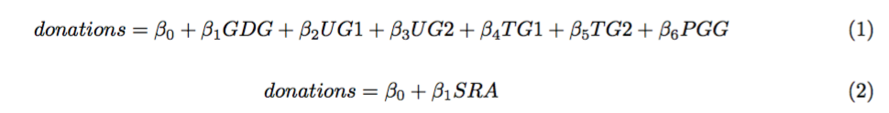
Analysis
UG1 = proposer’s pass rate (percentage of the initial endowment of points passed to the other player) in the ultimatum game
UG2 = minimum pass rate that the responder accepts in the ultimatum game
TG1 = proposer’s pass rate in the trust game
PGG = each player’s pass rate into the public fund
TG2 = responder’s reciprocity = regress passed back on the amount passed (slope)
SRA = self-report altruism score
Sum across the 20 items (“Never” = 0, “Once” = 1, “More than once” = 2, “Often” = 3, “Very often” = 4).

Slide 12
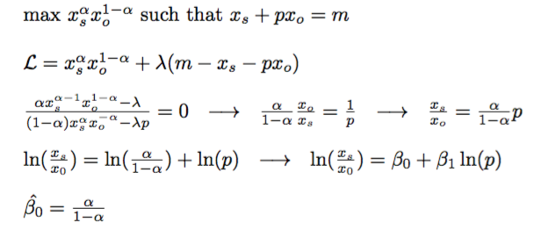
Analysis
GDG: Generalized dictator game consists of 11 different sets of endowments and prices of giving.
GDG = 1-α = sharing propensity

Slide 13
Analysis
Do experimental games or non-incentivized self-report questions better predict field measures?

Slide 14
So What?
Add to the growing literature -- are experimental games a useful tool to examine social preferences?
Experimental games are costly
Payments
Time
Spark interest into future studies into the external validity of other behavioral economics topics where lab experiments are commonly used

Slide 15
Timeline
2nd week of January: send out emails to Wesleyan seniors and recent alumni (UR)
Reminder emails
Set deadline to 2nd week of February
By end of February: payment
Analysis

