Slide 1

6110COMP User eXperience Design
Faculty of Engineering and Technology
School of Computer Science and Mathematics
Andy Symons Thomas Hughes-Roberts
a.symons@ljmu.ac.uk t.hughesroberts@ljmu.ac.uk
Room 717, Byrom Street Room 607b, Byrom Street

Slide 2

Lecture 2b – Dealing with Data

Slide 3
Learning outcomes
At the end of this session you should:
Understand how to do an initial cleanse of your data
Be Understand the concept of an outlier

Slide 4

In this session…
Conducting an initial analysis of your data.
Identifying possible data points to remove.
Outliers and their role in analysis.

Slide 5
Process Overview
Hypothesis?
Metric?
What data do we have – initial analysis…
Data?
Does any of the data points impact our validity?
Clean/Code Data
Distribution?
Parametric Tests
Non-Parametric

Slide 6
Goals of Statistical Analysis
Generalisation – if we have significance in our data then we can determine a relationship that we may be able to generalise.
And/or
Prediction – if certain relationships exist, can we predict based on characteristics that form those relationships?

Slide 7
Initial Data Analysis
What type of data do I have? Helps determine what tests we will do later on…
Four broad types:
Data Type | Description
Nominal | Labelling of variables without quantitative value – e.g. Gender, hair colour and so on.
Ordinal | Values on the scale have order but unknown difference – e.g. Likert scale of satisfaction (very satisfied, somewhat, neutral etc.).
Interval | Numeric scales where we know the order and exact difference between values – e.g. a temperature scale.
Ratio | As per interval but with an allowable “absolute zero”.

Slide 8
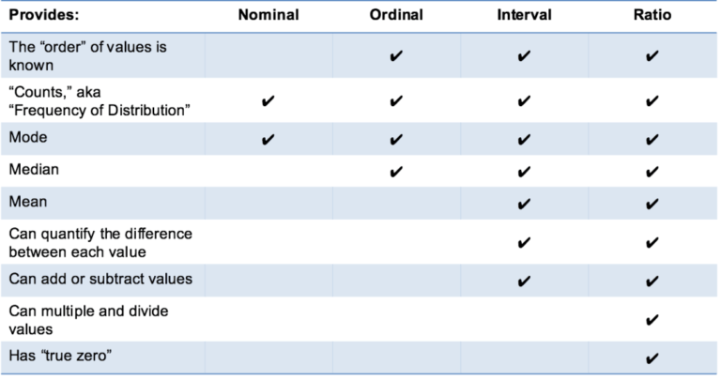
What data?

Slide 9
Why do we need to know?
What data we have determines how we intend to test it, what tests we are “allowed” to run.
We may need to re-code data if we find that certain assumptions are not met in order to run a test. More on this next week.
E.g. We have a non-normally distributed continuous variable – re-code to a categorical.

Slide 10
Example…
You have been given a number of metrics in your coursework dataset.
From lecture 2a – Task Success is a categorical variable (specifically nominal); either yes or no (incidentally, nominal variables with only two outcomes – dichotomous).
No of errors – continuous and so on.

Slide 11
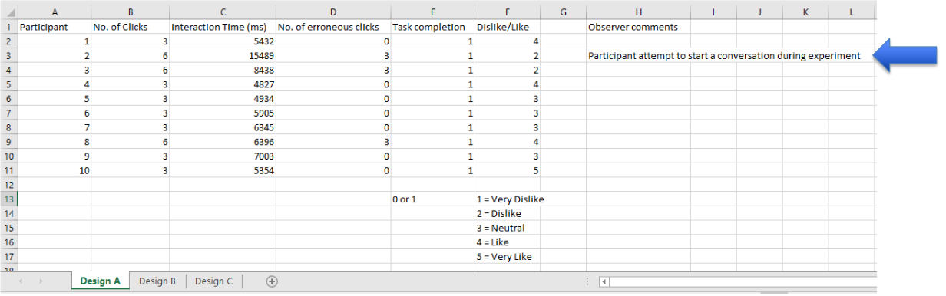
Cleaning Data
During our initial analysis we need to check the validity of the data that has been gathered.
This is why observational notes are very useful.

Slide 12
Task Completion
Did your participant complete their task?
If not, why? What does this mean for your other measures.
Should we include data for “number of clicks” if they did not complete their task? What about interaction time or erroneous clicks?

Slide 13
Cleaning Data Continued
Remove data that has been manipulated by outside intervention.
Invalid data points – data that is disconnected from the experiment – unique to the data point.
Erroneous data points – gathered in error or influenced by a mistake.

Slide 14
Outliers
Identify the outliers – results found at the “tails” of the data; i.e. “extreme” values.
Could be the most interesting cases…
Why are they outliers?
They should be rare, if not the experimental method may have issues.
Should have little statistical impact if they are rare.
Is the sample too small?
Did something else impact on the experiment?

Slide 15
Outliers…
Are there any extreme values?

Slide 16
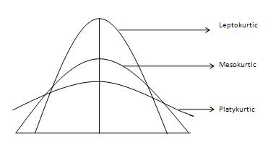
Evaluating the Tails - Kurtosis
The shape of the bell curve gives an indication of the quality of the data.
Kurtosis is a measure of outliers:
High Kurtosis – heavy tails, many outliers.
Low Kurtosis – light tails, low number of outliers.

Slide 17
Options for outliers
Delete the data.
Restrict the data collection to controlled limits in the first place.
Replace with a median value – be careful at small sample sizes.

Slide 18
Summary
In this lecture, we have learned:
About data types and how to identify what data we have.
Initial data analysis – removing data that effects the validity of our experiment.

