Slide 1

6110COMP User eXperience Design
Faculty of Engineering and Technology
School of Computer Science and Mathematics
Andy Symons Thomas Hughes-Roberts
a.symons@ljmu.ac.uk t.hughesroberts@ljmu.ac.uk
Room 717, Byrom Street Room 607b, Byrom Street

Slide 2

Lecture 2c – Normalised or Not?

Slide 3
Learning outcomes
At the end of this session you should:
Understand what a normal distribution looks like.
Be able to determine if your dataset is normally distributed.

Slide 4

In this session…
Data distribution
Frequency graphs
Kolmogorov-Smirnov tests for normality.

Slide 5
Process Overview
Hypothesis?
Metric?
Data?
Clean/Code Data
Do we have a normal distribution?
Distribution?
Parametric Tests
Non-Parametric

Slide 6
Normal Distribution – when?
In order to further identify what test we can run, we need to ascertain if our data is normally distributed – assuming it is a continuous variable.
For example, task completion is not a continuous variable but categorical and therefore we do not run a test for normality – which automatically rules out certain statistical tests.

Slide 7
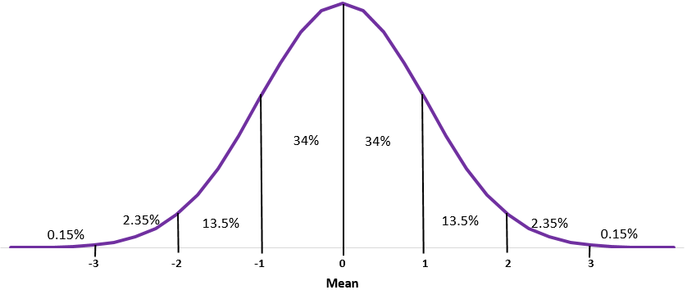
A Normal Distribution
Continuous data that has a symmetric distribution – a bell shape.
Get an idea from a graphical view of the data….

Slide 8
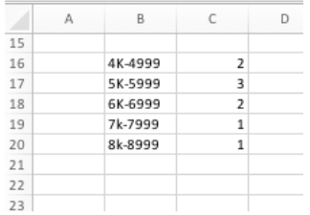
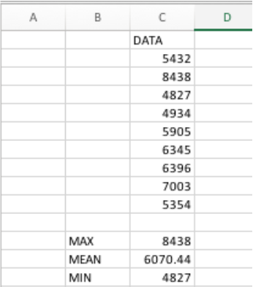
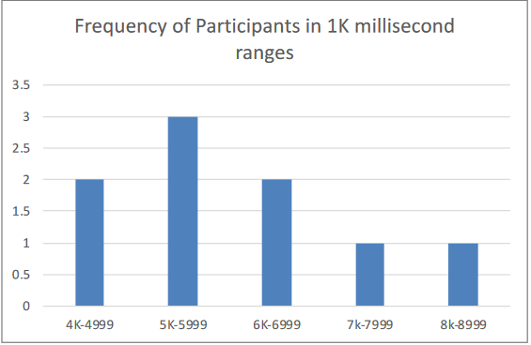
Frequency Distribution
From some sample data (worksheet provided in this weeks session), we can plot a range of interaction times.

Slide 9
However…
Just viewing the data in this format does not lend itself well to accuracy…
We have formal tests we can run against the data to determine its distribution.

Slide 10
Kolmogorov-Smirnov Test
A test that can determine if a single sample of data is normally distributed.
Using a Hypothesis/null hypothesis testing:
H1: The data is not normally distributed.
H0: The data is normally distributed.

Slide 11
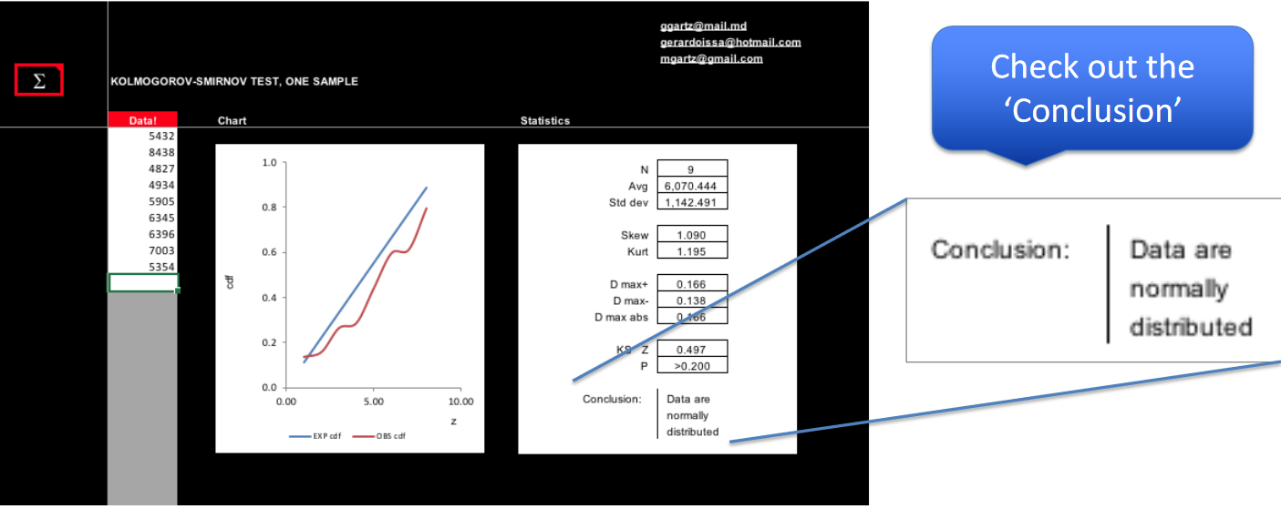
Using Excel
We have provided a spreadsheet sourced online for you to run a KS test on your data.
Our data

Slide 12
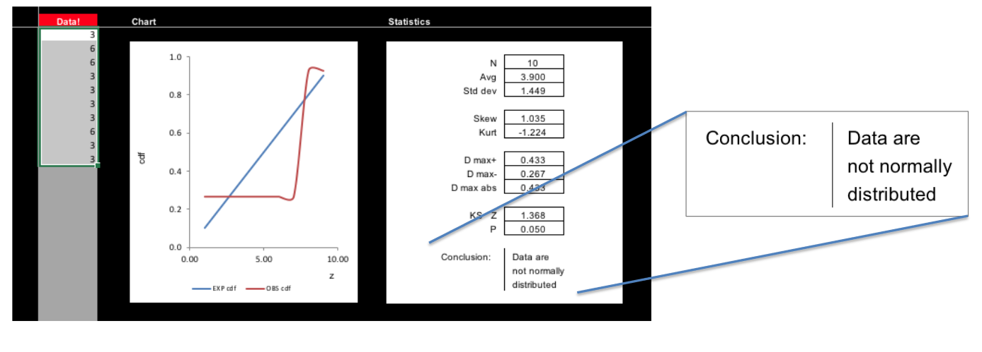
KS Tests continued
Significant Value:

Slide 13
Note…
This test tends to be used on larger sample sizes.
However, for the purposes of this module it provides a good starting point for evaluating normality.
Shapiro Wilk is a similar test that could be utilised.

Slide 14
Be aware…
We will cover the statistical tests the module will deliver next week.
For now, note that all tests have a set of assumptions that we must meet in order to utilise that particular test.
These assumptions include (but are not limited to) the data type (nominal, ordinal etc.) and the distribution of the data.
E.g. https://statistics.laerd.com/statistical-guides/independent-t-test-statistical-guide.php

Slide 15
Summary
In this lecture, we have learned:
To identify normalised data.
From the lectures this week, we should know:
What kind of data we have.
How to “treat” the data.
What our data distribution is.

