Slide 1
Basic Calculator with GUI
Sarah Fadenrecht
CS3080 001
Zanyar Zohourianshahzadi
December 9, 2025

Slide 2
What is the Basic Calculator
2
A simple, functional desktop calculator
Performs: addition, subtraction, multiplication, division
Includes backspace and clear features
GUI built with Tkinter
Notes:
I designed this calculator with all the core operations you expect, including a backspace and clear feature. I also designed the GUI using Tkninter and modified the look to include a pink theme.

Slide 3
Program Structure
3
CalculatorLogic class
  Stored and updates the expression in the window
  Validates characters
  Handles calculation using Python’s eval()
CalculatorApp (Tkinter GUI class)
  Builds the display area
  Creates and places buttons
  Connects buttons to logic
  Adds pink styling
Notes:
The program is separated into two classes. CalculatorLogic handles the math operations, while CalculatorApp builds the GUI which inherits from Tkinter’s base class – this means the calculator is a TK window and I extend its behavior by adding widgets and logic.

Slide 4
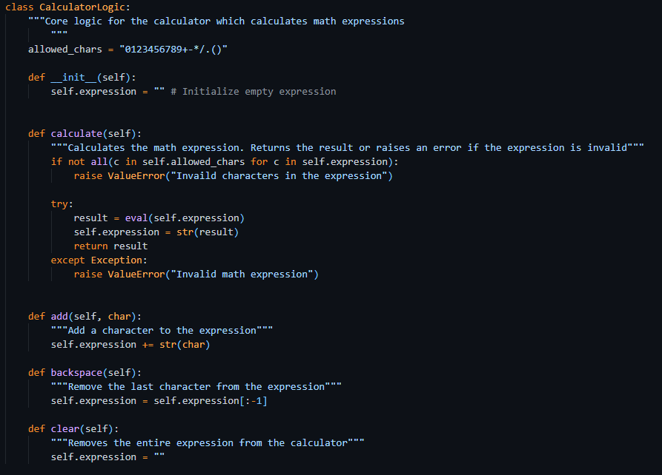
Calculator Logic
The “brain” of the calculator.
Notes:
CalculatorLogic
Handles the internal functionality of the calculator:
Stores and updates the math expression
Ensures only valid characters are accepted
Evaluates the expression using Python's eval() function
Clears or deletes characters from the expression

Slide 5
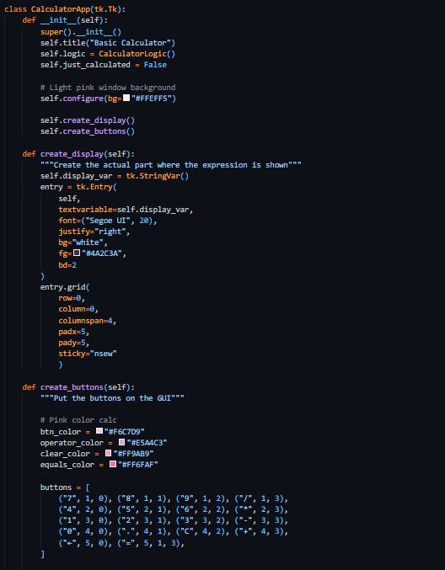
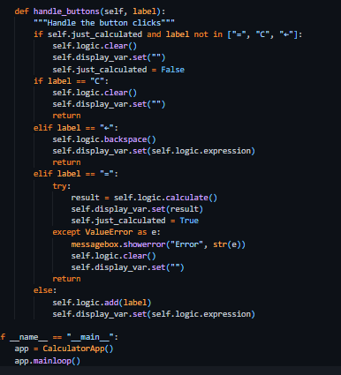
CalculatorApp
The GUI
Notes:
CalculatorApp
Inherits from tk.Tk
Creates and arranges all buttons and the display entry field
Applies simple color styling for a light pink theme
Connects UI button actions to the logic class
Updates the display based on user interactions
Separating the logic from the interface improves readability and maintainability.

Slide 6
What I learned
Key Takeaways:
Basics of GUI development with Tkinter
How to bind buttons to functions
Practical debugging
Styling with Tkinter
Sources:
https://docs.python.org/3/library/tkinter.html
https://www.geeksforgeeks.org/python/python-gui-tkinter/

