Slide 1
New method of thresholding – using Discrete Fournier Transformation for smoothing
Preliminary developments
Vivian Leung
27 November 2016

Slide 2
New method to address samples with many barcodes
Smooth data using Discrete Fournier Transformation, then invert DFT to retrieve data in original units
Identify threshold in rank-ordered transformed data according to first derivative: threshold is the segment with the greatest negative change.
Appears to work for both high and low numbers of barcodes

Slide 3
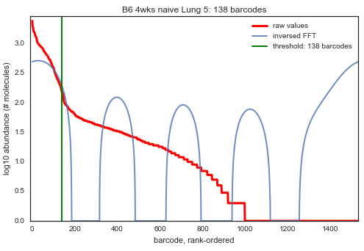
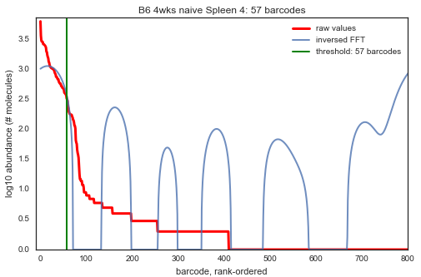
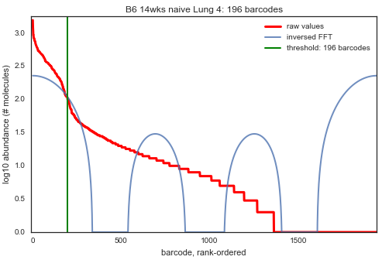
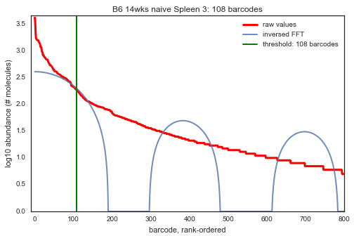
Ex. Naïve – represents one mouse at one time point
Lung
Spleen
Raw values
Transformed data
threshold
138 BC
57 BC
4 weeks
196 BC
108 BC
14 weeks
In folder: figs-png-indiv-all or …-svg--...

Slide 4
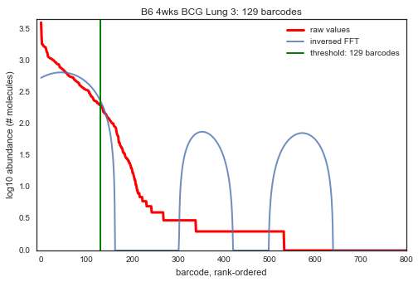
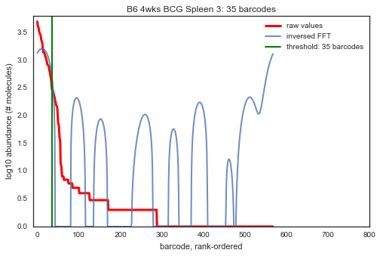
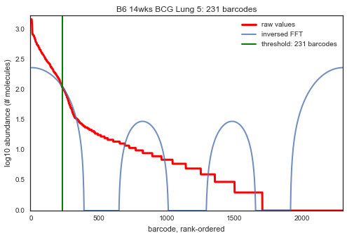
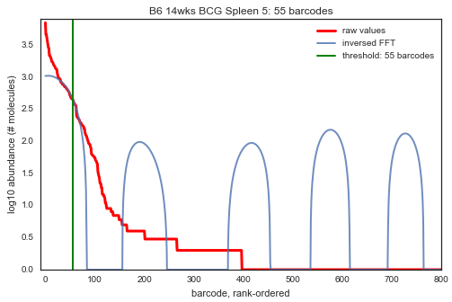
Ex. BCG – represents one mouse at one time point
Lung
Spleen
Raw values
Transformed data
threshold
129 BC
35 BC
4 weeks
231 BC
55 BC
14 weeks
In folder: figs-png-indiv-all or …-svg--...

Slide 5
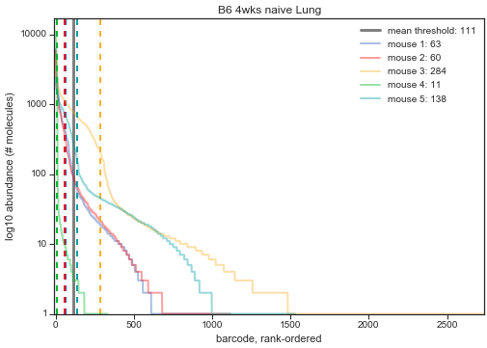
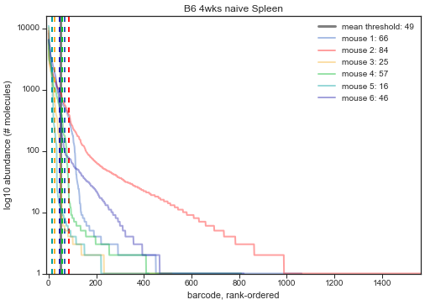
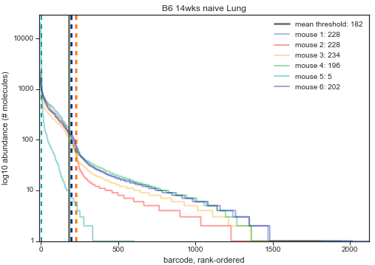
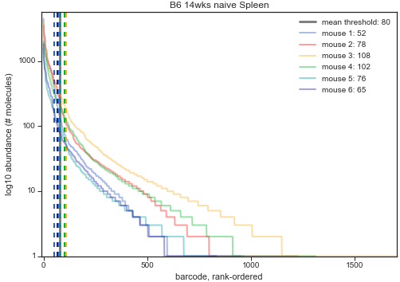
Lung
Spleen
Naïve:
each line represents one mouse (same time point, tissue)
Mean: 111
Mean: 49
4 weeks
14 weeks
Mean: 182
Mean: 80
In folder: figs-png-group-reps-all or …-svg--...

Slide 6
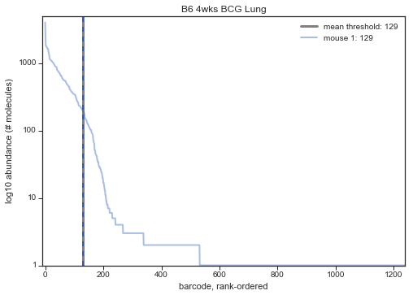
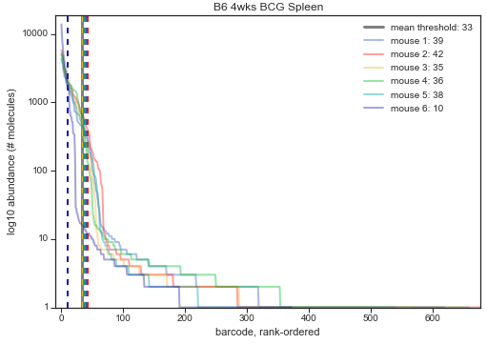
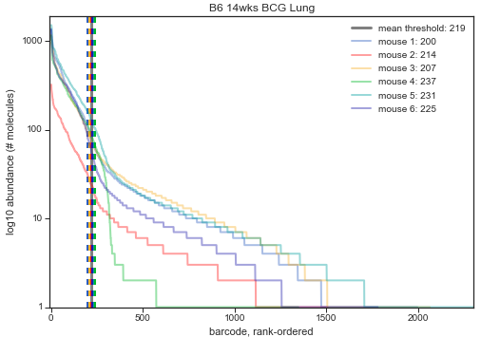
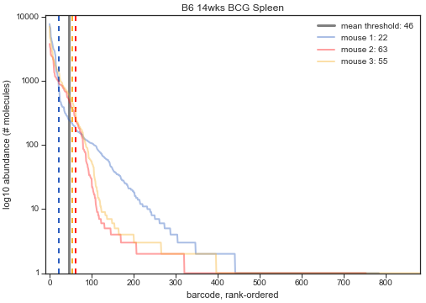
Lung
Spleen
BCG:
each line represents one mouse (same time point, tissue)
129 BC
Mean: 33
4 weeks
14 weeks
Mean: 219
Mean: 46
In folder: figs-png-group-reps-all or …-svg--...

Slide 7
Data in folder
thresholded-mouse.csv : thresholds of all – each entry/ row is a tissue of a mouse (i.e. one genotype-time-tbstrain-tissue-rep(mouse))
thresholded-by_rep-mouse.csv: thresholds arranged by reps. Each row represents one condition/tissue (i.e. one genotype-time-tbstrain-tissue). Data are sorted by rep into columns; each column represents the rep identified in the manifests.

