Slide 1
Time SERIES Forecasting Model to Predict Future Forest Areas Sarah Mahlangu

Slide 2
Introduction
Project Overview: This project focuses on building a time series forecasting model to predict future trends in the world’s forest area, based on historical data. The primary goal is to forecast changes in the percentage of land area covered by forests. This information can help policymakers, environmental organizations, and researchers understand future patterns of deforestation or afforestation and take proactive measures to protect the world’s forests. The significance of this project lies in its potential to provide insights into global forest trends, which are crucial for environmental Conservation, policy and regulation, sustainability and research
Data Overview: The forest area dataset contains percentage forest areas for 256 different countries. The dataset spans several decades from 1990 to 2021, with yearly data points available for analysis.
Project Objectives:
Data Preprocessing & Exploration: Cleaning, preprocessing and exploratory data analysis.
Feature Engineering: Creating new features from the existing dataset for modeling purposes.
Model Development: Training and comparing different machine learning models.
Model Evaluation: Using metrics such as mean absolute error to assess model performance.

Slide 3
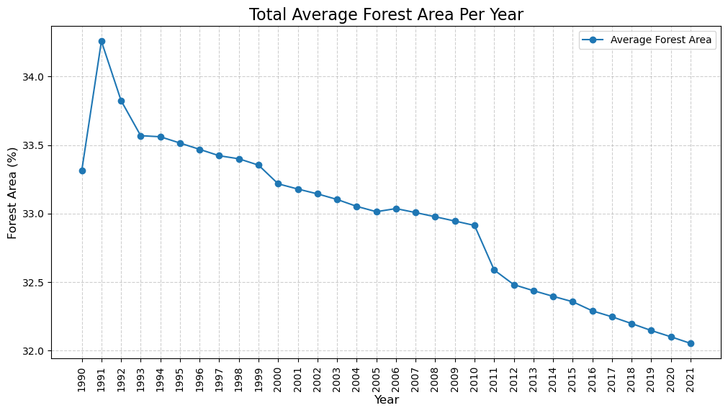
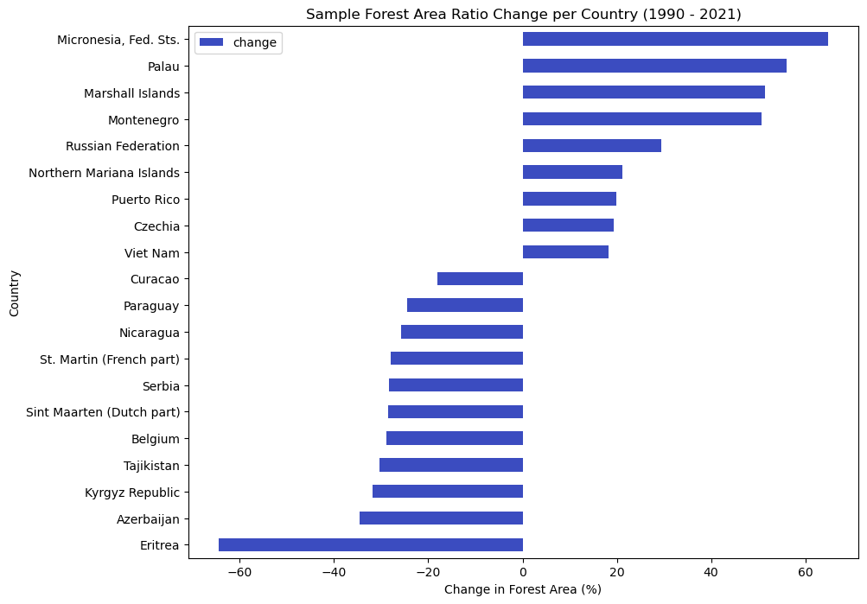
Exploratory data analysis
Countries such as Micronesia, Montenegro and Russian federation have an increased forestation over the years while counties such as Indonesia, slovak Republic and brazil have experienced significant deforestation.
There is a general downward trend in the forest area percentage over the years, indicating a decrease in overall forest coverage. There was a significant increase in average percentage forest area in 1991 followed by a decrease in the following years.

Slide 4
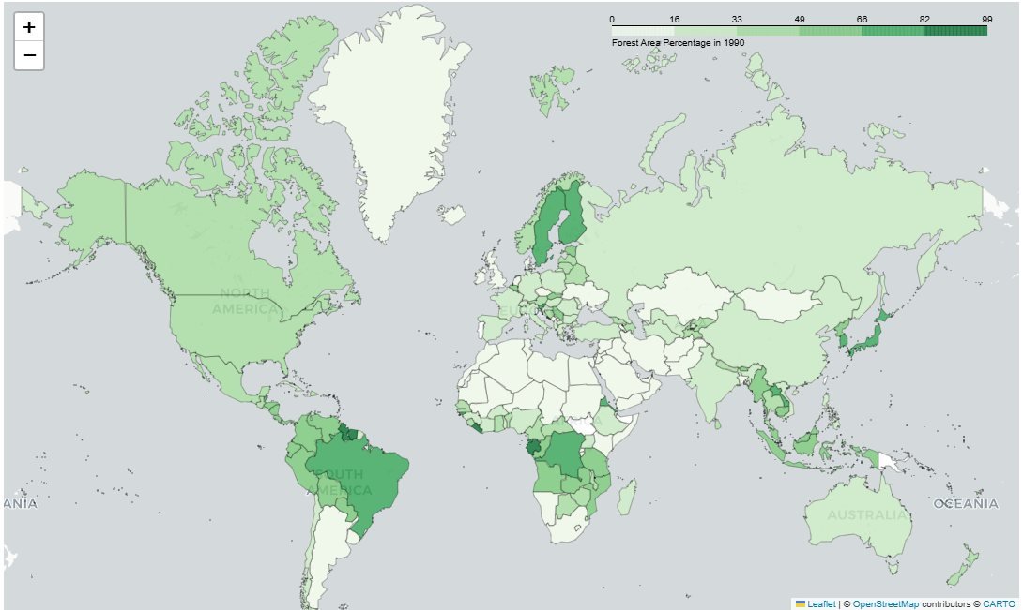
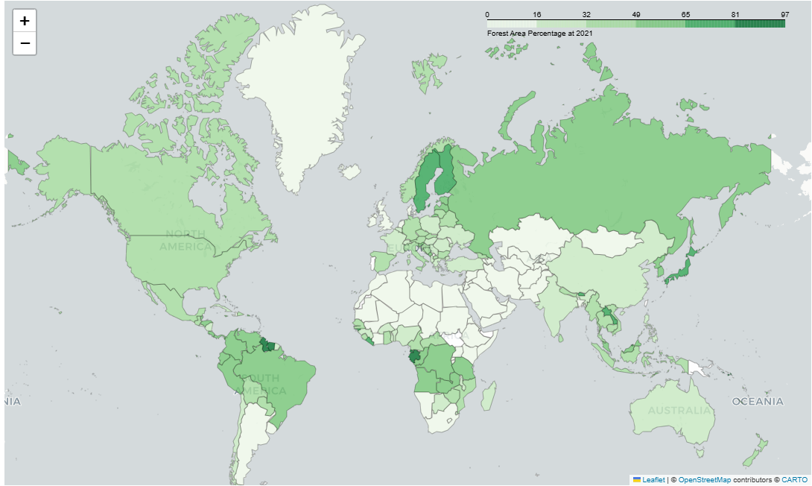
Exploratory data analysis
Forestation in 2021
Nations such as Germany, Canada, the United States, and China maintained a mix of forested and non-forested land, with forest coverage ranging between 30% and 70%. Canada had about 3.47 million km² of forest, while China’s forest area was around 2.22 million km².
The United States, despite having large forested areas, had only about 30.8% forest coverage relative to its land area.
Some regions, such as Egypt, Saudi Arabia, and other desert nations, had minimal forest cover, with forests covering less than 1% of their total land area. Deforestation in heavily impacted countries like Haiti and parts of Southeast Asia further contributed to this category.
Forestation in 1990
Countries like Suriname, Guyana, Finland, Sweden, and Russia had significant forest cover, often exceeding 70% of their total land area.
Nations such as Germany, Canada, the United States, and China had a balanced mix of forests and other land uses, with forest coverage ranging between 30% and 70%.
Countries like India, Pakistan, South Africa, and parts of the Middle East had relatively low forestation due to arid climates, urbanization, and agricultural expansion.
Some regions, such as desert nations (e.g., Saudi Arabia) and highly deforested countries (e.g., Haiti), had minimal to no forest coverage.

Slide 5
Model Development
Data collection
Data downloaded from Kaggle
Data pre-processing
1. Impute nulls by interpolation
2. Remove outliers and incorrect data points
Model Training
Three time series forecasting models trained
1. Logistic Regression
2. Random Forest
3. ARIMA
Evaluation
1. Mean absolute error

Slide 6
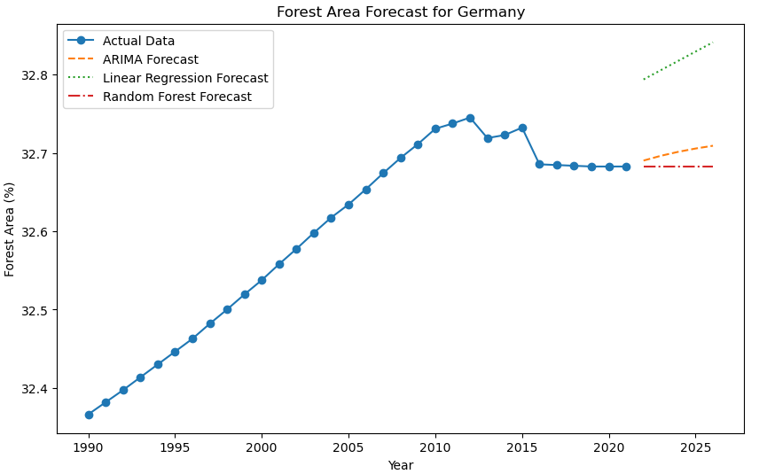
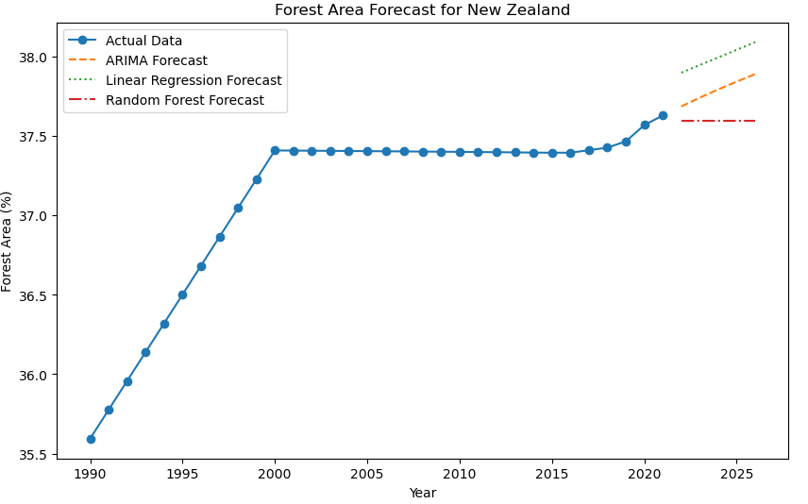
Model RESULTS|MODEL metrics and runtime
Country | MAE ARIMA | MAE Linear Regression | MAE Random Forest
Afghanistan | 0.00 | 0.00 | 0.00
Algeria | 0.01 | 0.04 | 0.00
Burundi | 0.23 | 1.03 | 0.00
Denmark | 0.09 | 0.38 | 0.04
New Zealand | 0.29 | 0.49 | 0.11
Germany | 0.02 | 0.13 | 0.00
Pakistan | 0.26 | 0.30 | 0.09
Ukraine | 0.03 | 0.88 | 0.02
Thailand | 0.32 | 0.64 | 0.12
South Asia | 0.23 | 0.26 | 0.08
Model performance
ARIMA has the lowest MAE in most cases, indicating it is the best-performing model overall. It performs exceptionally well in Afghanistan (0.00), Algeria (0.01), and Germany (0.02).
Linear Regression generally has higher MAE compared to ARIMA. Notably poor performance in Burundi (1.03) and New Zealand (1.49), indicating it may not be suitable for these datasets
Random Forest has many zero or near-zero errors, indicating it may be overfitting or failing to capture trends in certain datasets. Performs well in Afghanistan (0.00), Algeria (0.00), and Germany (0.00).
Overall, ARIMA appears to be the best model overall, with lower MAE across most cases. Linear Regression struggles with complex time series patterns, especially in certain countries. Random Forest has inconsistencies, possibly indicating it struggles with time series dependencies.

Slide 7
Conclusion & FUTURE WORK
Insights:
The general decline in forest area percentage over the years highlights ongoing deforestation. While some countries (e.g., Micronesia, Montenegro, and Russia) have increased forestation, others (e.g., Indonesia, Slovakia, and Brazil) have seen significant losses. The spike in average forest area percentage in 1991, followed by a decline, suggests a data anomaly or policy-driven changes in forest conservation efforts.
Model Performance:
ARIMA is the most reliable model, achieving the lowest Mean Absolute Error (MAE) in most cases. However, it struggles in regions such as Thailand and Pakistan, possibly due to complex deforestation trends. Linear Regression has generally higher errors and performs poorly in regions with intricate patterns, such as Burundi and New Zealand. Random Forest shows inconsistencies, often achieving zero error but also struggling in some cases, suggesting it may be overfitting or failing to recognize temporal dependencies.
Conclusion:
The continuous decline in global forest coverage raises concerns about deforestation and environmental sustainability. While some nations have improved their forest area, significant deforestation in others outweighs these gains. Among the models tested, ARIMA proves to be the most effective for forecasting forest area changes, while Linear Regression and Random Forest show limitations in handling time series data.
Future Work:
In future we could combine ARIMA with other models (e.g., LSTM or Prophet) to enhance forecasting accuracy in regions where it struggles as well as introduce additional variables such as climate change indicators, economic policies, and reforestation programs to improve model performance. We can also integrate satellite imagery and GIS data to analyze deforestation at a finer scale and investigate the impact of conservation policies and economic incentives on forest trends to recommend data-driven interventions.

