Slide 1

mtcars
Hands On Lesson 6
Sarah Hagans

Slide 2
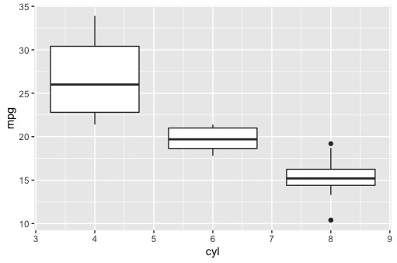
Mtcars boxplot
The more cylinders a car has seems to indicate a lower gas milage.
Notes:
library(ggplot2)
#make a box plot
ggplot(mtcars, aes(x = cyl, y = mpg)) + geom_boxplot(aes(group=cyl))
Table created with
mtcars %>% group_by(cyl) %>% summarize(count = n())

Slide 3
Code Used
head(mtcars)
library(dplyr)
#view mt cars
mtcars
library(ggplot2)
#make a box plot
ggplot(mtcars, aes(x = cyl, y = mpg)) + geom_boxplot(aes(group=cyl))
# group number of cars by how many cylinders.
mtcars %>% group_by(cyl) %>% summarize(count = n())

