Slide 1

Horsepower vs Vehicle Weight
By Quarter Mile Time
Sarah Hagans
Hands On L8

Slide 2
Coming Up…
Effect of Horsepower on Quarter Mile Time
Effect of Vehicle Weight on Quarter Mile Time
Conclusion

Slide 3
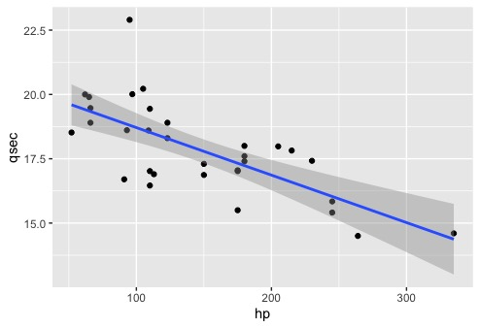
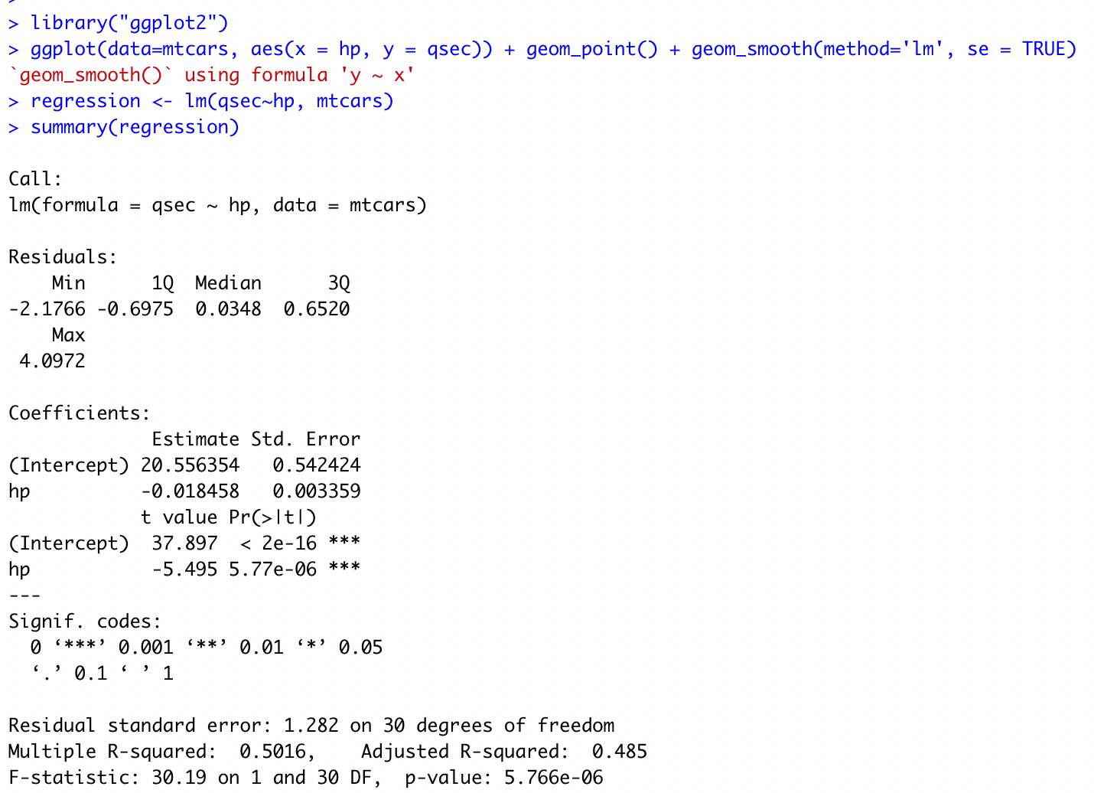
Effect of Horsepower on Quarter Mile Time
Negative Correlation
Horsepower explains about 48.5% variance of Quarter Mile Time.

Slide 4
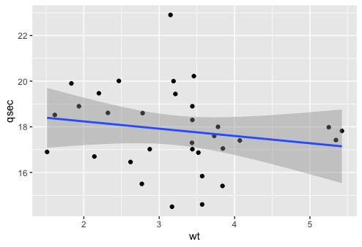
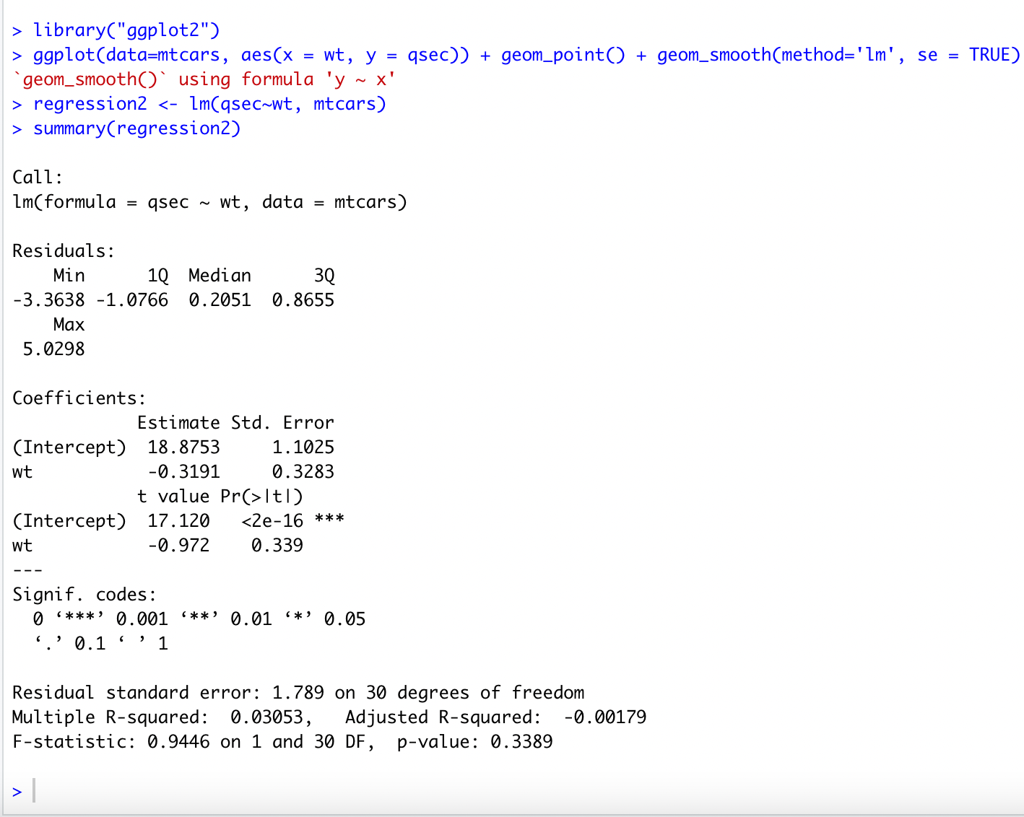
Effect of Vehicle Weight on Quarter Mile Time
Uncorrelated
The weight explains no significant percentage of variance on quarter mile time.

Slide 5
In Conclusion
Horsepower influences quarter mile start time where vehicle weight does not.
It is recommended to choose a car with higher horsepower to have a successful start in a race. The weight does not have an effect.

