Slide 1

Life Expectancy by Country
Lesson 9 Hands On
Sarah Hagans

Slide 2
Which Countries I Chose
Argentina
Bolivia
Chile
Dominican Republic
Ecuador

Slide 3
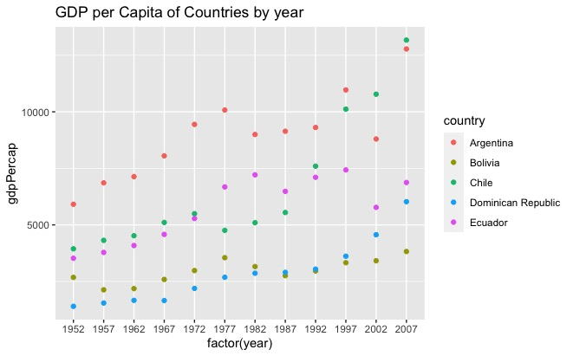
Highs and Lows of GDP per Capita
Highest in 1952 is Argentina
Highest in 2007 Chile
Lowest in 1952 Dominican Republic
Lowest in 2007 Bolivia

Slide 4
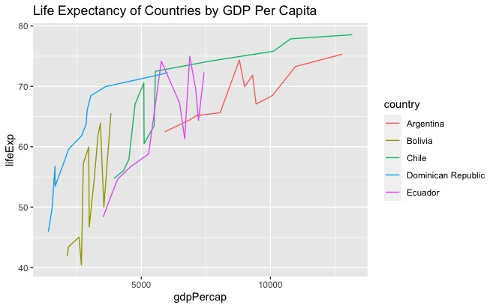
Life Expectancy and GDP
The main trend appears to be life expectancy increases with GDP. The relationship could be higher GDP leads to higher life expectancy.
Chile and the Dominican Republic (DR) have similar shapes but DR has an overall lower life expectancy with lower GDP.
The countries that have zig zags could be related to political unrest. GDP and life expectancy can be drastically affected by volatile political relations.

Slide 5
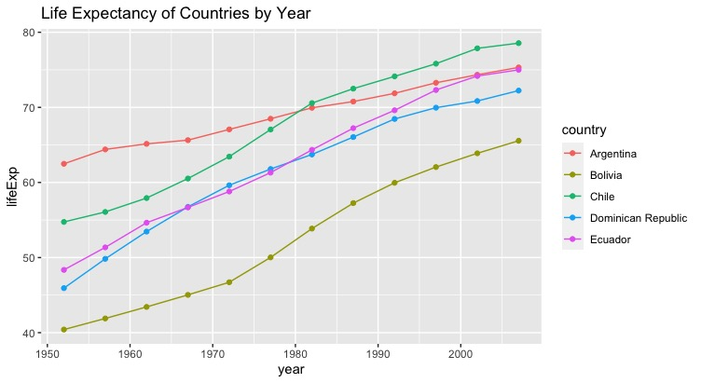
Life Expectancy
Life Expectancy of all countries have increased each year

Slide 6
Life Expectancy and gapminders.dataset
The only country that had a lower median than the median of the rest of the data set was Bolivia. This makes sense because Bolivia is one of the poorest countries in South America and has been this way for some time. Low GDP correlates to low life expectancy as shown previous slide.

