Slide 1

Rivers of North America
Hands On Lesson 5
Sarah Hagans
Code used is listed in notes and at the end of presentation.

Slide 2
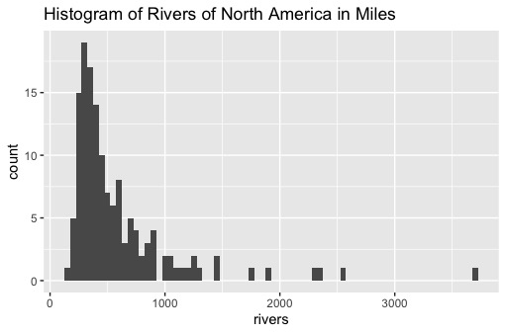
Histogram
This Data appears skewed to the right with outliers past 1,500 miles.
Notes:
Code:
rivers <- ggplot(rr, aes(x = rivers))
rivers + geom_histogram (binwidth = 50)+ ggtitle("Histogram of Rivers of North America in Miles")

Slide 3
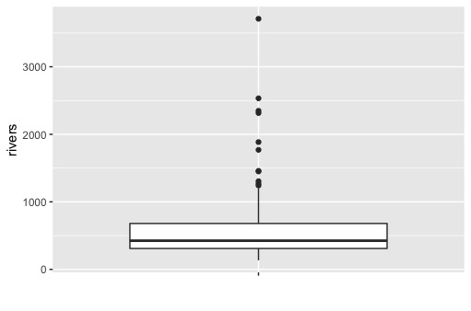
BoxPlot
Rivers Summary Statistics (in Miles)
Min. : 135.0
1st Qu.: 310.0
Median : 425.0
Mean : 591.2
3rd Qu.: 680.0
Max. :3710.0
There appears to be some high outliers between 1,500 to 4,000miles.
Notes:
Code:
summary(rr)
summary(rr$rivers)
rivers <- ggplot(rr, aes(x = "", y = rivers))
rivers + geom_boxplot() + xlab("")

Slide 4
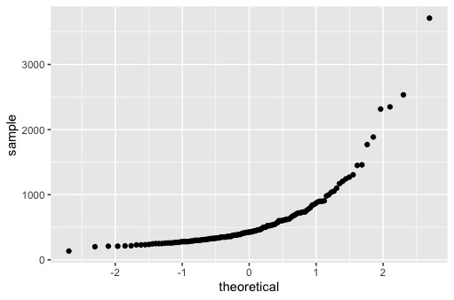
Distribution
This data does not appear normally Distributed. Which is understandable looking at the Histogram and boxplot. There are outliers on the high end of the dataset.

Slide 5
Code Used
rr = data.frame(rivers)
head(rr)
rivers <- ggplot(rr, aes(x = rivers))
rivers + geom_histogram (binwidth = 50)+ ggtitle("Histogram of Rivers of North America in Miles")
summary(rr)
summary(rr$rivers)
rivers <- ggplot(rr, aes(x = "", y = rivers))
rivers + geom_boxplot() + xlab("")
ggplot(rr, aes(sample = rivers)) + geom_qq()
Notes:
Code:
ggplot(rr, aes(sample = rivers)) + geom_qq()

