Slide 1

SUPERVISED MACHINE LEARNING
DSO106 L6
SARAH HAGANS

Slide 2
PREDICTING DIAMOND PRICES
We used supervised ML to predict the price of diamonds using the variables
Cut
Color
Clarity
Carat

Slide 3
Train Test Split
So When Machine Learning, You need to subset data to use to “train” a model and to “test” the model for accuracy.
With the method in this lesson, we can develop a linear regression model for prediction.

Slide 4
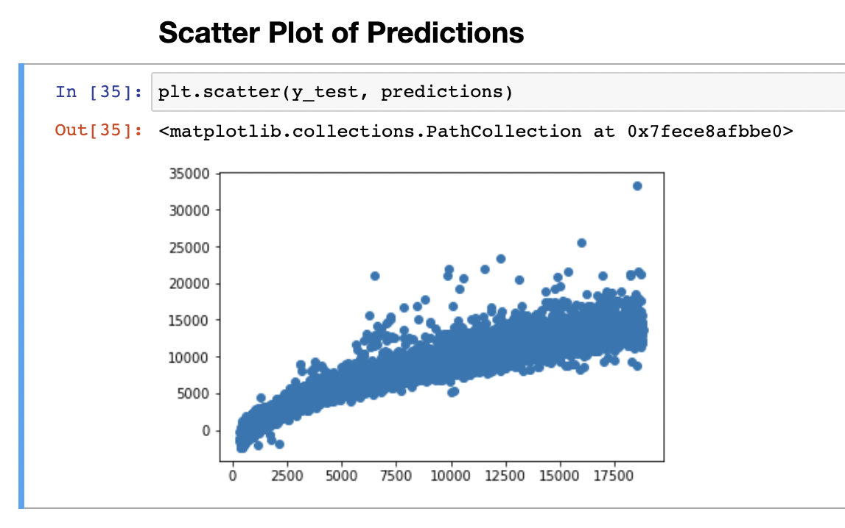
Linear Regression model
Here is the Scatter Plot of the predictions made with the linear regression model created earlier.
This looks like a good model. Very solid spread. Can over shoot the price possibly.

Slide 5
Acuracy Scores
THE accuracy Score : Score: 0.9043201853815037 VERY Good under 1!
MAE Score: 858.565179648647 Very big, but these gems tend to be hundreds of thousands of dollars so less than 1 thousand is alright IMO.
MSE Score:1535738.6746536687 Squared still big. Yikes.
RMSE Score: 1239.2492383107074 still big.

Slide 6
Cross Validation
5- iteration K-Fold score: 0.90505423, 0.90592706, 0.90134682
Interpretation? These look great to me. Those scores that were big before must just be from big dollar amount we are looking at.

