Slide 1
Not-So-Cryptic Cryptocurrency
A Research Project by: Matt Tolman, Phil Quintanilla, Sarah Heavner, and Tony Odom

Slide 2
Cryptocurrency Overview
Defined by Investopedia.com, cryptocurrency is : ”a digital or virtual currency that is secured by cryptography, which makes it nearly impossible to counterfeit or double-spend.” (1)
While most US Dollars are traded digitally today, the difference is that the dollar is a centralized currency and transactions can take up to multiple days to be confirmed; cryptocurrency is uncentralized and transactions may complete in as little as 10 minutes.
According to Forbes, cryptocurrency exchange volume in the US has grown from an estimated 1.3 billion USD in 2015 to 227 billion USD in 2019.(2)

Slide 3
APIs / CSV Data Used
Yahoo Finance
CSV files with 5-year historical financial data, stock volume, and USD trends
LunarCrush
API with short term data and social data
Nomics
Year to Date data

Slide 4
Research Goals
Analyze trends in the top 5 Cryptocurrencies by volume (BTC, ETH, LTC, BCH, BNB) and top 5 Cryptocurrencies by market cap (BTC, XRP, USDT, ETH, BCH) to determine the following questions:
Cryptocurrency Stability
Do short term trends follow long term trends?
Most Traded Cryptocurrency
What is the most traded Cryptocurrency?
Does the price of Bitcoin follow the USD?
Does social media influence pricing changes?
Do we think Cryptocurrency is a good investment?
Which coin do we recommend?

Slide 5
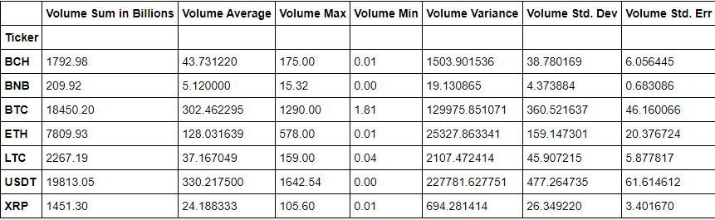
Summary Statistics - Volume

Slide 6
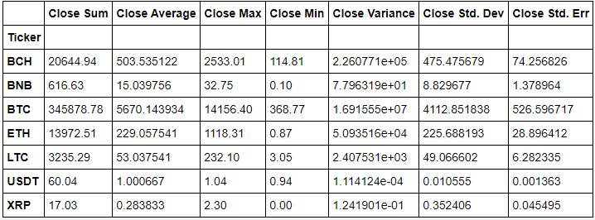
Summary Statistics – Closing Price

Slide 7
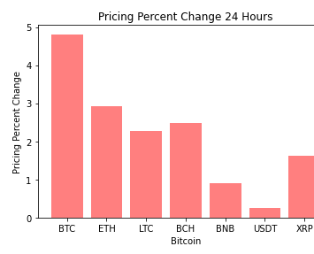
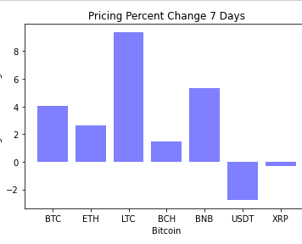
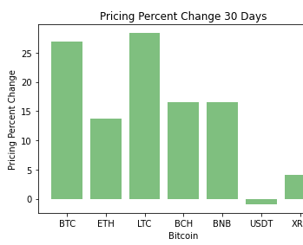
Cryptocurrency Pricing Stability – Short Term

Slide 8
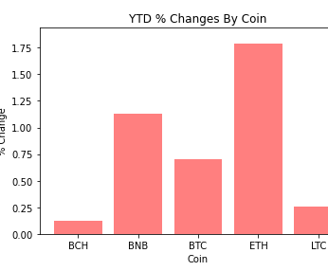
Cryptocurrency Pricing Stability - YTD

Slide 9
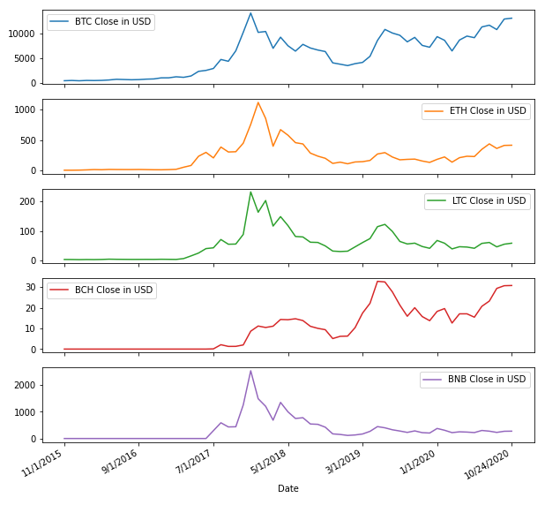
Cryptocurrency Pricing Stability – 5 Year

Slide 10
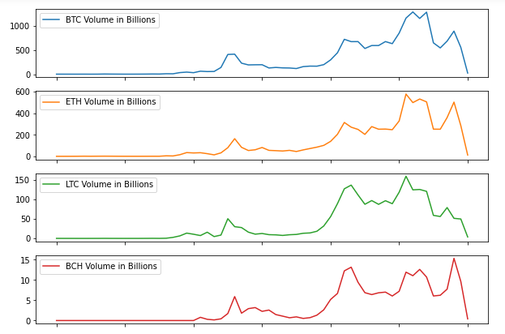
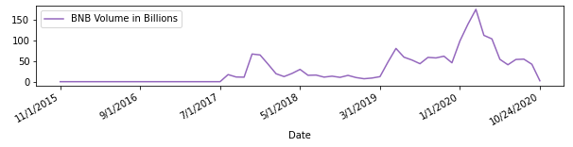
What is the most traded Cryptocurrency?

Slide 11
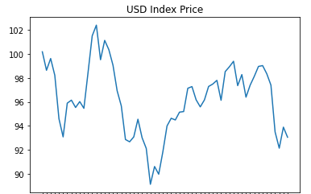
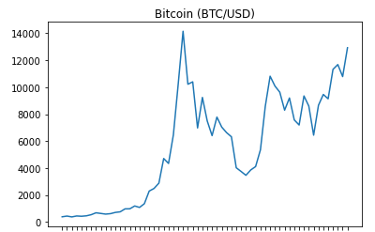
Does the price of Bitcoin follow the USD?

Slide 12
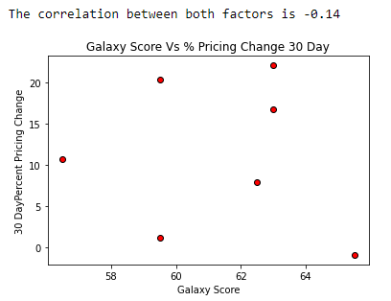
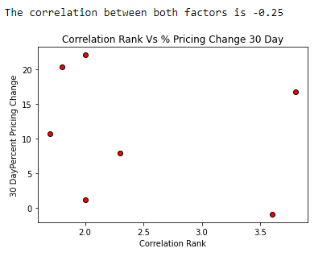
Does social media influence pricing changes?

Slide 13
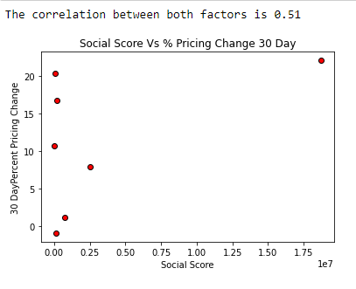

Slide 14
Do we think Cryptocurrency is a good investment?
What Cryptocurrency appears to be the best investment?
Bitcoin (BTC) appears to be the most stable, however it is also the most expensive to begin investing
Bitcoin may be reliant on the strength of the USD, if USD falls it might be a good time to sell your Bitcoin
Binance (BNB) has the most upward trajectory but also is one of the newest coins. It shows consistent stability and is an inexpensive investment if you are looking for something more entry level than Bitcoin
Tether (USDT) is the most unstable

