Slide 1
STDISCM Problem Set 3:
Networked Producer and Consumer
Submitted by:
JUMILLA, Sarah
RAMOS, Ashley
REFUERZO, Lloyd
ROJO, Kate

Slide 2
Key Implementation Steps
Simulated Environment with VM
A virtual machine to simulate the producer system.
The host machine acts as the consumer.
Network communication between them is established using a VirtualBox Bridged Adapter. The VM acts like a separate machine on the same network as the host and it gets its own IP address
Socket-Based Communication
The producer and consumer interact over a TCP socket connection on port 8080.
The consumer listens for connections using a boost::asio::tcp::acceptor.
The producer connects using boost::asio::tcp::socket to send files from the producer folder to the consumer.
Producer-Side File Monitoring & Sending
Multiple producer threads are created, each responsible for monitoring a folder
Each thread loops, checking its folder every few seconds for new files.
When a file is found, the filename is sent first. Then, the file is read in binary mode and transmitted in 1024-byte chunks to the Consumer.
Consumer-Side Receiving and Queueing
The Consumer accepts incoming connections and reads the video byte stream.
A std::queue is used to buffer incoming video jobs (VideoJob struct) up to a user-defined max queue size.
Threading on Both Sides
Each producer runs in its own std::thread, enabling concurrent monitoring and sending from multiple folders.
Each consumer thread dequeues one video job and processes it independently.
Web-based Browser (server.cpp)
A simple HTTP server was implemented to allow users to preview uploaded videos via a web browser. This is achieved using sockets that serve video files from the saved directory
Bonus Features
If the queue is full, the Consumer returns a "QUEUE_FULL" message back through the socket to notify the Producer that the queue cannot accept more jobs.
A SHA-256 hash of the video data is computed to detect duplicates.
The consumer thread saves the raw video to disk and compresses it using an ffmpeg system call.

Slide 3
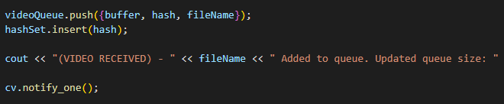
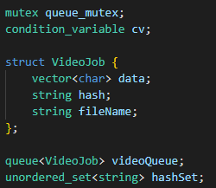
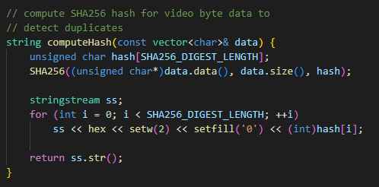
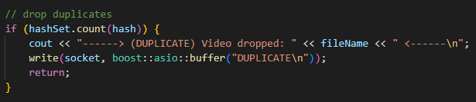
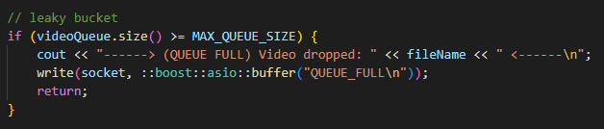
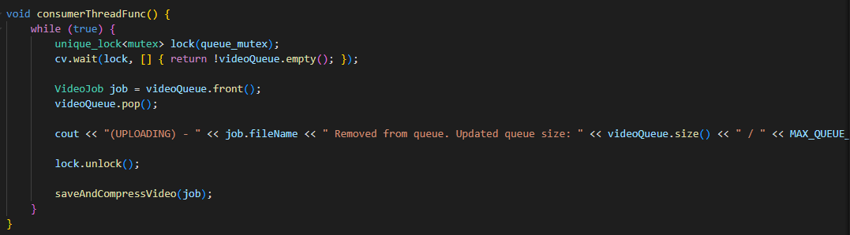
Queueing Details
Queue System
A thread-safe in-memory queue temporarily stores incoming video files before processing.
A mutex, condition_variable, and multiple consumer threads coordinate access to this queue.
The queue mutex protects both videoQueue and hashSet from concurrent access, meaning only one thread (producer or consumer) can read/write to the queue or hash set at a time.
Duplicate Detection
Before adding a job, the producer thread computes a SHA256 hash of the video data. If the hash already exists in hashSet, the video is considered a duplicate and is dropped.
Leaky Bucket
The queue has a fixed maximum size, set at runtime.
If the queue is full when a new video arrives, the job is dropped, and the producer is notified.
Consumer Thread
Multiple consumer threads wait on a condition_variable for new jobs. When notified, a thread safely pops a job from the queue and processes it.
Threads unlock the queue before doing I/O to allow others to proceed.

Slide 4
Breakdown of producer and consumer concepts applied
The Producer is responsible for providing data and placing it in a shared queue or buffer. The Consumer, on the other hand, takes that data and processes it. In our system, the producer and consumer work together to handle video uploads and processing. The Producer is responsible for generating video files and sending them to the Consumer for processing.
producer.cpp
This acts as the producer by detecting and sending video files to the consumer for processing. It operates by scanning specific directories for new video files, which are then read into memory. Once a file is identified, the producer prepares it for transmission by extracting the file name and then also dividing the file into smaller chunks which are sent over a TCP connection to the consumer. After the transmission, the producer waits for a response from the consumer to confirm if the file has been successfully received or if it was rejected due to duplication or a full queue.
consumer.cpp
This implements the consumer by receiving video data, buffering it, and processing it asynchronously. It takes video data from the queue. The consumer then processes the video, which involves saving the file. To ensure efficient handling of multiple video files, the consumer uses multiple threads, with each thread pulling videos from the queue and processing them independently. The consumer also manages synchronization between threads.

Slide 5



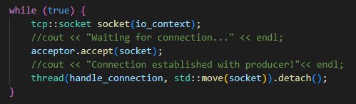

Synchronization Mechanisms
Mutex Locking
A single mutex (queue_mutex) is shared between producer and consumer threads.
It ensures atomic access to both the videoQueue and the hashSet, preventing race conditions during insertion, popping, and duplicate checking.
Condition Variable
To avoid polling, consumers sleep until notified that work is available.
Consumers wait, producers notify.
No busy wait, immediate wake-up when a job is available.
Thread Isolation
Each incoming connection from a producer is handled in its own thread. This avoids shared socket access and the need for socket-related synchronization.
Each producer thread monitors a unique folder. Since they don’t share any data or state, no mutexes or synchronization are needed between them.

