Slide 1


Labour Chowk SGP-1(CSE204)
Guided By : Dharmendrasinh Rathod
Team Members : Charmi Dodiya (23CS021)
Sarah Kamdar (23CS031)
Krina Lakhani (23CS038)

Slide 2
Content of the Presentation
Introduction( Outline of your Project)
Idea/Approach Details
Need of System (Functions it can perform)
Design and Development Process(Screenshots of UI/UX Design)
Database Design
Flow Diagram/ Flow Chart of System
Department of Computer Science & Engineering ,CSPIT

Slide 3
Introduction
Labour Chowk is an initiative aimed at bridging the gap between daily wage laborers and potential employers. The project seeks to digitize and streamline the traditional labor market, making it more accessible, efficient, and transparent.
Objective: Empower Laborers, Connect Employers and Laborers, Ensure Fair Wages, Improve Working Conditions.
Key Features: Labour Registration, Job Posting, Matching Algorithm, Rating and Feedback, Payment Integration, Resource Centre.
Outline of the Project: Project Planning and Research, Platform Development, Database and Security, Marketing and Outreach.

Slide 4
Idea/Approach Details
Describe your idea
Labour Chowk is a digital platform designed to connect daily wage laborers with potential employers efficiently and transparently.
It aims to empower laborers by providing an easy-to-use interface for job opportunities, ensuring fair wages, and improving working conditions.
Employers can quickly find and hire laborers based on their skills and availability.
Describe your Technology stack here:
Frontend: HTML, CSS and Java Script
Backend: PHP
Version Control and Collaboration: GitHub
Development Tools:Visual Studio Code

Slide 5
Need of System (Functions it can perform)
Employment Opportunities for Laborers
Efficient Hiring for Employers
Transparency and Fairness
Improved Working Conditions
Digital Inclusion

Slide 6
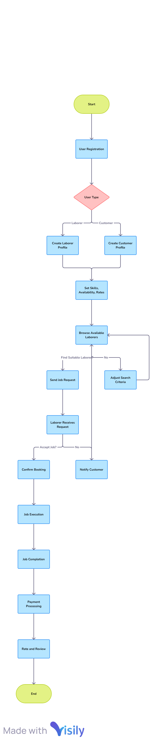
Flow Diagram/ Flow Chart of System

Slide 7
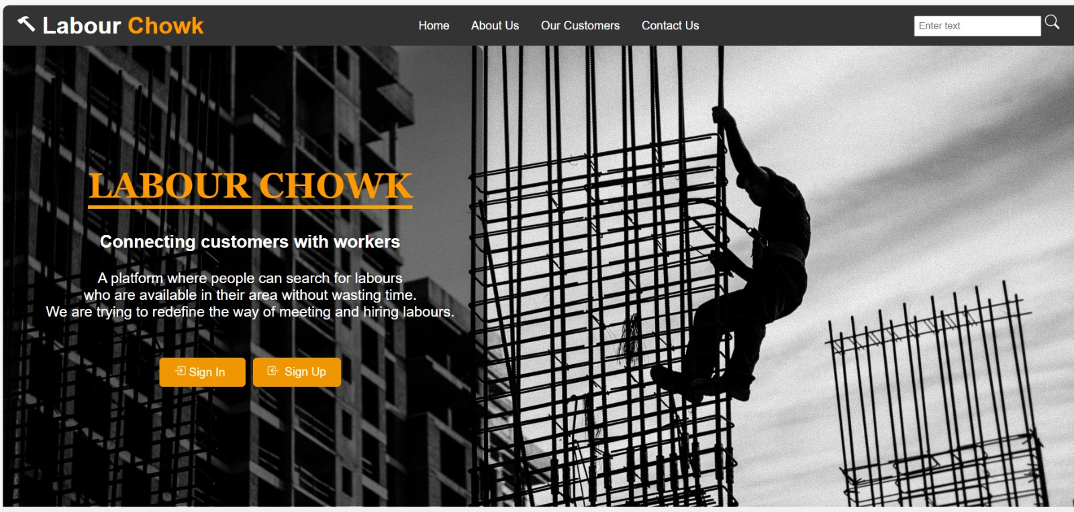
Design and Development Process(Screenshots of UI/UX Design)

Slide 8
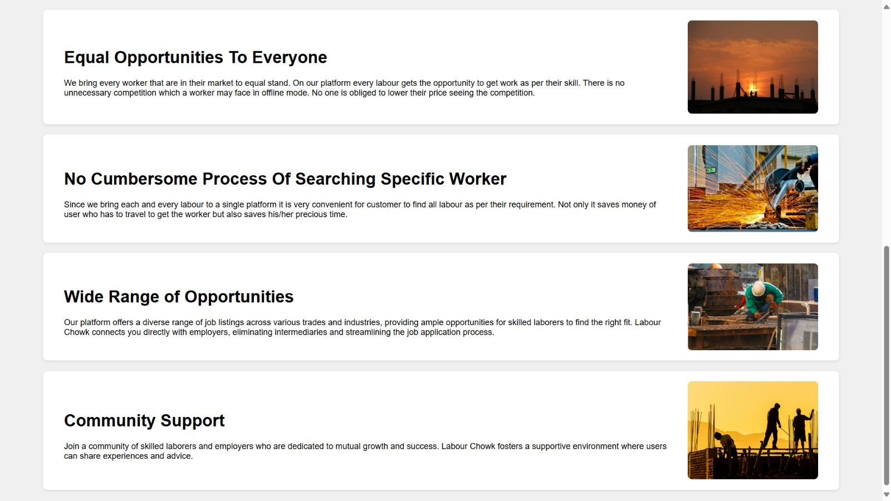

Slide 9
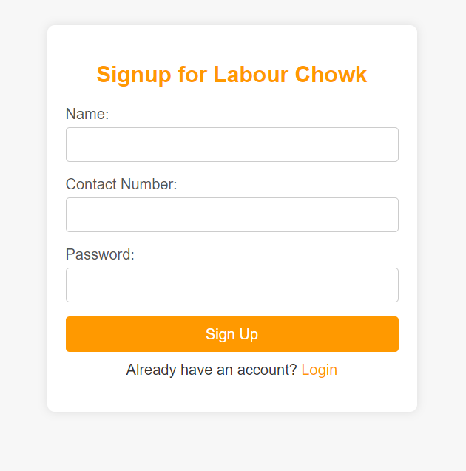
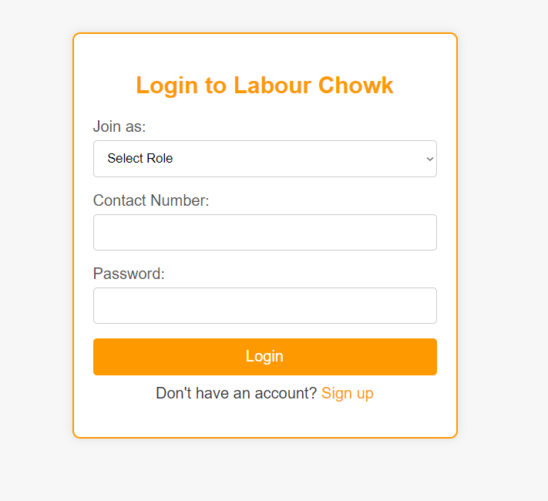

Slide 10
Conclusion
The Labour Chowk system addresses critical issues faced by daily wage laborers and employers by providing a digital platform that enhances visibility, efficiency, transparency, and fairness in the labor market.
By leveraging technology, the system aims to create a more inclusive, equitable, and productive workforce, benefiting both laborers and the broader economy.

