Slide 1

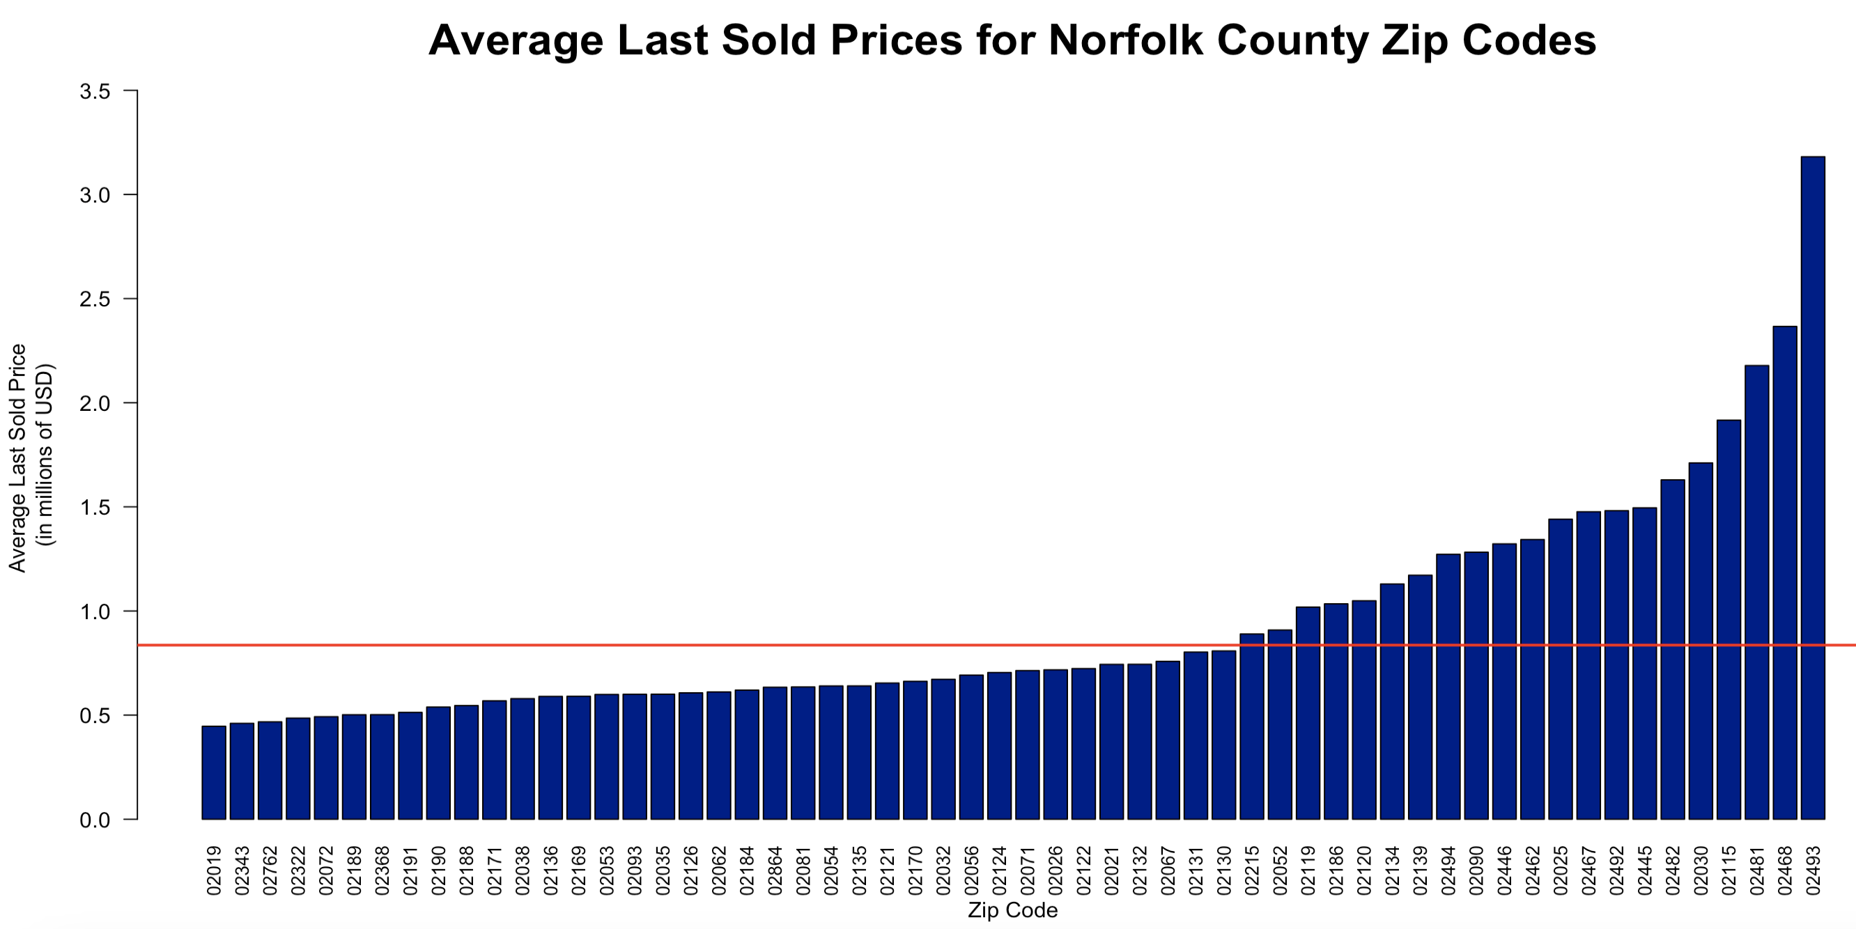
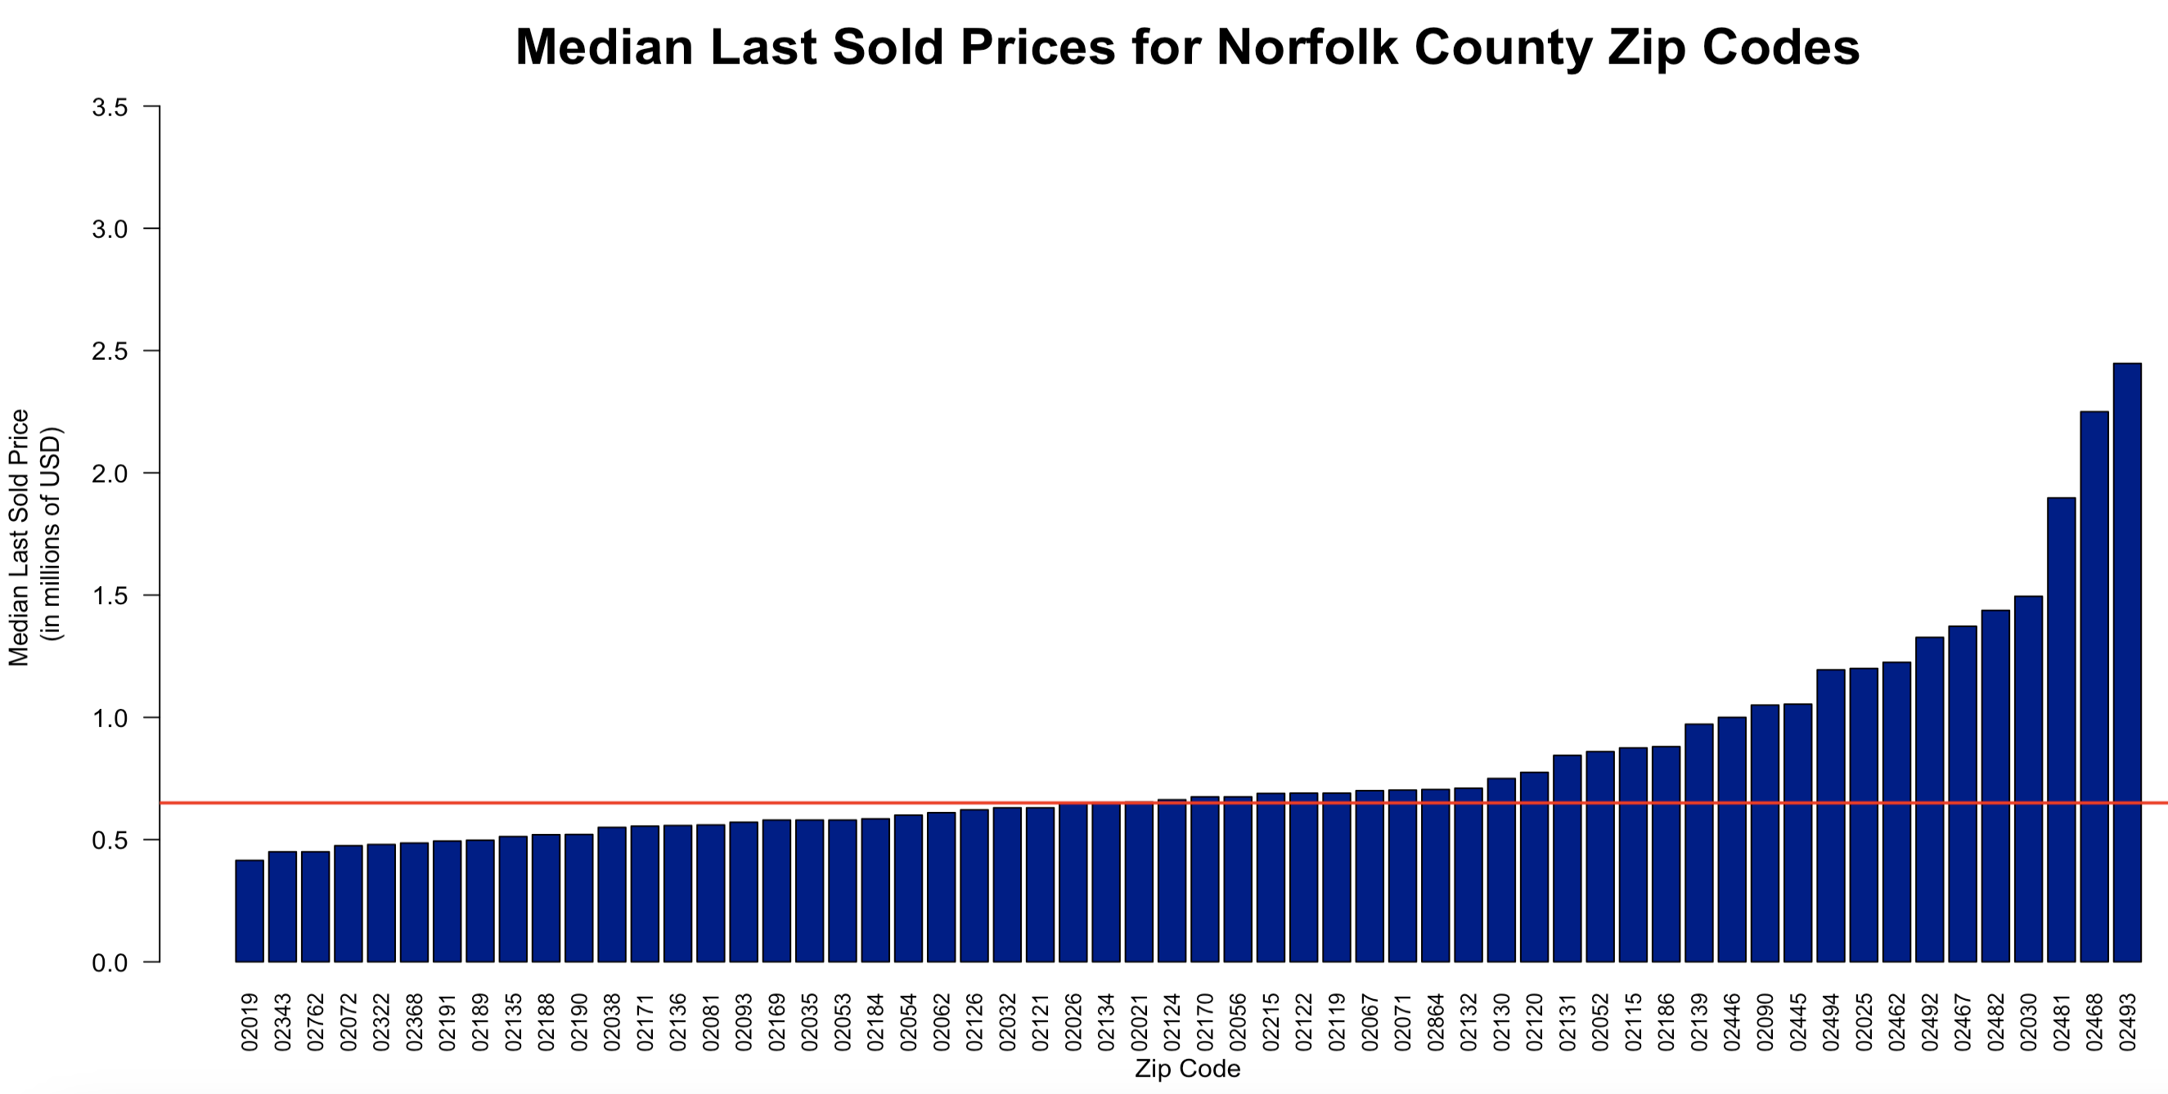
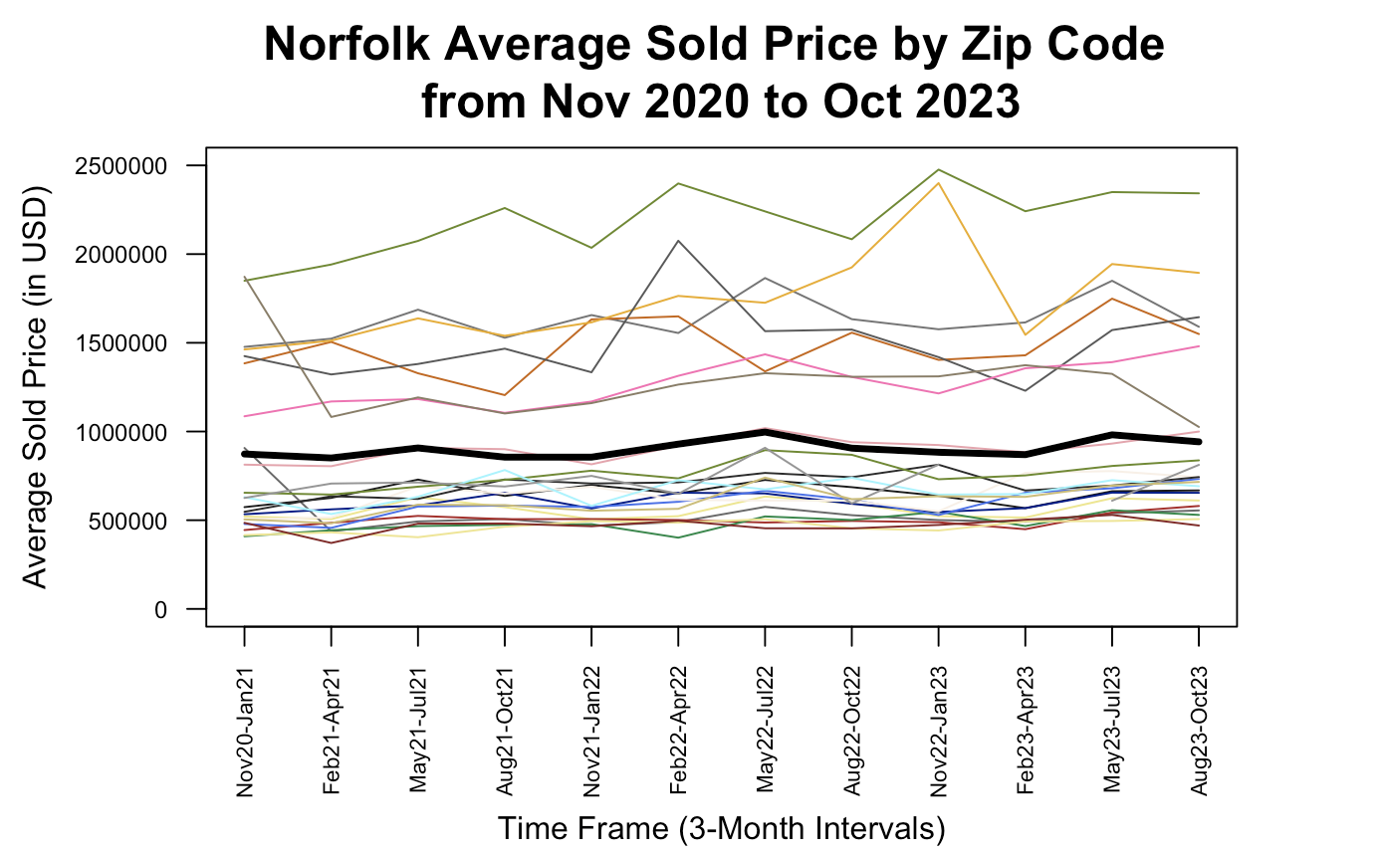
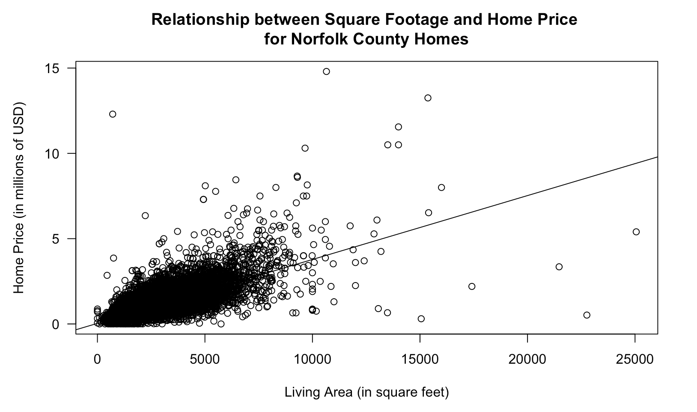
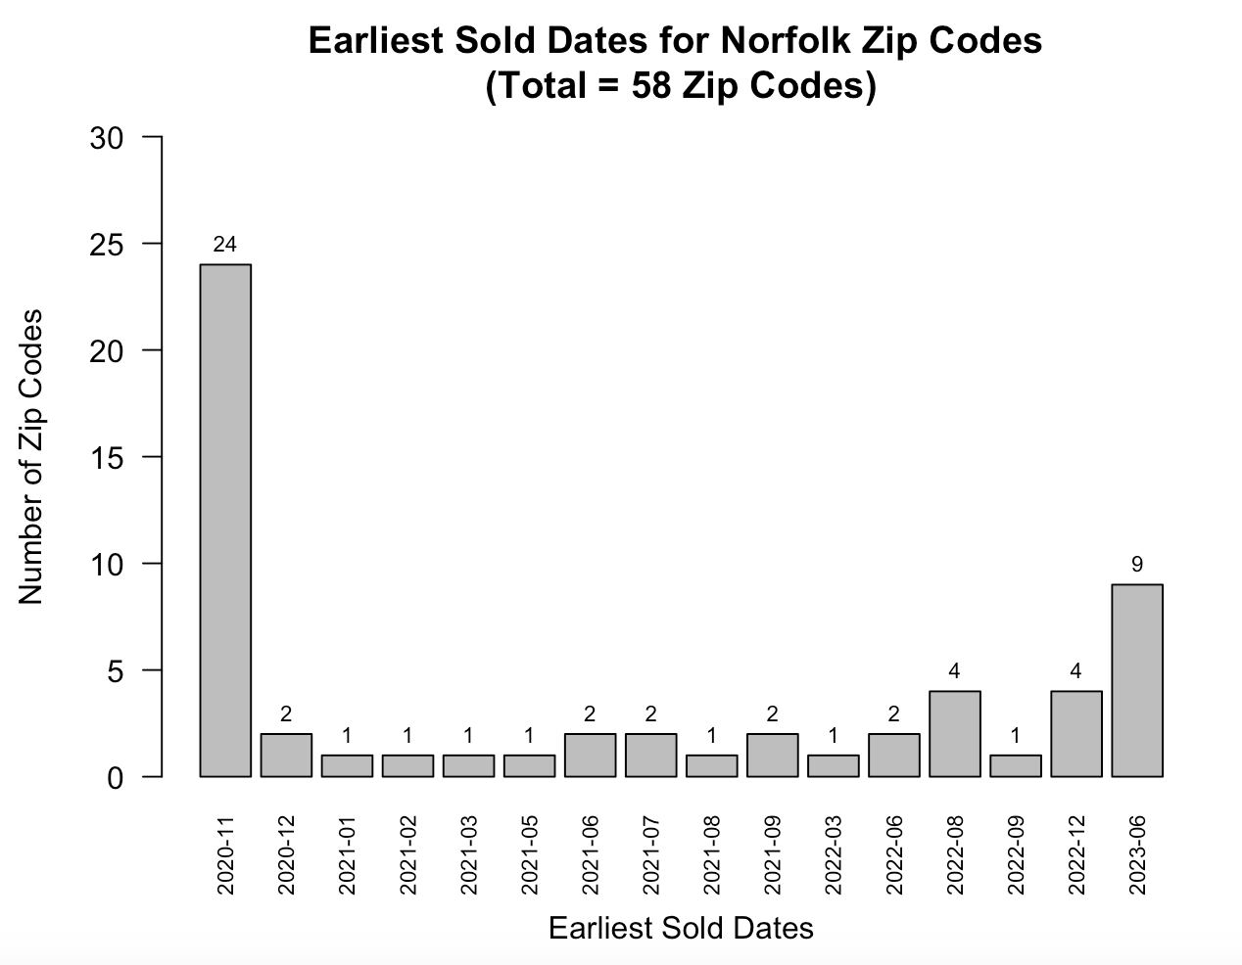
Correlation Between Home Attributes and Price in Norfolk County, Massachusetts
Sarah Katz ‘24, Data Science Major Capstone
Background and Research Questions
Data Visualizations
Data Modeling and Analysis
There are many stakeholders (such as brokers, appraisers, lenders, buyers and/or sellers) that could benefit from having access to a clear model that uses home attributes to predict housing prices. In the greater Boston area, where the housing market has become highly competitive, there are both economic and informational benefits of understanding which characteristics of homes are valuable. This project focuses specifically on the county that Wellesley College is in: Norfolk.
Question:
What home characteristics are most important for explaining the variation in home prices in Norfolk County, Massachusetts?
The five zip codes with the highest average sold prices are:
Weston
Newton
Wellesley Hills
Boston
Dover
And the lowest:
Bellingham
Holbrook
Plainville
Avon
Stoughton
A first-order regression model was used to predict a house’s last sold price using: zip code (as a categorical variable), the number of bedrooms, the number of bathrooms, the square footage, the garage parking capacity, the overall parking capacity, the school distance, the school rating, and the area of one of the rooms. Of the 58 zip codes in the data, 8 were significant for the model, so overall, this additive model includes 15 variables. This model explains 87.29% of the variation in last sold price for the houses in the dataset.
predicted lastSoldPrice = -1.135e+06 + 1.514e+06(address_zipcode = 02139) + 2.203e+05(address_zipcode = 02169) + 4.893e+05(address_zipcode = 02184) + 4.903e+05(address_zipcode = 02191) + 1.348e+06(address_zipcode = 02445) + 1.353e+06(address_zipcode = 02446) + 5.733e+05(address_zipcode = 02462) + 7.712e+05(address_zipcode = 02468) + 6.689e+04(bedrooms) + 1.201e+05(bathrooms) + 3.722e+02(livingAreaValue) -2.800e+04(resoFacts_garageParkingCapacity) + 1.155e+05(schools_0_distance) -2.750e+04(schools_0_rating) + 9.185e+04(resoFacts_parkingCapacity)
The eight zip codes in this model are: Cambridge, Quincy, Braintree, North Weymouth, Brookline, another Brookline zip code, Newton Lower Falls, and Waban.
All variables except for two (garage parking capacity and school rating) have a positive correlation with last sold price. These two variables with negative correlation (as well as the positive correlation between school distance and the response variable) could be due to some inclusion of locations outside county lines that are wealthy but urban.
The five zip codes with the highest median sold prices are:
Weston
Newton
Wellesley Hills
Dover
Wellesley
And the lowest:
Bellingham
Holbrook
Plainville
Stoughton
Avon
Limitations and Future Work
Data Collection and Cleaning
The eight zip codes (of 24 shown) with the highest average sold prices in the last time frame are:
Wellesley Hills
Dover
Needham
Wellesley
Cohasset
Needham Heights
Westwood
Medfield
There are more zip codes included in the data than there really are in Norfolk County, because Zillow’s “recently sold” homes for a county do not necessarily stay within county lines.
There are missing values in other variables that have not yet been properly accounted for.
Any evaluations of price trends over time must use time series analysis, which as of now has not been included. This might be used for the final project.
The additive model has not undergone thorough evaluation other than checking for multicollinearity. This must be done for the final project.
Future work will likely include data from three other Massachusetts counties that have recently successfully been web scraped, including: Essex, Suffolk, and Middlesex. This would give a broader geographical coverage of the greater Boston area.
The web scraping program can only retrieve a fixed number of “recently sold” houses for a certain zip code, and so the available time frames for each zip code are not uniform. For example, zip codes with high housing turnover may have earliest sold houses in 2023. See graphic for more explanation.
A web scraping program was developed to build a novel data set with housing transactions from an online real estate platform (Zillow). The raw data set consists of 24,638 recently sold houses in Norfolk County, Massachusetts, each with 937 variables. The time frame ranges from November 2020 to November 2023.
The data does not contain any duplicates. The response variable “lastSoldPrice” had no missing values but one zero value, and this row was removed. Initially, the data included 70 unique zip codes, but any zip codes with fewer than 10 houses were removed, which resulted in 58 unique zip codes. After making these changes, the data set contained 24,608 houses, with only 30 rows being removed.
This scatterplot shows the strong positive correlation between square footage and home price.

