Slide 1

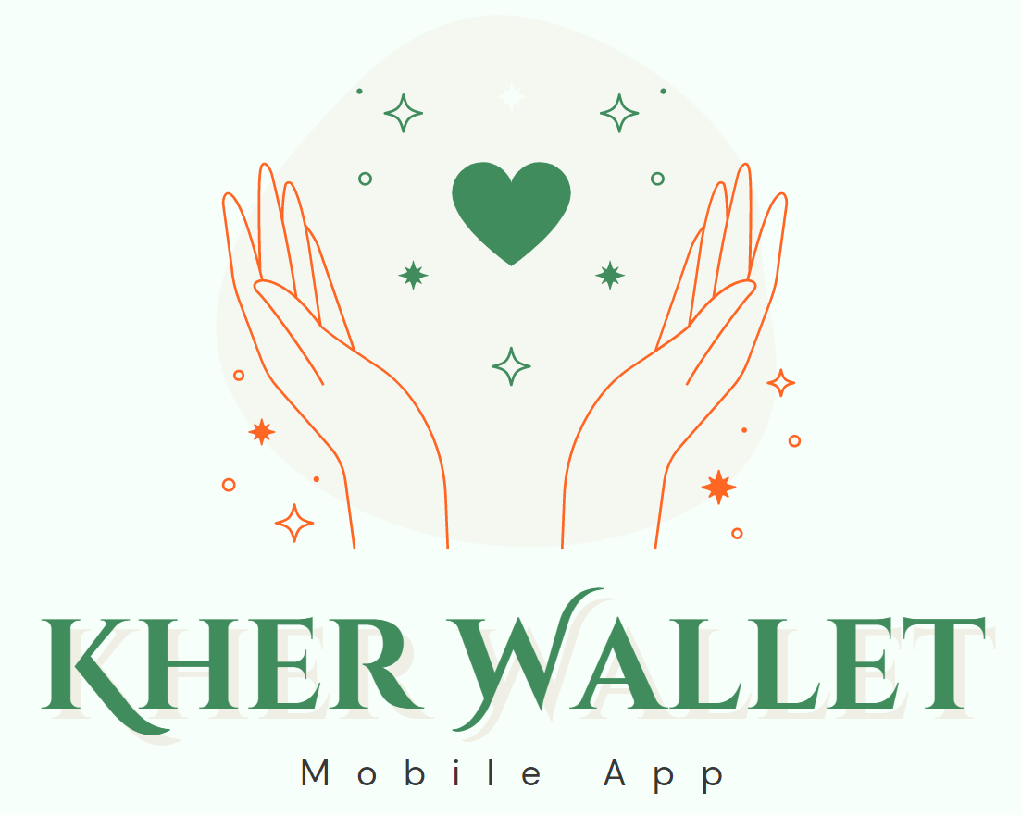
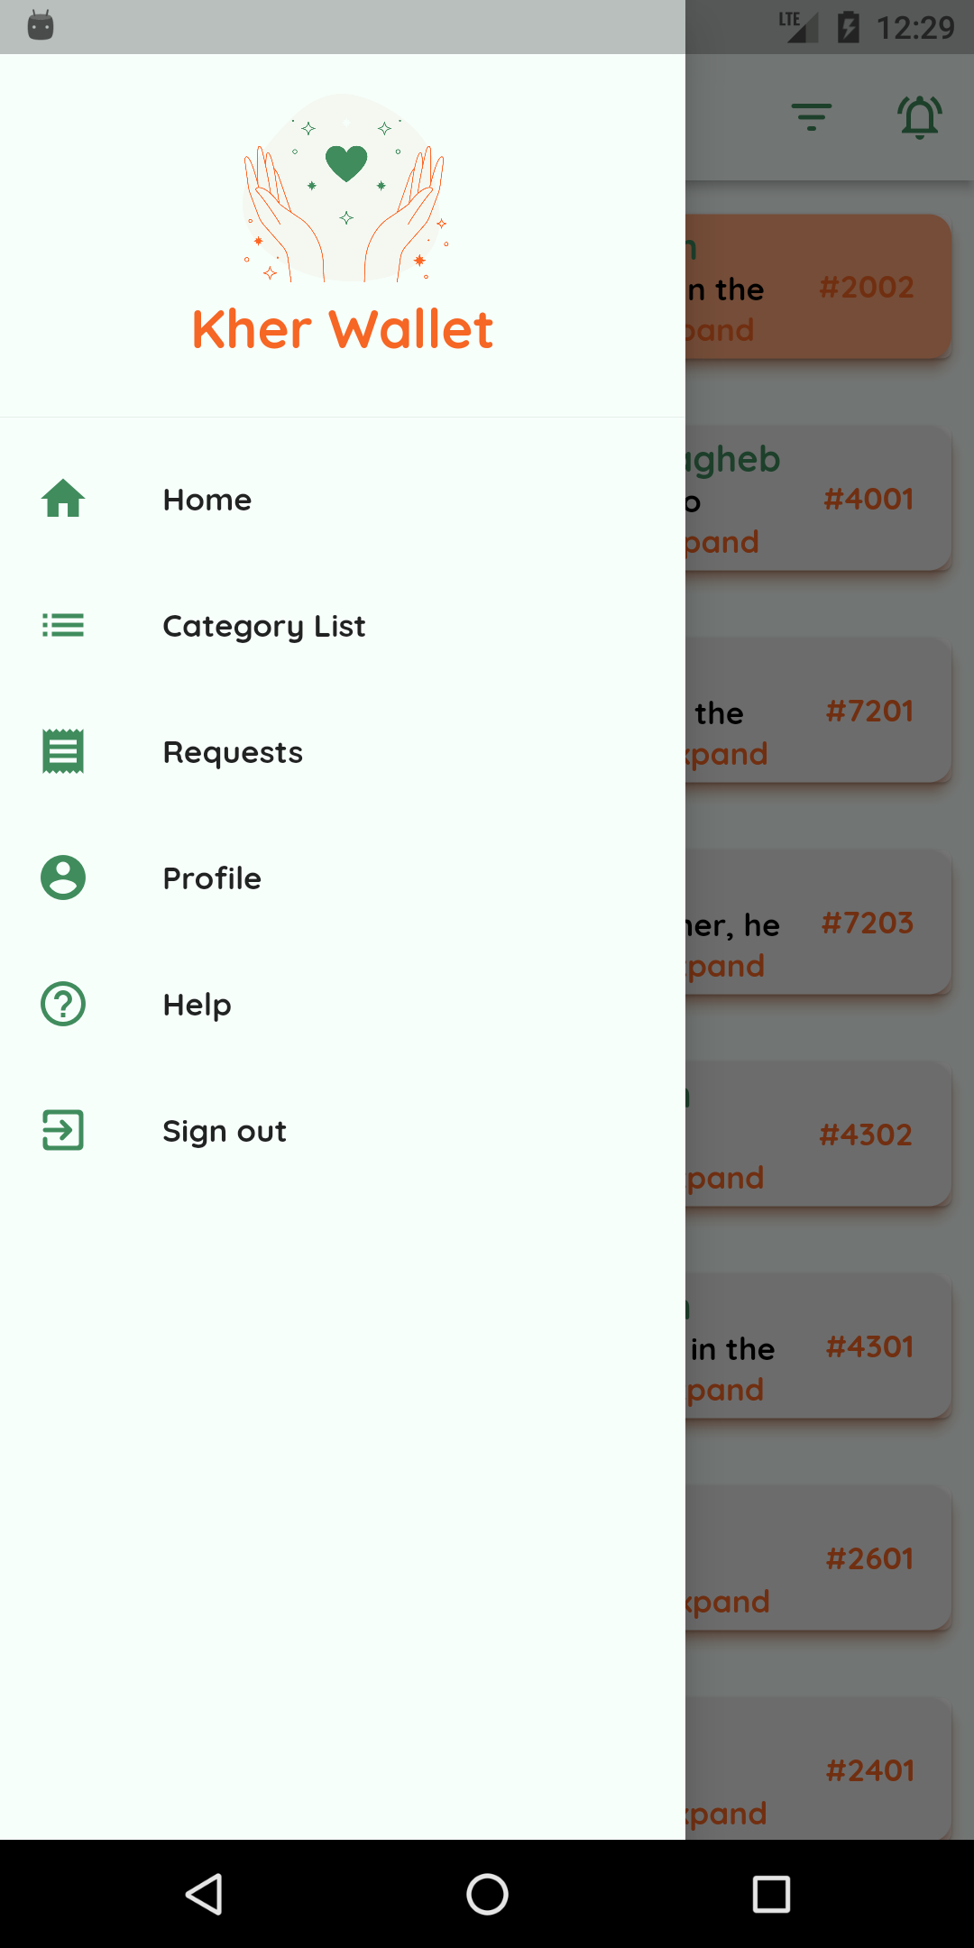
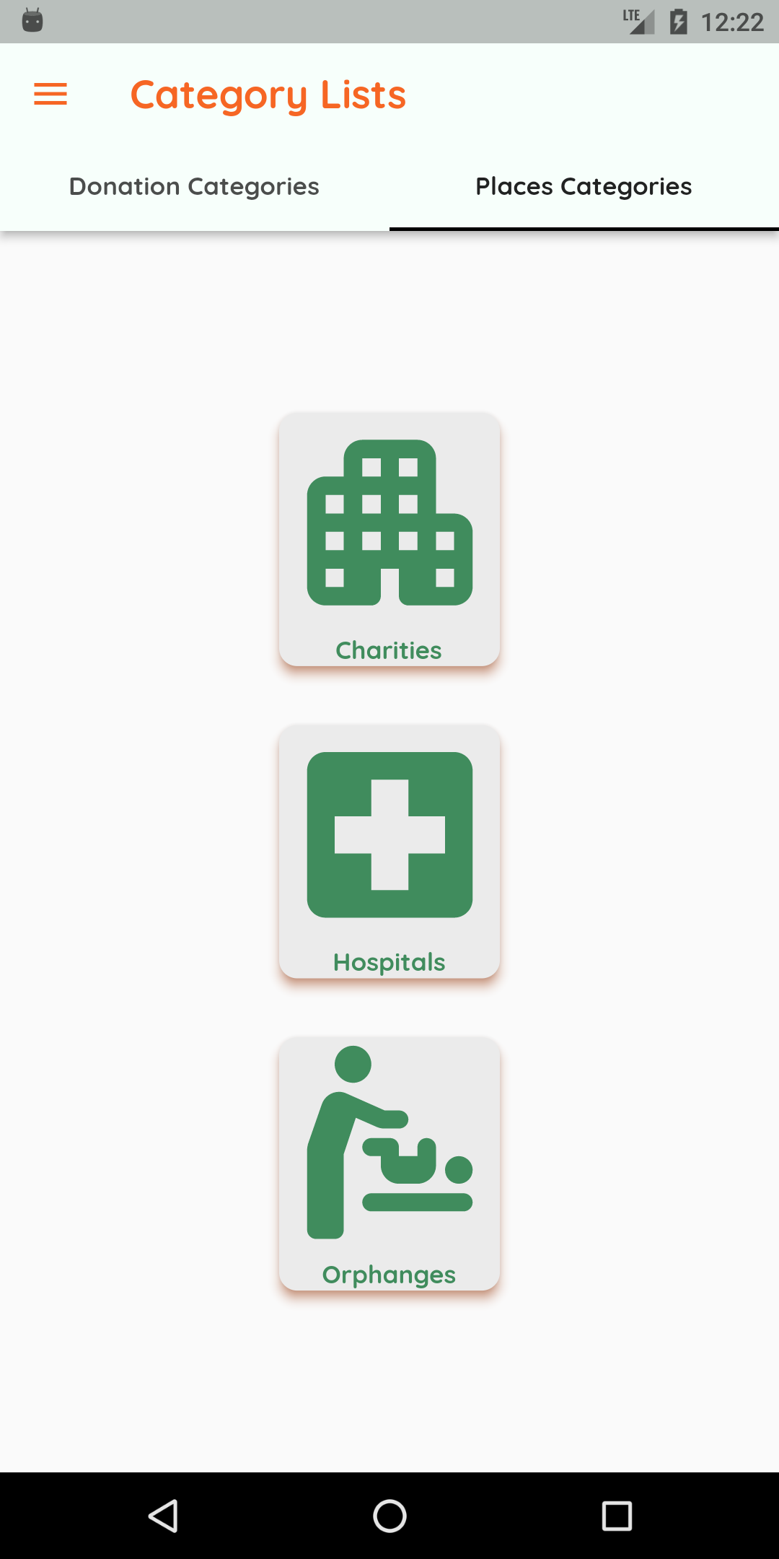
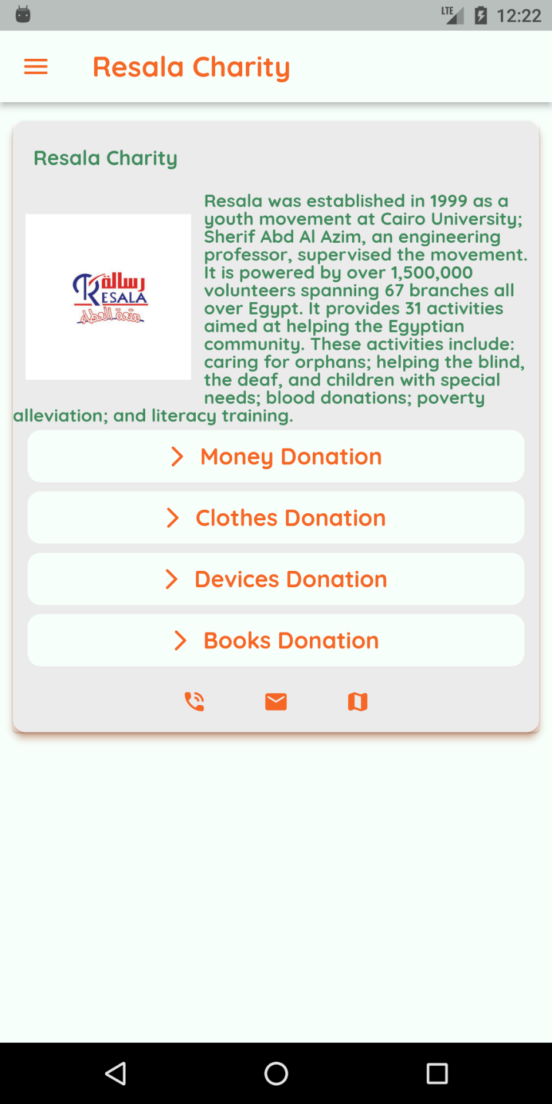
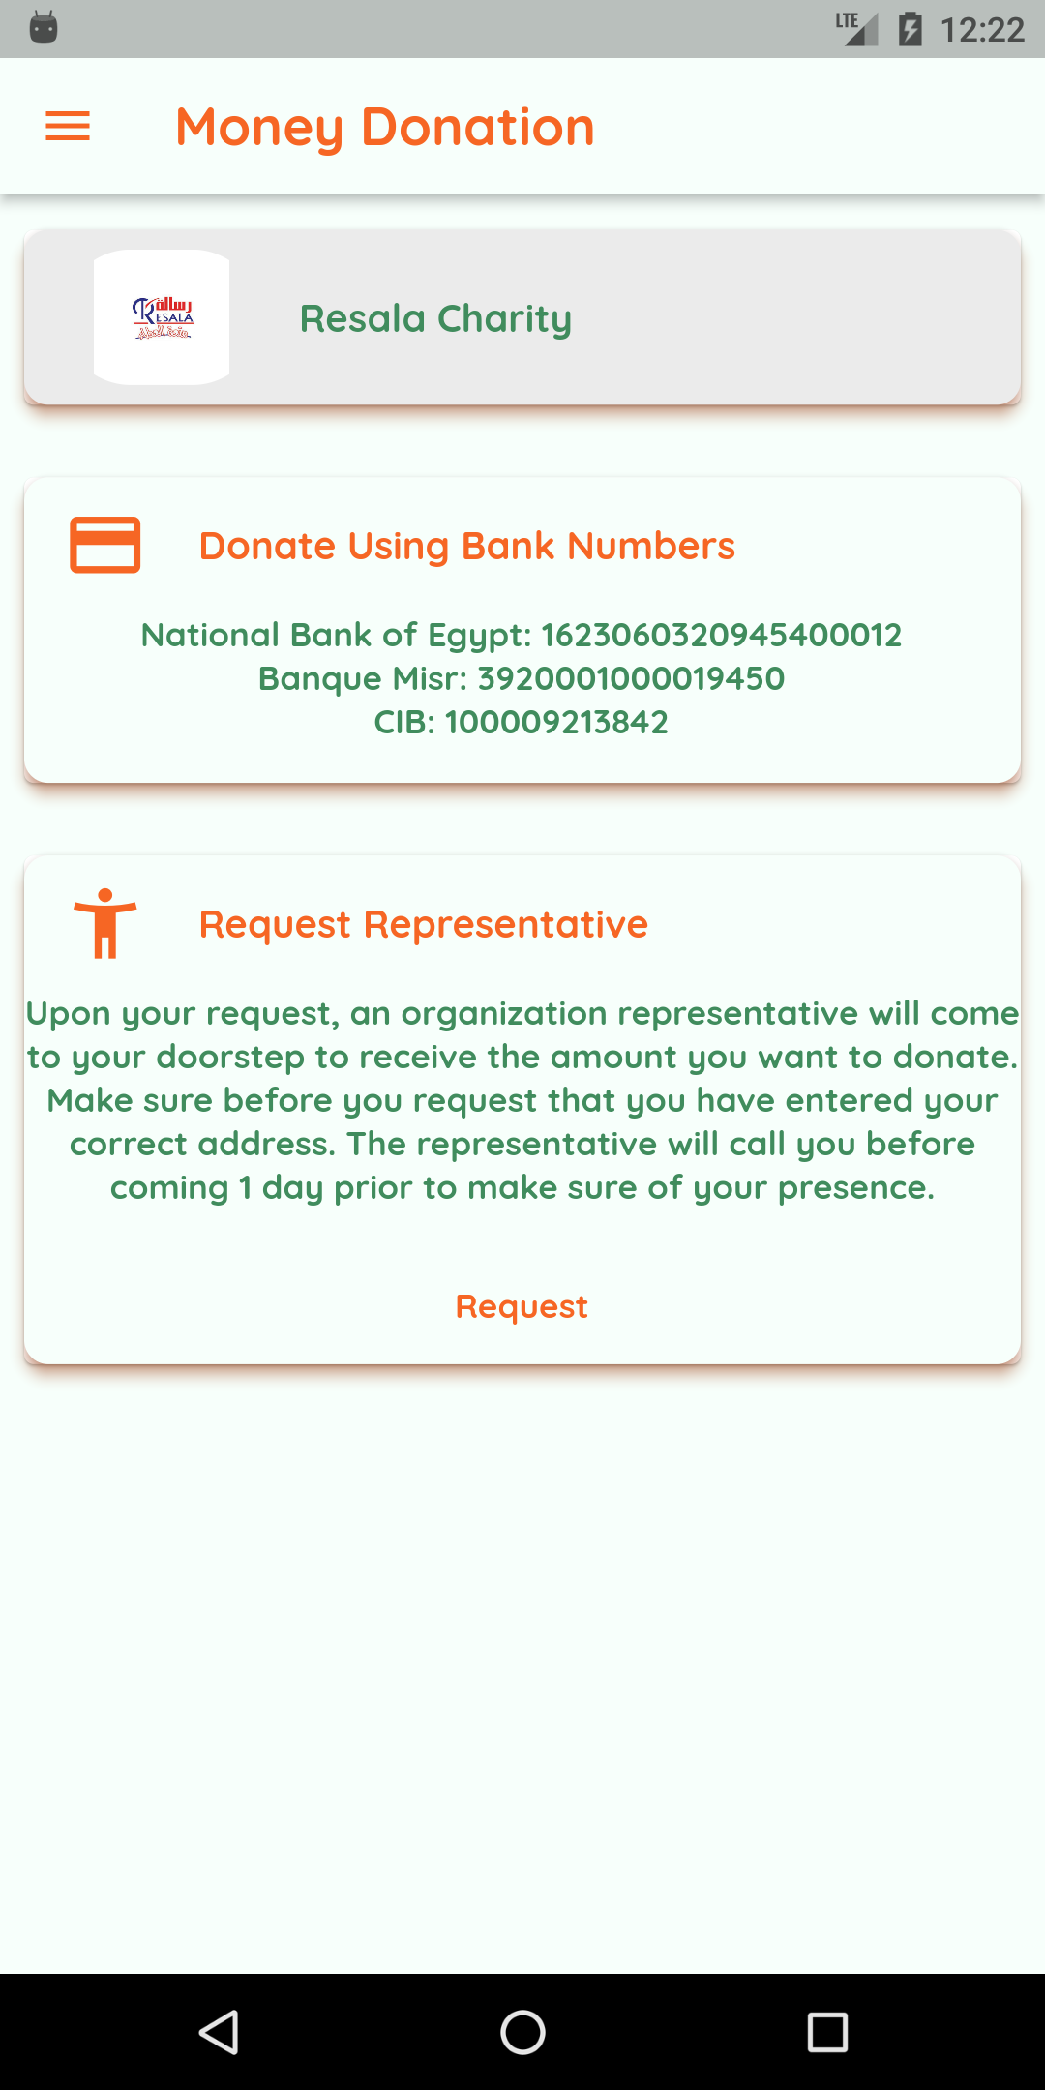
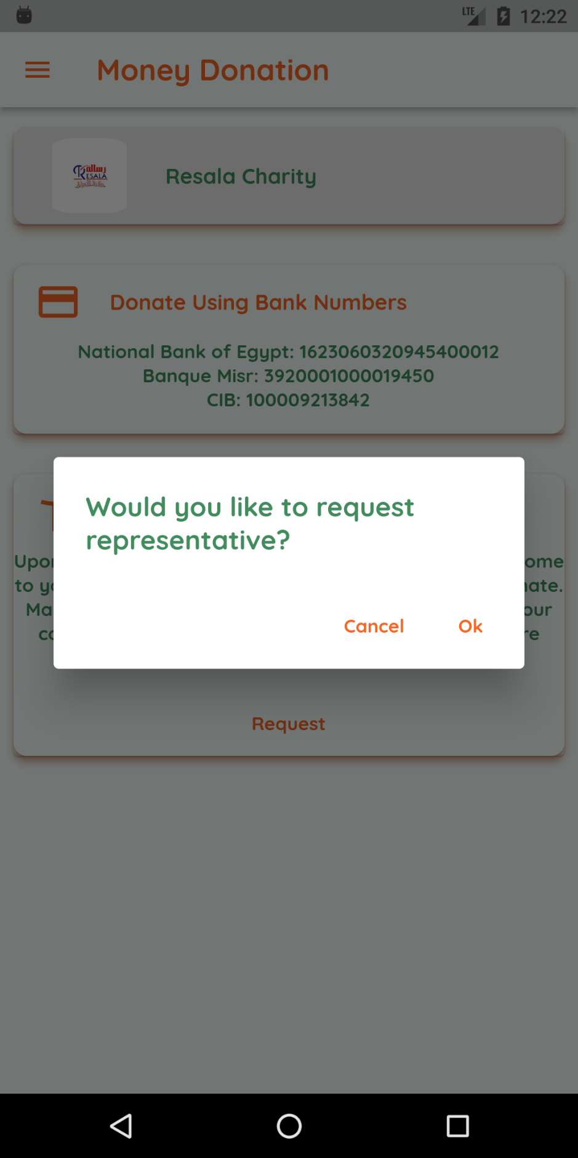
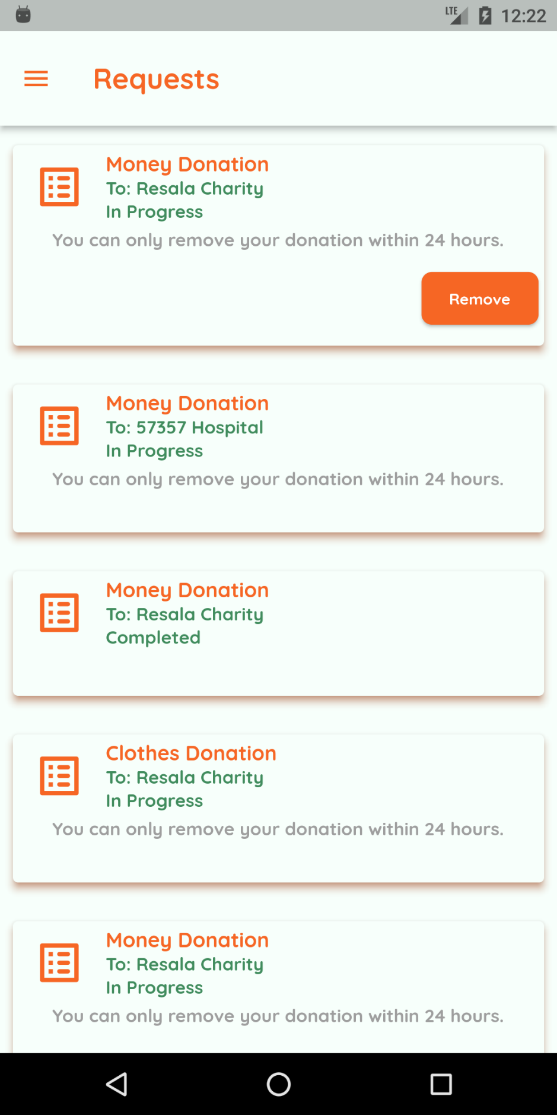
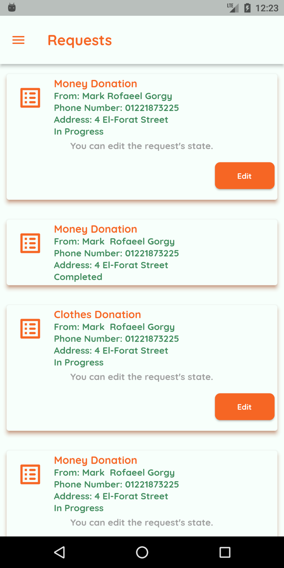
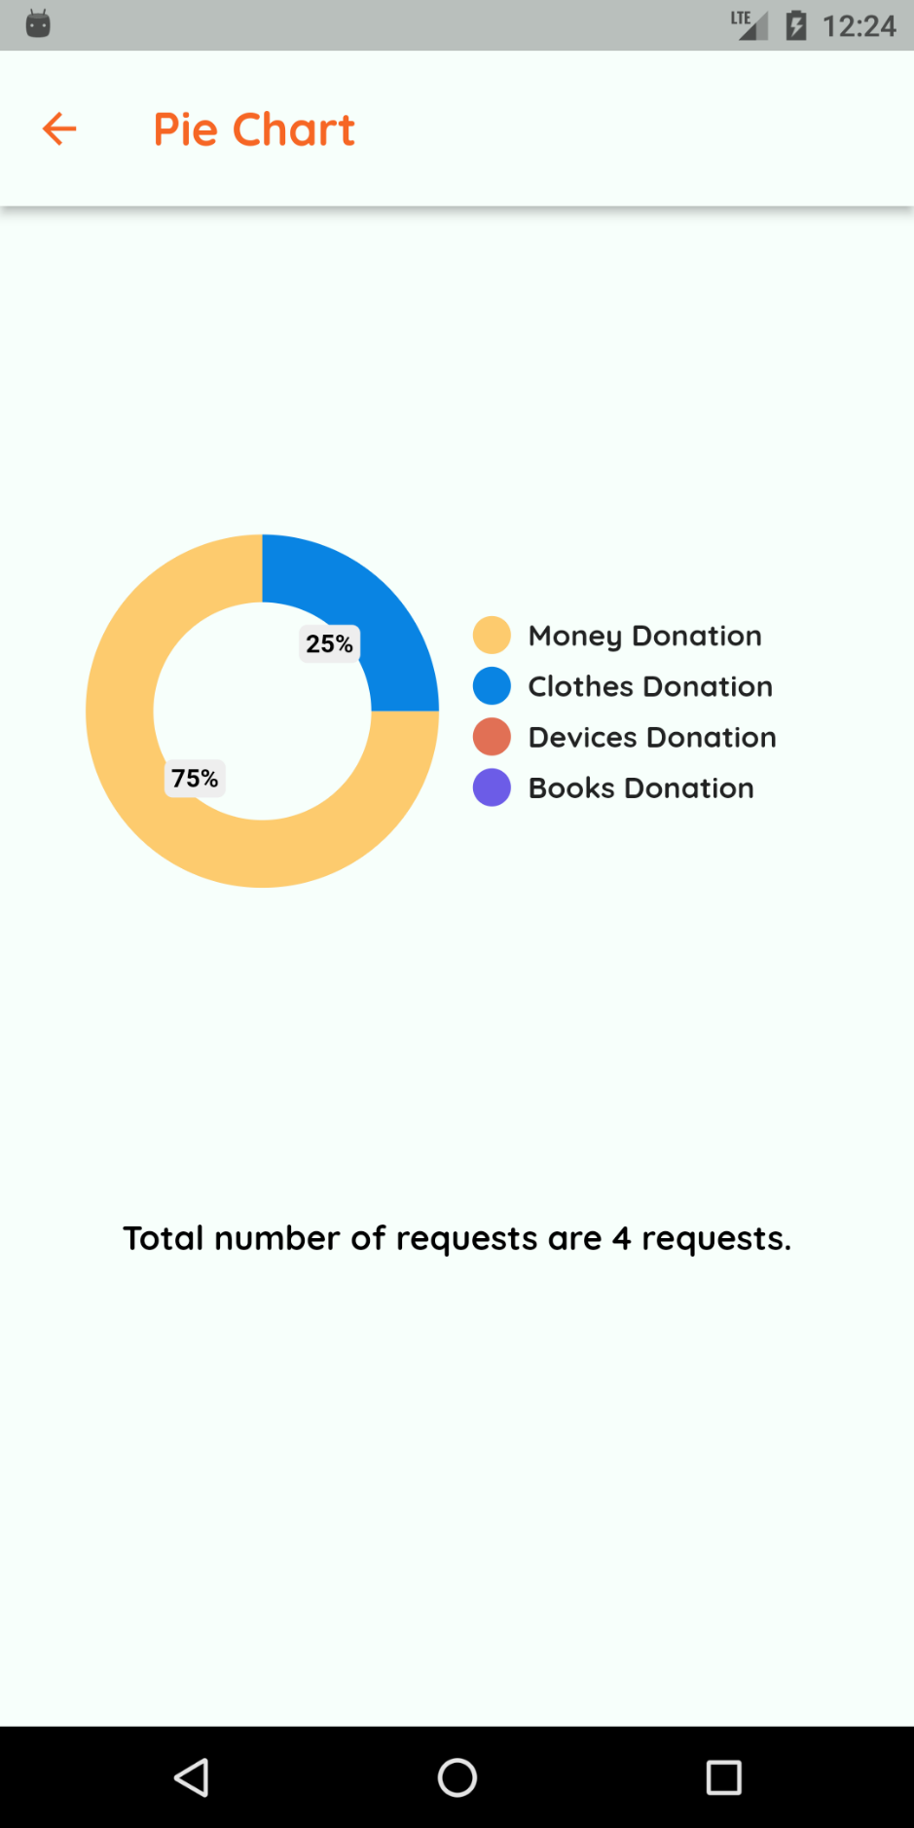
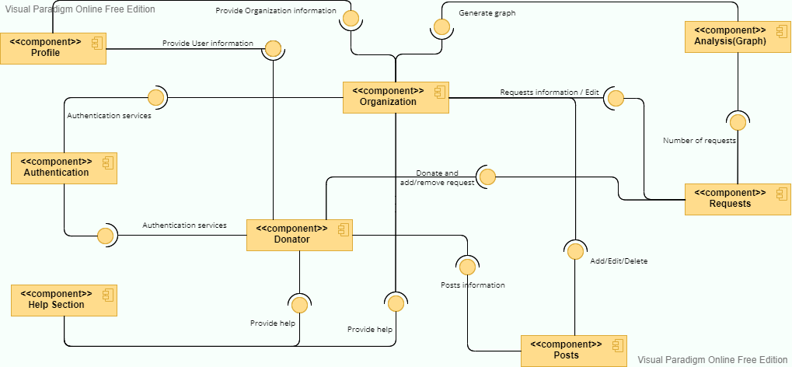
75 cm
Kher Wallet
30 cm
Cairo University, Faculty of Computers and Artificial intelligence
Nada Mohamed, Sarah Khaled, Mark Rofaeel, Ayat Hany and Yasmine Shehab
Supervisor: Dr. Khaled Wassif
Abstract
Methods
Nowadays, there are a lot of organizations that accept donations from different people, either by donating money, clothes, devices, books or even by volunteering in many events.
It takes time and effort for people to reach to these organizations so they can donate. Also, people do not even know when any organization need help during event times.
As well as the organizations! Organizations do not have an all-in-one platform to communicate on with people interested.
Considering this, our motivation is to solve these problems by implementing an Android/IOS application that gathers different kinds of organizations, that help people to donate in an easier way and notify them when there is a new post or event around the corner.
Kher Wallet may be the first donating platform in the Egyptian region.
Throughout the process of doing this project, we followed the Waterfall methodology and principles and the basic client-server architecture.
Design and format details are up the student's creativity
Save and submit 3 copies of the poster:
1. The poster in a “PDF” format, use the following name scheme:
<year>-<semester>-<dept.init>-GP2-<project number>-<project name>-Poster.pdf
2. The poster in a “png” format, use the following name scheme:
<year>-<semester>-<dept.init>-GP2-<project number>-<project name>-Poster.png
3. The poster page in the graduation project book.
Complete your project information in the “Template(6)-Graduation Project II - PosterPage.docx” file, add the image of the poster and scale it to 14% for both height and width.
use the following name scheme:
<year>-<semester>-<dept.init>-GP2-<project number>-<project name>-PosterPage.docx
70 cm
Introduction
Primarily Design
Our problem is that people spend so much time and effort to reach different organizations as charities, hospitals, and orphanage that has led to the shortage of the overall amount of donations.
Another key fact to remember is that those organizations do not have the capability to reach large amount of people to notify them with new posts or events.
The main objective of our application is filling the gap between different organizations and people by implementing Kher Wallet. An application that gathers different types of organizations which can be easily used by people to complete their donation process right at their own hands.
The donator can choose the preferred organization by going through the different places categories. The donator, now, can donate money, clothes, books, or devices by requesting a representative to come to his doorsteps to complete the donation process. This request is saved to the database and is retrieved by the specific organization anytime. A notification is sent to the organization specifying the donator’s name, address, phone number and the donation type made. The organization can view the request made by this donator in the request section. And the organization can, now, send the representative to the donator peacefully. A pie chart is generated with the total number of requests and the percentage of every donation type.
The component diagram shows how components are wired together to form larger components or software systems.
Conclusion
To conclude what we have made, Kher Wallet’s major goal is to bridge the gap between various groups of people and organizations. Our application that compiles several organizations that users can utilize to simply finish their donation procedure at their own fingertips. We are so proud of what we have achieved so far, we hope one day that this application will be used by a lot of people through these digital evolution days! Throughout the next period, we are looking forward to the next milestone of developing and evolving this application.
15 cm
For all soft copy formats
For print use only
20 cm
Contact us via email: kherwallet@gmail.com

