Slide 1

Rockbuster Stealth
Strategy & Analysis

Slide 2
Introduction
Rockbuster Stealth is a leading movie rental platform transitioning to a primarily online streaming service. Due to business motions in this direction, along with international alterations in film and video intake, an analysis on customer participation has been run.
By considering involvement regarding international regions, film genres, and other diagnostics, our goal is to increase revenue for Rockbuster Stealth and satisfy new as well as dedicated customers.

Slide 3
Business Questions
Which movies contributed to the most revenue gain?
What was the average rental duration?
Where are Rockbuster customers located in?
Who are lifetime value customers, and where are they based?
Do sales figures vary between geographic regions?

Slide 4
Average Content Rental & Mode
 | Min | Max | Avg
Rental duration | 3 | 7 | 4.985
Rental rate | 0.99 | 4.99 | 2.98
Movie length | 46 | 185 | 115.272
Replacement cost | 9.99 | 29.99 | 19.984
Title Mode | Release Year Mode | Rating Mode
Academy Dinosaur | 2006 | PG-13
The following tables contain the descriptive statistics for the film table as well as the mode table.

Slide 5
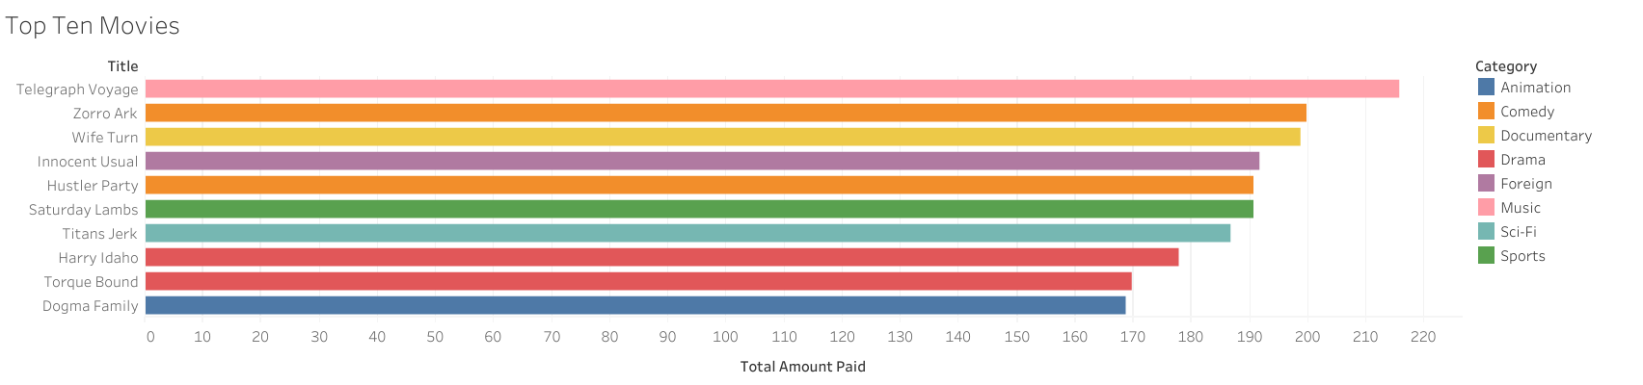
Top Ten Movies
215.75 was the total amount paid for Telegraph Voyage. The following titles include the films that received the greatest total amount paid.
While the top five genres include Animation, Comedy, Drama, Sci-Fi, and Sports, select Documentary, Foreign, and Music films made the top ranks concerning revenue.

Slide 6
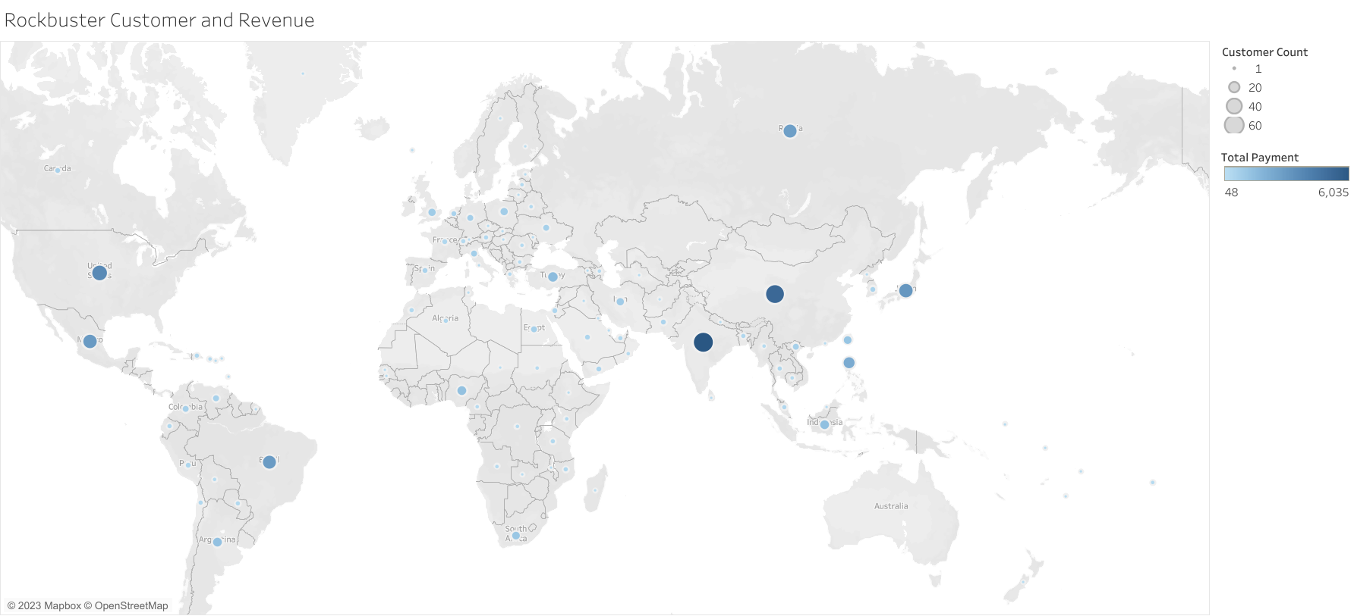
Where is Regional Revenue Coming From?
China and India have the highest volume of revenue. Promotion codes, discounts, and free trials can be pushed towards other regions to drive further interest and engagement in the hopes of matching or exceeding these rates.

Slide 7
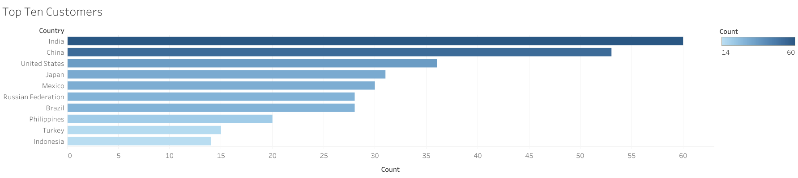
Top Ten Countries
For a more condensed and clear graph consisting of the top ten countries providing Rockbuster Revenue, this graph indicates that Indonesia, at a count of 14, still remains in the top ten Countries of Rockbuster users.

Slide 8
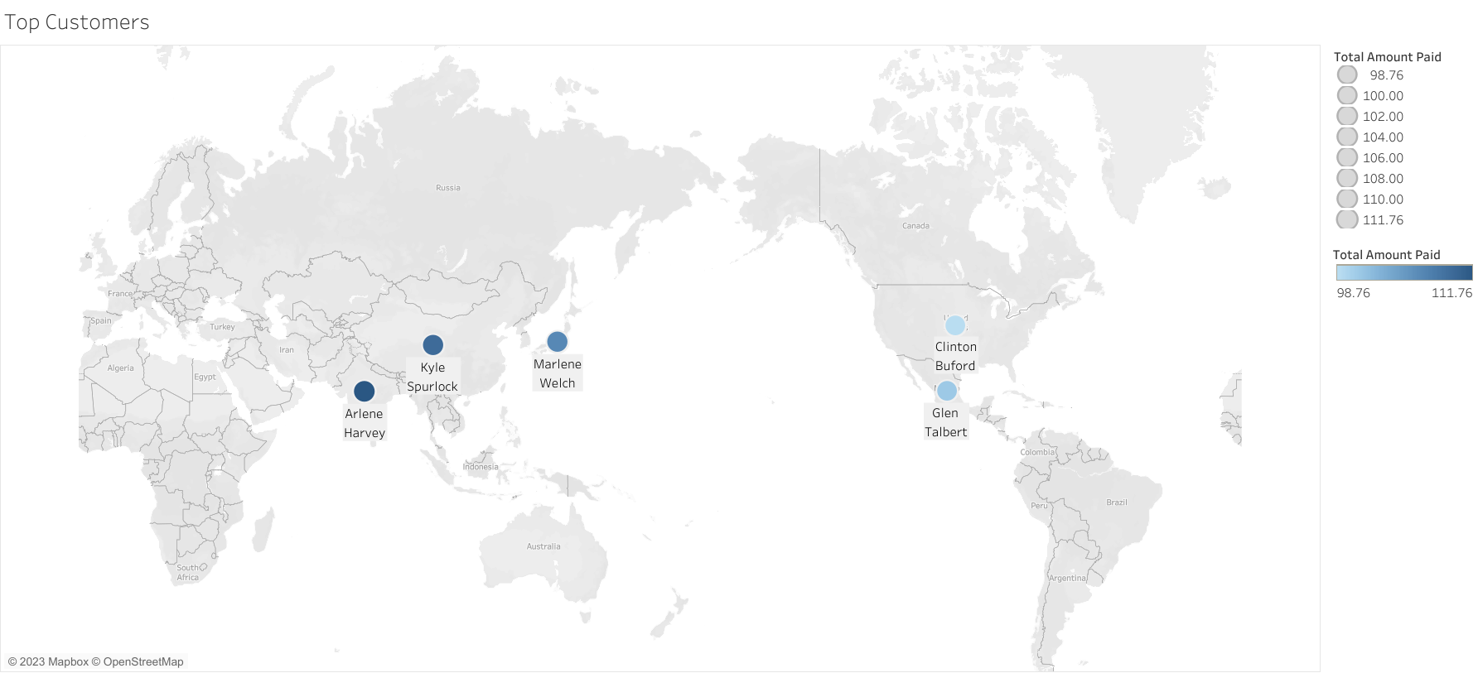
Where are Rockbuster’s lifetime valued customers?
In this visualization, we see where some of those clients reside.
Special offers such as family or friend plans may be rewarding to proven valued members to show appreciation as well as engage others in their networks.

Slide 9
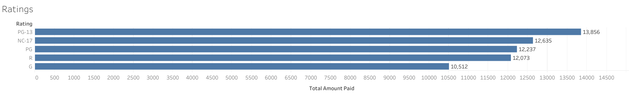
How do Ratings Compare?
Considerations:
If consistent revenue is coming from PG-13 movies, consideration to raise rates may be made to such ratings, while lower rates may be offered to movies rated G, R, or PG to drive further interest.
Alternatively, deals or coupons could be offered in collaboration with marketing initiatives for newly released movies of lower paying genres.

Slide 10
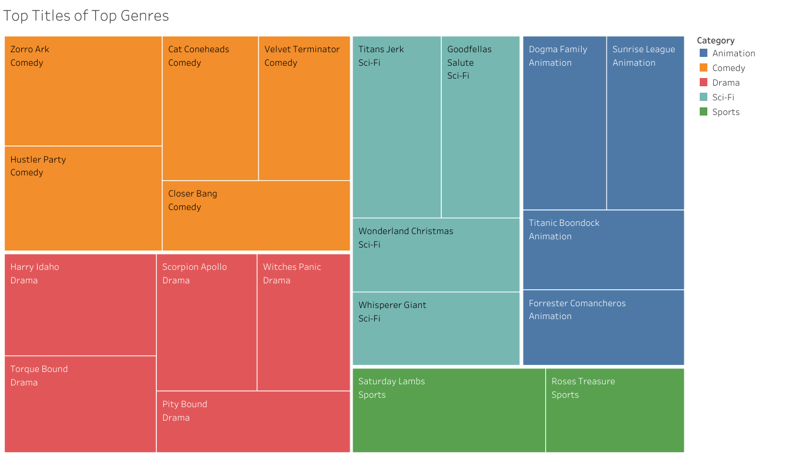
Top Titles Within Top Genres
Further insights can be drawn from the leading movies from the leading genres. Because genres are a common way of filtering films for users, are there commonalities between these categories which could strengthen future licensure or increase cost on the following films and their likes?

Slide 11

Thank You

