Slide 1

Exploratory Data Analysis
Hate Speech Detection
16-March-2023

Slide 2
Agenda
Background
Problem Statement
Data Analysis & Exploration
Feature Analysis
Recommendations

Slide 3
Background
Hate speech is any type of verbal, written and/or behavioral communication that attacks, uses derogatory/discriminatory language against a person or group based on inherent characteristics. For example: discrimination based on a person’s religion, ethnicity, nationality, race, color, ancestry, sex or any other identity. This type of discrimination creates a hostile and unwelcoming environment for may users and general decreases the usability of the online community.

Slide 4
Problem Statement
In this problem, we will implement a hate speech detection model in order to optimize the speed at which hate speech is identified and removed from a social media platform. Hate Speech Detection is generally a task of sentiment classification. A model that can classify hate speech from non-hate speech can be achieved by training it on data that is generally used to classify sentiments. For this task of hate speech detection, we will use pre-labeled tweets to train a ML model to identify tweets containing hate speech.

Slide 5
Data Analysis & Exploration
About the data:
1 file, .csv, 3.1 MB
3 columns (ID, tweet, and label)
31,962 observations
Cleaning the data:
Remove uppercase letters, punctuation, special characters, and stop words

Slide 6
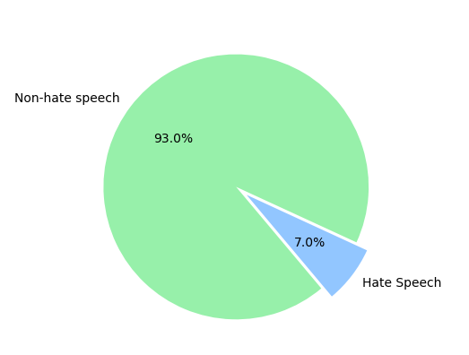
Analysis of Amount of Hate Speech

Slide 7
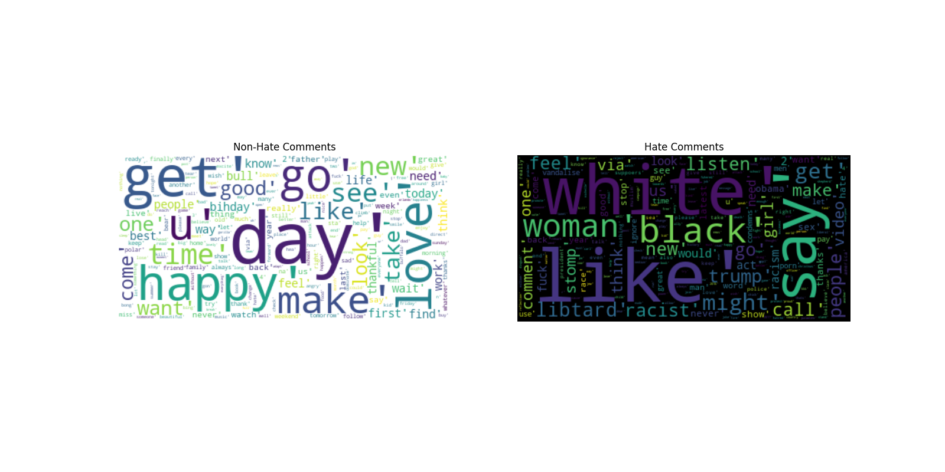
Analysis of Speech Content

Slide 8
Summary
Hate speech features significantly different words than normal speech
Hate speech is in the minority of total speech
97% normal speech, 3% hate speech

Slide 9
Recommendations
Following our evaluation, we’ve concluded that:
Use of Convolutional Neural Network (CNN) for feature extraction and Long short-term memory networks (LSTM) for sequence prediction give the best chance for success

Slide 10
Thank You

