Slide 1

Final Presentation
Hate Speech Detection
30-March-2023

Slide 2
Agenda
Background
Problem Statement
System Architecture
Result Evaluation
Conclusion

Slide 3
Background
Hate speech is any type of verbal, written and/or behavioral communication that attacks, uses derogatory/discriminatory language against a person or group based on inherent characteristics. For example: discrimination based on a person’s religion, ethnicity, nationality, race, color, ancestry, sex or any other identity. This type of discrimination creates a hostile and unwelcoming environment for may users and general decreases the usability of the online community.

Slide 4
Problem Statement
In this problem, we will implement a hate speech detection model in order to optimize the speed at which hate speech is identified and removed from a social media platform. Hate Speech Detection is generally a task of sentiment classification. A model that can classify hate speech from non-hate speech can be achieved by training it on data that is generally used to classify sentiments. For this task of hate speech detection, we will use pre-labeled tweets to train a ML model to identify tweets containing hate speech.

Slide 5
System Architecture
Data Collection
Data Cleaning
Feature Extraction
Classification
Prediction
Tokenizing
Removal of usernames, special characters, punctuation, etc.
Logistic Regression model
Evaluation of accuracy, precision, and other metrics
Removing Stop Words
Lemmatization

Slide 6
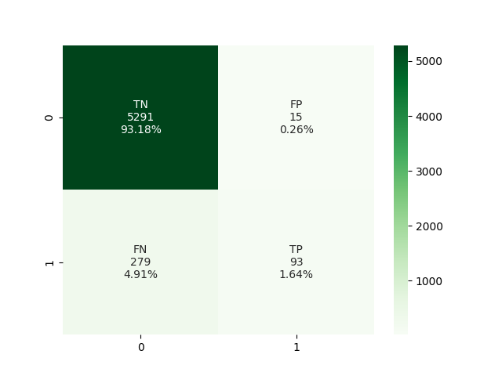
Result Evaluation

Slide 7
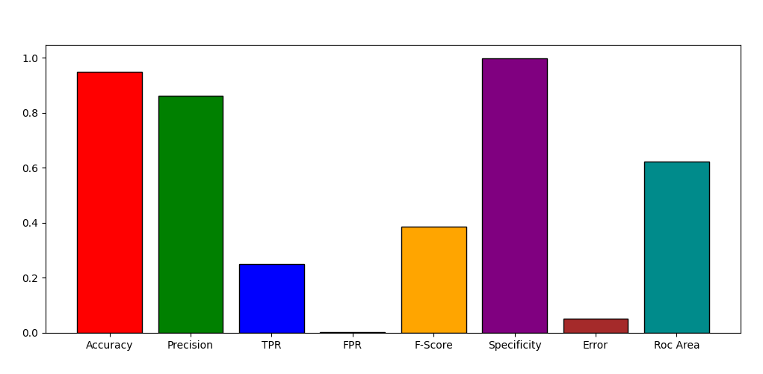
Result Evaluation

Slide 8
Conclusion
Use of a logistic regression model provided good accuracy and specificity
Hate speech detection was overall successful, although there is room for improvement, especially with regards to the false negatives

Slide 9
Thank You

