Slide 1
Replication Project? Schonfeld, B., & Winter-Levy, S. (2021). Policy or Partisanship in the United Kingdom? Quasi-Experimental Evidence from Brexit
Sarah Magdihs
Stats II

Slide 2

Who am I?
Sarah Magdihs
magdihss@tcd.ie
PhD Student in Political Science, TCD
Education: BA & MA in Political Science, University of Vienna
Research interests: Comparative Politics, Political Representation, Political Communication, Political Behaviour, Right-Wing Populism, Gender Politics, etc.

Slide 3
AGENDA
Background of the Study
Context
Research Question
Methods
Hypotheses
Replication
Extension
NOTE: this is not the final version but Overleaf is not doing what I want right now, so this has got to do for now, given that the deadline is now. I promise it will look actually good soon.

Slide 4
Background of the Study

Slide 5
Background I
voters are motivated by policy preferences or partisan identities?
two main hypotheses
‘party-over-policy’ hypothesis
‘policy-over-party’ hypothesis
Definitive evidence is hard to come by due to methodological issues
overcome these challenges: “study party realignments, which can occur when the policy position of a major party changes rapidly and significantly” (Schonfeld & Winter-Levy, 2021, p. 1451).

Slide 6
Background II
focuses on the ”sudden, unanticipated shift in Conservative Party positioning on Brexit following the surprising result of the 2016 referendum” (p. 1451).
In the aftermath of the 2016 Brexit referendum in the UK, the British Conservative Party repositioned themselves as a pro-Brexit party,
British Election Study: panel data prior to and post referendum (Wave 8 and Wave 9).

Slide 7
Replication

Slide 8
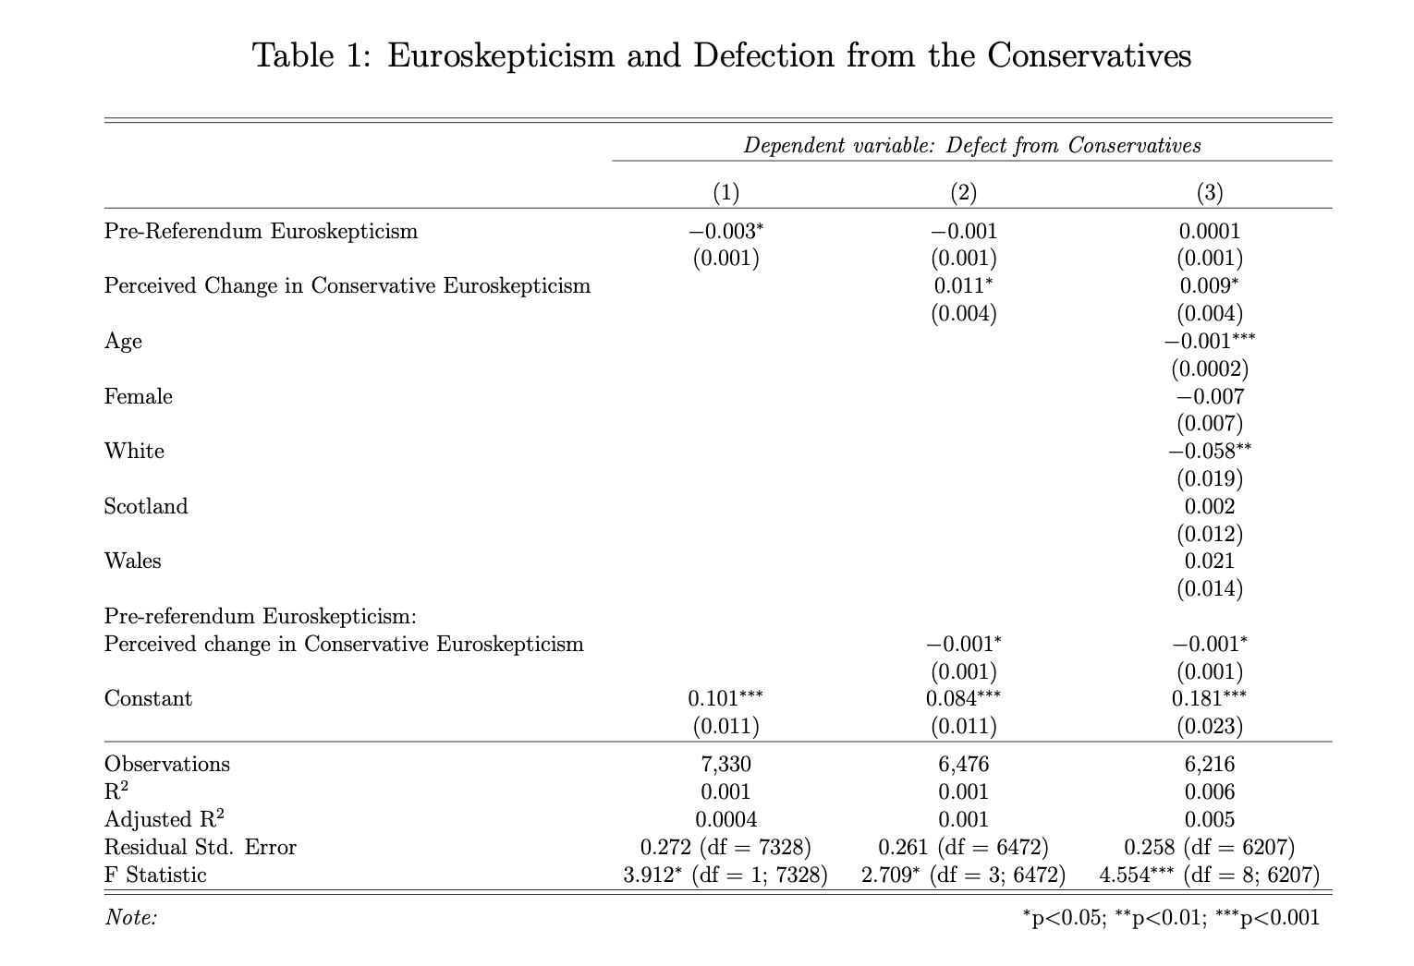

Slide 9
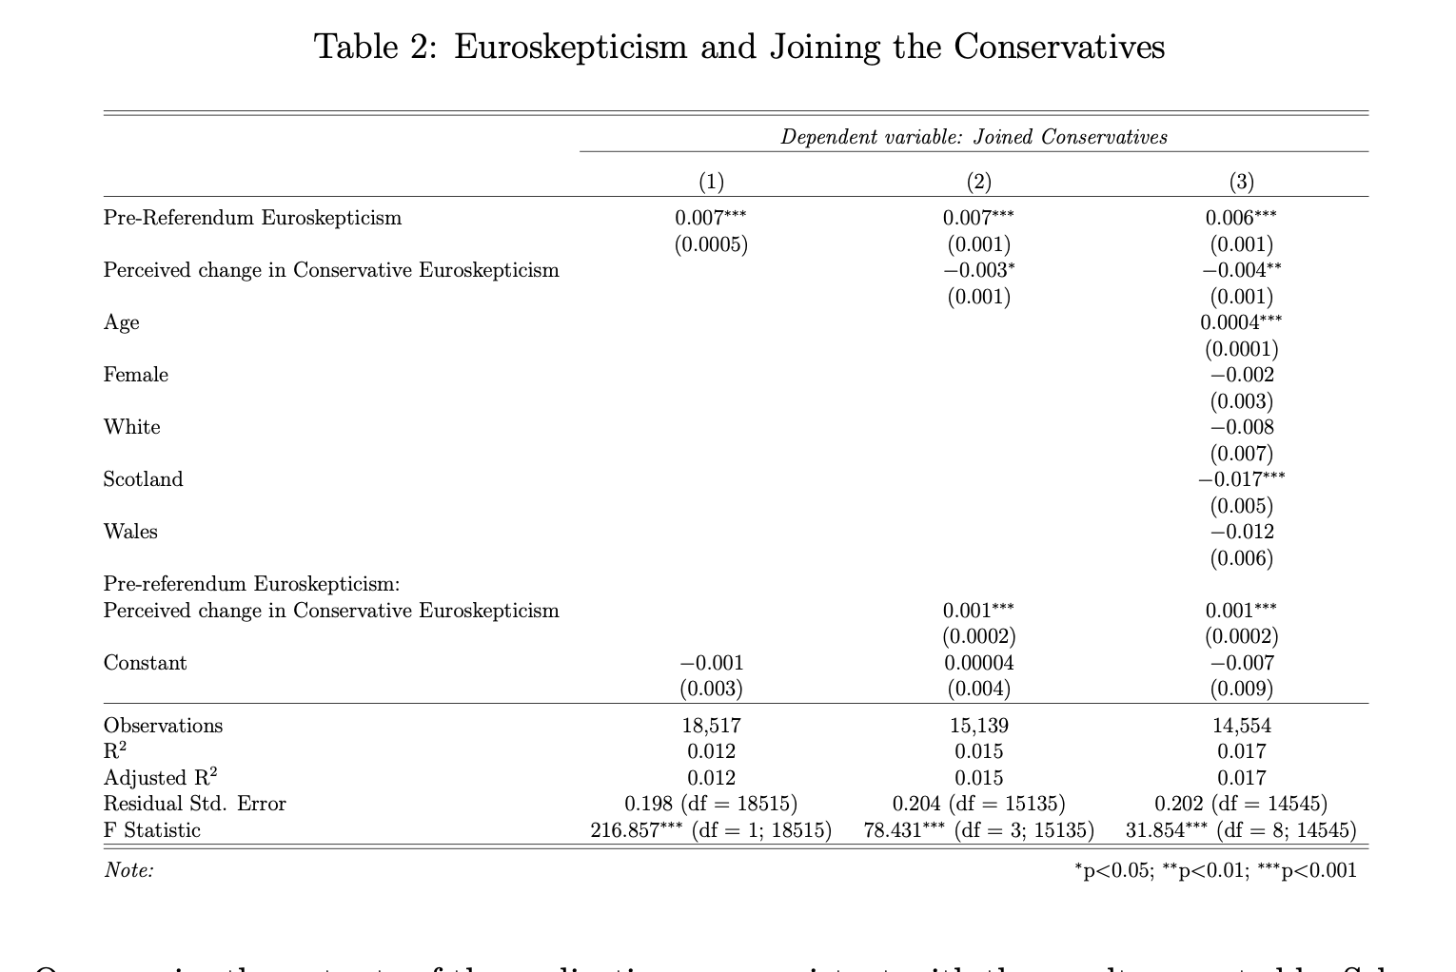

Slide 10
Extension

Slide 11
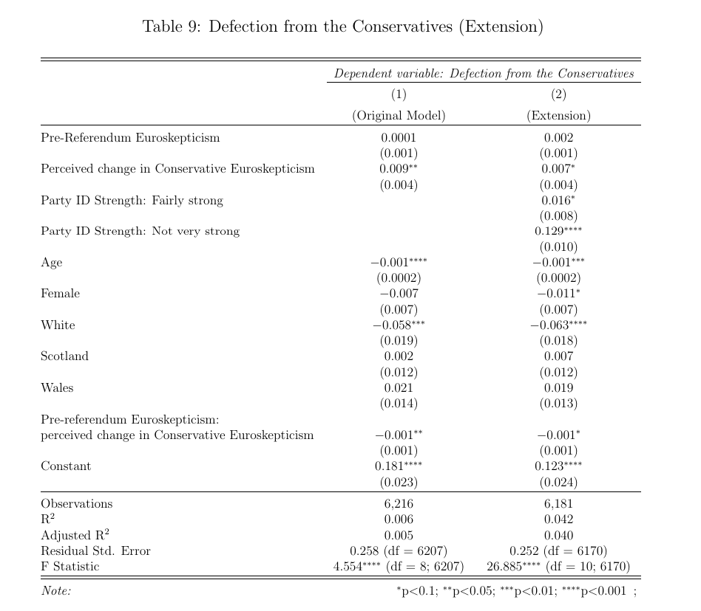

Slide 12
