Slide 1


SUDS Research Day 2022: Disparities in Climate-Induced Health Outcomes in the Greater Toronto Area
Sarah Mansoor
Notes:
Good morning everyone. My name is Sarah Mansoor and today I will be presenting my work on the Disparities in Climate-Induced Health Outcomes in the GTA. The growing impact of climate change in Canada demonstrates a clear and current threat to human health which is prevalent as the country continues to face the consequences of warming almost at twice the global rate. As Canada's population and economy continue to grow, an increase in demand for higher production and resources will inevitably follow. This will require more energy from extraction and in turn contribute to the production of pollutants that are harmful to peoples’ health. My work focused on an analysis of trends in temperature and pollution levels in Toronto over the last 20 years.

Slide 2

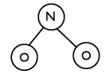

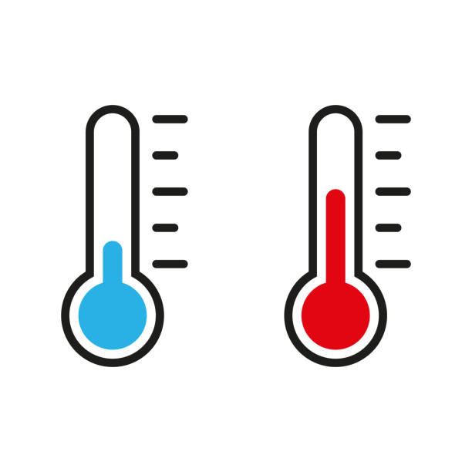





Data Science Methods
Data Collection
Temperature
Pollutants
Exploratory Analysis
Data Visualization
Regression Analysis
Notes:
The data collected includes temperature data from 2002 to 2022 in Toronto and includes maximum, minimum and mean temperatures on a daily scale. The pollution data that includes Nitric oxide, nitrogen dioxide, carbon monoxide, sulfur dioxide and ozone from 2002 to 2020 in Toronto. This data included hourly pollution levels for each pollutant for these years. The data was analyzed using exploratory analysis, data visualization, and regression analysis. Exploratory analysis was used to discover patterns and trends. Data visualization was used to understand and make insights on the data using plots. Regression analysis was used to explore the relationship between temperature and pollution levels in Toronto.

Slide 3
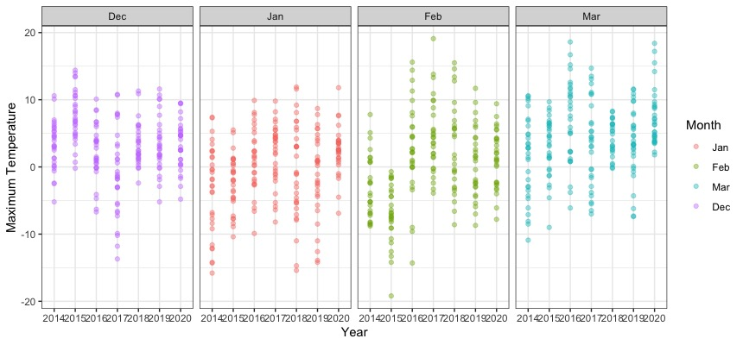
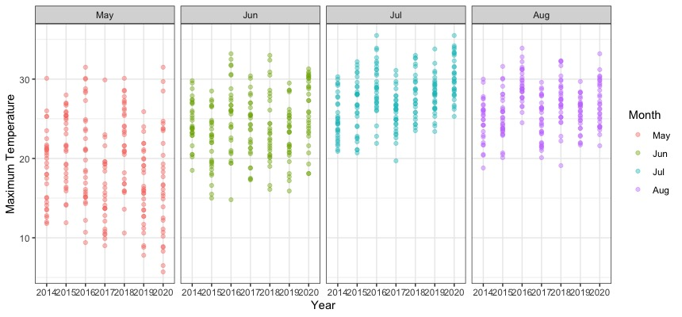
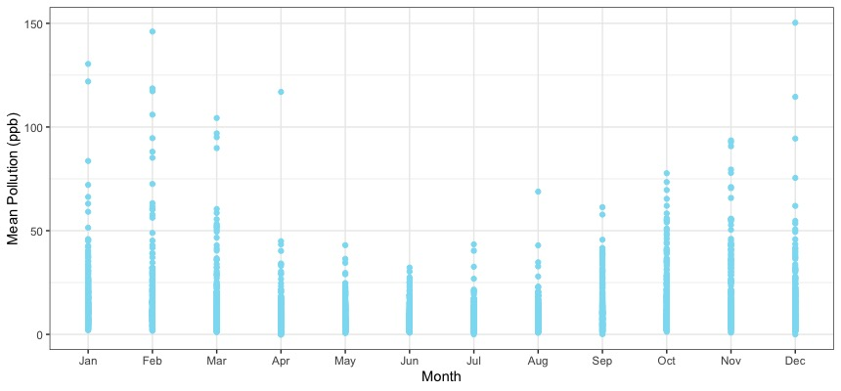
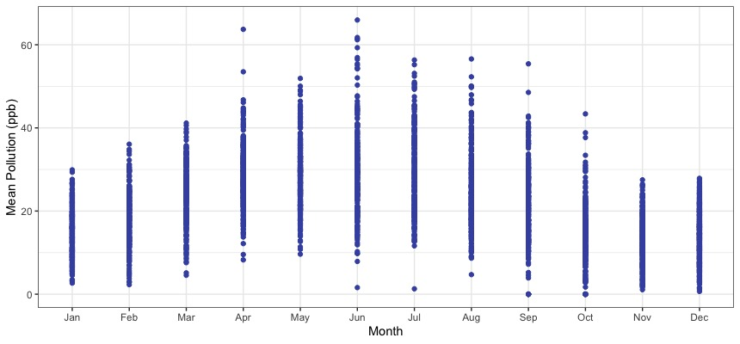
Results
Temperature
Winters less cold
Summers hotter
Pollution
NO, NO2, CO, SO2 levels have decreased and have higher levels in winter
O3 levels have increased and has higher levels in summer
Health Effects
Lung irritation
Respiratory illnesses
Heart disease
Cardiovascular diseases
Notes:
Subsequent findings showed that temperatures have continued to increase since 2002 and winters are experiencing less extreme cold while summers are experiencing more extreme heat as seen in the first two plots. Further, pollution levels for NO (Nitric Oxide), NO2 (Nitrogen Dioxide), CO (Carbon Monoxide), and SO2 (Sulfur Dioxide) have gone down since 2002 which may be related to laws and regulations put in place. Data visualizations showed that these pollutants appear to have higher levels in winter months while O3 (Ozone) pollution levels have remained mostly the same since 2002 and these levels have higher maximums in summer months as seen in the last two plots. The presence of these pollutants has a number of detrimental health effects for the Toronto population including lung irritation, increase in allergens for those with asthma, respiratory illnesses, heart disease, cardiovascular diseases, and reduced lung function. This research will provide insight into which pollutants are most problematic during particular months that should be prioritized in further research to reduce their effects on health for individuals in Toronto. Thank you.

