Slide 1


SUDS Research Day 2022: Disparities in Climate-Induced Health Outcomes in the Greater Toronto Area
Sarah Mansoor
Notes:
The growing impact of climate change in Canada demonstrates a clear and current threat to human health which is prevalent as the country continues to face the consequences of warming almost at twice the global rate. As Canada's population and economy continue to grow, an increase in demand for higher production and resources will inevitably follow. This will require more energy from extraction and in turn contribute to the production of harmful pollutants. This paper will provide an analysis of trends in temperature and pollution levels in Toronto over the last 20 years.

Slide 2









Data Science Methods
Data Collection
Temperature
Pollutants
Exploratory Analysis
Data Visualization
Regression Analysis
Notes:
The data collected includes temperature data from 2002 to 2022 in Toronto and pollution data that includes Nitric oxide, nitrogen dioxide, carbon monoxide, and ozone from 2002 to 2020 in Toronto. The data was analyzed using exploratory analysis, data visualization, and regression analysis.

Slide 3
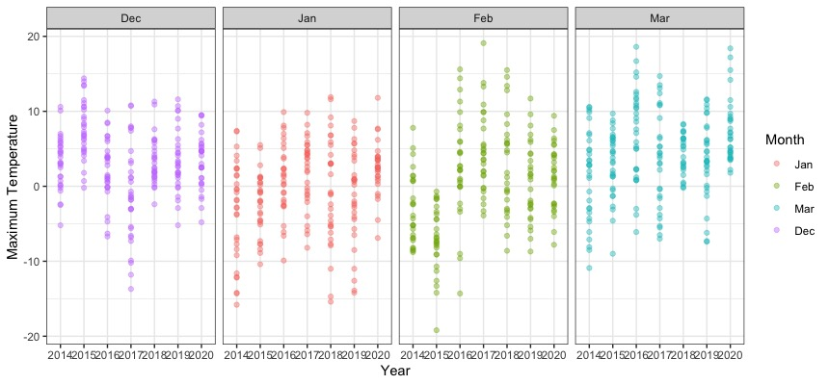
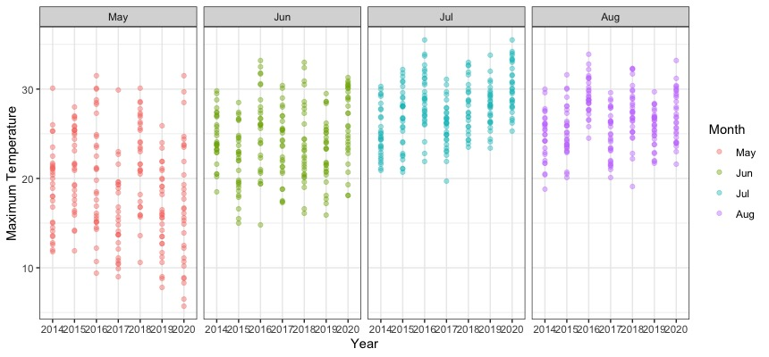
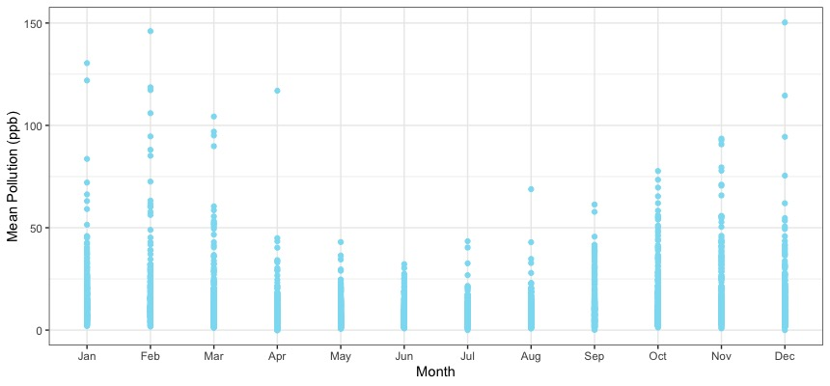
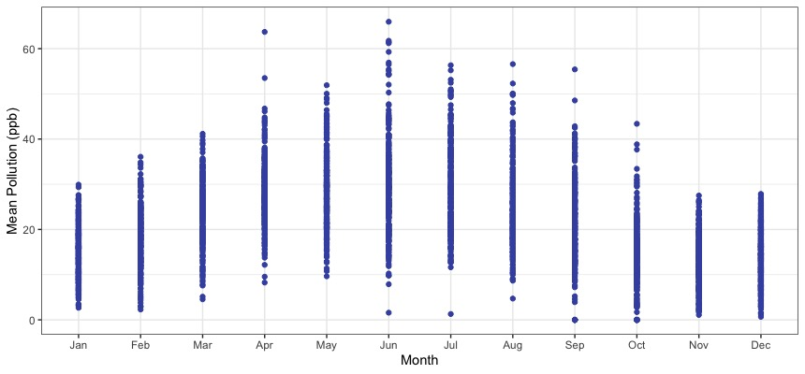
Results
Temperature
Winters less cold
Summers hotter
Pollution
NO, NO2, CO, SO2 levels have decreased and have higher levels in winter
O3 levels have increased and has higher levels in summer
Health Effects
Lung irritation
Respiratory illnesses
Heart disease
Cardiovascular diseases
Notes:
Subsequent findings showed that temperatures have continued to increase since 2002 and winters are experiencing less extreme cold while summers are experiencing more extreme heat. Further, pollution levels for NO (Nitric Oxide), NO2 (Nitrogen Dioxide), CO (Carbon Monoxide), and SO2 (Sulfur Dioxide) have gone down since 2002 which may be related to laws and regulations put in place. Data visualizations showed that these pollutants appear to have higher levels in winter months while O3 (Ozone) pollution levels have remained mostly the same since 2002 and these levels have higher maximums in summer months. The presence of these pollutants has a number of detrimental health effects for the Toronto population including lung irritation, increase in allergens for those with asthma, respiratory illnesses, heart disease, cardiovascular diseases, and reduced lung function. This research will provide insight into which pollutants are most problematic during particular months that should be prioritized in further research to reduce their effects on health.

