Slide 1
ANALYZING Song Lyrics
By Genre
HOME
TABLE OF CONTENTS
PLAYLIST
01
Background
02
Data Processing
03
Our Findings
04
Recommendations
Mfolozi Dlamini, Kyle Guillen, Monami Mukherjee, and Sarah Olsen
ENJOY!

Slide 2
TABLE OF CONTENTS
Background
Data Processing
01
02
03
Sentiment Analysis
04
LDA (Topic Modeling)
05
Business Recommendation
HOME
TABLE OF CONTENTS
PLAYLIST
Background
01
02
Data Processing
03
Our Findings
04
Recommendations
ENJOY!

Slide 3
01
BACKGROUND
Our Question
Our Approach
HOME
TABLE OF CONTENTS
PLAYLIST
01
Background
How can we gain insights from song lyrics that improve songwriting strategy in different genres of music?
02
Data Processing
03
Our Findings
We used sentiment analysis and topic modeling to extract meaningful information from song lyrics and drew conclusions about each genre based on our results.
04
Recommendations
ENJOY!

Slide 4
02
Data Processing
HOME
TABLE OF CONTENTS
PLAYLIST
01
Background
02
Data Processing
03
Our Findings
04
Recommendations
ENJOY!

Slide 5
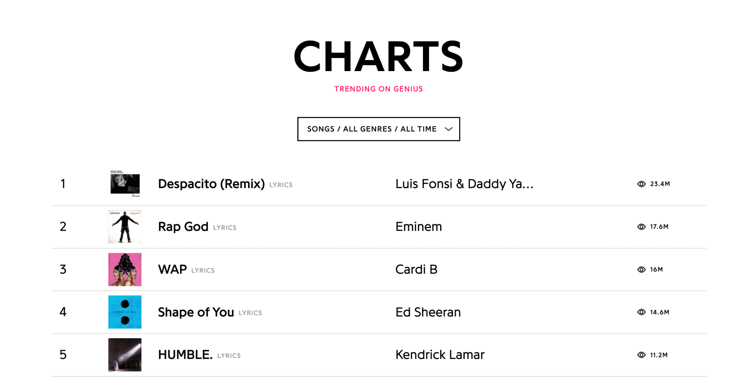
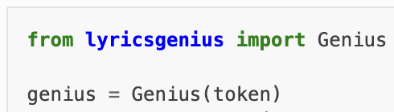
DATA SOURCES
Song Details
Song Lyrics
genius.com Most Viewed Lyrics of All Time Charts (filtered by Genre)
Genius API
https://lyricsgenius.readthedocs.io/en/master/

Slide 6
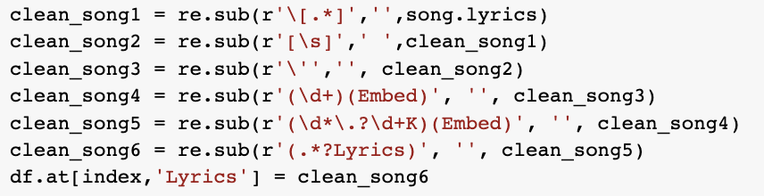
CLEANING THE DATA
Cleaning the Song Details
Cleaning the Song Lyrics
Transpose the data
Remove duplicate records
Regular expressions
Specify UTF-16 encoding when reading in the data
Some examples of our regex:

Slide 7
03
Sentiment Analysis & Machine Learning
HOME
TABLE OF CONTENTS
PLAYLIST
01
Background
02
Data Processing
03
Our Findings
04
Recommendations
ENJOY!

Slide 8

Lyrics Sentiment Methodology
We used TextBlob’s polarity feature as a way to calculate the polarity scores for each of our songs
Songs were then classified as positive or negative (1 or 0) depending on that score
The dataset was relatively balanced (60% positive sentiment, 40% negative sentiment)
We did not deem it appropriate to undersample or oversample given the size of our dataset (about 420 songs)

Slide 9
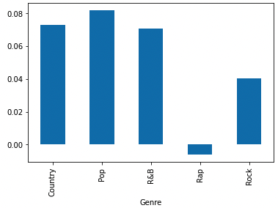
Listen to your Mood
(Sentiment by Genre)

Slide 10
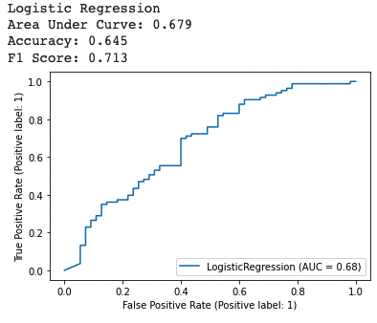
Logistic Regression Model

Slide 11
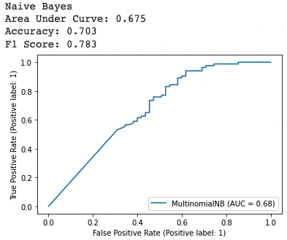
Naive Bayes Model

Slide 12
04
Latent Dirichlet Allocation
(Topic Modeling)
HOME
TABLE OF CONTENTS
PLAYLIST
01
Background
02
Data Processing
03
Our Findings
04
Recommendations
ENJOY!

Slide 13

Topic Modelling Methodology
A machine learning technique that automatically analyzes text data to determine cluster words for a set of documents.
Wanted to see which words would be grouped together in our dataset across 5 genres
We observed the topic clusters
We also wanted to observe Coherence Scores

Slide 14
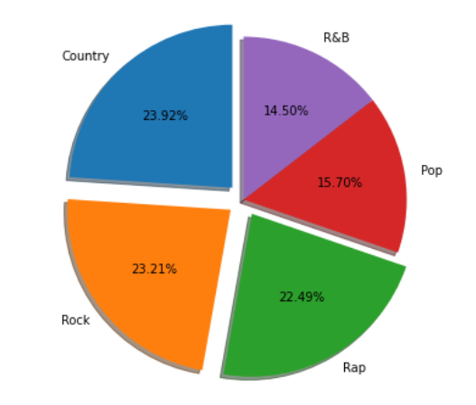
Dataset Balance
Notes:
The first thing we wanted to ensure was that we were dealing with relatively balanced data. From the above pie chart we can not that country, rap, rock songs were relatively the same around 100 songs each and Pop and RnB relatively lower with around 60 songs respectively. However we still felt confident in our samples as this wasnt a significant gap.

Slide 15
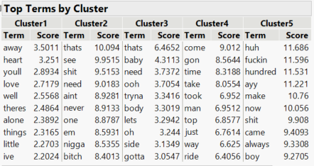
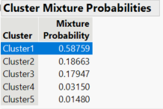
Latent Class Analysis

Slide 16
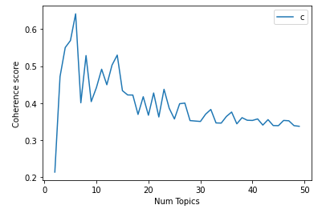
Coherence Scores
Used in topic modeling to measure how interpretable topics are to humans
Significant decline in coherence score as the number of topics increase
This makes intuitive sense because of the pre-chosen genres
Notes:
We can use the coherence score in topic modeling to measure how interpretable the topics are to humans. In this case, topics are represented as the top N words with the highest probability of belonging to that particular topic. Briefly, the coherence score measures how similar these words are to each other.
The idea is pretty simple. We want to maximize intra-topic and minimize inter-topic similarity. Also, by similarity, we imply the cosine similarity between words represented by word2vec embedding

Slide 17
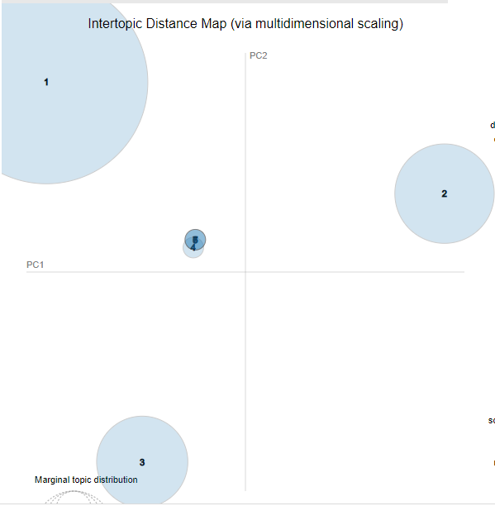
Intertopic
Distance
Map

Slide 18
06
Recommendations & Conclusion
HOME
TABLE OF CONTENTS
PLAYLIST
01
Background
02
Data Processing
03
Our Findings
04
Recommendations
ENJOY!

Slide 19
Recommendations
Pop
R&B
Country
Rock
Rap
Topics
Sentiment: Very Positive
Sentiment: Positive
Sentiment: Positive
Sentiment: Somewhat Negative / Neutral
Sentiment: Very Negative
We can see common topics, so we will use the results from the topic modeling to recommend a pop and R&B crossover album

Slide 20
Bonus:
Other Applications Of Our Project
Song Topics
Song Sentiment
Marketing & Promo
Record Labels
Factor song topics into song recommendation engines
Factor song sentiment into song recommendation engines
Extract lyrics from top charting songs to plan albums and singles
Discover preferences of music consumers to inform record labels’ marketing strategies

Slide 21
Bonus: Business Applications of our Project
Spotify Discover Weekly
Apple New Music Daily
Spotify Wrapped
A personalized list of 30 songs that fit that user's taste, curated weekly
A playlist of top trending songs of the day
Allows Spotify users to view a compilation of data about their activity on the platform over the past year

Slide 22
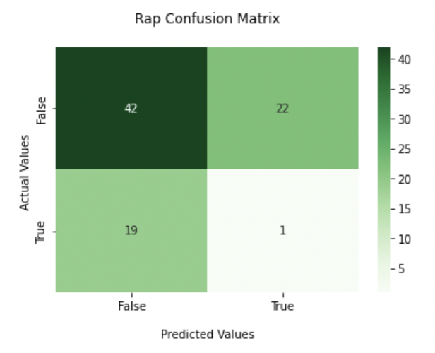
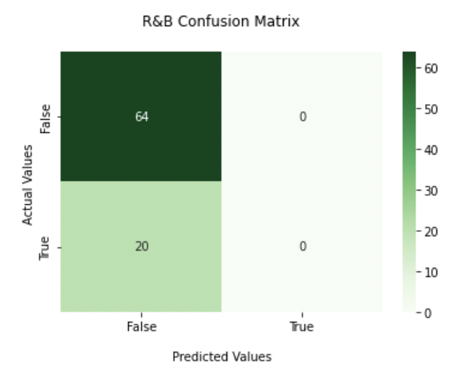

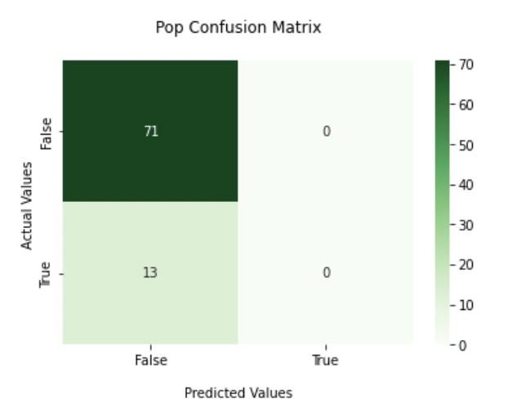
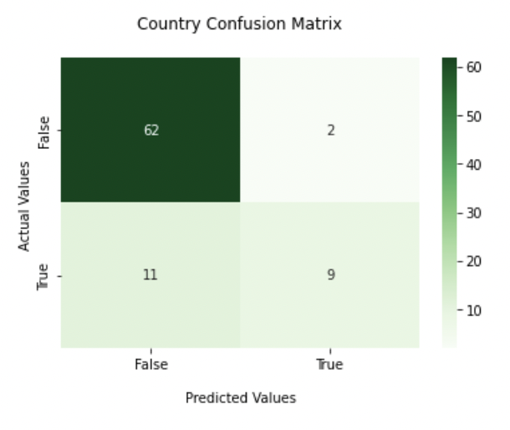
Can We Predict a Song’s Genre Using Song Lyrics?
We used BERT as a binary classifier to predict a songs’ genre
“Lyrics” is the input variable and “Genre” is the target variable

Slide 23
THANK YOU!
Notes:
Monami

