Slide 1

Task 10 – SCRUM

Slide 2
Content
Project team and working recourses
Burndown Chart
Product Backlog
Sprint Backlog

Slide 3
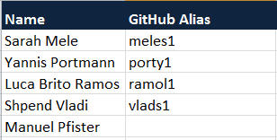
1. Project team and working recourses
150 hours

Slide 4
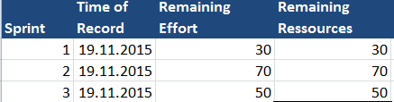
2. Burndown Chart

Slide 5
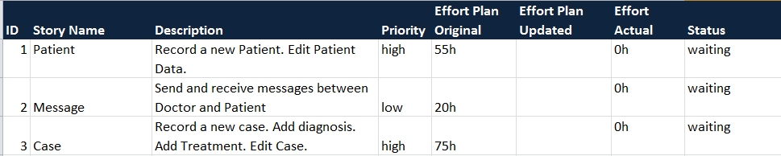
3. Product Backlog

Slide 6
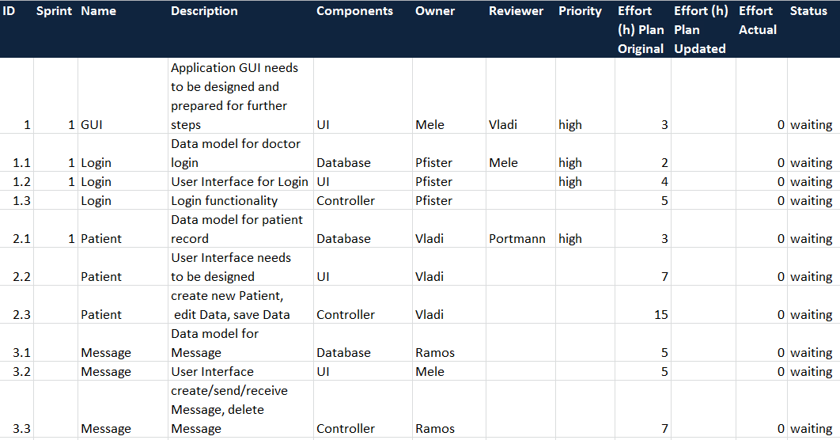
4. Sprint Backlog

Slide 7
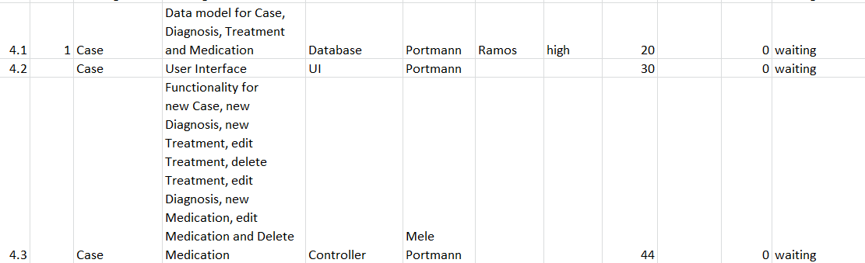
4. Sprint Backlog

Slide 8

5. Discussion
Fragen?

