Slide 1

Task 3 – SE Process
Projekt MHC-PMS

Slide 2
Content
UML class diagrams
Sequence diagrams
Discussion

Slide 3
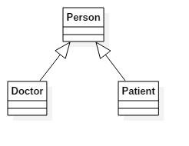
1. UML diagrams: Inheritance

Slide 4
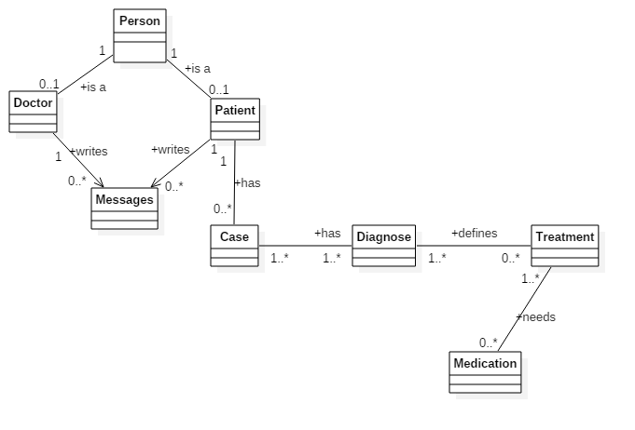
1. UML diagrams: Domain

Slide 5
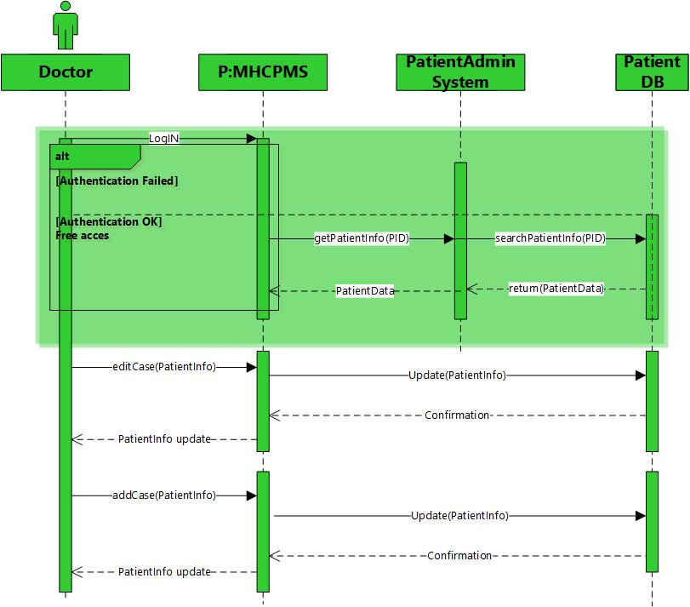
2. Sequence diagrams: Case

Slide 6

2. Sequence diagrams: Diagnosis

Slide 7

2. Sequence diagrams: Treatment

Slide 8
2. Sequence diagrams: Treatment

Slide 9

7. Discussion
Fragen?

