Slide 1

Task 14 – Final Presentation
Doctor Green App

Slide 2
Content
Demo of Prototype
Code Review
Personal Contribution of each Team member
Me, my team and the Course
Learning Process
Scrum Retrospective
Storyboard – Requirements – Design – Implementation

Slide 3
Demo
http://localhost:8080/

Slide 4
Code Review (Mele)
MyUI
Generic View
Login View
Home View
(State Pattern)

Slide 5
Code Review (Portmann)
Code Review (Pfister)
Login Controller
Patient Search
Patient View and Controller
(State Pattern)

Slide 6
Code Review (Vladi / Ramos)
Case View and Controller
Treatment View and Controller
Database

Slide 7
Personal Contribution of each Team member «Me, my team and the course»
Mele
Pfister
Portmann
Vladi
Ramos

Slide 8
Learning Process
Storyboards
Better Understanding for the App
Requirements
Not all Requirements could be implemented
Design
Prototyping is very important
Implementation
Organisation

Slide 9
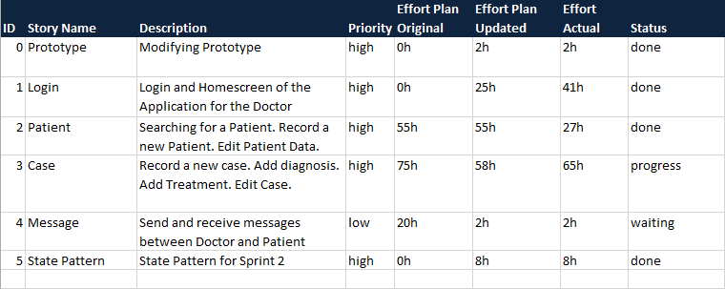
Learning Process
Scrum Retrospective
Product Backlog

Slide 10
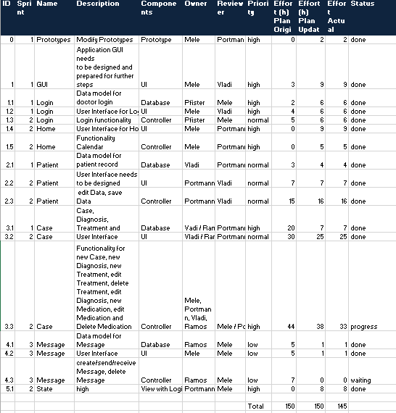
Learning Process
Scrum Retrospective
Sprint Backlog

Slide 11

Questions?

