Slide 1

Task 7 – Domain Model and Sequence Diagram
Projekt MHC-PMS

Slide 2
Content
UML Class diagrams
Sequence diagrams
Modified UML Class Diagram
Discussion

Slide 3
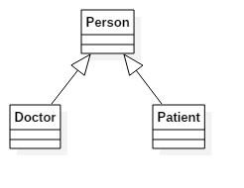
1. UML Diagrams: Inheritance

Slide 4
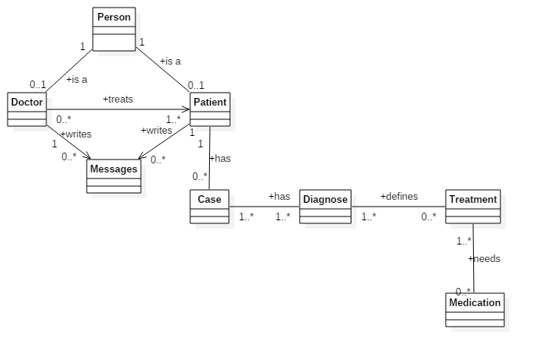
1. UML Diagrams: Domain

Slide 5
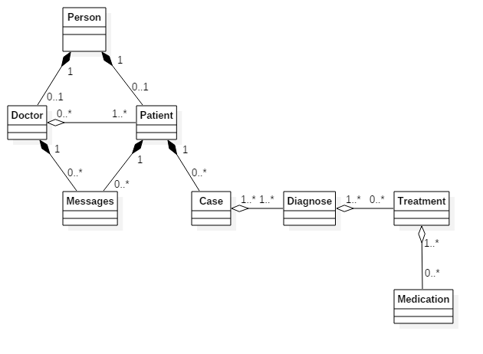
1. UML Diagrams: Aggregation / Composition

Slide 6
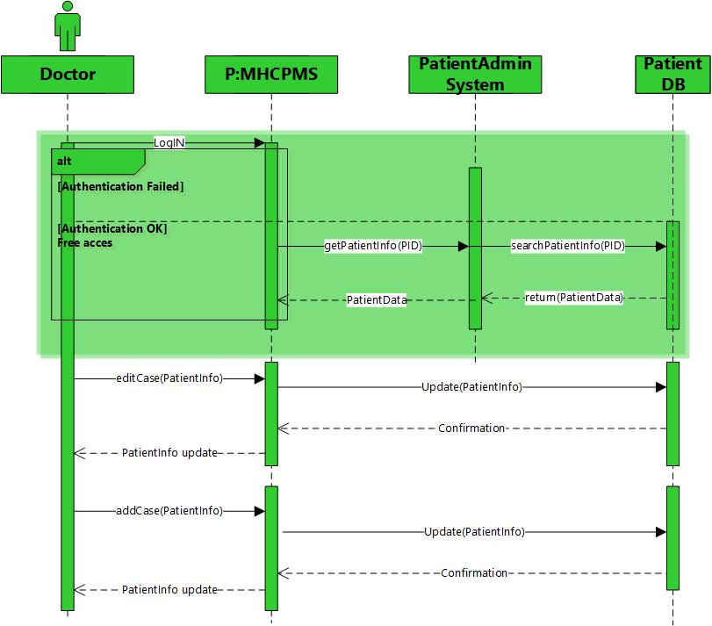
2. Sequence Diagrams: Case

Slide 7

2. Sequence Diagrams: Diagnosis

Slide 8

2. Sequence Diagrams: Treatment

Slide 9
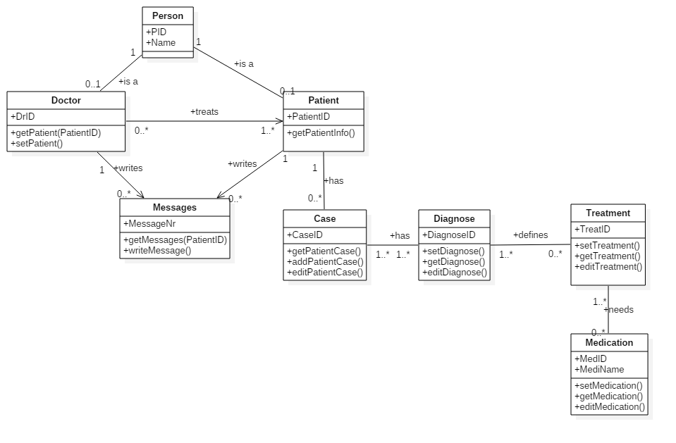
3. Modified UML – Class Diagram

Slide 10

7. Discussion
Fragen?

