Slide 1

Task 14 – Final Presentation
Doctor Green App

Slide 2
Content
Demo of Prototype
Code Review
Personal Contribution of each Team member
Me, my Team and the Course
Learning Process
Scrum Retrospective
Storyboard – Requirements – Design – Implementation

Slide 3
Demo
http://localhost:8080/

Slide 4
Code Review (Mele)
MyUI
Generic View
Login View
Home View
(State Pattern)

Slide 5
Code Review (Portmann)
Code Review (Pfister)
Login Controller
Patient Search
Patient View and Controller

Slide 6
Code Review (Vladi / Ramos)
Case View and Controller
Treatment View and Controller
Database

Slide 7
Personal Contribution of each Team member
Mele
Pfister
Portmann
Vladi
Ramos

Slide 8
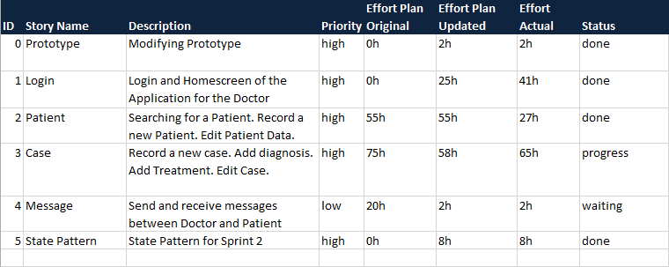
Learning Process
Scrum Retrospective
Product Backlog

Slide 9
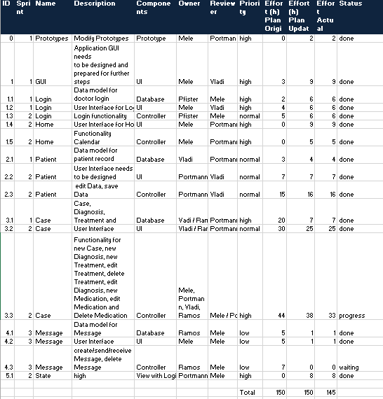
Learning Process
Scrum Retrospective
Sprint Backlog

Slide 10
Learning Process
Storyboards
Requirements
Design
Implementation

Slide 11

Questions?

