Slide 1
Team Green
Task 3 – SE Process
Projekt MHC-PMS

Slide 2
Content
Scoping
Research
Synthesize
Design
Mainfeatures
Storyboard
Prototyping

Slide 3
1. Scoping

Slide 4
2. Research
Curaprax

Slide 5
3. Synthesize

Slide 6
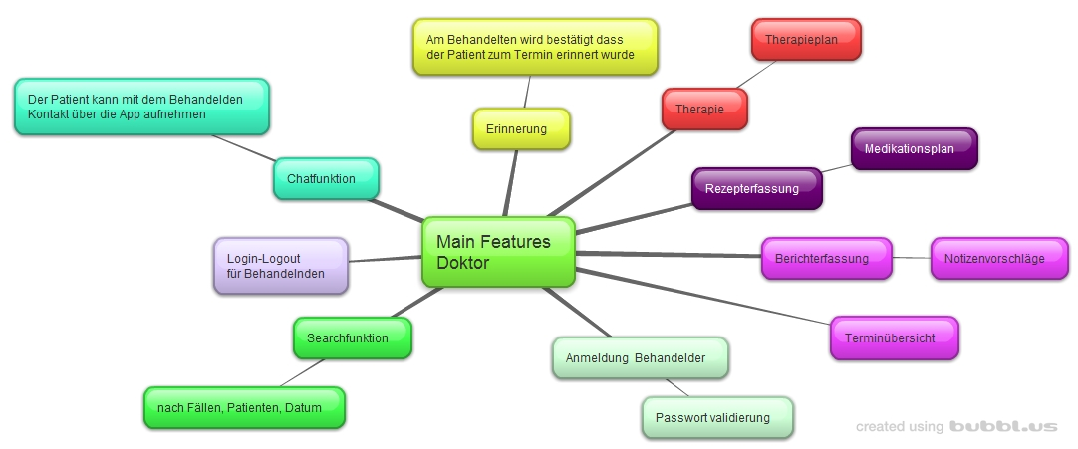
4. Design: Mainfeatures

Slide 7
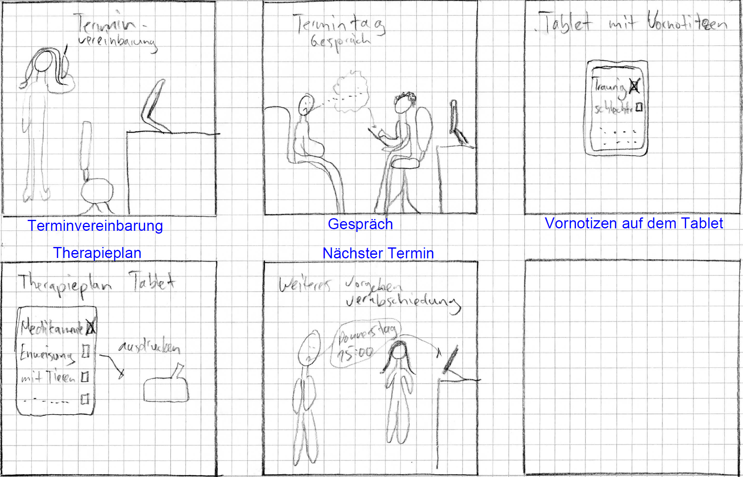
4. Design: Storyboard

Slide 8
4. Design: Prototyping

