Slide 1
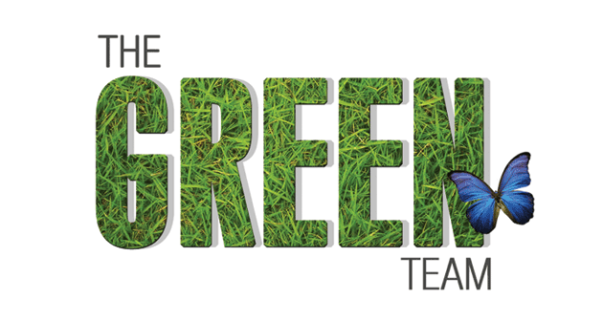
Task 9 – Software Architecture

Slide 2
Content
Modified UML Class diagram
High Level Software Architecture
MVC Pattern
Software Architecture

Slide 3
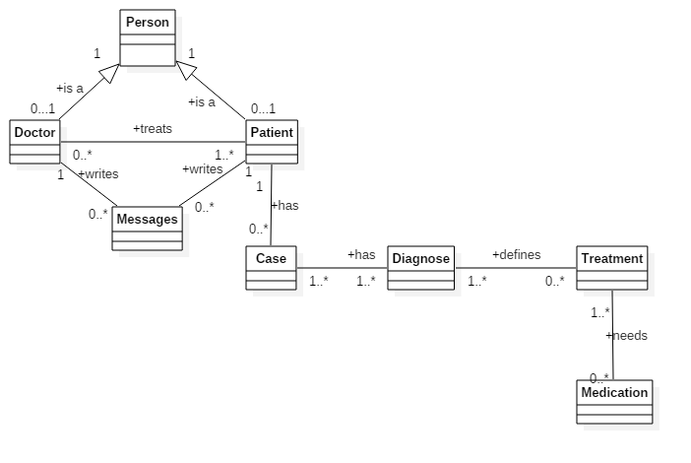
1. UML Class Diagram

Slide 4
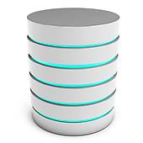
2. High Level Software Architecture
Webbrowser
Client
Java Webserver: jetty
UI Manager
Server
Application: DoctorGreen
Database

Slide 5
3. MVC Pattern: Application Doctor Green
Views | Models | Controllers
PatientInfo - View | PatientInfo - Model | PatientInfo - Controller
Message - View | Message - Model | Message - Controller
Case - View (Case/Diagnose) | Case - Model | Case - Controller
Treatment - View (Treatment/Medication) | Treatment - Model | Treatment - Controller

Slide 6
4. Software Architecture with Vaadin
WEBBROWSER
Vaadin Client Side Engine
Client Side UI
HTTPS
Request
HTTPS
Response
CONTROLLER
PatientInfo
Treatment
Message
Case
VIEW
PatientInfo
Treatment
Message
Case
UserInterface
Vaadin
Output
MODEL
PatientInfo
Treatment
Message
Case
CLASS
DATABASE
DataBinding
Vaadin

Slide 7

7. Discussion
Fragen?

