Slide 1
File writing and dictionaries
Programming Bootcamp 2015
Day 5 – 6/16/15

Slide 2
Today's schedule
File writing
Dictionaries

Slide 3
1. File writing

Slide 4
File writing
Opening an output file is almost identical to input, with a small difference:
var = open(fileName, 'w')
Example:
outFile = open("seqs.txt", 'w')

Slide 5
File writing
Opening an output file is almost identical to input, with a small difference:
var = open(fileName, 'w')
Example:
outFile = open("seqs.txt", 'w')
Important: opening a file in 'w' mode will overwrite the file if it already exists.

Slide 6
Writing to an output file
Once the output file is opened, we use:
var.write(someStr)
Example:
outFile.write("This is output!\n")

Slide 7
Writing to an output file
Once the output file is opened, we use:
var.write(someStr)
Example:
outFile.write("This is output!\n")
Don't forget the newline! Unlike print, .write() does not insert this for you.

Slide 8
Simple example
Code
fileName = "output.txt"
outFile = open(fileName, 'w')
outFile.write("This is me,")
outFile.write("printing to \n a file.")
outFile.close()
output.txt
This is me,printing to
a file.
Note the spacing and newline
Notes:
Weird spacing for educational purposes.

Slide 9
Only strings can be printed
Code
fileName = "output.txt"
outFile = open(fileName, 'w')
outFile.write(25)
outFile.close()
Error:
Traceback (most recent call last):
File "test.py", line 3, in <module>
outFile.write(25)
TypeError: expected a character buffer object

Slide 10
Only strings can be printed
Code
fileName = "output.txt"
outFile = open(fileName, 'w')
outFile.write(str(25))
outFile.close()
output.txt
25
A simple fix.

Slide 11
Reading and writing can be done at the same time (as long as it's to different files)
Code
infile = "genes.txt"
outfile = "output.txt"
inFile = open(infileName, 'r')
outFile = open(outfileName, 'w')
for line in inFile:
line = line.rstrip('\n')
outFile.write("Found " + line + "\n")
outFile.close()
inFile.close()
output.txt
Found uc007zzs.1
Found uc009akk.1
Found uc009eyb.1
Found uc008wzq.1
Found uc007hnl.1
genes.txt
uc007zzs.1
uc009akk.1
uc009eyb.1
uc008wzq.1
uc007hnl.1
Notes:
This can pretty much be used as a template for most situations.

Slide 12
2. Dictionaries

Slide 13
Lists vs Dictionaries
Two main differences:
You retrieve elements from a dictionary using a "key", rather than an index
Dictionaries are unordered

Slide 14
1. Indexing by keys
A dictionary is similar to a list, except instead of accessing elements by their index, you access them by a name ("key") that you pick.
>>> print dict["animal"]
cat
 | 'age' | 'animal' | 'num' | 203 | 'count' | 'flag'
hash | 3 | "cat" | 56.9 | 4 | 10 | True
Notes:
Single or double quotes are fine.

Slide 15
1. Indexing by keys
A dictionary is similar to a list, except instead of accessing elements by their index, you access them by a name ("key") that you pick.
>>> print dict["animal"]
cat
 | 'age' | 'animal' | 'num' | 203 | 'count' | 'flag'
hash | 3 | "cat" | 56.9 | 4 | 10 | True
Keys can be strings or numbers. You can use single quotes or double quotes around the strings; doesn't matter
Dictionaries are similar to what other languages call "hash tables". So I might call them that sometimes.
Notes:
Dictionaries are similar to what other languages call "hash tables". So I might call them that sometimes.

Slide 16
2. Unordered
Lists are all about keeping elements in some order. Though you may change the ordering from time to time, it's still in some order.
You should think of dictionaries more like magic grab bags. You mark each piece of data with a key, then throw it in the bag. When you want that data back, you just tell the bag the key and it spits out the data assigned to that key.

Slide 17
2. Unordered
Lists are all about keeping elements in some order. Though you may change the ordering from time to time, it's still in some order.
You should think of dictionaries more like magic grab bags. You mark each piece of data with a key, then throw it in the bag. When you want that data back, you just tell the bag the key and it spits out the data assigned to that key.
Technicality:
Ok, so in reality, there is an order to your dictionary. But it is an order that Python picks that obeys complex rules and is essentially unpredictable by us. So for all intents and purposes, it may as well be unordered. Don't worry about it too much... just treat it like a magic grab bag and all will be well.

Slide 18
Practice with dictionary keys
What will this code print?
print hash['count']
 | 'age' | 'animal' | 'num' | 205 | 'count' | 'flag'
hash | 3 | "cat" | 56.9 | 4 | 10 | True

Slide 19
Practice with dictionary keys
What will this code print?
print hash['count']
Result:
10
 | 'age' | 'animal' | 'num' | 205 | 'count' | 'flag'
hash | 3 | "cat" | 56.9 | 4 | 10 | True

Slide 20
Practice with dictionary keys
What will this code print?
print hash['num']
 | 'age' | 'animal' | 'num' | 205 | 'count' | 'flag'
hash | 3 | "cat" | 56.9 | 4 | 10 | True

Slide 21
Practice with dictionary keys
What will this code print?
print hash['num']
Result:
56.9
 | 'age' | 'animal' | 'num' | 205 | 'count' | 'flag'
hash | 3 | "cat" | 56.9 | 4 | 10 | True

Slide 22
Practice with dictionary keys
What will this code print?
print hash[age]
 | 'age' | 'animal' | 'num' | 205 | 'count' | 'flag'
hash | 3 | "cat" | 56.9 | 4 | 10 | True

Slide 23
Practice with dictionary keys
What will this code print?
print hash[age]
Result:
Traceback (most recent call last):
File "<stdin>", line 1, in <module>
NameError: name 'age' is not defined
 | 'age' | 'animal' | 'num' | 205 | 'count' | 'flag'
hash | 3 | "cat" | 56.9 | 4 | 10 | True
(we didn't put quotes around "age")

Slide 24
Practice with dictionary keys
What will this code print?
var = 'animal'
print hash[var]
 | 'age' | 'animal' | 'num' | 205 | 'count' | 'flag'
hash | 3 | "cat" | 56.9 | 4 | 10 | True

Slide 25
Practice with dictionary keys
What will this code print?
var = 'animal'
print hash[var]
Result:
cat
 | 'age' | 'animal' | 'num' | 205 | 'count' | 'flag'
hash | 3 | "cat" | 56.9 | 4 | 10 | True
Notes:
So if you store the key in a variable, you can use that variable to index into the hash at that key.

Slide 26
Creating a dictionary
Create an empty dictionary:
hash = {}
Create a dictionary with elements:
hash = {"Joe": 25, "Sally": 35}
 | "Joe" | "Sally"
hash | 25 | 35
Notes:
{'Joe': 25, 'Sally':35}
Commas separate entries. Keys precede their values and are separated by a colon

Slide 27
Creating a dictionary
Create an empty dictionary:
hash = {}
Create a dictionary with elements:
hash = {"Joe": 25, "Sally": 35}
 | "Joe" | "Sally"
hash | 25 | 35
"value"
"key"
Notes:
{'Joe': 25, 'Sally':35}
Commas separate entries. Keys precede their values and are separated by a colon

Slide 28
Adding to a dictionary
Add entry:
hash[newKey] = newVal
Example:
>>> hash = {}
>>> hash["Joe"] = 25
>>> hash["Bob"] = 39
>>> print hash
{'Bob': 39, 'Joe': 25}

Slide 29
Adding to a dictionary
Add entry:
hash[newKey] = newVal
Example:
>>> hash = {}
>>> hash["Joe"] = 25
>>> hash["Bob"] = 39
>>> print hash
{'Bob': 39, 'Joe': 25}
Note that Python printed them in a different order than we entered them.

Slide 30
Removing from a dictionary
Delete entry:
del hash[existingKey]
Example:
>>> hash = {"name": "Joe", "age": 35, "job": "plumber"}
>>> print hash
{'job': 'plumber', 'age': 35, 'name': 'Joe'}
>>> del hash["age"]
>>> print hash
{'job': 'plumber', 'name': 'Joe'}

Slide 31
Phonebook example
Code:
phonebook = {}
phonebook["Joe Shmo"] = "958-273-7324"
phonebook["Sally Shmo"] = "958-273-9594"
phonebook["George Smith"] = "253-586-9933"
name = raw_input("Lookup number for: ")
print phonebook[name]
Output example:
Lookup number for: <we enter>Sally Shmo
958-273-9594

Slide 32
Phonebook example
Code:
phonebook = {}
phonebook["Joe Shmo"] = "958-273-7324"
phonebook["Sally Shmo"] = "958-273-9594"
phonebook["George Smith"] = "253-586-9933"
name = raw_input("Lookup number for: ")
print phonebook[name]
Output example:
Lookup number for: <we enter>Sally Shmo
958-273-9594
Notice that we can store the name of a key in a variable, and then use that variable to access the desired element. In this case, name holds the name that we input in the terminal, Sally Shmo.
What would happen if we entered a name that was not in the phonebook?

Slide 33
Checking if something is in the dict
This is the same as with a list. Use in:
ages = {}
ages["Joe"] = 35
ages["Sally"] = 36
ages["George"] = 39
if "Joe" in ages:
print "Yes, Joe is in the dictionary"
else:
print "No, Joe is not in the dictionary"
Result:
Yes, Joe is in the dictionary

Slide 34
Dictionary methods
Here are some useful dictionary methods:
dict.keys() - returns a list of the keys only
dict.values() - returns a list of the values only
dict.items() - returns a list of key-value pairs
Example:
>>> colors = {"apple": "red", "banana": "yellow", "grape": "purple"}
>>> colors.keys()
['grape', 'apple', 'banana']
>>> print colors.values()
['purple', 'red', 'yellow']
>>> print colors.items()
[('grape', 'purple'), ('apple', 'red'), ('banana', 'yellow')]

Slide 35
Using .keys()
Code:
ages = {}
ages["Joe"] = 35
ages["Sally"] = 36
ages["George"] = 39
for name in ages.keys():
print name, "is in the dictionary."
Output:
Sally is in the dictionary.
Joe is in the dictionary.
George is in the dictionary.
Once again, notice that things are printed in a seemingly random order.

Slide 36
Using .keys()
Code:
ages = {}
ages["Joe"] = 35
ages["Sally"] = 36
ages["George"] = 39
for name in ages.keys():
print name, "is", ages[name]
Output:
Sally is 36
Joe is 35
George is 39
This gets the value associated with the name

Slide 37
Using .keys()
Code:
ages = {}
ages["Joe"] = 35
ages["Sally"] = 36
ages["George"] = 39
for name in ages:
print name, "is", ages[name]
Output:
Sally is 36
Joe is 35
George is 39
Note that in a for loop, you can actually leave off the .keys(), because this is what python loops over by default when a dict is the iterable.

Slide 38
Using .values()
Code:
ages = {}
ages["Joe"] = 35
ages["Sally"] = 36
ages["George"] = 39
for age in ages.values():
print "There is a person who is", age
Output:
There is a person who is 36
There is a person who is 35
There is a person who is 39
The order is still random-seeming, but note that it's the same order as when we printed the keys.

Slide 39
Using .items()
Code:
ages = {}
ages["Joe"] = 35
ages["Sally"] = 36
ages["George"] = 39
for (name, age) in ages.items():
print name, "is", age
Output:
Sally is 36
Joe is 35
George is 39
.items() returns two variables each time it is called: a key and its value. This is why we can simultaneously assign the result to two variables

Slide 40
Sorting a dictionary
You can not sort a dictionary. However, you can emulate sorting in the following way:
ages = {}
ages["Joe"] = 35
ages["Sally"] = 36
ages["George"] = 39
for name in sorted(ages.keys()):
print name, "is", ages[name]
Output:
George is 39
Joe is 35
Sally is 36
Sorted based on person's name
Notes:
This prints in a sorted order, but the hash itself is unaffected!
Basically, what we are sorting is the list returned by ages.keys(), then we are indexing into the dict in that order

Slide 41
Sorting by values
Occasionally, you'll also want to sort the keys of your dictionary based on their value, rather than the key itself. Here's one way to do it:
ages = {}
ages["Joe"] = 35
ages["Sally"] = 36
ages["George"] = 39
for name in sorted(ages, key=ages.get):
print name, "is", ages[name]
Output:
Joe is 35
Sally is 36
George is 39
Sorted based on age rather than name

Slide 42
Terminology quiz
ages = {}
ages["Joe"] = 35
ages["Sally"] = 36
ages["George"] = 39
"Joe" is most accurately referred to as...
a. an element
b. an index
c. a key
d. a value

Slide 43
Terminology quiz
ages = {}
ages["Joe"] = 35
ages["Sally"] = 36
ages["George"] = 39
"Joe" is most accurately referred to as...
a. an element
b. an index
c. a key
d. a value

Slide 44
Terminology quiz
ages = {}
ages["Joe"] = 35
ages["Sally"] = 36
ages["George"] = 39
35 is most accurately referred to as...
a. an element
b. an index
c. a key
d. a value

Slide 45
Terminology quiz
ages = {}
ages["Joe"] = 35
ages["Sally"] = 36
ages["George"] = 39
35 is most accurately referred to as...
a. an element
b. an index
c. a key
d. a value
"an element" is OK too, but value is the more common terminology

Slide 46
Terminology quiz
ages = [] #this is a list
ages[0] = 35
ages[1] = 36
ages[2] = 39
0 is most accurately referred to as...
a. an element
b. an index
c. a key
d. a value

Slide 47
Terminology quiz
ages = [] #this is a list
ages[0] = 35
ages[1] = 36
ages[2] = 39
0 is most accurately referred to as...
a. an element
b. an index
c. a key
d. a value

Slide 48
Terminology quiz
ages = [] #this is a list
ages[0] = 35
ages[1] = 36
ages[2] = 39
39 is most accurately referred to as...
a. an element
b. an index
c. a key
d. a value

Slide 49
Terminology quiz
ages = [] #this is a list
ages[0] = 35
ages[1] = 36
ages[2] = 39
39 is most accurately referred to as...
a. an element
b. an index
c. a key
d. a value

Slide 50
Appendix
A longer example, complete with R code for graphing

Slide 51
Why use a dictionary?
Technically, anything you can do with a dictionary you could also just do with a list instead. But dictionaries make coding certain tasks much easier.

Slide 52
Example: matching across files
One problem I encounter a lot is where I have two files with different information about a transcript, and I need to integrate the info.
REAL LIFE SITUATION (!!)
I have a file with transcript ids and translation start sites. I need to normalize these start positions by transcript length so that I can graph the distribution of start sites across all transcripts in my dataset. To do this, I need to divide the start site position by the full length of the transcript. Unfortunately, I have transcript lengths stored in a separate file, so I need to match up start sites with their full transcript lengths.
0nt
start site
309nt
1,045nt
transc.
0
0.296
1
(309 / 1045 = 0.296)

Slide 53
Ex. cont.: data files
Here are the formats of my data files:
Start site file:
knownGene Gene InitCodon DistCDS Frame InitContext CDSLen PeakSt PeakWidth #Reads PeakScore Codon Product
uc007afd.1 Mrpl15 248 79 1 AATATGG 15 247 2 368 2.61 aug internal-out-of-frame
uc007afh.1 Lypla1 36 5 0 AACATGT 225 34 4 783 3.27 aug n-term-trunc
uc007afi.1 Tcea1 28 -24 0 GGCTTGT 325 27 3 446 1.43 nearcog n-term-ext
uc007afi.1 Tcea1 100 0 0 GCCATGG 301 99 3 3852 3.79 aug canonical
uc007afn.1 Atp6v1h 100 -13 -1 GCTATCC 10 99 3 728 0.77 nearcog uorf
uc007afn.1 Atp6v1h 149 3 0 AAGATGG 480 147 3 1407 1.36 aug n-term-trunc
uc007agb.1 Pcmtd1 120 -97 -1 GCGCTGG 45 119 3 65 0.75 nearcog uorf
uc007agb.1 Pcmtd1 265 -49 0 GCGCTGC 42 264 3 133 0.86 nearcog uorf
...
Transc. length file:
SeqID Len
uc009gmc.1 4900
uc008mue.1 459
uc007hzr.1 4578
uc007gtm.1 1257
uc007axo.1 2311
uc007wps.1 2694
uc007gqc.1 30
uc009smc.1 1530
...
The common piece of information between these files is the transcript ID, so this is what we will use to match up start sites to transcript lengths.

Slide 54
Ex. cont.: Plan
When working with more than one file, it sometimes helps to write down a step-by-step plan before you start coding.
Here's my plan:
1. Open length file
2. For each line in length file:
a. Extract the id (1st column) and length (2nd column)
b. Store lengths in hash based on id
hash[id] --> length
3. Open output file
4. Open tss file
5. For each line in tss file:
a. Extract the id (1st column) and start site (3rd column)
b. Using the id, lookup the length of the transcript from the hash
c. Divide the start position by the length of the transc.
d. Print the result to the output file

Slide 55
Ex. cont.: Code pt. 1
# input files
tssFile = "all_start_sites.txt"
lenFile = "transc_lengths.txt"
# output files
normOut = "normalized_tss.txt"
# data
lengths = {}
# read in lengths, store in hash
input = open(lenFile, 'r')
input.readline() #don't forget to skip the header!
for line in input:
line = line.rstrip('\n')
(id, len) = line.split() #split on whitespace
lengths[id] = len #store len in hash labeled by the id
input.close()
... continued on next slide

Slide 56
Ex. cont.: Code pt. 2
# read in TSS, use stored lengths to normalize,
# then print. No need to store TSS.
output = open(normOut, 'w')
output.write("RelativePos\n") #header line for output file
input = open(tssFile, 'r')
input.readline() #skip header in input file
for line in input:
line = line.rstrip('\n')
data = line.split() #data is now a LIST
id = data[0] #id is the first data value in the list
tss = float(data[2]) #start site is third data value in the list
if id in lengths: #make sure there is an entry in hash for this id**
fullLen = int(lengths[id]) #using hash, lookup the length of this transc
norm = tss / fullLen #divide start position by full length
output.write(str(norm) + "\n") #output the result to a file
input.close()
output.close()
** If there are transcript ids in the TSS file that were not in the length file, then we will get an error when we try to look up that id in the hash (because it's just not there). If you think there is a chance this might happen (and there almost always is) just add this quick if statement to skip over any ids that would cause an error.

Slide 57
Ex. cont.: Output
Here's what the output looks like:
RelativePos
0.0147118921128
0.0506072874494
0.0754048582996
0.0229226361032
0.0506208213945
0.0787010506208
0.140783190067
0.170009551098
0.0329929300864
0.0675569520817
0.0523469608479
0.0627298291153
0.0752757949384
0.100800346096
...
This file can now be easily imported into R for graphing.

Slide 58
Bonus: Graphing the data
This type of data is best represented using a histogram. Here's how you can easily create a histogram using the ggplot2 package for R (run this code in R, not python):
library("ggplot2")
startSites <- read.table("normalized_tss.txt", header=T)
ggplot(startSites, aes(x=RelativePos)) + geom_histogram()
Note: You must first install both R and the ggplot2 package to do this. If you already have R installed, you can install ggplot2 by typing install.packages("ggplot2") into your R terminal. The ggplot2 docs (found at http://had.co.nz/ggplot2/) are very useful and give lots of examples of what you can do.

Slide 59
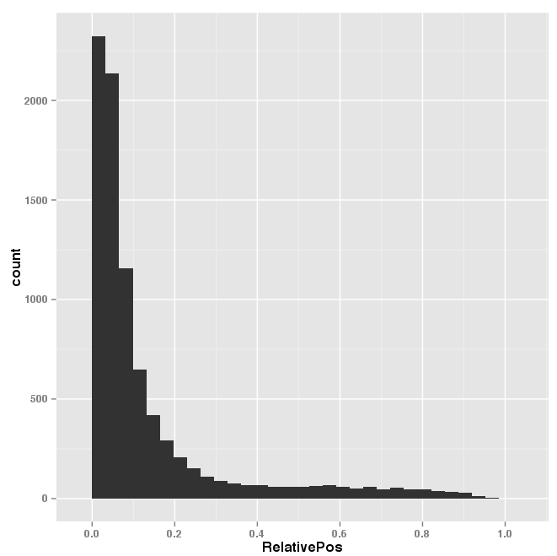
Using ggplot2
The previous commands produce this graph:

Slide 60
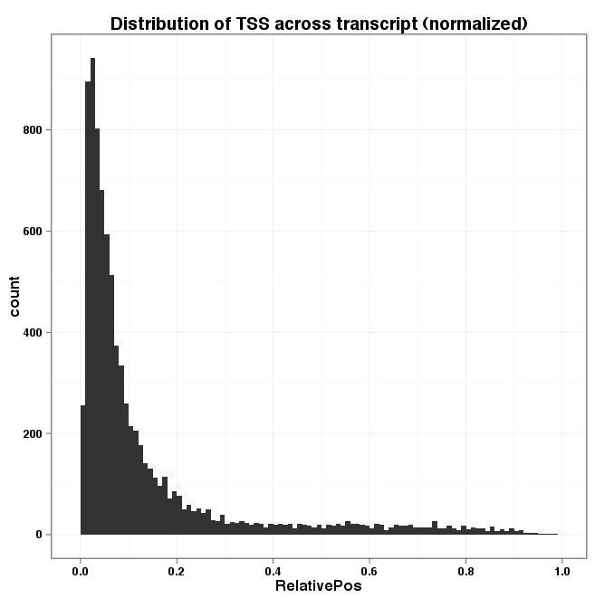
Using ggplot2
ggplot(startSites, aes(x=RelativePos)) +
geom_histogram(binwidth=0.01) +
opts(title="Distribution of TSS across transcript (normalized)") +
theme_bw()

Slide 61
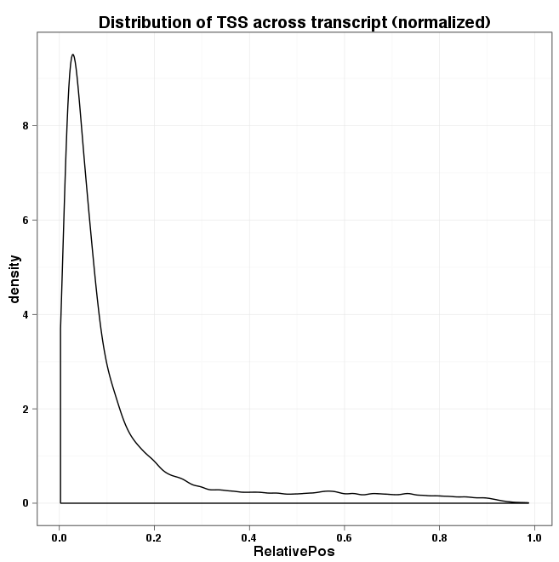
Using ggplot2
We could also use a density plot instead of a histogram:
ggplot(startSites, aes(x=RelativePos)) +
geom_density() +
opts(title="Distribution of TSS across transcript (normalized)") +
theme_bw()

