Slide 1
Useful Python modules
Programming Bootcamp 2015
Day 7 – 6/23/15
Sign in!

Slide 2
Today's schedule
Review of modules
Useful modules
optparse – fancy command line options
os – doing things with file systems
glob – getting lists of files
subprocess – system commands from within python
time - get the system time, create a timer
Other modules
Odds 'n ends

Slide 3
1. Review of modules

Slide 4
What is a module?
In Python, a module is a separate file containing code and functions which can be imported into other scripts
We've already used several built-in Python modules: math, random, sys ...
If you did lab 6, you've actually already created your own module: my_utils.py

Slide 5
Built-in modules
Built-in modules are those that come with every Python installation
They must be imported before they can be used (unlike built-in functions, such as int())
Since anyone can make a module, there are also many non-built-in modules out there, but you'll have to download them separately.
Example: SciPy and NumPy – not built-in, but super useful and well-developed (http://www.scipy.org/)
Today we'll go over a few useful built-in modules

Slide 6
Different ways to import
import math
math.log(5)
from math import log
log(5)
from math import *
log(5)
sqrt(4)
import math as m
m.log(5)
Imports whole module. Must use module name to access functions.
Imports only one function from the module.
Do not need to use module name to access.
No other functions from the module are available.
Imports whole module.
Do not need to use module name to access.
All functions from the module are available.
Imports whole module.
Gives the module an alternate name of your choice, which you use to access the functions of the module.
Notes:
Although option #3 (import *) seems the easiest, I generally don't recommend it. It makes your code very confusing to anyone else who has to read it later, especially if you are importing several modules. They'll be left wondering where this mysterious function you're using came from. Explicitly stating the module name next to the function clarifies this a lot. Also, when not using the module name, there's potential for problems when two functions have the same name.

Slide 7
2a. optparse

Slide 8
optparse
Purpose: Create nicer command line options
Example:
python myscript.py -a -b --file=data.txt --cpu=4
More info:
http://www.alexonlinux.com/pythons-optparse-for-human-beings
http://docs.python.org/2/library/optparse.html

Slide 9
optparse – Set up parser
import optparse
msg = "Usage: %prog INFILE [options]"
parser = optparse.OptionParser(usage=msg)

Slide 10
optparse – Set up parser
import optparse
msg = "Usage: %prog INFILE [options]"
parser = optparse.OptionParser(usage=msg)
A "usage message" – this will automatically be printed if the user uses the -h option. %prog is automatically replaced with the name of your script.
Creates a "parser". Right now, this parser will not recognize any command line options--we have to explicitly define which options we expect to see.
Arguments that are absolutely required should not be added as options, but rather as "bare arguments". This is indicated to the user by listing such requirements here.

Slide 11
optparse – Add options
parser.add_option("--out", action="store", dest="OUTFILE", default=None, help="Optional file to print output.")

Slide 12
optparse – Add options
parser.add_option("--out", action="store", dest="OUTFILE", default=None, help="Optional file to print output.")
If the user specifies this option, the parser will store the indicated value in a variable called OUTFILE
This allows the parser to recognize an option called --out.
The user can specify the option like so:
python script.py --out=outFile.txt
If the option is not specified by the user, this default value will be stored in OUTFILE. The default can be pretty much anything you want.
If the user types -h or --help after the script name, a help message will be printed that contains info about each possible option. The help message for each command is defined here.

Slide 13
optparse – Add options
parser.add_option("--out", action="store", dest="OUTFILE", default=None, help="Optional file to print output.")
parser.add_option("--cpu", action="store", type='int', default=1, dest="MAX_CPU", help="Max number of CPUs to use. Default is %default.")

Slide 14
optparse – Add options
parser.add_option("--out", action="store", dest="OUTFILE", default=None, help="Optional file to print output.")
parser.add_option("--cpu", action="store", type='int', default=1, dest="MAX_CPU", help="Max number of CPUs to use. Default is %default.")
Indicates that the type must be an int. If we didn't include this, anything would be accepted and converted to a string.
For this option, we specify that the value supplied to --cpu must be an integer. If the user provides a non-integer, a useful error message will be printed and the program will not run.
The %default placeholder is automatically replaced by the default value when the help message is invoked.

Slide 15
optparse – Add options
parser.add_option("--out", action="store", dest="OUTFILE", default=None, help="Optional file to print output.")
parser.add_option("--cpu", action="store", type='int', default=1, dest="MAX_CPU", help="Max number of CPUs to use. Default is %default.")
parser.add_option("--e-val", action="store", type='float', default=1.0, dest="E_THRESH", help="E-value threshold. Default is %default.")

Slide 16
optparse – Add options
parser.add_option("--out", action="store", dest="OUTFILE", default=None, help="Optional file to print output.")
parser.add_option("--cpu", action="store", type='int', default=1, dest="MAX_CPU", help="Max number of CPUs to use. Default is %default.")
parser.add_option("--e-val", action="store", type='float', default=1.0, dest="E_THRESH", help="E-value threshold. Default is %default.")
parser.add_option("--verbose", action="store_true", default=False, dest="VERBOSE", help="Print progress messages.")

Slide 17
optparse – Add options
parser.add_option("--out", action="store", dest="OUTFILE", default=None, help="Optional file to print output.")
parser.add_option("--cpu", action="store", type='int', default=1, dest="MAX_CPU", help="Max number of CPUs to use. Default is %default.")
parser.add_option("--e-val", action="store", type='float', default=1.0, dest="E_THRESH", help="E-value threshold. Default is %default.")
parser.add_option("--verbose", action="store_true", default=False, dest="VERBOSE", help="Print progress messages.")
Indicates that this option is a "flag". If it is used, the flag is set to True, otherwise, False.

Slide 18
optparse – Read user's choices
After all the options have been added to the parser, we parse the actual command line options that the user specified:
(opts, args) = parser.parse_args()
This adds all the option values to their respective variable inside of an object called opts. Any additional "bare" arguments will get put in a list called args.

Slide 19
optparse – All together
import optparse
msg = "Usage: %prog INFILE [options]"
parser = optparse.OptionParser(usage=msg)
parser.add_option("--out", action="store", dest="OUTFILE", default=None, help="Optional file to print output.")
parser.add_option("--cpu", action="store", type='int', default=1, dest="MAX_CPU", help="Max number of CPUs to use. Default is %default.")
parser.add_option("--e-val", action="store", type='float', default=1.0, dest="E_THRESH", help="E-value threshold. Default is %default.")
parser.add_option("--verbose", action="store_true", default=False, dest="VERBOSE", help="Print progress messages.")
(opts, args) = parser.parse_args()

Slide 20
optparse – All together
import optparse
msg = "Usage: %prog INFILE [options]"
parser = optparse.OptionParser(usage=msg)
parser.add_option("--out", action="store", dest="OUTFILE", default=None, help="Optional file to print output.")
parser.add_option("--cpu", action="store", type='int', default=1, dest="MAX_CPU", help="Max number of CPUs to use. Default is %default.")
parser.add_option("--e-val", action="store", type='float', default=1.0, dest="E_THRESH", help="E-value threshold. Default is %default.")
parser.add_option("--verbose", action="store_true", default=False, dest="VERBOSE", help="Print progress messages.")
(opts, args) = parser.parse_args()
inFile = args[0]
We are requiring the user to input the name of an input file (that's why it's a bare argument, not an option).
As indicated in our usage message, this will be the FIRST bare argument; therefore we can expect it to be put into the first position of the args list.

Slide 21
optparse – Usage
opt_test.py
import optparse
msg = "Usage: %prog INFILE [options]"
parser = optparse.OptionParser(usage=msg)
parser.add_option("--out", action="store", dest="OUTFILE", default=None, help="Optional file to print output.")
parser.add_option("--cpu", action="store", type='int', default=1, dest="MAX_CPU", help="Max number of CPUs to use. Default is %default.")
parser.add_option("--e-val", action="store", type='float', default=1.0, dest="E_THRESH", help="E-value threshold. Default is %default.")
parser.add_option("--verbose", action="store_true", default=False, dest="VERBOSE", help="Print progress messages.")
(opts, args) = parser.parse_args()
inFile = args[0]
print "Opts:", opts
print "Args:", args
Command line:
>>> python opt_test.py

Slide 22
optparse – Usage
opt_test.py
import optparse
msg = "Usage: %prog INFILE [options]"
parser = optparse.OptionParser(usage=msg)
parser.add_option("--out", action="store", dest="OUTFILE", default=None, help="Optional file to print output.")
parser.add_option("--cpu", action="store", type='int', default=1, dest="MAX_CPU", help="Max number of CPUs to use. Default is %default.")
parser.add_option("--e-val", action="store", type='float', default=1.0, dest="E_THRESH", help="E-value threshold. Default is %default.")
parser.add_option("--verbose", action="store_true", default=False, dest="VERBOSE", help="Print progress messages.")
(opts, args) = parser.parse_args()
inFile = args[0]
print "Opts:", opts
print "Args:", args
Command line:
>>> python opt_test.py
Traceback (most recent call last):
File "opt_test.py", line 13, in <module>
inFile = args[0]
IndexError: list index out of range
We must specify at least the INFILE!

Slide 23
optparse – Usage
opt_test.py
import optparse
msg = "Usage: %prog INFILE [options]"
parser = optparse.OptionParser(usage=msg)
parser.add_option("--out", action="store", dest="OUTFILE", default=None, help="Optional file to print output.")
parser.add_option("--cpu", action="store", type='int', default=1, dest="MAX_CPU", help="Max number of CPUs to use. Default is %default.")
parser.add_option("--e-val", action="store", type='float', default=1.0, dest="E_THRESH", help="E-value threshold. Default is %default.")
parser.add_option("--verbose", action="store_true", default=False, dest="VERBOSE", help="Print progress messages.")
(opts, args) = parser.parse_args()
inFile = args[0]
print "Opts:", opts
print "Args:", args
Command line:
>>> python opt_test.py infile.txt

Slide 24
optparse – Usage
opt_test.py
import optparse
msg = "Usage: %prog INFILE [options]"
parser = optparse.OptionParser(usage=msg)
parser.add_option("--out", action="store", dest="OUTFILE", default=None, help="Optional file to print output.")
parser.add_option("--cpu", action="store", type='int', default=1, dest="MAX_CPU", help="Max number of CPUs to use. Default is %default.")
parser.add_option("--e-val", action="store", type='float', default=1.0, dest="E_THRESH", help="E-value threshold. Default is %default.")
parser.add_option("--verbose", action="store_true", default=False, dest="VERBOSE", help="Print progress messages.")
(opts, args) = parser.parse_args()
inFile = args[0]
print "Opts:", opts
print "Args:", args
Command line:
>>> python opt_test.py infile.txt
Opts: {'OUTFILE': None, 'MAX_CPU': 1, 'E_THRESH': 1.0, 'VERBOSE': False}
Args: ['infile.py']
This works, and sets all options to their default values.

Slide 25
optparse – Usage
opt_test.py
import optparse
msg = "Usage: %prog INFILE [options]"
parser = optparse.OptionParser(usage=msg)
parser.add_option("--out", action="store", dest="OUTFILE", default=None, help="Optional file to print output.")
parser.add_option("--cpu", action="store", type='int', default=1, dest="MAX_CPU", help="Max number of CPUs to use. Default is %default.")
parser.add_option("--e-val", action="store", type='float', default=1.0, dest="E_THRESH", help="E-value threshold. Default is %default.")
parser.add_option("--verbose", action="store_true", default=False, dest="VERBOSE", help="Print progress messages.")
(opts, args) = parser.parse_args()
inFile = args[0]
print "Opts:", opts
print "Args:", args
Command line:
>>> python opt_test.py infile.txt --out=outfile.txt

Slide 26
optparse – Usage
opt_test.py
import optparse
msg = "Usage: %prog INFILE [options]"
parser = optparse.OptionParser(usage=msg)
parser.add_option("--out", action="store", dest="OUTFILE", default=None, help="Optional file to print output.")
parser.add_option("--cpu", action="store", type='int', default=1, dest="MAX_CPU", help="Max number of CPUs to use. Default is %default.")
parser.add_option("--e-val", action="store", type='float', default=1.0, dest="E_THRESH", help="E-value threshold. Default is %default.")
parser.add_option("--verbose", action="store_true", default=False, dest="VERBOSE", help="Print progress messages.")
(opts, args) = parser.parse_args()
inFile = args[0]
print "Opts:", opts
print "Args:", args
Command line:
>>> python opt_test.py infile.txt --out=outfile.txt
Opts: {'OUTFILE': 'outfile.txt', 'MAX_CPU': 1, 'E_THRESH': 1.0, 'VERBOSE': False}
Args: ['infile.py']
This also works, and changes the output file name to outfile.txt.

Slide 27
optparse – Usage
opt_test.py
import optparse
msg = "Usage: %prog INFILE [options]"
parser = optparse.OptionParser(usage=msg)
parser.add_option("--out", action="store", dest="OUTFILE", default=None, help="Optional file to print output.")
parser.add_option("--cpu", action="store", type='int', default=1, dest="MAX_CPU", help="Max number of CPUs to use. Default is %default.")
parser.add_option("--e-val", action="store", type='float', default=1.0, dest="E_THRESH", help="E-value threshold. Default is %default.")
parser.add_option("--verbose", action="store_true", default=False, dest="VERBOSE", help="Print progress messages.")
(opts, args) = parser.parse_args()
inFile = args[0]
print "Opts:", opts
print "Args:", args
Command line:
>>> python opt_test.py infile.txt --cpu=X

Slide 28
optparse – Usage
opt_test.py
import optparse
msg = "Usage: %prog INFILE [options]"
parser = optparse.OptionParser(usage=msg)
parser.add_option("--out", action="store", dest="OUTFILE", default=None, help="Optional file to print output.")
parser.add_option("--cpu", action="store", type='int', default=1, dest="MAX_CPU", help="Max number of CPUs to use. Default is %default.")
parser.add_option("--e-val", action="store", type='float', default=1.0, dest="E_THRESH", help="E-value threshold. Default is %default.")
parser.add_option("--verbose", action="store_true", default=False, dest="VERBOSE", help="Print progress messages.")
(opts, args) = parser.parse_args()
inFile = args[0]
print "Opts:", opts
print "Args:", args
Command line:
>>> python opt_test.py infile.txt --cpu=X
Usage: opt_test.py INFILE [options]
opt_test.py: error: option --cpu: invalid integer value: 'X'
Since --cpu is defined to take an integer, this gives an error.

Slide 29
optparse – Usage
opt_test.py
import optparse
msg = "Usage: %prog INFILE [options]"
parser = optparse.OptionParser(usage=msg)
parser.add_option("--out", action="store", dest="OUTFILE", default=None, help="Optional file to print output.")
parser.add_option("--cpu", action="store", type='int', default=1, dest="MAX_CPU", help="Max number of CPUs to use. Default is %default.")
parser.add_option("--e-val", action="store", type='float', default=1.0, dest="E_THRESH", help="E-value threshold. Default is %default.")
parser.add_option("--verbose", action="store_true", default=False, dest="VERBOSE", help="Print progress messages.")
(opts, args) = parser.parse_args()
inFile = args[0]
print "Opts:", opts
print "Args:", args
Command line:
>>> python opt_test.py --help

Slide 30
optparse – Usage
opt_test.py
import optparse
msg = "Usage: %prog INFILE [options]"
parser = optparse.OptionParser(usage=msg)
parser.add_option("--out", action="store", dest="OUTFILE", default=None, help="Optional file to print output.")
parser.add_option("--cpu", action="store", type='int', default=1, dest="MAX_CPU", help="Max number of CPUs to use. Default is %default.")
parser.add_option("--e-val", action="store", type='float', default=1.0, dest="E_THRESH", help="E-value threshold. Default is %default.")
parser.add_option("--verbose", action="store_true", default=False, dest="VERBOSE", help="Print progress messages.")
(opts, args) = parser.parse_args()
inFile = args[0]
print "Opts:", opts
print "Args:", args
Command line:
>>> python opt_test.py --help
Usage: opt_test.py INFILE [options]
Options:
-h, --help show this help message and exit
--out=OUTFILE Optional file to print output.
--cpu=MAX_CPU Max number of CPUs to use. Default is 1
--e-val=E_THRESH E-value threshold. Default is 1.0
--verbose Print progress messages.
This prints out a nice help message. -h also works. We do not need to define this option, it is automatically created by the parser.

Slide 31
optparse – Using provided data
import optparse
msg = "Usage: %prog INFILE [options]"
parser = optparse.OptionParser(usage=msg)
parser.add_option("--out", action="store", dest="OUTFILE", default=None, help="Optional file to print output.")
parser.add_option("--cpu", action="store", type='int', default=1, dest="MAX_CPU", help="Max number of CPUs to use. Default is %default.")
parser.add_option("--e-val", action="store", type='float', default=1.0, dest="E_THRESH", help="E-value threshold. Default is %default.")
parser.add_option("--verbose", action="store_true", default=False, dest="VERBOSE", help="Print progress messages.")
(opts, args) = parser.parse_args()
inFile = args[0]
# example of using the option values
if opts.VERBOSE == True:
print "Reading in file"
ins = open(inFile, 'r')
for line in ins:
cols = line.split()
if cols[2] <= opts.E_THRESH:
print cols[0] #print only if below threshold
ins.close()

Slide 32
optparse – Using provided data
import optparse
msg = "Usage: %prog INFILE [options]"
parser = optparse.OptionParser(usage=msg)
parser.add_option("--out", action="store", dest="OUTFILE", default=None, help="Optional file to print output.")
parser.add_option("--cpu", action="store", type='int', default=1, dest="MAX_CPU", help="Max number of CPUs to use. Default is %default.")
parser.add_option("--e-val", action="store", type='float', default=1.0, dest="E_THRESH", help="E-value threshold. Default is %default.")
parser.add_option("--verbose", action="store_true", default=False, dest="VERBOSE", help="Print progress messages.")
(opts, args) = parser.parse_args()
inFile = args[0]
# example of using the option values
if opts.VERBOSE == True:
print "Reading in file"
ins = open(inFile, 'r')
for line in ins:
cols = line.split()
if cols[2] <= opts.E_THRESH:
print cols[0] #print only if below threshold
ins.close()
So the basic syntax for accessing these values is
opts.VAR_NAME

Slide 33
2b. os

Slide 34
os
Purpose: Useful functions for working with file names/directory paths.
Example:
>>> os.path.exists("test_file.txt")
True
>>> os.mkdir("newFolder")
More info:
http://docs.python.org/2/library/os.path.html
http://docs.python.org/2/library/os.html#module-os

Slide 35
os.path
>>> import os
>>> os.path.exists("test_file.txt") #checks if file/directory exists
True
>>> os.path.isfile("test_file.txt") #checks if it is a file
True
>>> os.path.isdir("test_file.txt") #checks if it is a directory
False
>>> os.path.getsize("test_file.txt") #gets size of file
18L
>>> os.path.abspath("test_file.txt") #gets absolute/full path of file
'/cygdrive/c/Users/Sarah/Dropbox/Python/PythonBootcamp2013/lab8/test_file.txt'
>>> fullPath = os.path.abspath("test_file.txt")
>>> os.path.basename(fullPath) #extracts file name from longer path
'test_file.txt'
>>> os.path.dirname(fullPath) #extracts path, removes file name
'/cygdrive/c/Users/Sarah/Dropbox/Python/PythonBootcamp2013/lab8'
>>> os.mkdir("newFolder") #makes a new directory

Slide 36
A note on file paths
So far we've mostly worked with input/output files stored in the same directory as our script
What if we want to work with files stored somewhere else?
# open a file in a directory contained
# inside the current directory:
inFile = open("data/input_file.txt", 'r')
# open a file in the directory that contains
# the current directory (parent directory)
inFile = open("../input_file2.txt", 'r')
# open a file using an absolute path (i.e.
# a path that will always work, regardless of the
# current directory location)
inFile = open("/home/sarah/lab7/data/input_file.txt", 'r')
inFile = open("/home/sarah/lab7/input_file2.txt", 'r')

Slide 37
2c. glob

Slide 38
glob
Purpose: Get list of files in a folder that match a certain pattern. Good for when you need to read in a large number of files but don't have a list of all their file names.
Example:
glob.glob("../data/sequences/*.fasta")
More info:
http://docs.python.org/2/library/glob.html
Important to note:
The * here is a wildcard. So this will match any file in ../data/sequences/ that ends in .fasta.

Slide 39
glob
>>> import glob
>>> glob.glob("sequences/*") #get list of everything in "sequences" folder
['sequences/abcde.fasta', 'sequences/asdas123.fasta', 'sequences/README.txt', 'sequences/seq1.fasta', 'sequences/seq2.fasta', 'sequences/seq3.fasta', 'sequences/temp_file.tmp']
>>> glob.glob("sequences/*.fasta") #get list of all with .fasta extension
['sequences/abcde.fasta', 'sequences/asdas123.fasta', 'sequences/seq1.fasta', 'sequences/seq2.fasta', 'sequences/seq3.fasta']
>>> glob.glob("sequences/seq*.fasta") #get everything named seq*.fasta
['sequences/seq1.fasta', 'sequences/seq2.fasta', 'sequences/seq3.fasta']
>>> glob.glob("*") #get list of everything in current folder
['data', 'lab8_useful_modules.pptx', 'newFolder', 'opt_test.py', 'sequences', 'test_file.txt']
The * is a wildcard -- it will match anything.

Slide 40
2d. subprocess

Slide 41
subprocess
Purpose: Launch another program or a shell command from within a Python script.
Example:
subprocess.Popen("python other_script.py")
More info:
http://docs.python.org/2/library/subprocess.html
http://stackoverflow.com/questions/89228/calling-an-external-command-in-python

Slide 42
subprocess
Basic command:
job = subprocess.Popen(command)
Recommended version:
job = subprocess.Popen(command, shell=True, stdout=subprocess.PIPE, stderr=subprocess.STDOUT)

Slide 43
subprocess
Basic command:
job = subprocess.Popen(command)
Recommended version:
job = subprocess.Popen(command, shell=True, stdout=subprocess.PIPE, stderr=subprocess.STDOUT)
Allows us to run shell (terminal) commands
If the command would normally output something to the terminal, this allows us to capture that output in a string variable. That way we can read through it in our code and use it, if necessary.
Allows us to capture the "standard error" stream of the command. In other words, this will allow us to check if our command succeeded or gave an error.

Slide 44
subprocess - an example
# create and run command, use variable 'job' to access results
command = "blastn -query seq1.fasta -db refseq_rna"
job = subprocess.Popen(command, shell=True, stdout=subprocess.PIPE, stderr=subprocess.STDOUT)
# read whatever this command would have printed to the screen,
# and then actually print it (it's suppressed otherwise)
jobOutput = job.stdout.readlines()
for line in jobOutput:
print line,
# check for error and ensure that the script does not continue
# until the command has finished executing.
result = job.wait()
if result != 0:
print "There was an error running the command."

Slide 45
subprocess - in a custom function
(in useful_fns.py)
# A function that runs the given command using the system shell.
# Returns the output of the command in a list, the result variable, and whether there was an error.
def run_command(command, verbose=False):
import subprocess
error = False
if verbose == True:
print command
print ""
job = subprocess.Popen(command, shell=True, stdout=subprocess.PIPE, stderr=subprocess.STDOUT)
jobOutput = []
if verbose == True:
for line in job.stdout:
print " ", line,
jobOutput.append(line)
else:
jobOutput = job.stdout.readlines()
result = job.wait()
if result != 0:
error = True
return (jobOutput, result, error)

Slide 46
subprocess - in a custom function
# Using the custom function:
import useful_fns as uf
command = "blastn -query seq1.fasta -db refseq_rna"
(output, result, error) = uf.run_command(command, verbose=True)
# check for error
if error:
print "Error running command:", command
print "Exiting."
sys.exit()
# use output, or whatever
for line in output:
...

Slide 47
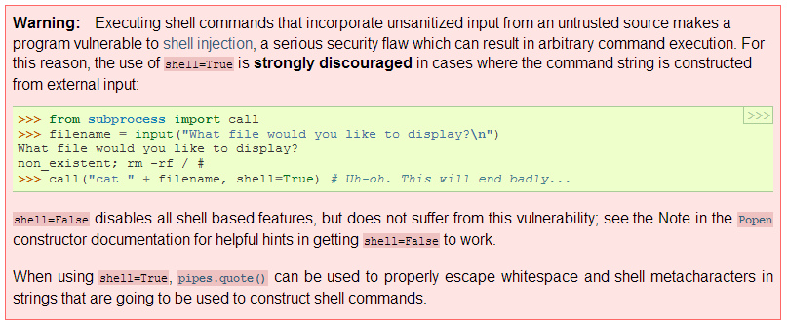
subprocess - a warning
If you set shell = True, this executes the command using the shell. This is good because it lets us do more things, but it's potentially dangerous because it essentially opens up a way for someone to run malicious shell commands (like in the example above, a command to delete all of your files...). Should you worry about this? Probably not, UNLESS you plan to run code on your computer/server that accepts input from strangers over the internet. If you're just running the code yourself, or letting other people run the code on their own computers themselves, this is a non-issue.

Slide 48
2e. time

Slide 49
time
Purpose: Get the current system time. Can be used to time your code.
Example:
import time
startTime = time.time()
...some code...
elapsedTime = startTime - time.time()
More info:
http://docs.python.org/2/library/time.html
elapsedTime will hold the difference, in seconds, between the two calls to time.time()
Important to note:
time.time() returns a float that indicates the time, in seconds, since the start of the "epoch" (this is operating system-dependent) at the current moment. It won't make much sense by itself, but we can use it to make simple timers as shown here.

Slide 50
3. Other modules

Slide 51



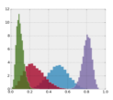
Other useful modules
Built-in:
multiprocessing – functions for writing parallel code that utilizes multiple CPU cores
argparse – the successor to optparse
re – regular expressions (advanced pattern matching)
collections – advanced data structures
logging – facilitates the creation of log files
datetime – for accessing/manipulating date & time info
Not built-in (must be installed before using)
SciPy – scientific/mathematical algorithms
NumPy – advanced math & linear algebra
matplotlib – plotting module for python
pandas – data structures and data analysis
matplotlib

Slide 52
4. Odds 'n ends

Slide 53
This is the end! (of our Python lessons)
Next time: Overview of R with Derek Oldridge
Some final odds 'n ends:
Nested dictionaries
Error handling with try-except
A whole world of built-in functions...
+=
Other ways to use and write Python

Slide 54
Nested dictionaries
A dictionary can store almost anything... including other dictionaries! This is useful for when you want to associate several pieces of info with a given key.
Example:
inFile = open("gene_positions.txt", 'r')
for line in inFile:
(geneID, chr, start, end, strand) = line.split()
geneDict[geneID] = {} #set this equal to a new hash
geneDict[geneID]['chromosome'] = chr
geneDict[geneID]['startPos'] = int(start)
geneDict[geneID]['endPosition'] = int(end)
geneDict[geneID]['strand'] = strand
inFile.close()
print geneDict['Actb']['strand'] #example of accessing data
Notes:
You can also make nested lists, or dictionaries in lists, or lists in dictionaries... you get the idea.
Each dictionary within the main dictionary is considered a completely separate entity, so it's fine to re-use keys as long as the keys within any single dictionary are unique.

Slide 55
Error handling with try-except
Purpose: catch a specific error before it causes the script to terminate, and handle the error in a manner of your choosing.
Syntax:
try:
...some code here...
...that might create an error...
except ErrorName:
...code to execute if error occurs...
else:
...(optional) code to execute if no error...
Example:
try:
inFile = open(fileName, 'r')
except IOError:
print "Error: could not open", fileName, "--exiting."
sys.exit()
for line in inFile:
...
You must provide the specific name of the error type (e.g. TypeError, ValueError, IOError, etc)
You can do anything you want in the except block; you do not have to exit. However, in general it's good form to at least print some kind of message/warning.
Notes:
The else is optional. You really don't need it if you're just going to exit if there's an error. It's mostly useful when you don't want to exit after the error, because then it lets you have code that will only be executed if there was no error.
You can check for multiple errors at once. You can also create a multi-except (kind of like a multi-elif). See the docs for more examples.

Slide 56
A whole world of built-in functions
There's tons of stuff I didn't get a chance to tell you about
In particular, there are several functions out that that automatically do things I made you do manually (sorry! It's for the sake of learning!)
String functions: https://docs.python.org/2/library/stdtypes.html#string-methods
string.count()
string.upper() / string.lower()
string.find()
string.join()
random.choice()
many more

Slide 57
+=
This is a shortcut for adding/concatenating onto a variable. Also valid (for ints): -= , *= , /=
Examples:
count = 0
while count < 100:
count += 1 #same as count = count + 1
name = ""
for c in "Wilfred"
name += c #same as name = name + c

Slide 58
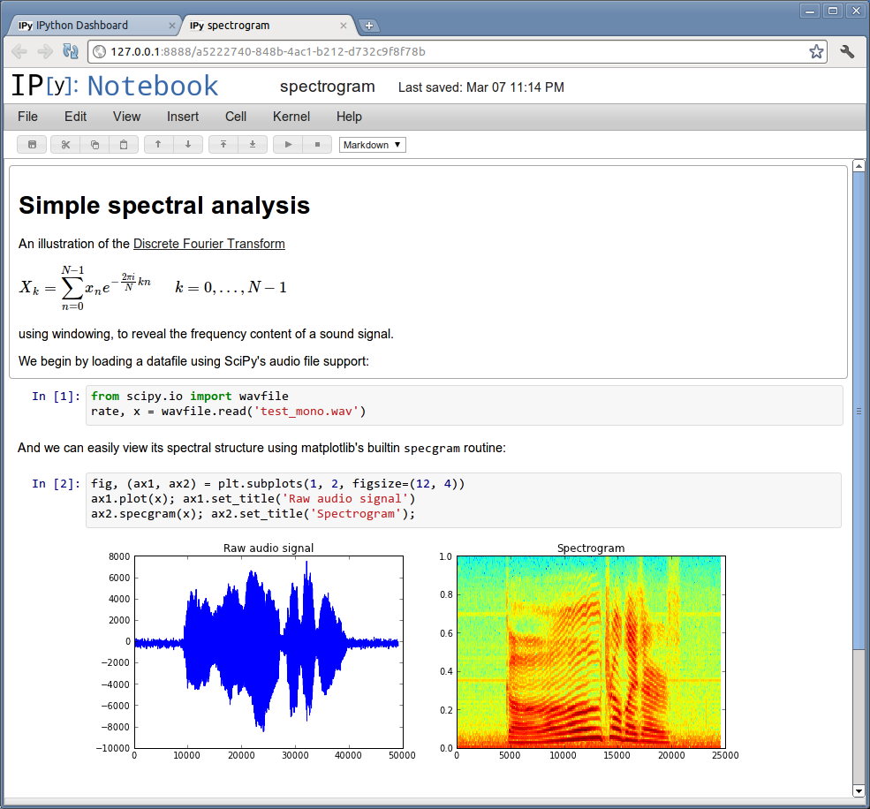

Other ways to write & use Python
iPython notebook (http://ipython.org/)– these are like a mixture of a script and the interpreter. Saves code output & figures inline with the code. Very good for exploratory data analysis!
Enthought Canopy (IDE + modules) (www.enthought.com/products/canopy/) – an advanced coding environment that comes with many useful non-built-in modules pre-installed (e.g. SciPy, NumPy). Also comes with iPython notebooks built-in.
iPython
Canopy

