Slide 1
// presentation
Applications of
C Programming
Real-World Embedded Systems & Beyond
Prisha Chaudhari • Ramai Chogale • Suvidya Deshmukh • Sannidhi Shenvi • Sarah Parekh

Slide 2
Introduction
🎮 Video Games
Created by Dennis Ritchie in 1972 at Bell Laboratories of AT&T Labs.
Originally designed to write the UNIX operating system.
🏦 Banking
🗄️ Databases
1972
C language created at Bell Labs
C Language
1978
K&R C published, standardized usage
☁️ Cloud
🖥️ GUI Apps
1989
ANSI C (C89) standard released
Today
Powers billions of embedded devices
🔧 Compilers
⚙️ Embedded

Slide 3
Why We Use C in Real Life
⚡
🔗
Lightning Fast
Bridge Language
CPU executes C directly without extra processing layers — the fastest high-level language
Middle-level language bridging the gap between low-level hardware and high-level abstractions
📝
🔧
Deep Understanding
Embedded Powerhouse
Writing code from scratch clears fundamental programming concepts and memory management
The dominant language for embedded systems — from microcontrollers to IoT devices

Slide 4
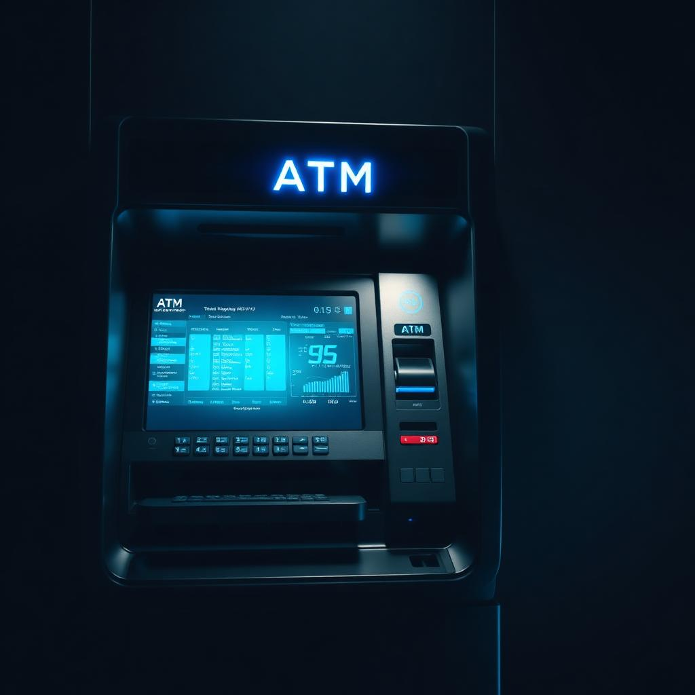
C in ATM Systems
How C controls every step of an ATM transaction
💳 Card Inserted
▼
🔍 Read Magnetic Chip
▼
🔢 PIN Entry & Validation
▼
🌐 Communicate with Bank
▼
💵 Dispense Cash

Slide 5
ATM — Security & Performance
C as the "control language" inside every ATM
💻 Key C Functions
🔐 Encryption
atm_control.c
Protects PINs and account details
// ATM PIN Validation & Encryption
#include <stdio.h>
#include <string.h>
int validatePIN(char *input, char *stored) {
return strcmp(input, stored) == 0;
}
void encryptData(char *data, int key) {
for (int i = 0; data[i]; i++)
data[i] ^= key; // XOR encryption
}
void dispenseCash(int amount) {
int notes = amount / 500;
printf("Dispensing %d notes\n", notes);
}
⚡ Real-Time
Immediate response, no crashes
🧠 Memory Safe
Reduces hacking risks
💡 "Without C, the ATM would just be a box of hardware with no instructions."

Slide 6
C in Traffic Lights
🏎️ Very fast execution for real-time signal control
💡 Direct interaction with LEDs, timers, and circuits
💾 Minimal memory usage for microcontrollers
🔄 Runs continuously without failure

Slide 7
Traffic Lights — Smart Control
🚗 Vehicle
Detected
→
📡 Sensor
Input
→
🧮 C
Processes
→
⏱️ Timer
Adjusted
→
🚦 Signal
Changed
💻 Key C Functions
⏱️ Precise Timing
📡 Sensor Integration
Manages exact timing for switching signals
Adjusts traffic flow with sensors
traffic_control.c
// Traffic Light Timer Control
#include <stdio.h>
#include <unistd.h>
#define RED 0
#define YELLOW 1
#define GREEN 2
void setSignal(int color, int dur) {
printf("Signal: %d for %ds\n",
color, dur);
sleep(dur);
}
void handleInterrupt(int sensorId) {
if (sensorId == 1) // Pedestrian
setSignal(RED, 30);
}
⚡ Optimized
🚨 Emergency
Optimizes performance and power
Quick response to emergencies

Slide 8
C in Lift Control
Real-time embedded system managing movement, safety & interaction
💻 Key C Functions
⚙️ Motor Control
lift_control.c
● Store requested floors
// Lift Control System
#include <stdio.h>
#include <stdbool.h>
int currentFloor = 0;
bool doorOpen = false;
void moveToFloor(int target) {
while (currentFloor != target) {
currentFloor += (target > currentFloor)
? 1 : -1;
printf("Floor: %d\n", currentFloor);
}
}
void openDoor() {
doorOpen = true;
printf("Door opened at %d\n",
currentFloor);
}
void emergencyStop() {
printf("EMERGENCY STOP!\n");
openDoor();
}
● Decide direction
● Control speed
● Move lift up/down
🛡️ Safety Management
● Open door at correct floor
● Prevent movement if open
● Emergency stop
● Power failure handling

Slide 9
C in Washing Machines
🌡️
🔄
📟
Sensors
Pumps & Valves
User Interface
Water level, temperature, door lock detection
Manages water intake and drainage operations
Controls display and button interactions
⚠️
🔧
💾
Error Detection
Hardware Control
Optimized Code
Safety handling for abnormal conditions
Direct low-level access to all components
Minimal memory and CPU footprint

Slide 10
💻 Sample Code — Part 1
washing_machine.c
#include <stdio.h>
#include <stdbool.h>
void main() {
int ch;
printf("***** Welcome to ABS Washers *****\n");
printf("Menu:\n 1) Wash\n 2) Soak\n 3) Dry\n");
printf("Choose operation: \n");
scanf("%d", &ch);
switch(ch) {
case 1: {
int num = 0;
bool flag = false;
char c;
printf("Enter number of items: \n");
scanf("%d", &num);
printf("Pour detergent. Done? [y/n]\n");
scanf(" %c", &c);
flag = (c == 'y');
if (flag) {
int time;
printf("Enter minutes for wash: \n");
scanf("%d", &time);
printf("Washing %d items for %d min.\n", num, time);
}
break;
}

Slide 11
💻 Sample Code — Part 2
washing_machine.c (continued)
case 2: {
int num2, t;
char c2;
printf("Enter number of items: \n");
scanf("%d", &num2);
printf("Minutes for soak? \n");
scanf("%d", &t);
printf("Additional spinning? [y/n]\n");
scanf(" %c", &c2);
if (c2 == 'y')
printf("Soaking + spinning %d items, %d min.\n", num2, t);
else
printf("Soaking %d items for %d min.\n", num2, t);
break;
}
case 3: {
int num3;
printf("Enter number of items: \n");
scanf("%d", &num3);
printf("Drying %d items...\n", num3);
break;
}
default:
printf("Invalid choice.");
}
}

Slide 12
Thank You
Applications of C Programming
🏧 ATMs
🚦 Traffic
🛗 Elevators
🫧 Washers
// end of presentation

