Slide 1



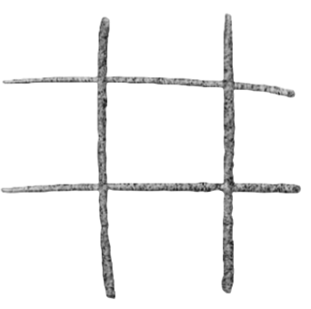
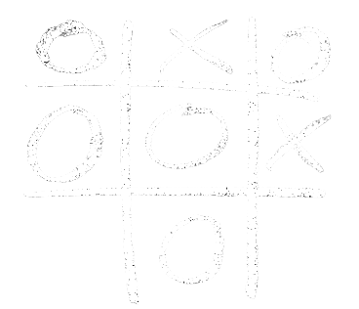
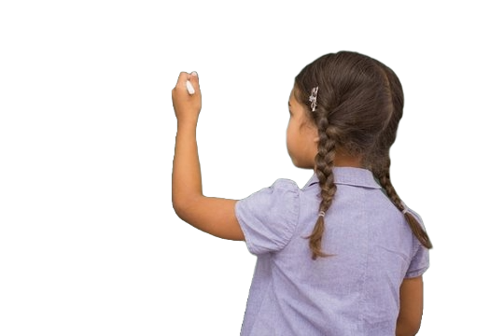
Machine Learning through Tic-Tac-Toe
Notes:
Jameson

Slide 2
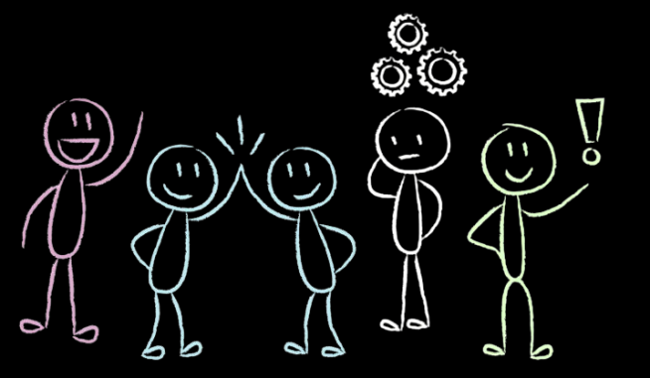
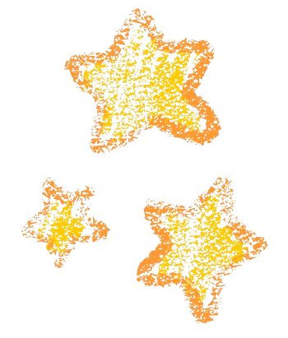


The Gang’s All Here
Dina Rodrigues
Jameson McLendon
Kimarlee Tran
Quinton Stibbins
Sarah Ryan
Notes:
Jameson

Slide 3

Data Source
From Kaggle
This dataset contains the 255,168 games of Tic-Tac-Toe where X starts
Notes:
Jameson

Slide 4
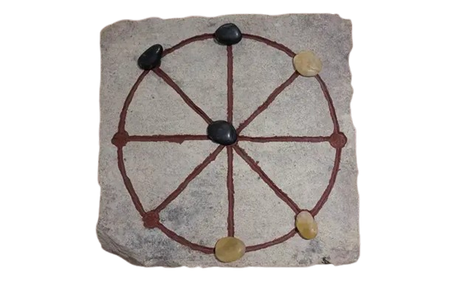
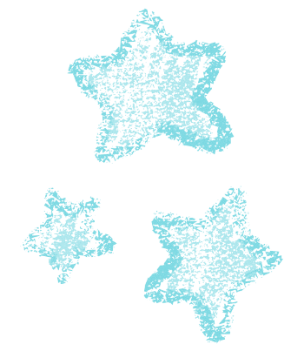
History & Limitations
Origins in Ancient Egypt and Rome
Game has been solved
Useful for teaching sportsmanship and AI/Machine Learning
Notes:
Jameson

Slide 5
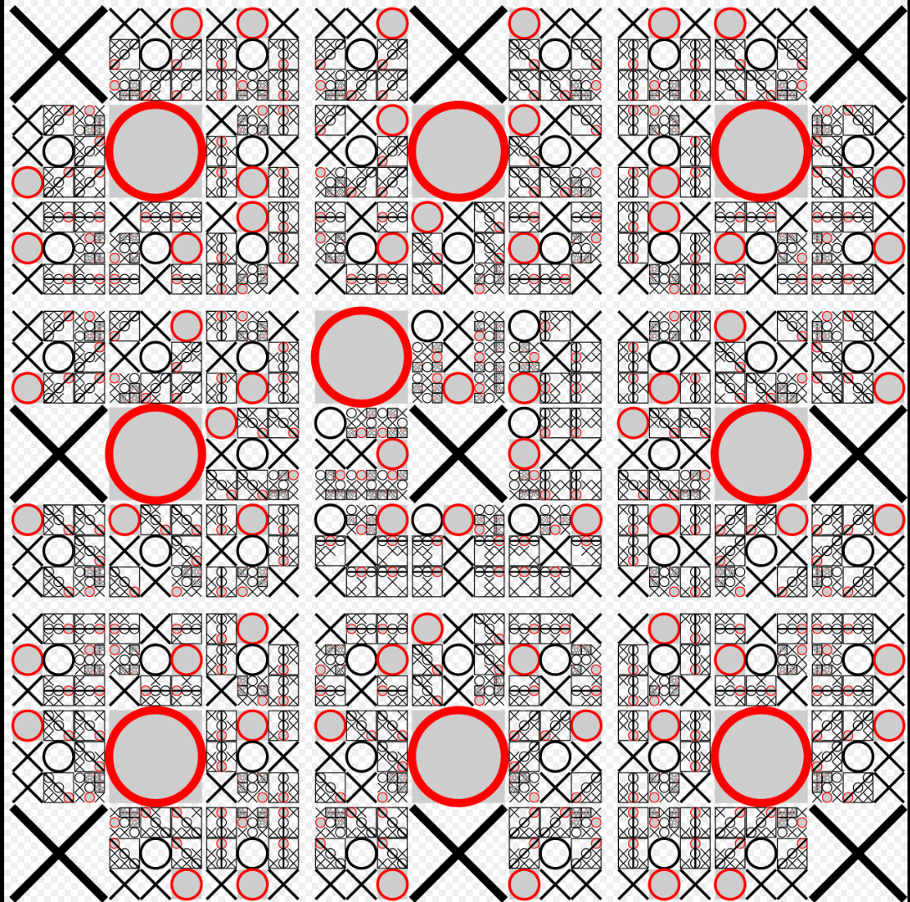
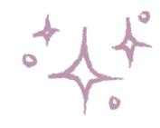
Methodology
https://colab.research.google.com/drive/1utnmYtWWmxEyl8CJgB9Pt3J8NJ4kFlqZ?usp=sharing#scrollTo=66G7xMA-y11o
Notes:
Dina

Slide 6
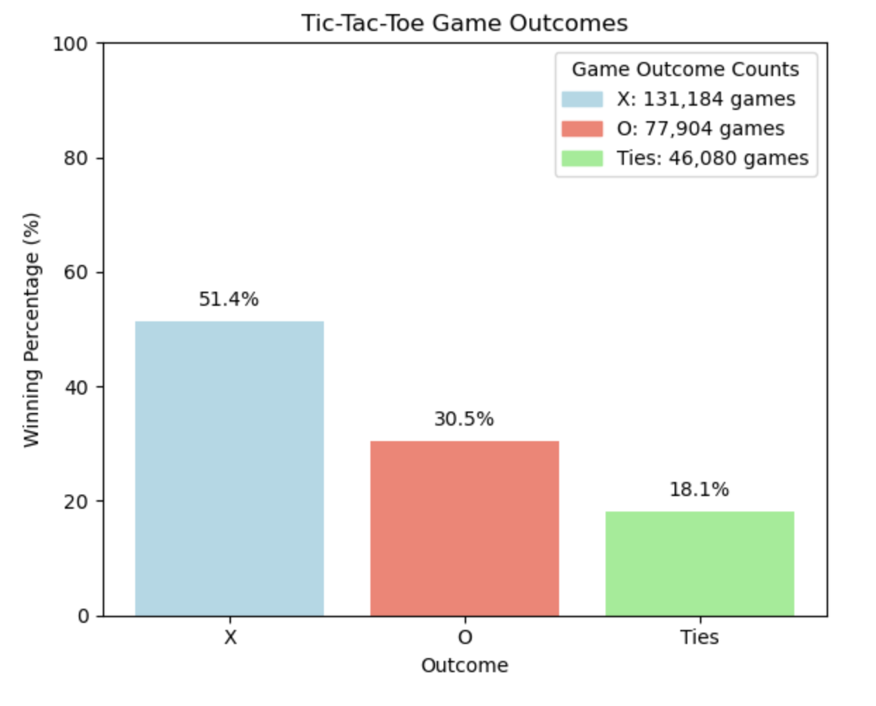
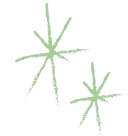
First vs. Second Player
First player has a slightly higher strategic advantage
Notes:
Kimarlee

Slide 7
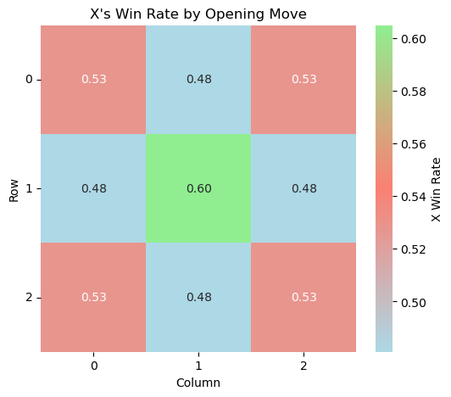

Best Opening Move
Center and corners are the best moves
Notes:
Kimarlee

Slide 8
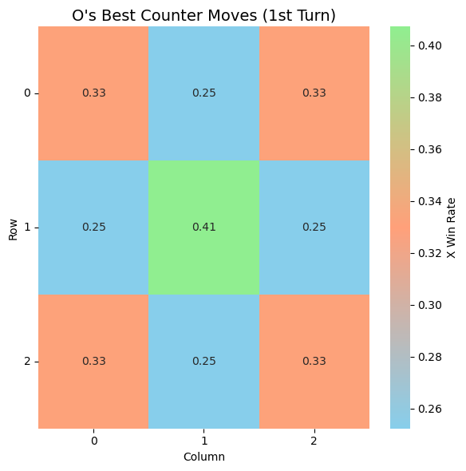

Best Counter Moves
Don’t just block — create dual threats by:
Picking moves that pressure opposite corners or center lines
Avoiding passive edge moves unless necessary
Notes:
Quinton
My focus was understanding what player O — the second player — can do to improve their chances and avoid getting stuck in ties.
I started by analyzing win rates for O’s early moves.
(Unsurprisingly, taking the center spot on Turn 2 had the highest win rate. But when we dug deeper, we found that this move also led to the most ties — so it’s not necessarily aggressive.)
Don’t just block — create dual threats by
Picking moves that pressure opposite corners or center lines
Avoiding passive edge moves unless necessary
If X starts in the center, then O playing a corner is:
One of the highest win-rate strategies for O (~30% win rate)
Win rates closer to 18–20% if playing a passive edge first

Slide 9
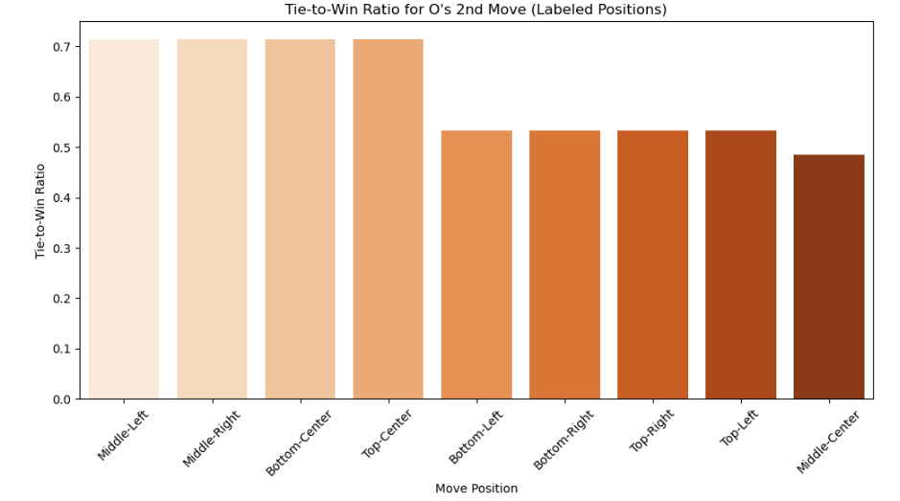
Ties
46080 tie games (18.06%)
Tied games tend to come from symmetrical patterns
Notes:
Quinton
46080 tie games (18.06%)
In tie games players mirroring each other, making safe plays, and no one was forcing an advantage.
If X starts in the center, then O playing a corner is:
Less likely to result in a tie
I visualized which move was most often the final one in winning games — and found that some board positions like 'Bottom-Right' or 'Middle-Center' frequently closed out games.
So the key takeaway is that to avoid a tie, you have to break symmetry early, play asymmetrically, and avoid passively responding with edge moves.

Slide 10

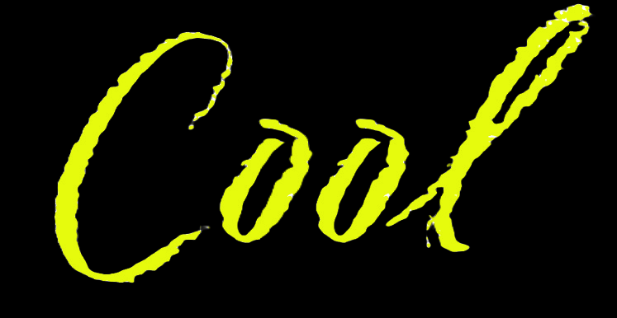

Tic-Tac-Take Away
Decision tree worked best — great for binary game logic
Deeper tree = smarter predictions (2¹⁰ → 2²⁰ games)
First move and center/corner plays win more often
Tic-tac-toe gave us a clear way to test machine learning
Could even reflect child logic and development
What’s Next?
Add human-like players with mistakes
Build an interactive board with win probabilities
Try a more complex game — like Connect 4
Explore how this applies to real-world logic
Notes:
Sarah

