Slide 1

IST 719 Final Project
VBay Vipers:
Travis Phelps, Archie Frank, and Sarah Morris

Slide 2
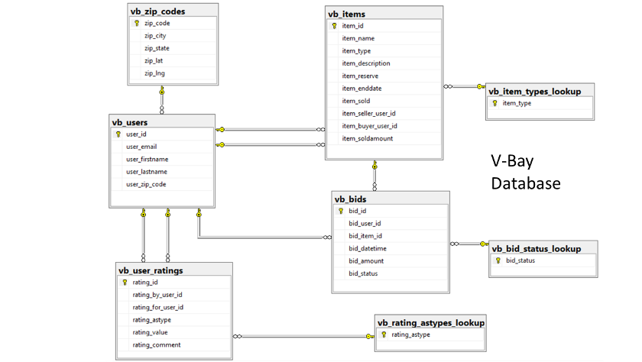
Overview of the Source Data
vbay_bids
vb_bid_status_lookup
vb_datedimension
vb_items
vb_item_types_lookup
vb_rating_astypes_lookup
vb_users
vb_user_ratings
vb_zip_codes

Slide 3
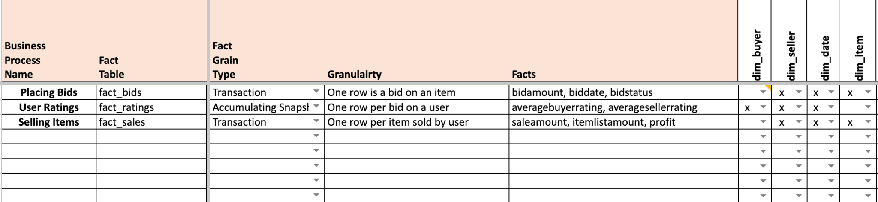
Bus Matrix

Slide 4
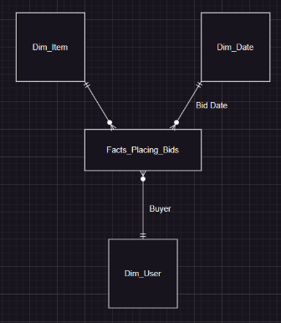
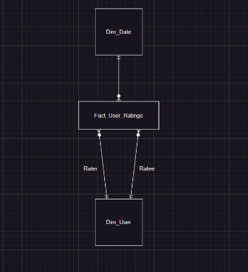
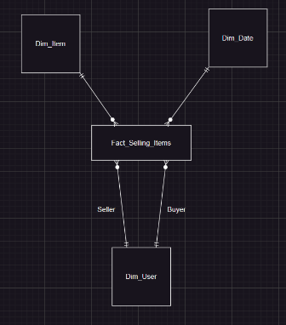
Star Schemas

Slide 5
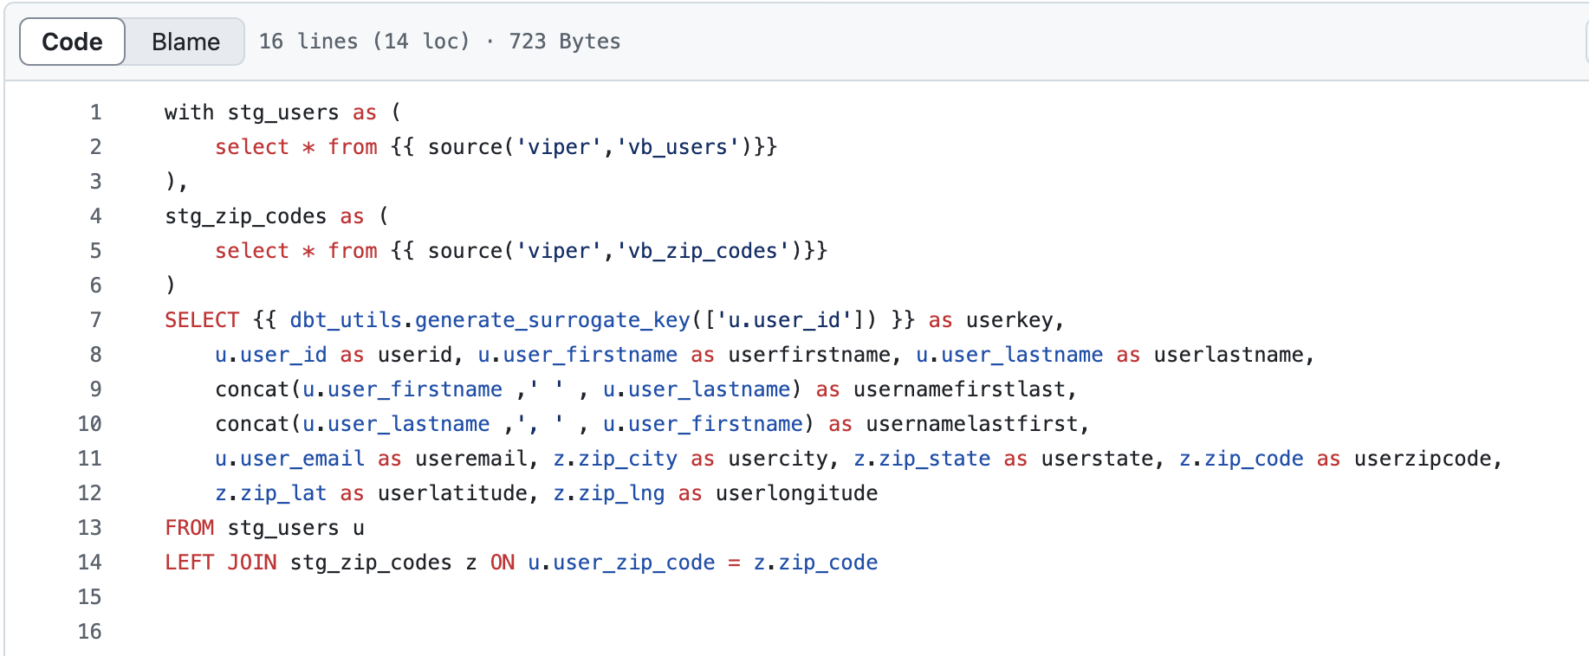
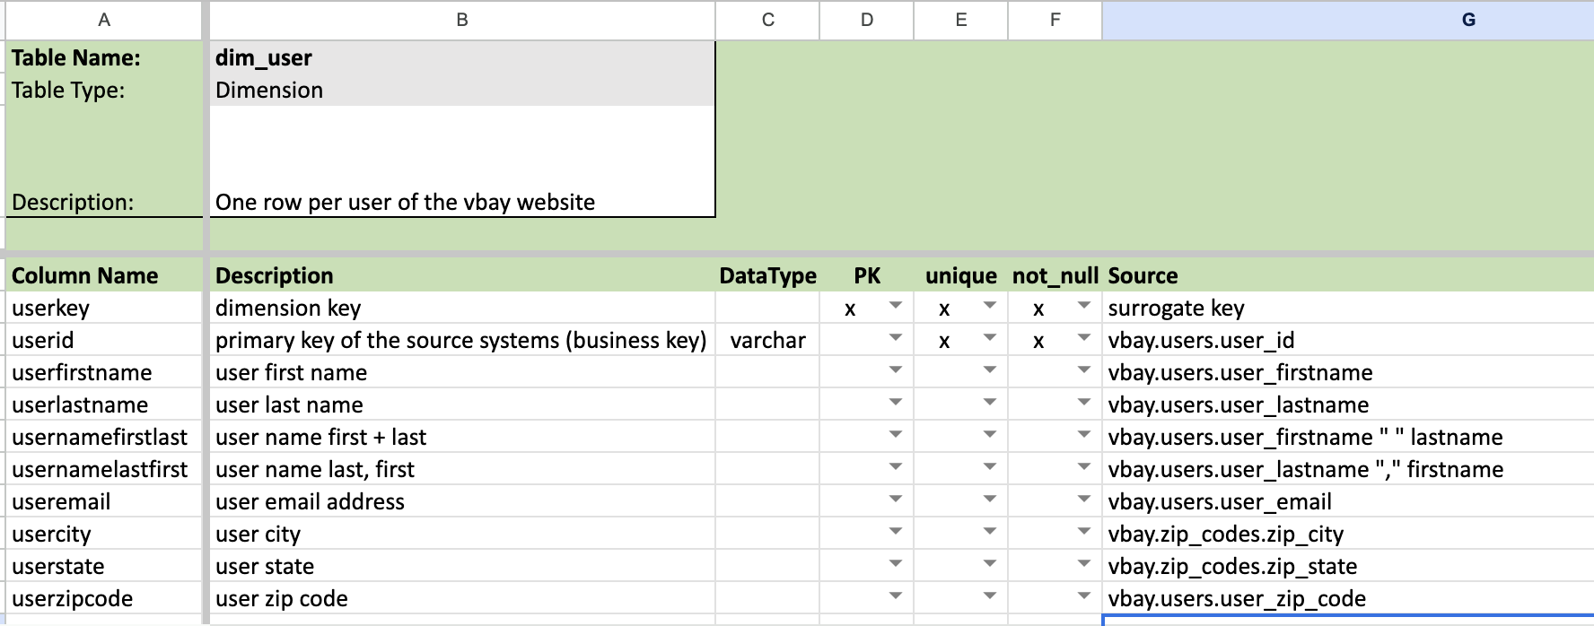
Dim_User Table

Slide 6
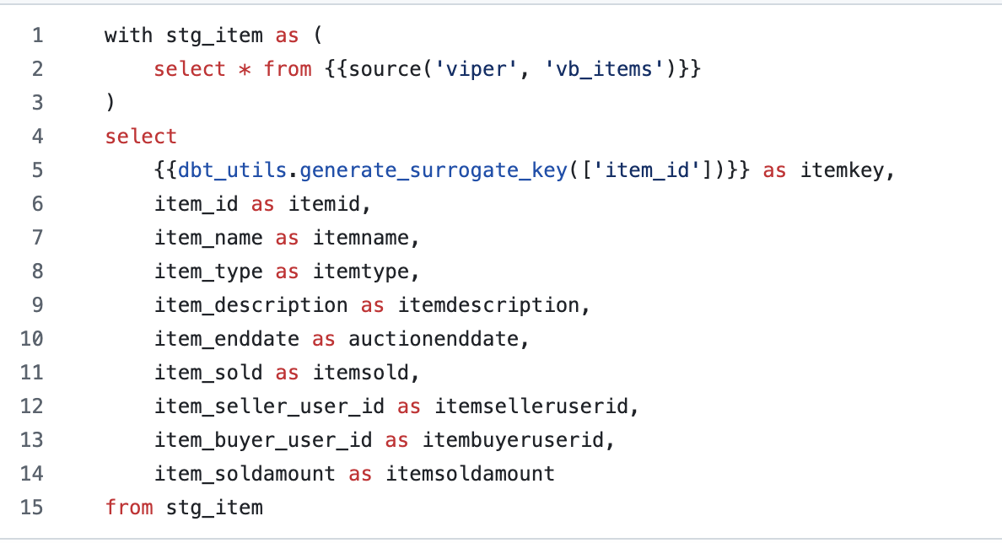
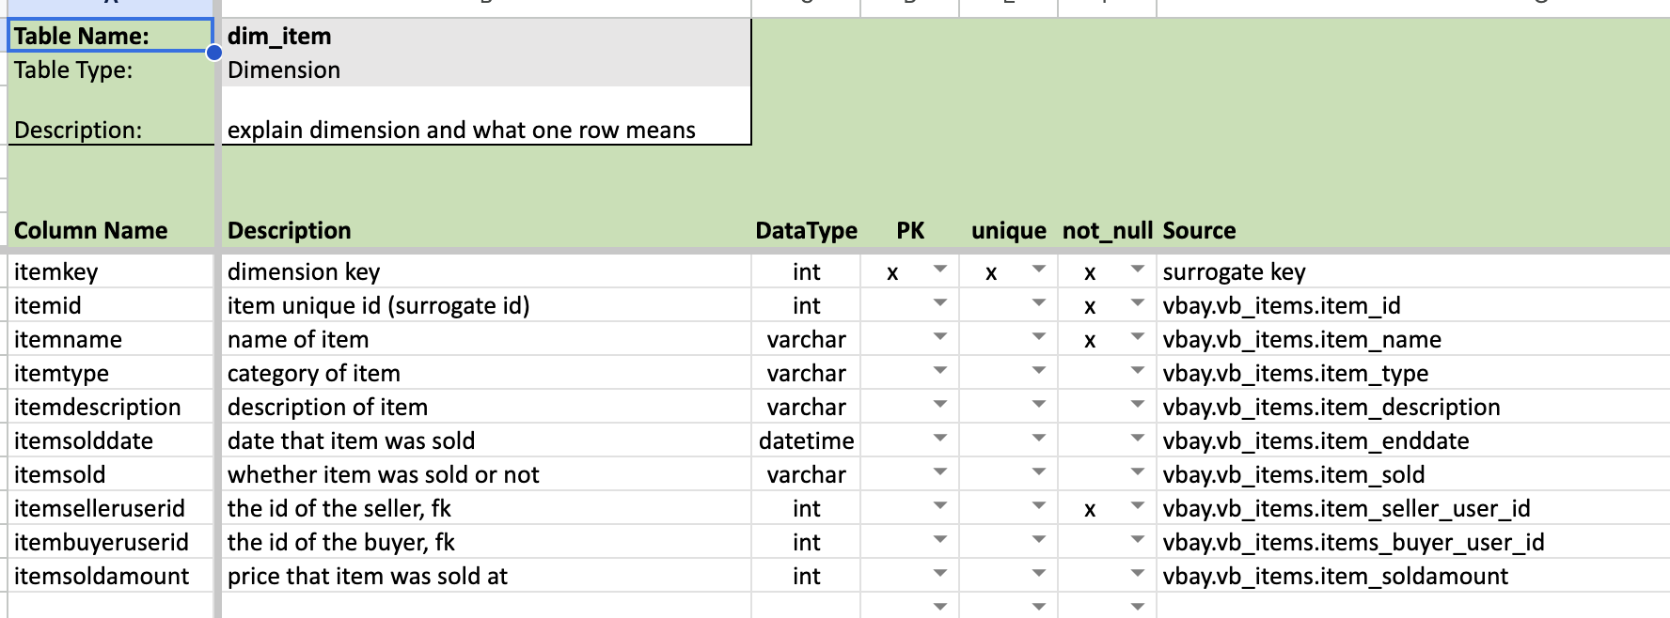
Dim_Item Table

Slide 7
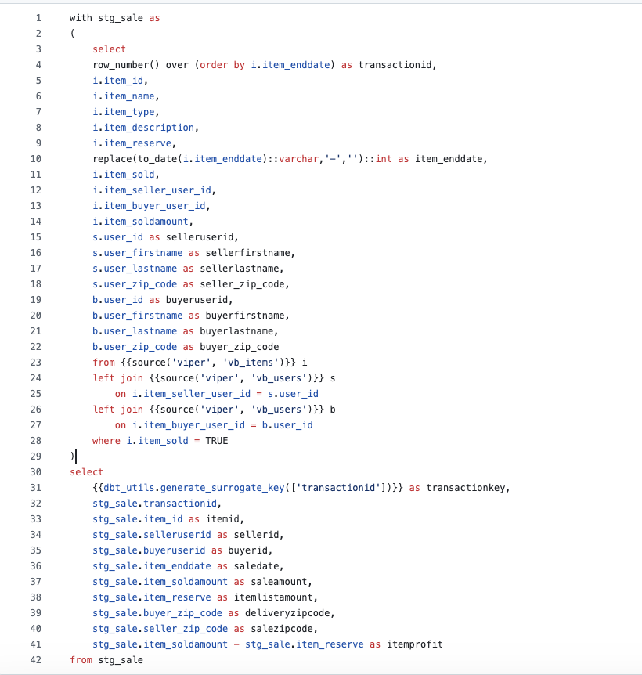
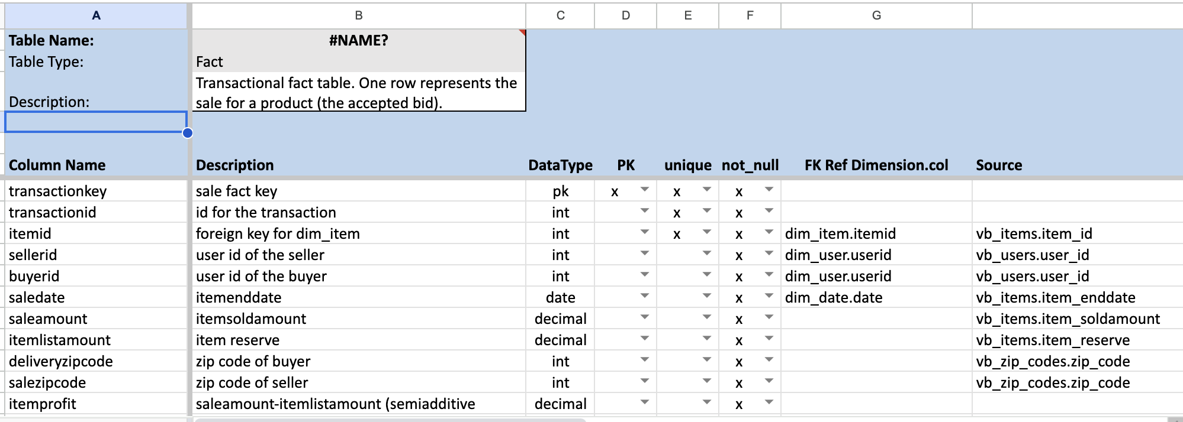
Fact_Sales Table

Slide 8
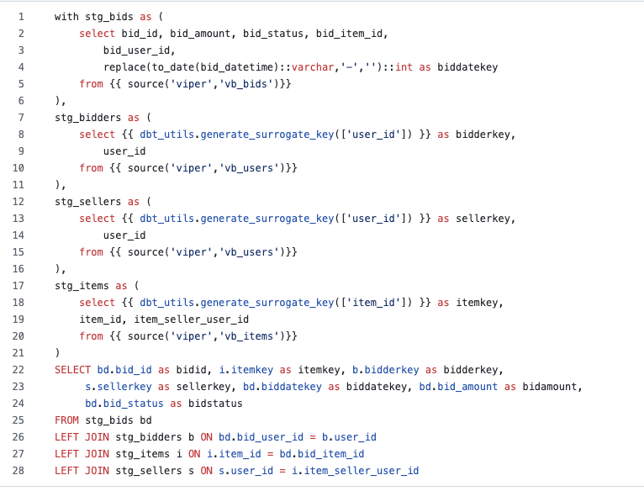
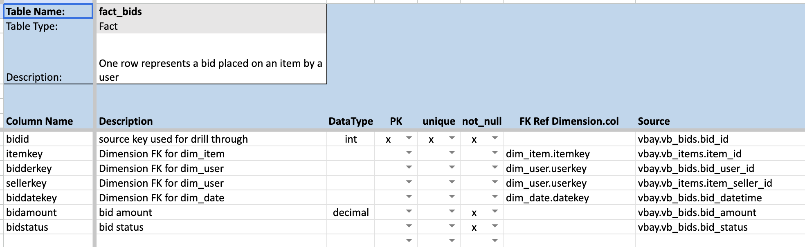
Fact_Bids Table

Slide 9
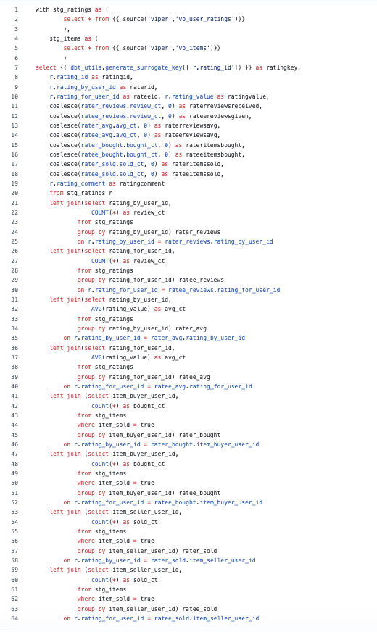
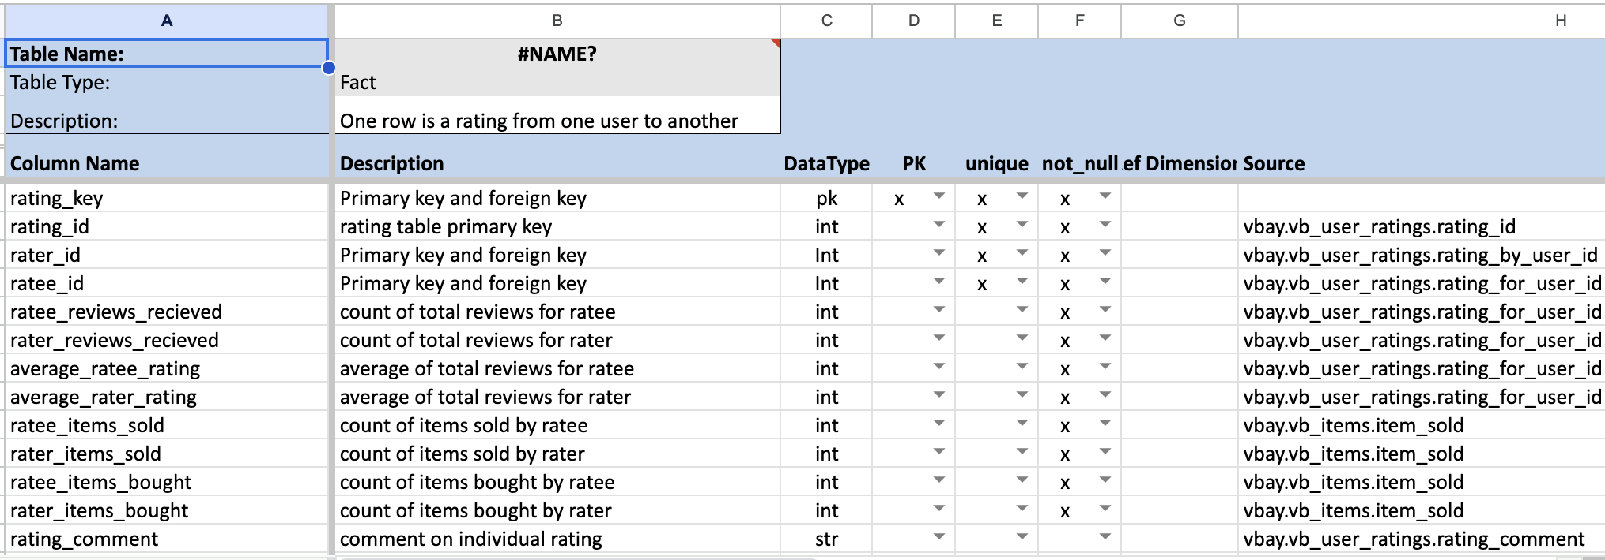
Fact_Ratings Table

Slide 10
Github Documentation: https://github.com/RTFrank/ist722_final_project/tree/main

