Slide 1
Diamonds Project
Sarah Saadeh
Tamara elheet
Ashraf abdel habrumman

Slide 2
Introduction
In this project we will deal with the diamonds dataset that contains the prices and other attributes of almost 54,000 diamonds.
Our goal is try to analyze diamonds by their cut, color, clarity, price and other attributes using some algorithms.
Obviously this a regression dataset and we will use different models of regression to find the best accuracy.

Slide 3
Describing Data (1)
Diamonds dataset are uploaded by Shivam Agrawal in 2017. The data shape is 53940 rows and 10 columns. And there are no null values. Also, we have 3 categorical data and rest of data are numerical.
The dataset contains 10 features: carat, cut, color, clarity, depth, table, price, x (length) and y (width) .
We will explain each feature at the next slide.

Slide 4
Describing Data (2)
1- Index counter 1, 2, 3, ...
2- Carat: weight of the diamond.
3- Cut: Quality of the diamond (Fair, Good, Very Good, Premium, Ideal)
4- Color: Color of the diamond, D the best and J the worst.
5- Clarity: How obvious inclusions are within the diamond.

Slide 5
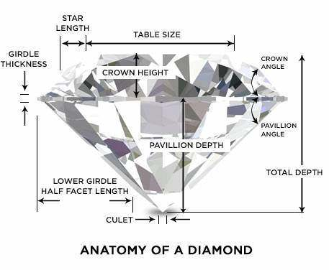
Describing Data (3)
6- Depth: The height of the diamond.
7- Table: The width of the diamond's table expressed as a percentage of its average diameter.
8- Price: the price of the diamond.
9- x: the diamond length in mm.
10- y: the diamond width in mm.

Slide 6
Data visualization (1)
Before we start visualizing all the data we will mainly look at the big picture. Now to get the knowledge that we need about the data we can present it in a histogram for each numerical attribute we have.
To get a deeper look we visualize. When we visualized we worked on a test set to avoid harming the training set.

Slide 7
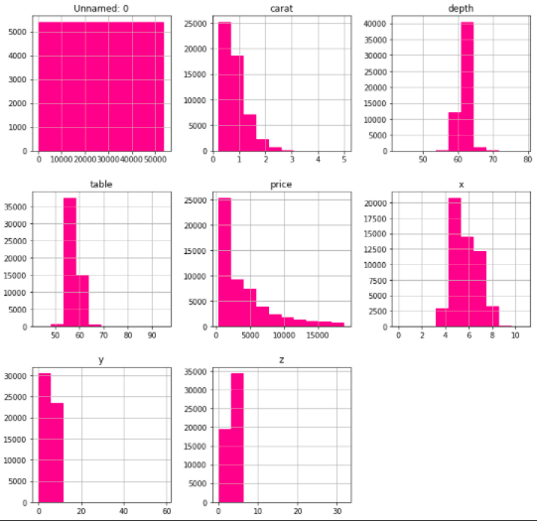
Data visualization (2)
Here is how we visualize our data:
presenting the data in histograms

Slide 8
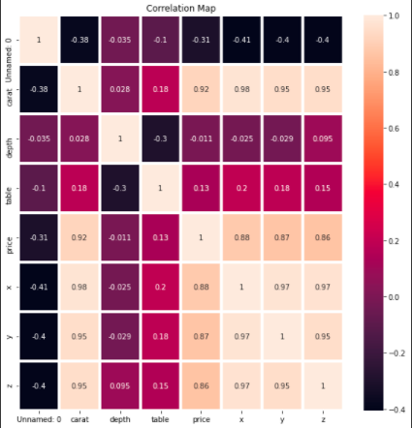
Data visualization (3)
2. We found it better to use the heatmap diagram to present the diamonds correlation.

Slide 9
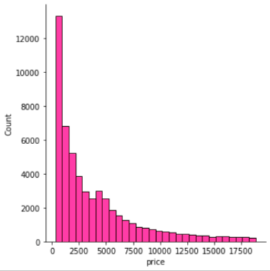
Data visualization (4)
3. Using displot to present the prices
of the diamonds:

Slide 10
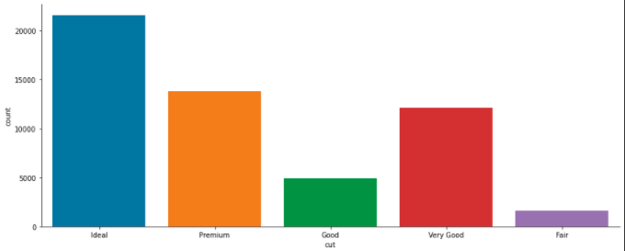
Data visualization (4)
4. Display plots for the cut, color and the clarity of the diamonds.

Slide 11
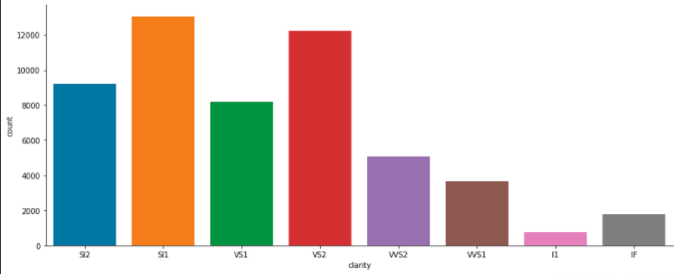
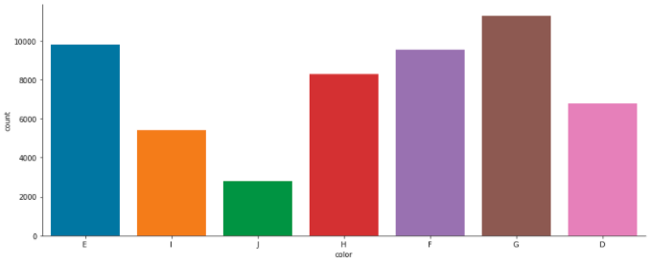
Data visualization (4)

Slide 12
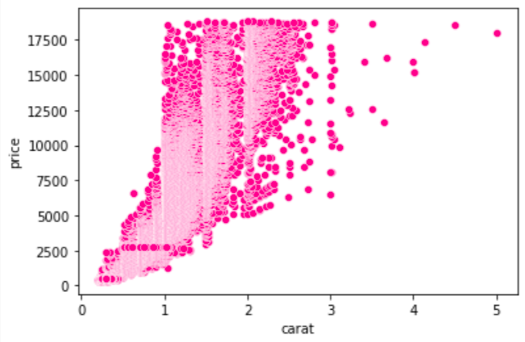
Data visualization (5)
4. plotting the carat vs. its price:

Slide 13
Preparing data for ML:
What we did is that we basically performed some data cleaning since most of the ML algorithms do not work with missing features.
We applied what we learned in this step, we got rid of corresponding districts, the whole attribute and we set the missing values to some values.
We also handled the text and categorical attributes.

Slide 14
Features Engineering (1)
Volume:
Volume = x * y * z
Reduced Features by create Volume
and Volume has a very High correlation with price more than x, y, z

Slide 15
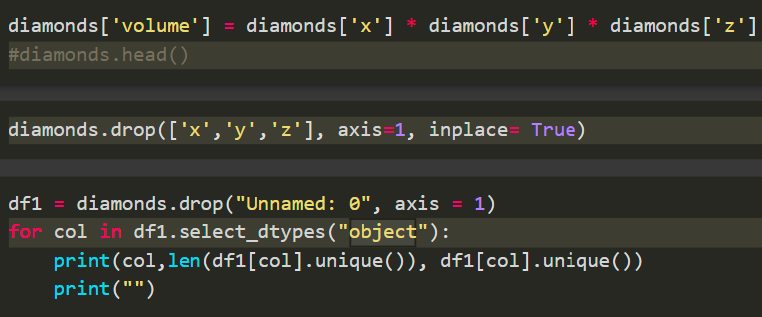
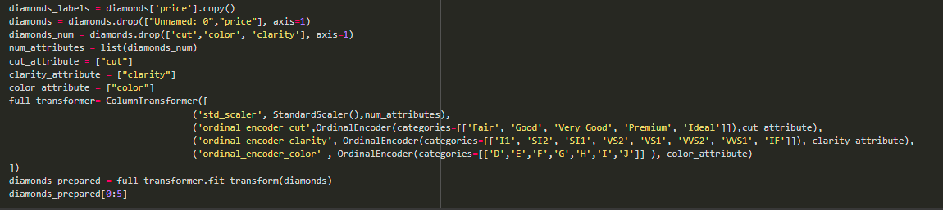

Slide 16
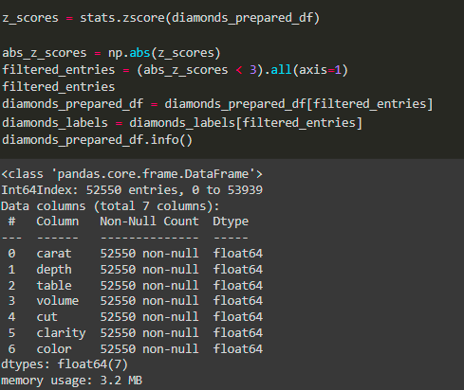
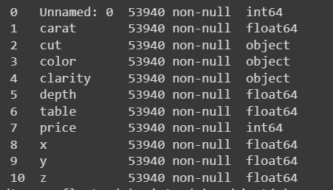
Remove the outliers
After removing the outliers
Before removing the outliers

Slide 17
Training and Evaluating on the Training Set (1) :
Now that we framed the problem, explored the data and sampled a training set and a test set, we started to actually train our training set. what we did here is that we choose 5 ML models to train as follows:

Slide 18
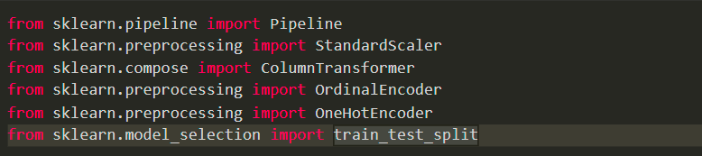
Training and Evaluating on the Training Set (2) :
We trained a LinearRegression model, RandomForest, SVM, KNeighborsclass, and decisionTreeRegressor models :

Slide 19
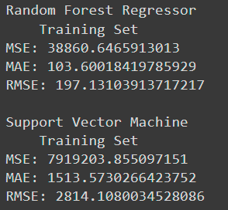
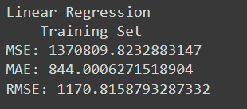
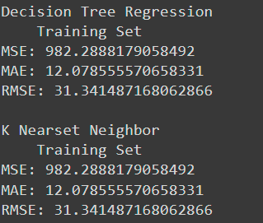
Training and Evaluating on the Training Set: (3)
Now, to get better results we calculated the rmse to check which model has the least error percentage for the training set and it went as follow:

Slide 20
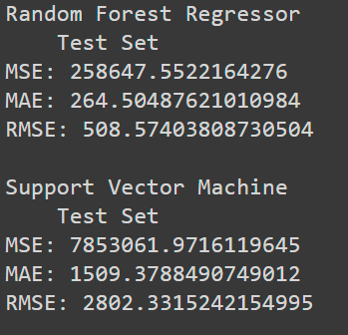
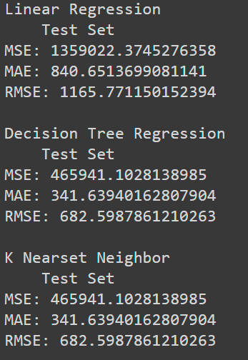
Training and Evaluating on the Training Set (4) :
Now, to get better results we calculated the rmse to check which model has the least error percentage for the test set and it went as follow:

Slide 21
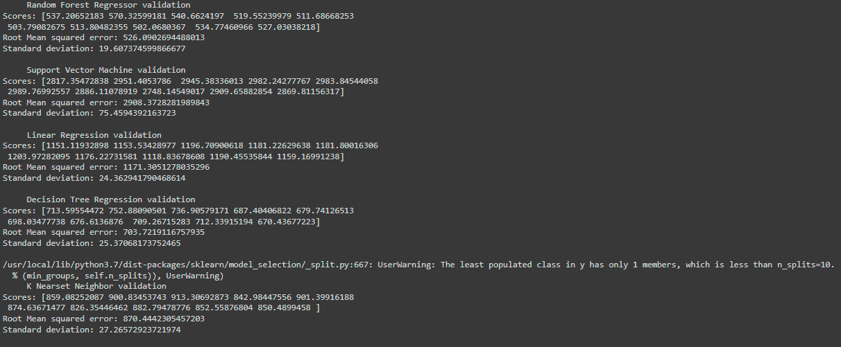
Training and Evaluating on the Training Set: (5)
Validation:

Slide 22
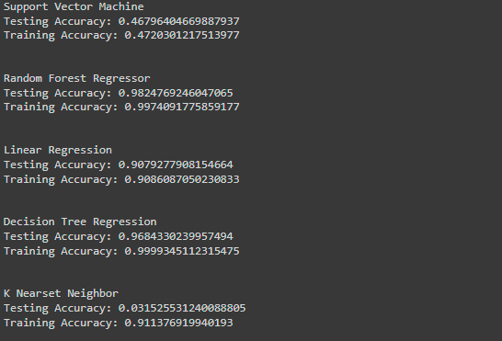
Training and Evaluating on the Training Set: (6)
After training and testing the accuracy of the models, we figured out that the best results were given by the decision tree of : 0.9999 and the random forest regression as well 0.9974, so these two are the best models. The worst model was the SVM with accuracy of 0.4720

Slide 23
Training and Evaluating on the Training Set : (7)
The K Nearest Neighbor usually used for classification dataset.
As we can see, the rmse in the Random Forest Regression is the least among the other models and its equal to 508. This means that the best model we got is the random forest regression model.

Slide 24
Fine tuning (1) :
For our final step, we performed fine-tuning on the Random Forest Regression since it was our best model. The goal of doing this step is to simply improve the accuracy.
We used the Grid search to fine-tune our project as follows:

Slide 25
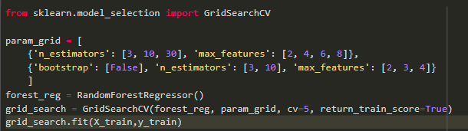
Fine tuning (2):

Slide 26
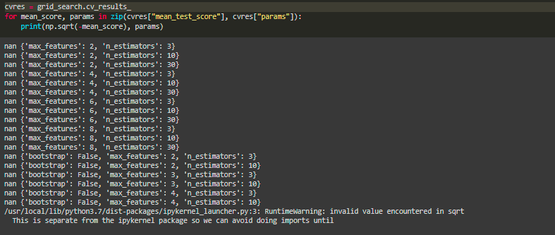
Fine tuning: (3)

Slide 27
Conclusion:
We really did enjoy working on this project because it help us to conclude and work on everything we have learned in this course so far.
We believe that we will be able to work on more ML project in the future with more efficiency and experience.
Thank you!!

