Slide 1
SARAH SAFWAN / PORTFOLIO 2026
SELECTED WORK
2026 PORTFOLIO
SARAH
SAFWAN
Digital Marketing &
Creative Specialist
Marketing / Strategy / Creative Direction / Digital Content
Selected projects, independent ideas,
and professional experience.
View the online portfolio
Sarah Safwan / Digital Marketing & Creative Specialist 01 / 17

Slide 2
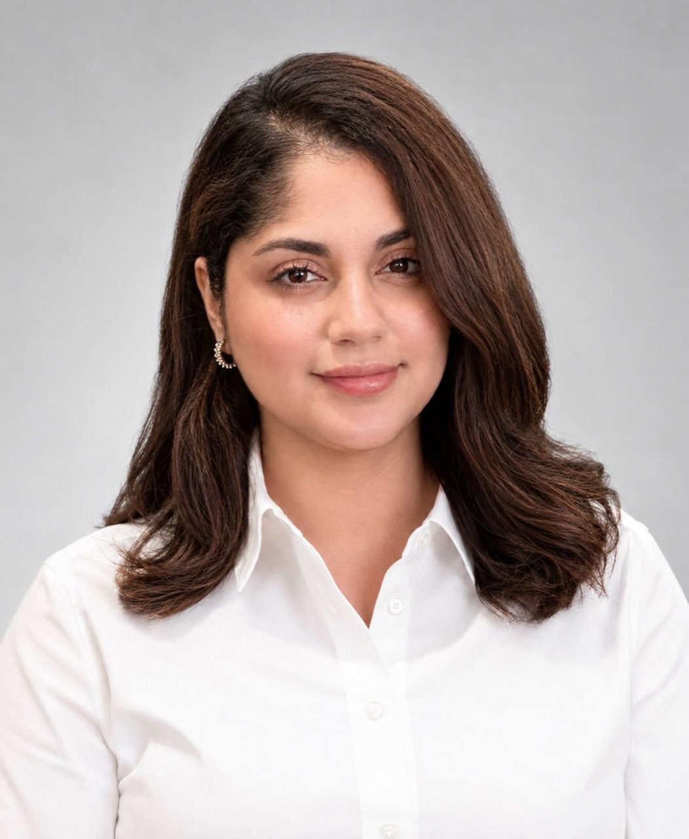
SARAH SAFWAN / PORTFOLIO 2026
INTRODUCTION
About
I'm interested in what makes people pay attention, what makes them stay, and why certain ideas stick with them.
My work brings together marketing, research, writing, and creative production. I enjoy understanding how brands communicate, developing concepts, and figuring out how an idea can become something people actually want to engage with.
My experience spans fashion marketing, independent publishing, educational content, podcast production, and digital projects. I'm particularly interested in brand strategy, creative direction, and the thinking behind successful campaigns.
INSIDE THIS PORTFOLIO
Rhode / Independent strategy
04–08
Thy Academia / Educational publishing
12–13
DAXUEN / Fashion marketing
09–10
The Sae Talk / Audio production
14
BellaBelles Egypt / Creative production
11
Sarah Safwan / Editorial writing
15
Sarah Safwan / Digital Marketing & Creative Specialist 02 / 17

Slide 3
SARAH SAFWAN / PORTFOLIO 2026
CAPABILITIES
Expertise
Working areas across marketing, production, and digital publishing
Marketing & Strategy
Content Strategy
Social Media Marketing
Campaign Ideation
Marketing Research
Competitor Analysis
Content Planning
I use research and planning to understand a brief, develop content ideas, and consider how a brand communicates with its audience.
Creative Production
Creative Direction
Visual Content Development
Short-form Video Editing
Copywriting
Editorial Writing
AI-assisted Creative Production
My work connects concepts with the writing and visual production needed to express them clearly.
Digital
Website Content
Website Design and Development
Digital Publishing
Basic HTML/CSS
Website Builders
I work on the relationship between page structure, written content, and the way a digital project is presented.
Sarah Safwan / Digital Marketing & Creative Specialist 03 / 17

Slide 4
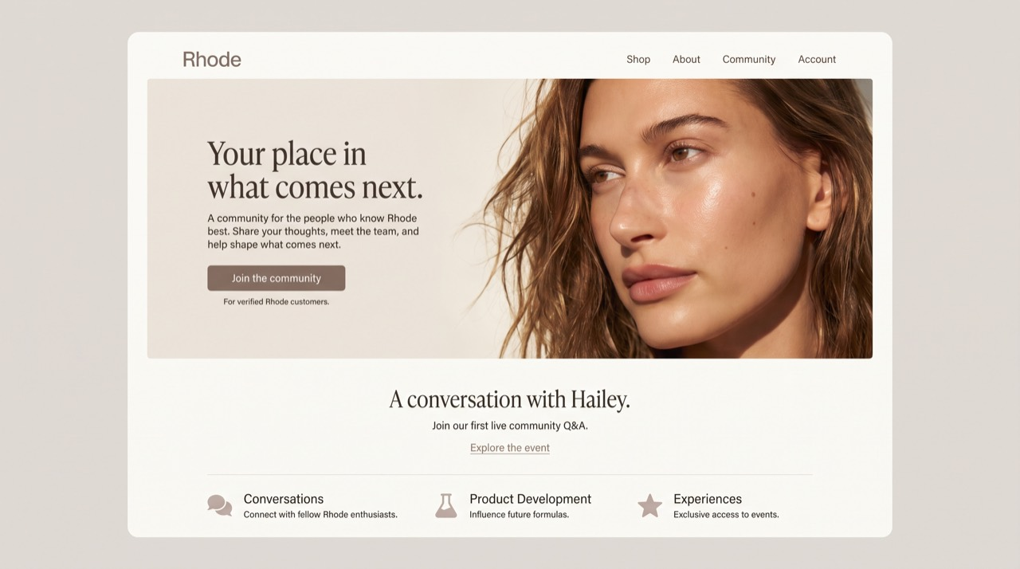
SARAH SAFWAN / PORTFOLIO 2026
INDEPENDENT CONCEPT
Rhode: From Influence
to Involvement
Independent Marketing Strategy & Creative Concept / Brand studied: Rhode
A dedicated space for the people who know Rhode best.
THE OPPORTUNITY
Rhode has established a distinctive identity through its visual direction, product presentation, and Hailey Bieber’s cultural influence. This independent project explores how the brand could develop a closer relationship with everyday customers by creating more opportunities for direct involvement.
THE PROPOSAL
A verified-customer community within Rhode’s existing digital ecosystem, designed to connect feedback, direct conversations, and participation in what comes next.
Independent speculative concept. Not commissioned by, affiliated with, or endorsed by Rhode.
Sarah Safwan / Digital Marketing & Creative Specialist 04 / 17

Slide 5
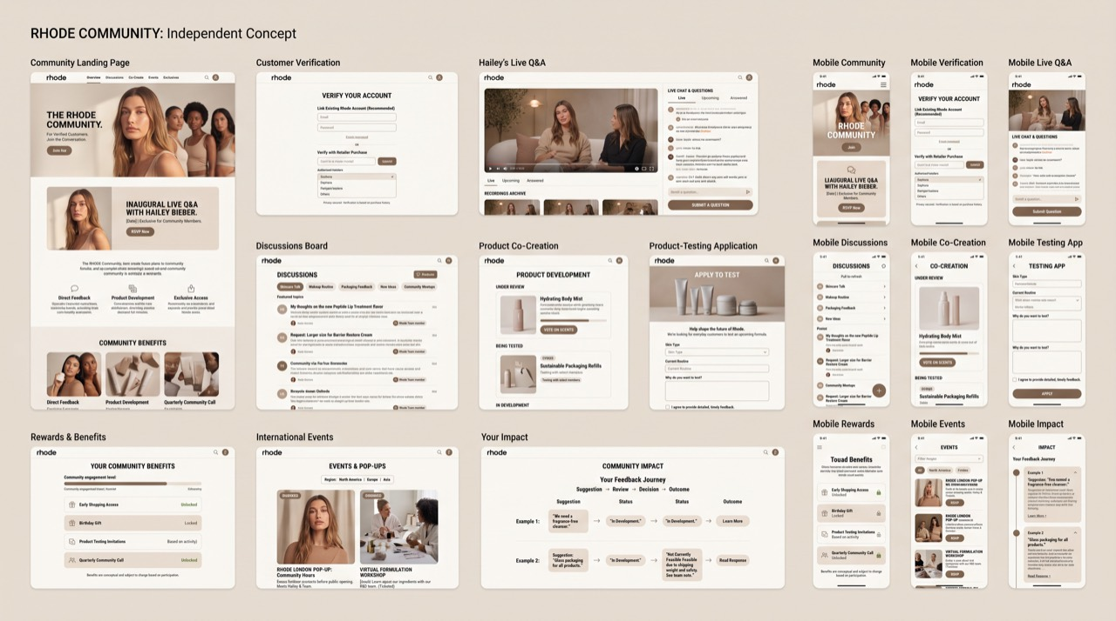
SARAH SAFWAN / PORTFOLIO 2026
RHODE / STRATEGY
From visibility
to participation
An independent strategic observation, not a claim about current brand practice
Early exploration of a customer-centered Rhode digital ecosystem.
COMPLEMENTING INFLUENCE
Influencer visibility and everyday customer participation serve different purposes. My hypothesis is that Rhode could build on its existing influence by giving verified customers more direct access to conversation, product feedback, and experiences. The concept does not propose abandoning influencer marketing.
The proposed ecosystem
Product suggestions and voting
Customer-testing applications
Rewards and participation benefits
Direct conversations with the team
International community experiences
Visible updates on customer ideas
Sarah Safwan / Digital Marketing & Creative Specialist 05 / 17

Slide 6
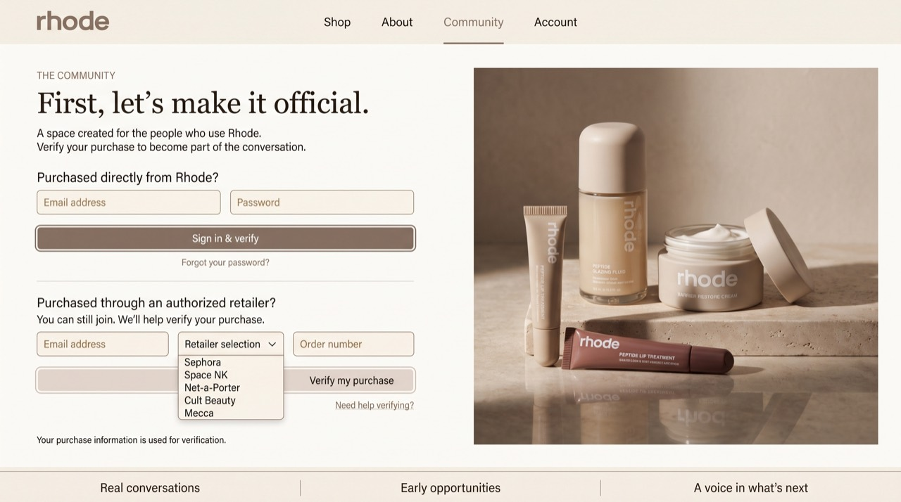
SARAH SAFWAN / PORTFOLIO 2026
RHODE / CUSTOMER ACCESS
Membership starts
with customers
Customer Verification & Onboarding
Membership begins with a genuine relationship to the brand.
ACCESS BASED ON CUSTOMERSHIP
The proposed onboarding flow gives customers a purchase-based route into the community. It distinguishes direct purchases from purchases through authorized retailers, with a verification path for each. Eligibility is central to the strategy: this is intended as a place for people using the products, rather than another audience built only around visibility.
A PROPOSED FLOW, NOT A LIVE INTEGRATION
The interface illustrates the intended customer journey. Retailer verification, account access, and handling of purchase information would need to be designed and tested before implementation. The mockup does not establish that these integrations exist.
Sarah Safwan / Digital Marketing & Creative Specialist 06 / 17

Slide 7
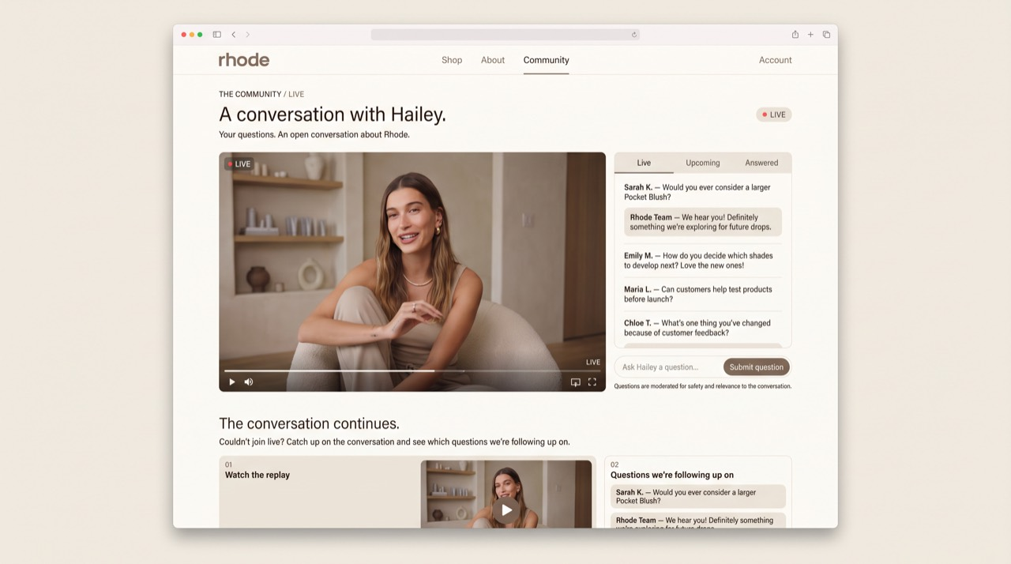
SARAH SAFWAN / PORTFOLIO 2026
RHODE / FOUNDER ACCESS
A conversation
with Hailey
Proposed inaugural community event
A more direct conversation between Hailey and Rhode’s customers.
LIVE INTERACTION OVER A PROMOTIONAL FILM
The proposed opening event puts customer questions at the center. A live Q&A could create space for spontaneous answers and the concerns customers bring to the discussion, rather than relying on a highly scripted promotional format.
KEEPING THE CONVERSATION OPEN
The concept includes a replay and a visible follow-up area for unanswered questions. Moderation would support a respectful conversation, while follow-through would keep the event connected to the wider community. Hailey Bieber has not participated in developing this project.
Sarah Safwan / Digital Marketing & Creative Specialist 07 / 17

Slide 8
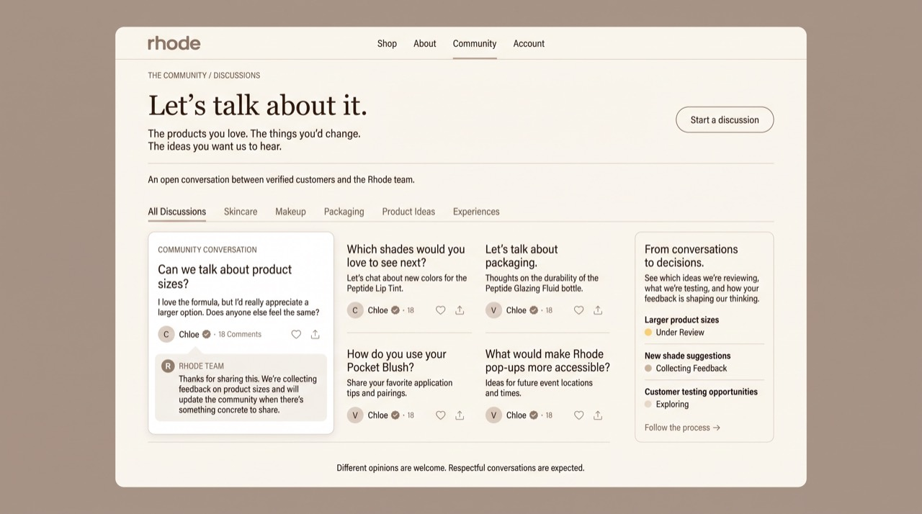
SARAH SAFWAN / PORTFOLIO 2026
RHODE / FEEDBACK
Conversations that
lead somewhere
Discussions & Customer Feedback
Customer feedback should lead to conversation and visible follow-through.
VISIBLE RESPONSES
The discussion space makes room for criticism, product suggestions, and responses from the team. A progress area proposes showing what is being reviewed, tested, or explored so contributions have a visible path beyond the original conversation.
Potential strategic value
Proposed measurement
Stronger relationships, loyalty, repeat engagement, retention, community participation, and customer-led product insights are objectives of the concept, not measured results.
Verified membership, meaningful participation, returning members, satisfaction, feedback acted on, testing participation, repeat purchases, and event attendance.
View the full strategy presentation
Sarah Safwan / Digital Marketing & Creative Specialist 08 / 17

Slide 9
SARAH SAFWAN / PORTFOLIO 2026
PROFESSIONAL EXPERIENCE
DAXUEN
Marketing Intern / September 2026 to Present
Fashion marketing,
from research to production.
My internship brings together campaign ideation, content marketing, advertising research, and creative production. I develop concepts and social content ideas, work with fashion references, and create and revise AI-assisted visual materials.
Campaign and content ideas
I develop creative concepts for fashion marketing and social media, considering the visual references and message behind the material.
Research and references
I examine competitors’ marketing and advertising approaches to understand how they use creative formats, messaging, and fashion imagery.
Production and revision
I work on campaign visuals and social media materials, incorporating feedback and revisions. My participation also includes exposure to influencer marketing and advertising activities.
Visit DAXUEN
DAXUEN on Instagram
Sarah Safwan / Digital Marketing & Creative Specialist 09 / 17

Slide 10
SARAH SAFWAN / PORTFOLIO 2026
DAXUEN / PRACTICE
Developing the
creative material
Selected responsibilities and working approach
01
Reading the category
Competitor research helps me examine how fashion brands organize their advertising and communicate their products. I focus on creative approaches, message structure, and formats rather than treating another brand’s campaign as a template to copy.
02
Working with visual references
Creative references and fashion imagery support the development of campaign ideas. My AI-assisted production work is part of that process, alongside editing and the preparation of social media materials.
03
Revising for the brief
Developing a visual is followed by feedback and revision. My role includes adapting campaign and social materials so the next version responds to the requirements and comments provided.
This experience demonstrates research-led concept development, visual production, and the ability to revise creative material within a professional marketing setting.
Sarah Safwan / Digital Marketing & Creative Specialist 10 / 17

Slide 11
SARAH SAFWAN / PORTFOLIO 2026
CREATIVE PRODUCTION
BellaBelles Egypt
Creators Program / August to September 2026
Brand-focused content,
prepared for a defined brief.
I participated in BellaBelles Egypt’s creators program, planning, producing, and delivering visual content according to the brand’s requirements. The work centered on the products and brief provided, with agreed creative materials prepared for delivery.
Planning
Developing content around the products and requirements supplied by the brand.
Production
Creating brand-focused visual material for the program’s agreed deliverables.
Delivery
Completing and submitting the creative materials required by the program.
This was participation in a creators program, rather than an employee or marketing-management role.
Visit BellaBelles Egypt
BellaBelles on Instagram
Sarah Safwan / Digital Marketing & Creative Specialist 11 / 17

Slide 12
SARAH SAFWAN / PORTFOLIO 2026
INDEPENDENT PUBLISHING
Thy Academia
Founder / 2022 to 2025 / Completed project
Educational content
with student life in view.
Thy Academia was an independent educational platform I founded and managed. Its content covered academic life, studying, productivity, and student wellbeing. I researched topics, wrote and published educational material, and managed the content across Instagram and Medium.
Research and writing
Developing educational subjects and turning research into writing that students could understand and use.
Editorial direction
Planning content, choosing topics, and organizing the publication’s written and visual communication.
Independent management
Taking responsibility for the platform’s content planning, production, and publishing as its founder.
Thy Academia on Instagram
Read on Medium
Sarah Safwan / Digital Marketing & Creative Specialist 12 / 17

Slide 13
SARAH SAFWAN / PORTFOLIO 2026
THY ACADEMIA / EDITORIAL
One subject,
different formats
Research / Writing / Content planning / Visual communication
Managing both long-form publishing and social content required me to think about how an educational subject changes when the format changes. Medium supported written development; Instagram supported concise visual communication.
Long-form writing
Social content
Researching topics
Developing written explanations
Organizing article structure
Publishing on Medium
Planning content
Producing graphics and carousels
Communicating ideas visually
Publishing on Instagram
WHAT THE PROJECT DEMONSTRATES
Thy Academia connects research, editorial judgment, and independent project management. It shows my experience sustaining a defined subject area while handling both the writing and visual communication behind the platform.
Content focus
Academic life / Studying / Productivity / Student wellbeing
Sarah Safwan / Digital Marketing & Creative Specialist 13 / 17

Slide 14

SARAH SAFWAN / PORTFOLIO 2026
AUDIO PRODUCTION
The Sae Talk
Podcast Creator & Host / Completed project
An independently created podcast exploring personal growth, identity, and everyday experiences.
I developed the concept, planned episodes, wrote scripts, recorded and edited the audio, and published the finished material.
FROM AN IDEA TO FINISHED AUDIO
The project brought editorial planning and production together in one format. Developing the subject and script was followed by recording, editing, and preparing the episode for publication. My role covered both the direction of the podcast and the work needed to produce it.
The Sae Talk is presented here as a completed independent project.
Listen on Spotify
Listen on Apple Podcasts
Sarah Safwan / Digital Marketing & Creative Specialist 14 / 17

Slide 15
SARAH SAFWAN / PORTFOLIO 2026
EDITORIAL WRITING
Sarah Safwan
Independent publication / Substack
Long-form writing
and editorial judgment.
My independent publication is part of my writing and editorial practice. I develop article ideas, research topics where relevant, write long-form pieces, and edit the material for structure, clarity, and tone.
Subject development
Considering the subject, the perspective I want to take, and how the piece can develop beyond its starting point.
Writing and structure
Developing a longer piece through connected ideas, with attention to the relationship between its paragraphs and overall argument.
Editing
Revisiting the draft to refine the wording, progression, and tone before publication.
Read Sarah Safwan on Substack
Sarah Safwan / Digital Marketing & Creative Specialist 15 / 17

Slide 16
SARAH SAFWAN / PORTFOLIO 2026
TOOLS & TRAINING
Professional toolkit
Selected platforms and completed qualifications
MARKETING
CREATIVE
Meta Business Suite, Google Trends, Google Keyword Planner, HubSpot, Ubersuggest.
Canva, CapCut, Final Cut Pro, Higgsfield.
WRITING & ORGANIZATION
WEB
Notion, Google Docs, Microsoft Word.
VS Code, GitHub, HTML/CSS, website builders.
Completed qualifications
GOOGLE
HUBSPOT ACADEMY
Fundamentals of Digital Marketing
Social Media Marketing
Digital Advertising
SEO
Email Marketing
Inbound Marketing
Content Marketing
LINKEDIN LEARNING / TRAINING
Social Media Marketing Strategy
Content Creation
Marketing Analytics
Consumer Behaviour
Product Marketing
Strategic Partnerships
AI for Marketing
High-Impact Storytelling
EF SET
English Proficiency Certificate
C2 / 74 out of 100
Sarah Safwan / Digital Marketing & Creative Specialist 16 / 17

Slide 17
SARAH SAFWAN / PORTFOLIO 2026
CONTACT
CONTACT
SARAH
SAFWAN
Digital Marketing & Creative Specialist
Interested in working together? You can reach me by email or connect with me on LinkedIn.
Email / sarahsaafwan@gmail.com
LinkedIn / sarahsafwan
Portfolio / View selected work online
Instagram / sarahsaafwan
Sarah Safwan / Digital Marketing & Creative Specialist 17 / 17

