Slide 1
SOFTWARE QUALITY ASSURANCE

Slide 2
WHAT IS SQA ?
Software Quality Assurance (SQA) is a set of activities for ensuring quality in software engineering processes. It ensures that developed software meets and complies with the defined or standardized quality specifications. SQA is an ongoing process within the Software Development Life Cycle (SDLC) that routinely checks the developed software to ensure it meets the desired quality measures.

Slide 3
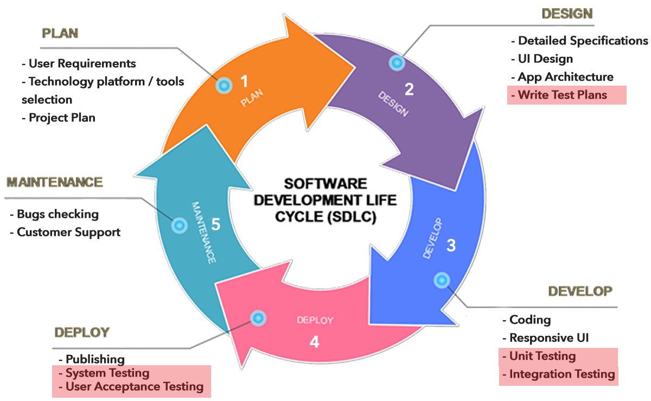
Software Development Life Cycle

Slide 4
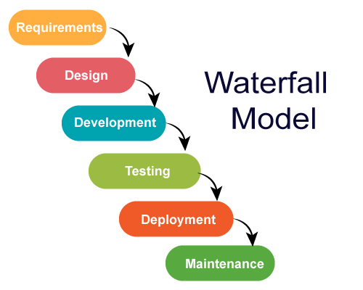
SDLC – Waterfall model
Takes months of planning before development can start
Testing comes very late. If testing fails, months of planning can be wasted
Customer has to wait a long time before deployment

Slide 5
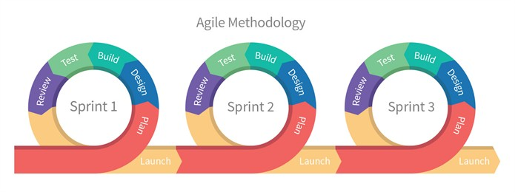
SDLC – Agile model
Short 2 week sprints – each sprint completes all stages of SDLC.
Fail fast approach

Slide 6
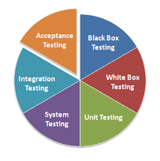
TYPES OF TESTING

Slide 7
TYPES OF TESTING
Manual Testing
A manual tester (human) is asked to use the app and find bugs
Time consuming
Not repeatable
Automated Testing
Tests are written in code by a programmer and performed by the computer
Can be repeated many times
Very fast execution
One time effort of writing (programming) tests

Slide 8
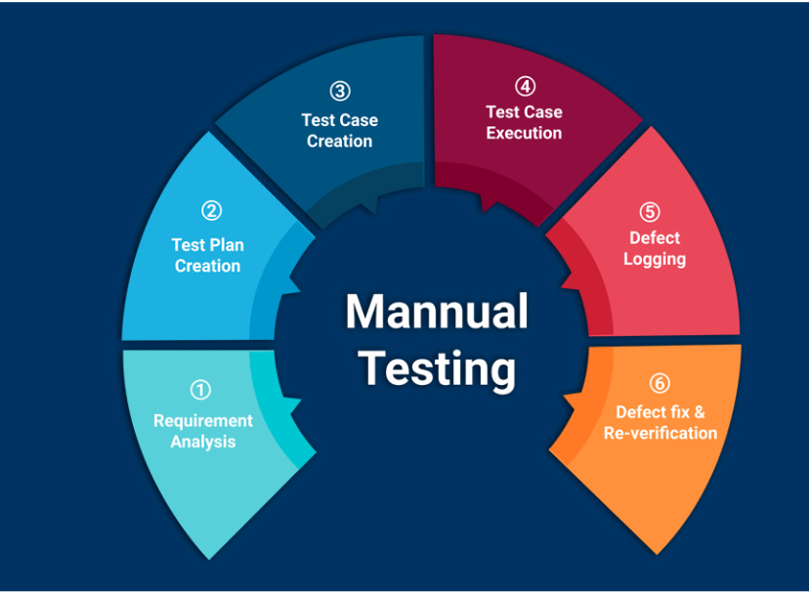
Manual Testing

Slide 9
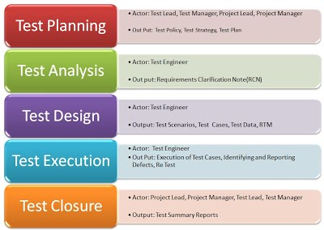
WHAT IS STLC?

Slide 10
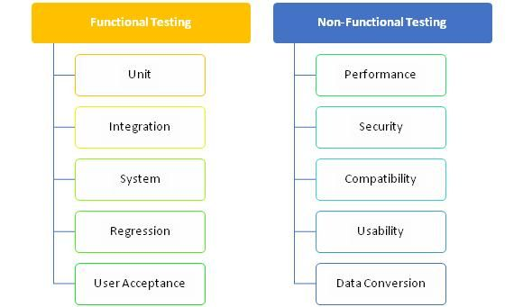
FUNCTIONAL vs NON_FUNCTIONAL TESTING
FUNCTIONAL TESTING:
What a system does!
NON-FUNCTIONAL TESTING:
How WELL a system does!

Slide 11
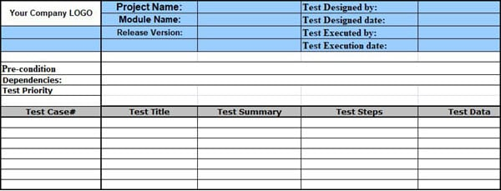
HOW TO WRITE A TEST CASE?

Slide 12
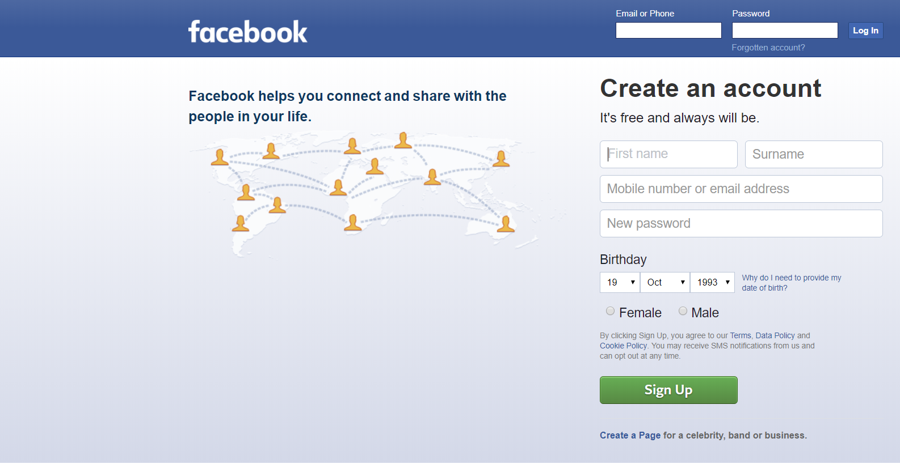

Slide 13
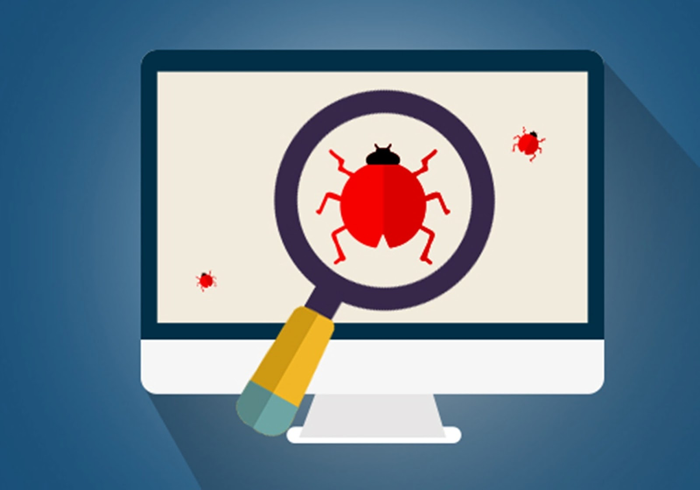
WHAT IS BUG?

Slide 14
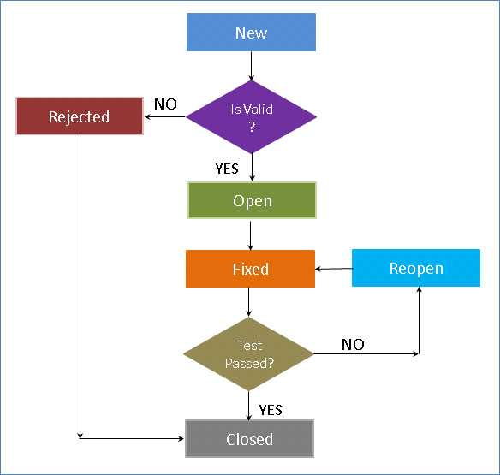
BUF LIFE CYCLE

Slide 15
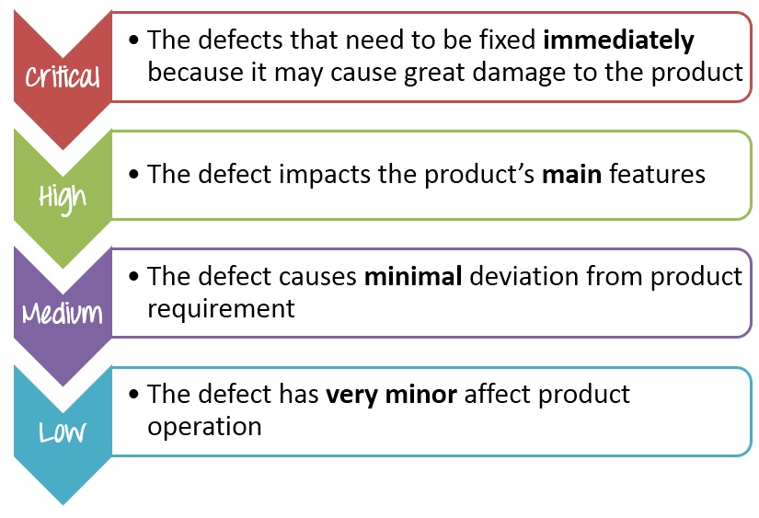
SEVERITY OF A BUG:

Slide 16
USE THIS SITE TO TEST:
https://sarahahmed.me/qa-website/

Slide 17
Resources
- https://www.guru99.com/levels-of-testing.html

Slide 18
