Slide 1

Movies and Money
Movie Stats
Kalyan, Sarah, Mandar, Hasan, Helen

Slide 2
Motivations
Movies are filmed and enjoyed all around the world. The film industry brings in multiple millions annually.
We were motivated to see which movies made the most money based on revenue

Slide 3

Hypothesis and Null Hypothesis
Hypothesis :
Action movies will make the most revenue.
Null hypothesis:
There is no correlation between revenue across all genre

Slide 4
Data Sources
Kaggle.com
Movie_metadata.csv: 45,291 rows and 24 columns

Slide 5
Assumptions
Movies can fall under one or more genre ( example Action Thriller). for this study, we are taking the first Genre as primary to keep it simple.
1
This study will involve the following data points( revenue, release year, genre , popularity, votes average,budget, title)
2

Slide 6
Data Cleanup & Exploration
Filtering out $0 budget: 8,886 rows
Filtering out $0 revenue: 5,381 rows
Filtering out movie release_year beyond 2019: 5,364 rows
Cleaning the value in column Genre from JSON objects
Convert the release date to an acceptable date format

Slide 7
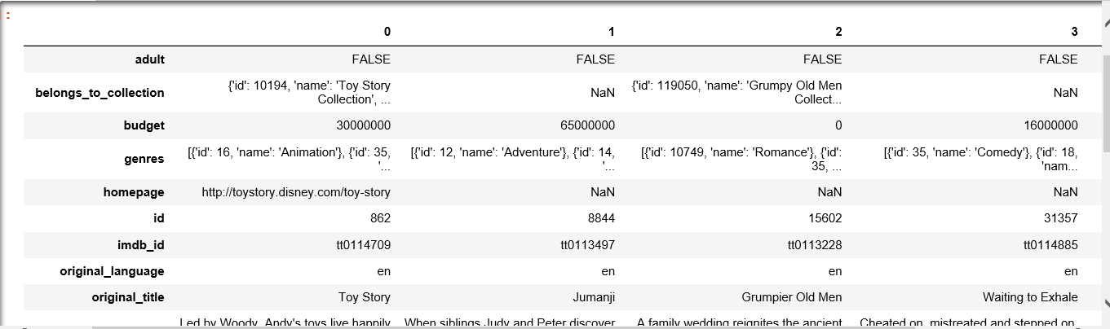
Raw Data

Slide 8
Parsing Genre Column
We categorized the movie by Genre because genre is used to tell the story of the movie.
A movie can be in more than one Genre:
[{'id': 16, 'name': 'Animation'}, {'id': 35, 'name': 'Comedy'}, {'id’:
10751, 'name': 'Family’}]
clean_movie_data_df['Primary Genre']=[json.loads(row.genres.replace("'",'"'))[0]['name'] if row.genres != '[]' else '' for _,row in clean_movie_data_df.iterrows()]
Set the movie Primary Genre to the first value in the genre column

Slide 9
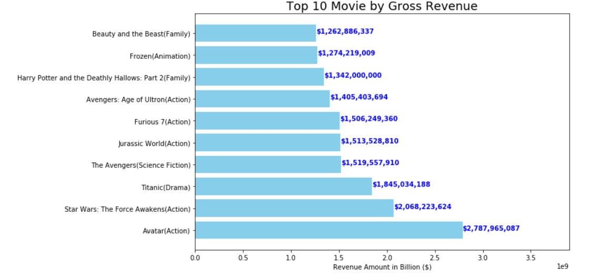

Slide 10
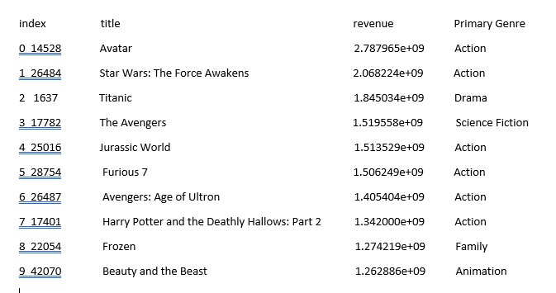
Top 10 movies by revenue and genre

Slide 11
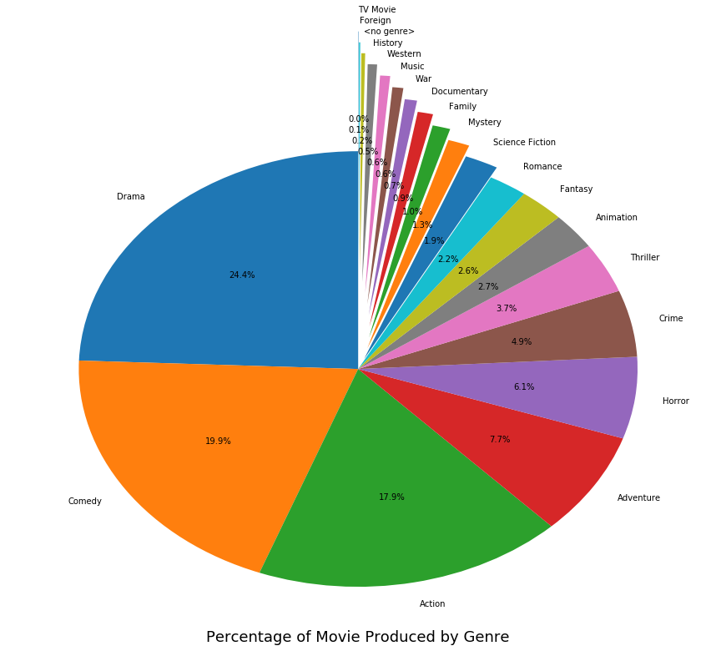

Slide 12
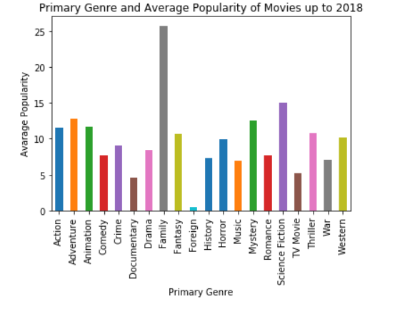

Slide 13
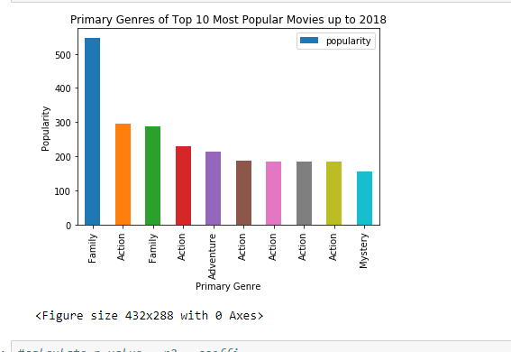
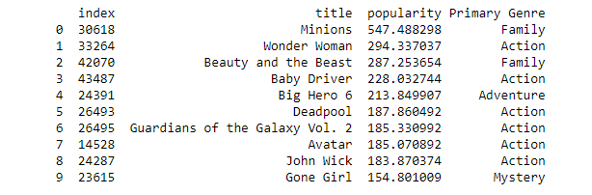
TOP 10 POPULAR MOVIES UP TO 2018

Slide 14
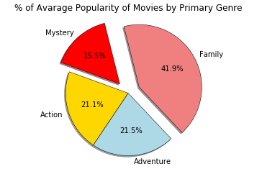

Slide 15
Movies by Popularity
Observations:
TWO FAMILY MOVIES
SIX ACTION MOVIES

Slide 16
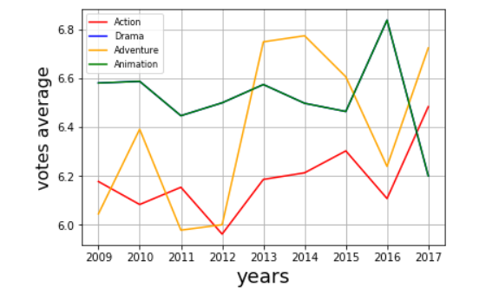
Vote Trends

Slide 17
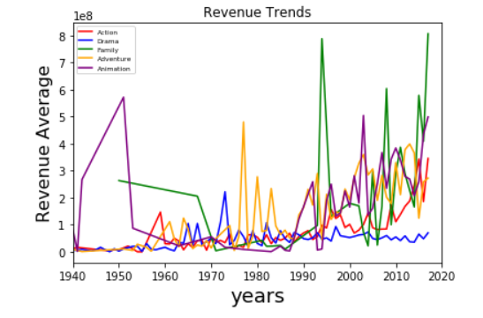

Slide 18
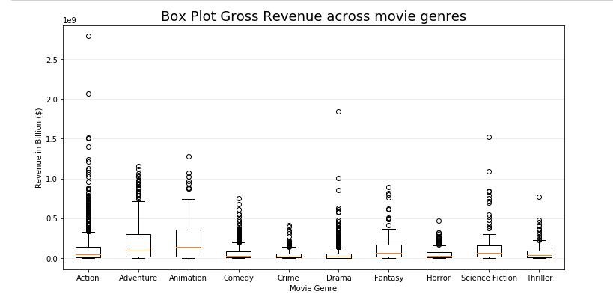

Slide 19
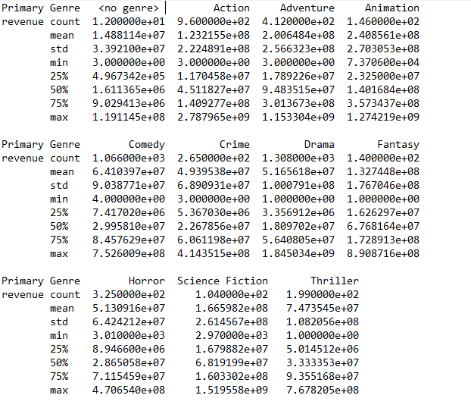
Statistical Analysis using describe()

Slide 20
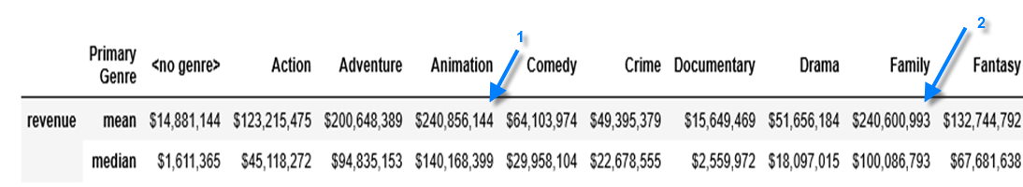

Mean and Median of Gross Revenue

Slide 21
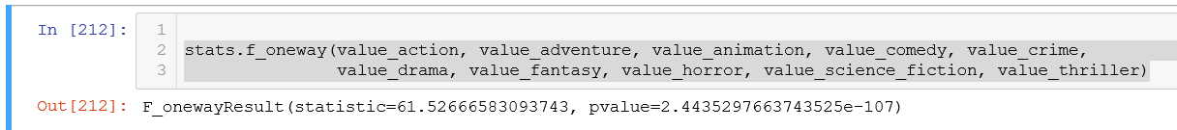
Observations
One-Way ANOVA tests:
The one-way ANOVA tests the null hypothesis that two or more groups have the same population mean. The test is applied to samples from two or more groups, possibly with differing sizes.
Conclusion:
there are two or more groups with differing sizes. The resulting pvalue was less than 0.05. Based on the cleaned dataset ,We can reject the null hypothesis and conclude that there is a significant difference between gross revenue for each movie genre. Even though we have obtained a very low p-value, we cannot make any assumptions about the magnitude of the effect.

Slide 22
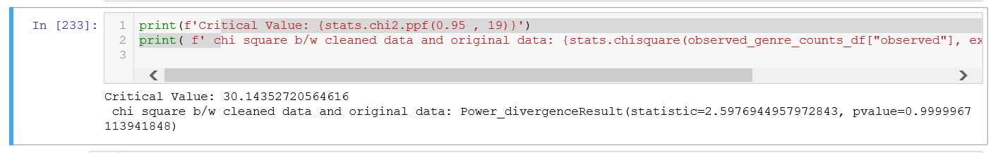
Chi-Square Test : Goodness of fit test to see if the cleaned data set is a good sampling of the original dataset.
Ho: the cleaned dataset is consistent with a specified distribution
Ha: the cleaned dataset is not consistent with a specified distribution
the test statistic came out as 2.597 and the critical value is 30.14 and the p value is 0.997. the outcome is that the cleaned dataset that we worked with may be a good sample representation of the full dataset .

