Slide 1
Group Process Presentation
Group 5:
Mitchell Follett (a1770751), Sophie Porter (a1780903) and
Sarah Telford (a1810750)

Slide 2
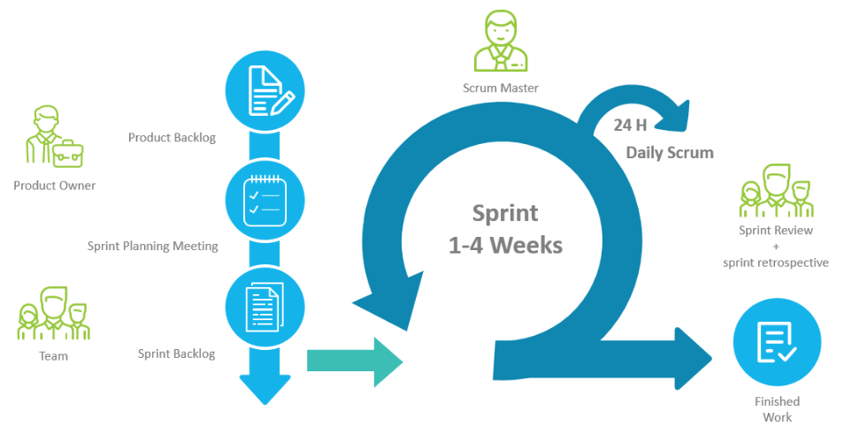
Agile
Used the agile development methodology SCRUM
1 week sprints
Run by the scrum master (Mitch)

Slide 3
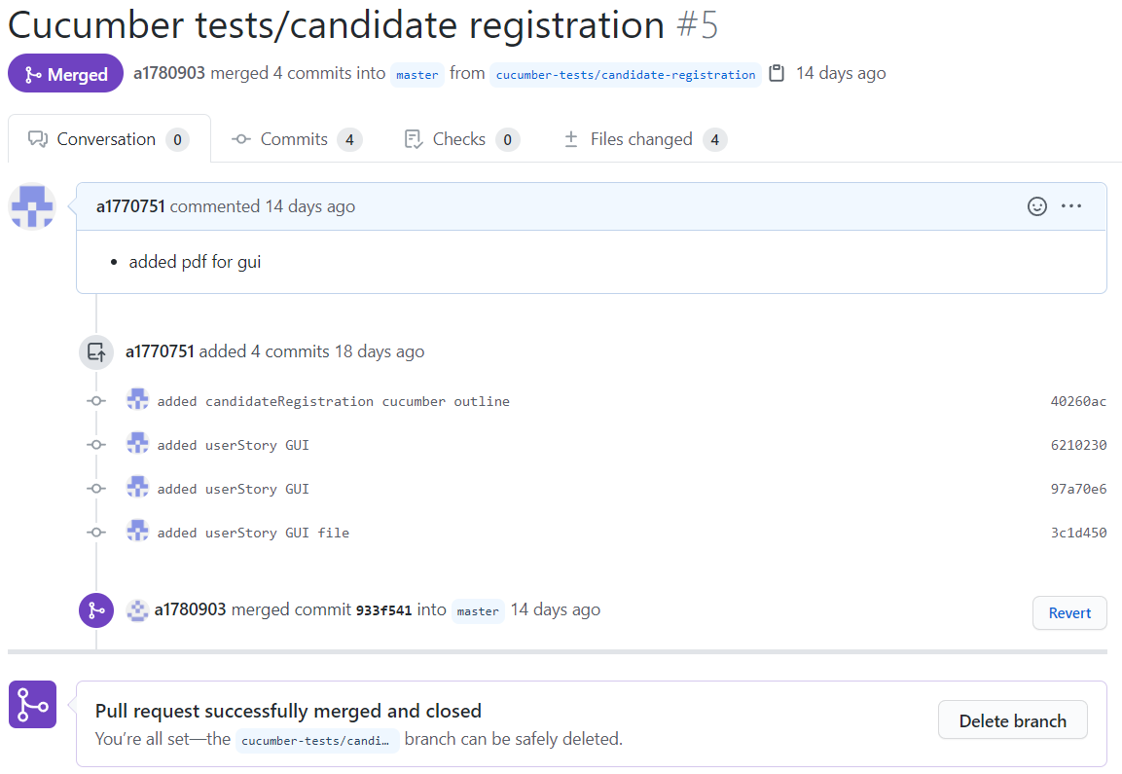
Git
Git pull request approved by another member
Review changes
Communicate to avoid merge conflicts
Branch for each change
Easily reviewable
Formatted into categories

Slide 4
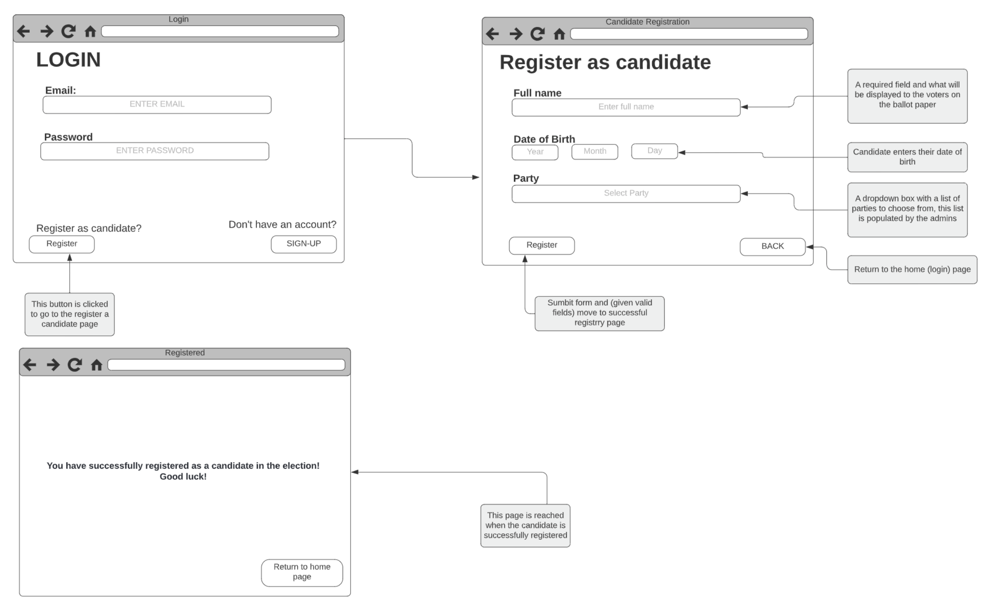
Iteration 1
Developed user stories
Create GUI drawings
Focus on main priorities of the website
Registering candidates
Viewing candidates/parties
Review and approval from team members before implementation
Registering Candidate
GUI Drawing

Slide 5
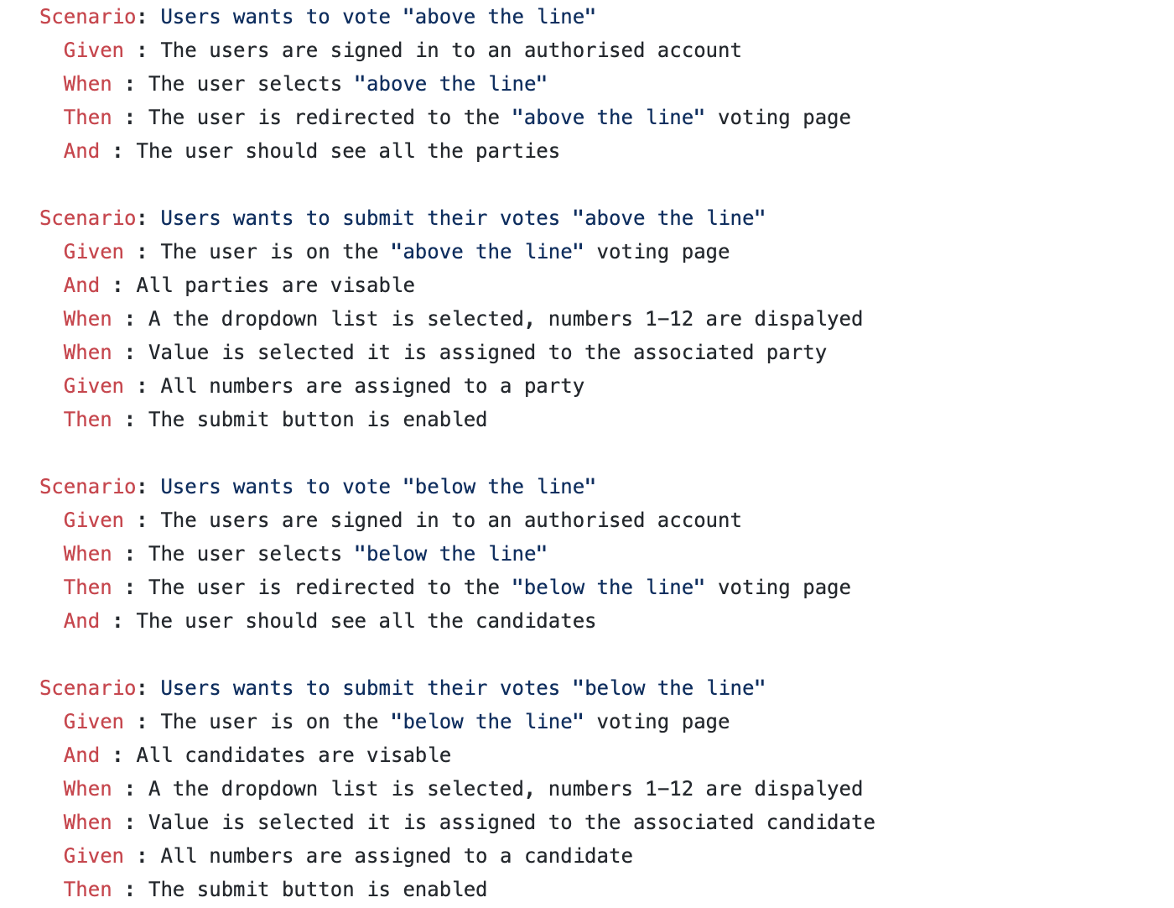
Iteration 2
Creating the database
Adding testing to codebase for iteration 1 implementations
Rspec testing
Cucumber tests
Voting System
Cucumber Tests

Slide 6
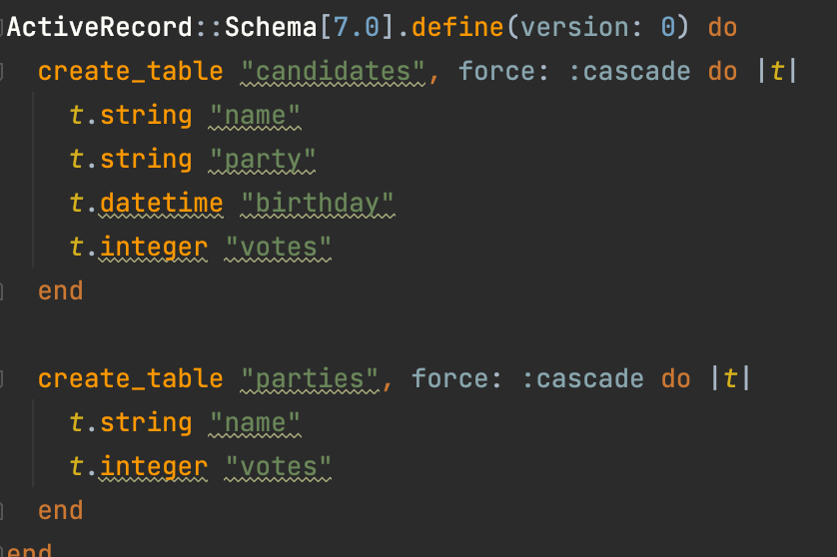
DATABASE

Slide 7
Iteration 3
Expand user stories
Create GUI drawings
Expand the capabilities around the main priorities of the website
Edit and delete existing candidates
Implement voting methods
Above the line (vote for parties)
Below the line (vote for candidates)
Review and approval from team members before implementation

Slide 8
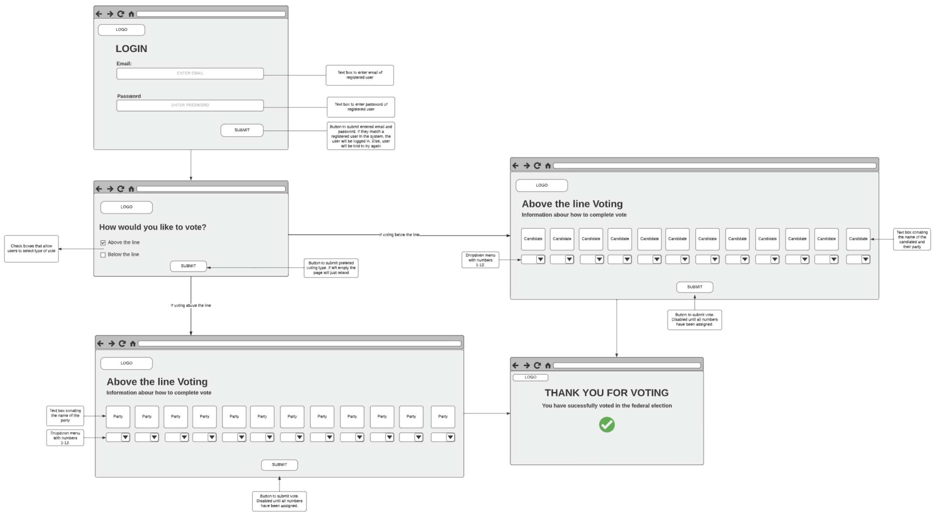
Iteration 4
Authentication of users
/admin can access the registration of users and view votes
/public can vote for candidate or parties
Fixing the appearance of the website
Fixing the CSS and styles sheets for the website to match GUI
Develop tests for iteration 3 implementations
Rspec testing
Cucumber testing
Voting Above and Below Line
GUI Drawing

