Slide 1
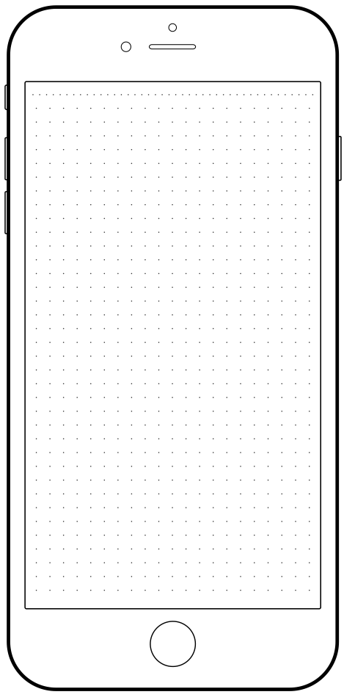
Groups
Living room
Bedroom
Hallway

Slide 2


Devices
Lamp
Main light

Slide 3

Devices
Plug 1

Slide 4

Lamp
0%
100%
Timers
On, everyday, 17.30
Edit

Slide 5
Lamp
0%
100%
Timers
On, everyday, 17.30
Edit

Slide 6


Living room lamp
Set state to
at
17.30
on
Monday,Tuesday…
Save

Slide 7

Living room lamp
Set state to
at
17.30
on
Monday,Tuesday…
Save

Slide 8

Living room lamp
Set state to
Monday
Tuesday
at
Wednesday
17.30
Thursday
Friday
Saturday
on
Sunday
Monday,Tuesday…
Save
Save

Slide 9

Plug
Timers
On, everyday, 17.30
Edit

Slide 10

Plug
Timers
On, everyday, 17.30
Edit

