Slide 1
MicroSuisse
Grace Hseu | University of Texas
Sarah Wang | Carnegie Mellon University
Sponsored by GM Data Analytics and GM Research

Slide 2
Current State of Play
Limited to flat pdfs
Slow and stalled process
Need for dynamic, interactive, and visual content
Notes:
Currently the industry is highly limited and stalled during the process of sharing data.
Visuals and graphs are usually distributed through flat PDFs

Slide 3
Idea
Sector specific microsites
Easily configurable platform
Enhanced client experience
Notes:
Ability to share insights with partners

Slide 4
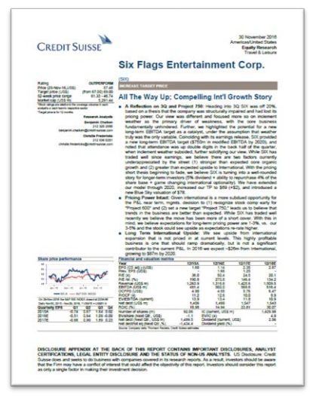
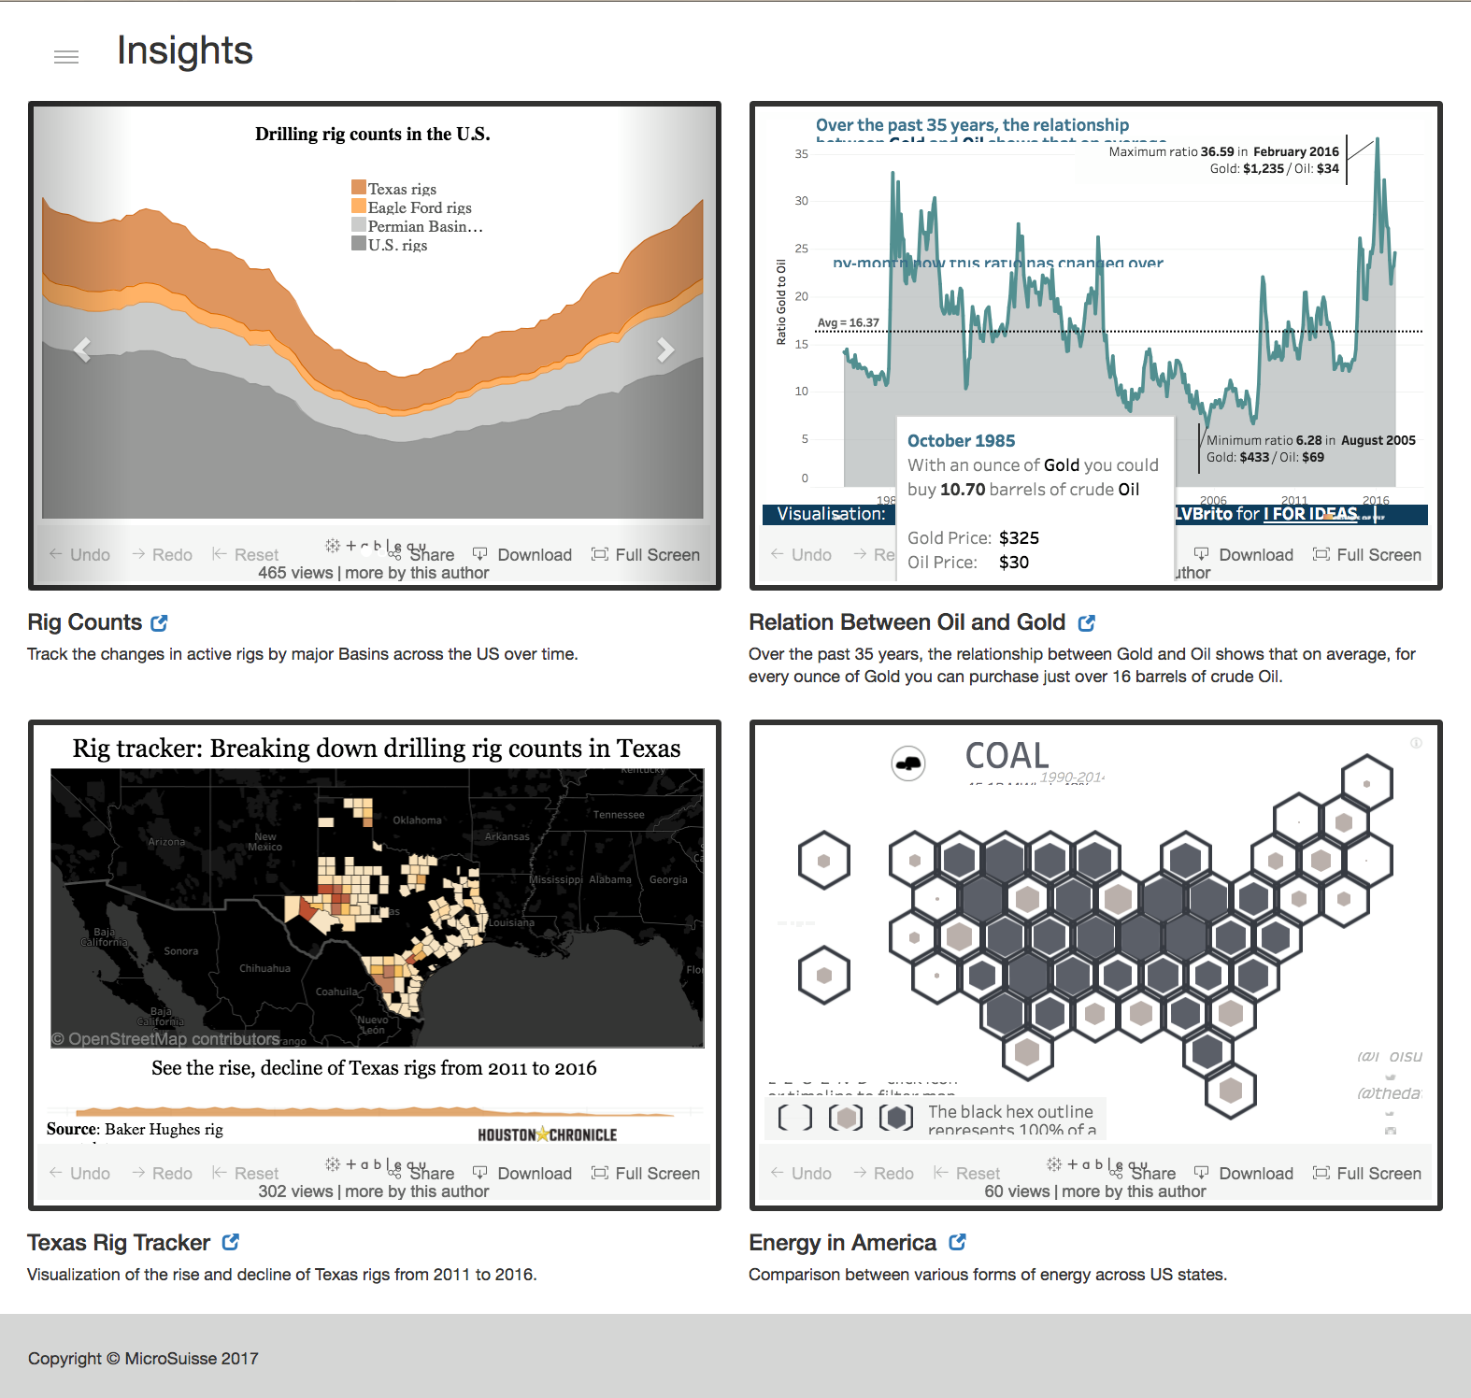
Solution
Notes:
Client experience before have to email for raw data now easily downloadable

Slide 5
Future State
Implementing drag and drop tile swapping on the admin side
Ability to comment on the expanded tile
Add analytics on admin side to view client consumption
Notes:
More client engagement
more fluidity for both the site and the content within it

Slide 6
Lessons Learned
Web development
Analytics and client interaction
Future of banking in tech
Notes:
Roles in the company
Speech on the future of big banking and blockchain how bitcoin works and what this means for banks

Slide 7
Conclusion
Higher tier of service could drive revenues
Easy maintenance for research analysts
Additional traceability for interactions between clients and research
Notes:
Better expeerience
More tracibility which leads to a beter understanding of client consumption

Slide 8
Thank you!

