Slide 1
HandLog ✍️
An AI journal that thinks with you — capture your day by voice or text, get weekly reviews written back to you.
VOICE INPUT
AI REVIEW
NOTION SYNC
MOOD SCORE
✍️ HandLog
handlog.app

Slide 2
WHO IS THIS FOR
02
People who want to remember their lives.
✦
✦
✦
The Reflective One
The Busy Person
The Self-Builder
Journals occasionally but never goes back to read it. Wants to understand their own patterns — emotions, energy, relationships — without the effort of a therapist.
Life moves fast. Meetings, family, decisions. Wants to capture the day in 2 minutes — voice note on the way home — and have something meaningful to look back on.
Tracks habits, reads self-improvement books, wants data on themselves. Mood scores, people patterns, energy trends — they want the dashboard of their own life.
"I write a lot but I never know what it all means."
"I forget what happened last week, let alone last year."
"I want to see myself the way data sees me."
✍️ HandLog
handlog.app

Slide 3
THE PROBLEM
03
Most journals
never get read
again.
1
No structure
Free-form notes pile up with no summary, no themes, no meaningful takeaways.
2
Too much friction
Opening an app, typing a full entry — it feels like homework. Most people stop within a week.
We write, we forget. There's no structure, no reflection, no way to see the patterns in your own life — until now.
3
No reflection
Without review, journaling is just venting. The growth comes from looking back — but nobody does.
✍️ HandLog
handlog.app

Slide 4
HOW IT WORKS
04
Three steps.
Effortless habit.
1
2
3
Capture
AI Reviews
Auto-Saved
Speak or type freely — what happened, who you saw, how you felt. No format required. Voice transcription included.
Every week, AI reads your entries and writes a structured review — key events, mood score, themes, and personal reflections.
Everything syncs to your Notion workspace automatically. Your memories, organised exactly the way you like them.
✍️ HandLog
handlog.app

Slide 5
DASHBOARD & TIMELINE
05
Your life, visualised.
8.2
47
12
3×
AVG MOOD SCORE
ENTRIES THIS MONTH
PEOPLE MENTIONED
REVIEW TYPES
Daily, weekly & monthly mood tracked from 1–10.
Voice + text. Short is fine. Consistency is everything.
Timeline tracks every person in your life story.
Daily · Weekly · Monthly — all AI-generated, all in Notion.
✍️ HandLog
handlog.app

Slide 6
FEATURES
06
Everything you need,
nothing you don't.
Voice Capture
Weekly Review
Deep Chat
Record a voice note, and Whisper AI transcribes it instantly. Log your day in under 60 seconds.
AI reads your week and generates a full narrative review — with highlights, patterns, and a mood score.
Ask your AI about your own life. "Who did I see most this month?" "What made me stressed in November?"
Mood Dashboard
Timeline
Notion Sync
Visual mood tracking across weeks and months. See your emotional patterns at a glance.
Browse your life story chronologically — every entry, every review, every person you mentioned.
All your notes and reviews auto-save to Notion. Your data, in your workspace, always.
✍️ HandLog
handlog.app

Slide 7
DEEP CHAT
07
YOU
"Who did I spend the most time with in May?"
Ask your AI
about your life.
HANDLOG AI
"Based on your May entries, you mentioned Sarah 11 times — mostly around work projects and two weekend brunches. You also spent significant time with your sister during the 18th–22nd."
Your journal knows you. Ask it anything — your AI has read every entry and can surface insights you never noticed yourself.
YOU
"What's been making me stressed lately?"
HANDLOG AI
PERSONAL MEMORY
PATTERN DETECTION
"Your last 3 weeks show a recurring theme around deadlines and sleep quality. Mood scores dip noticeably on Sunday evenings — you mentioned work pressure 8 times this month."
CONTEXT-AWARE
✍️ HandLog
handlog.app

Slide 8
A REAL MOMENT
08
"
The Sunday Ritual
☀ 9am — open HandLog on your phone
It was a Sunday morning. I asked HandLog
"What made me happy this month?"
It came back with three things I had completely forgotten.
🎤 Voice note — 2 mins about your week
✨ AI generates your weekly review
💬 Ask it anything about your month
📓 Everything saved to Notion, forever
That's the moment I understood what this tool is for. Not productivity. Not habit tracking. Memory.
✍️ HandLog
handlog.app

Slide 9
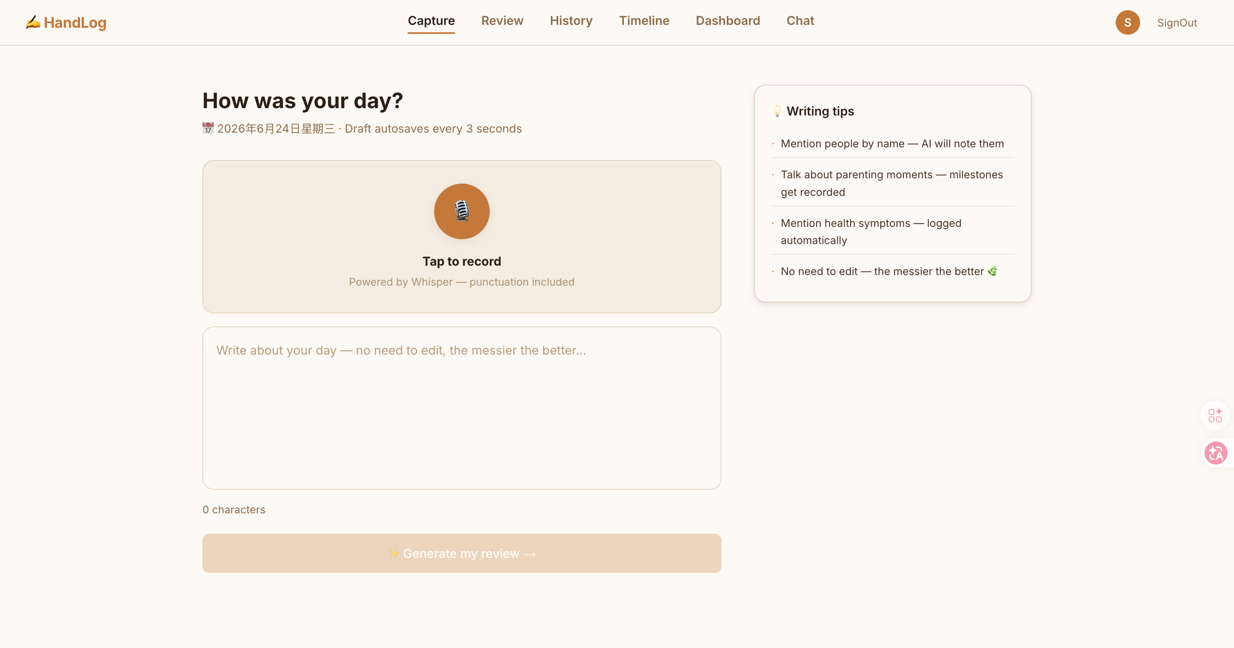
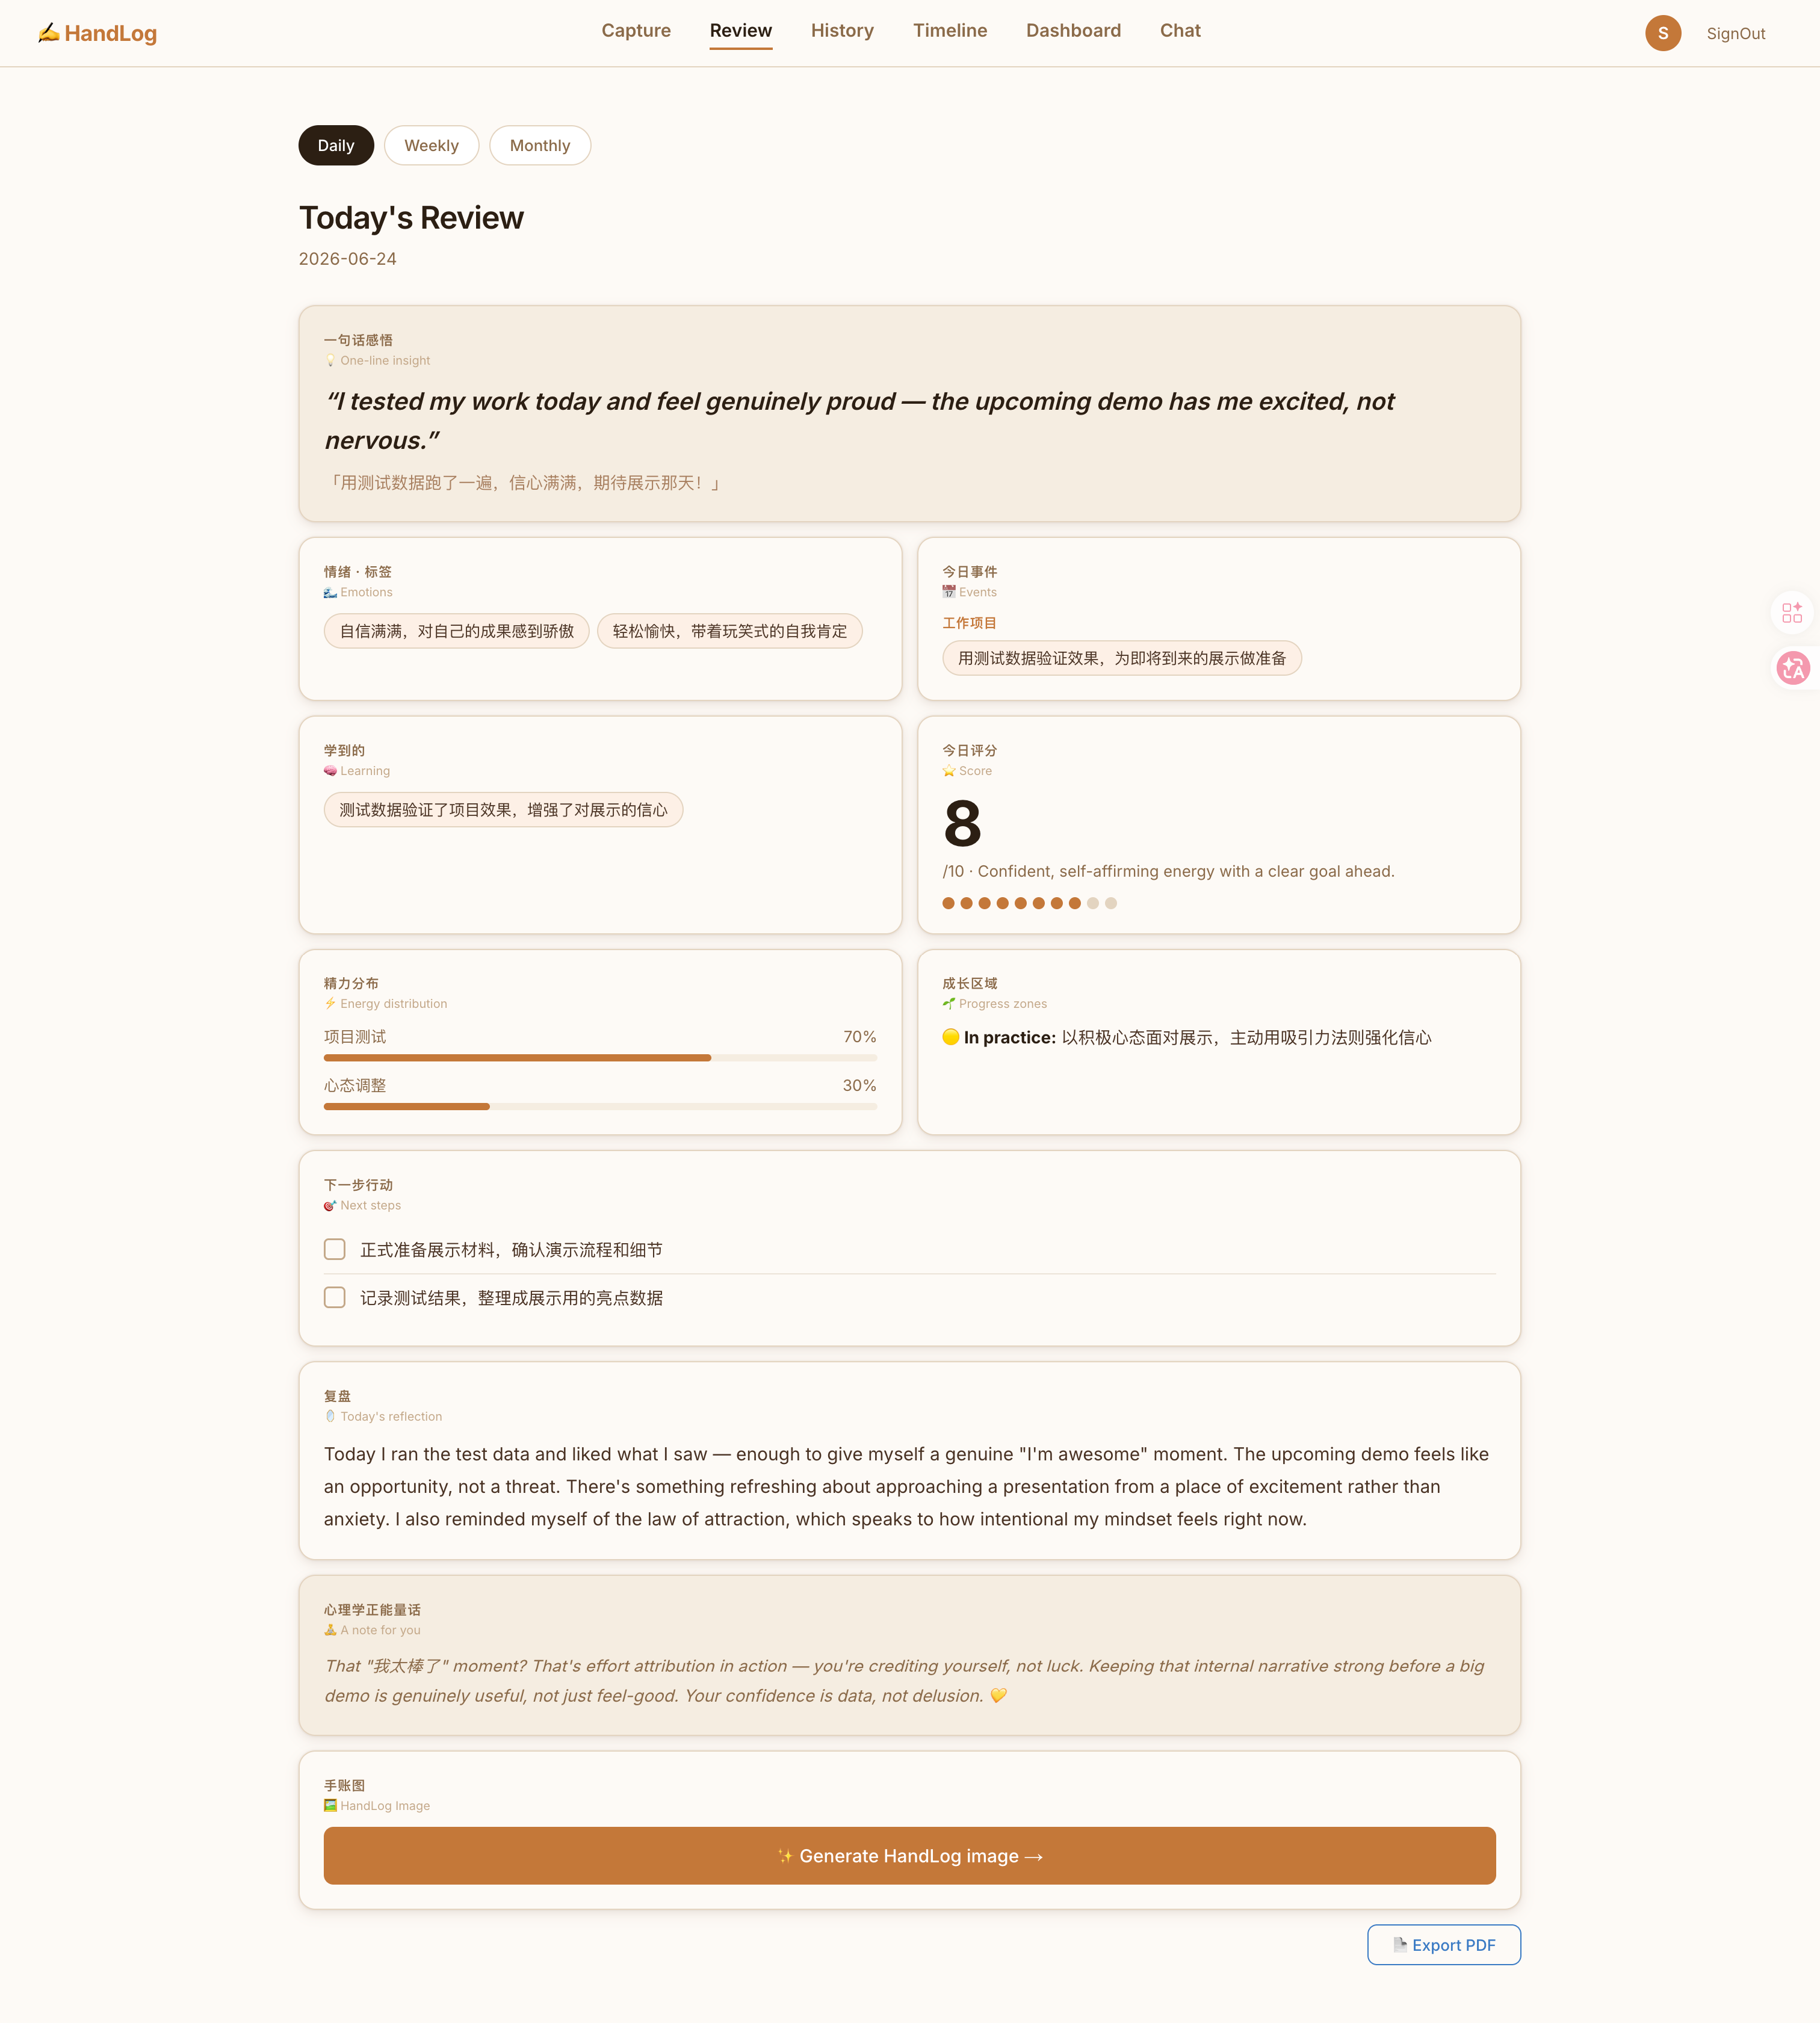
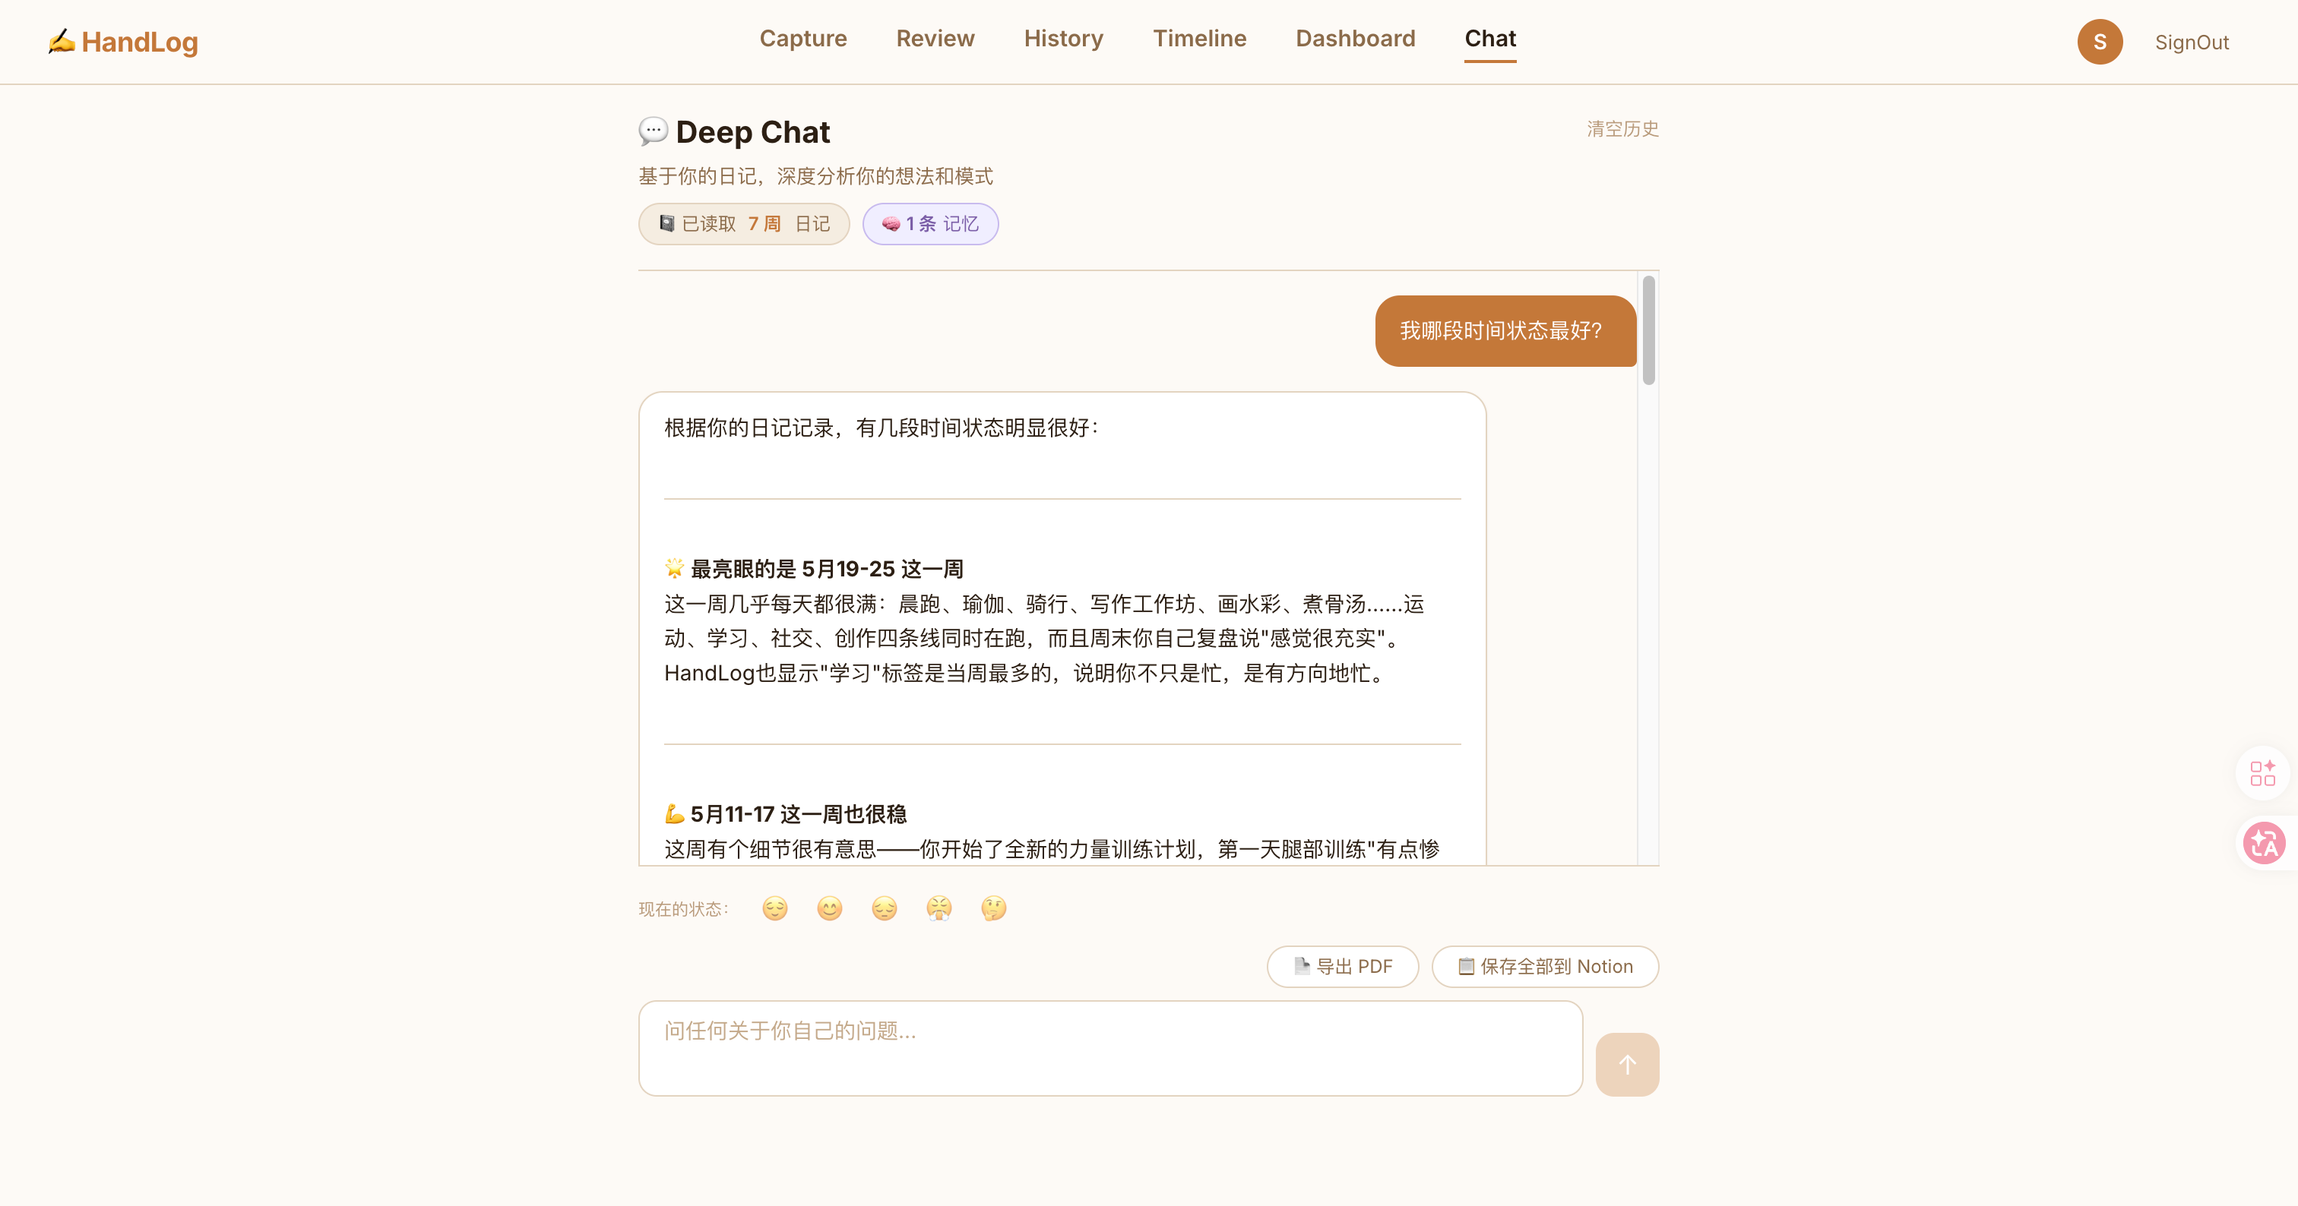
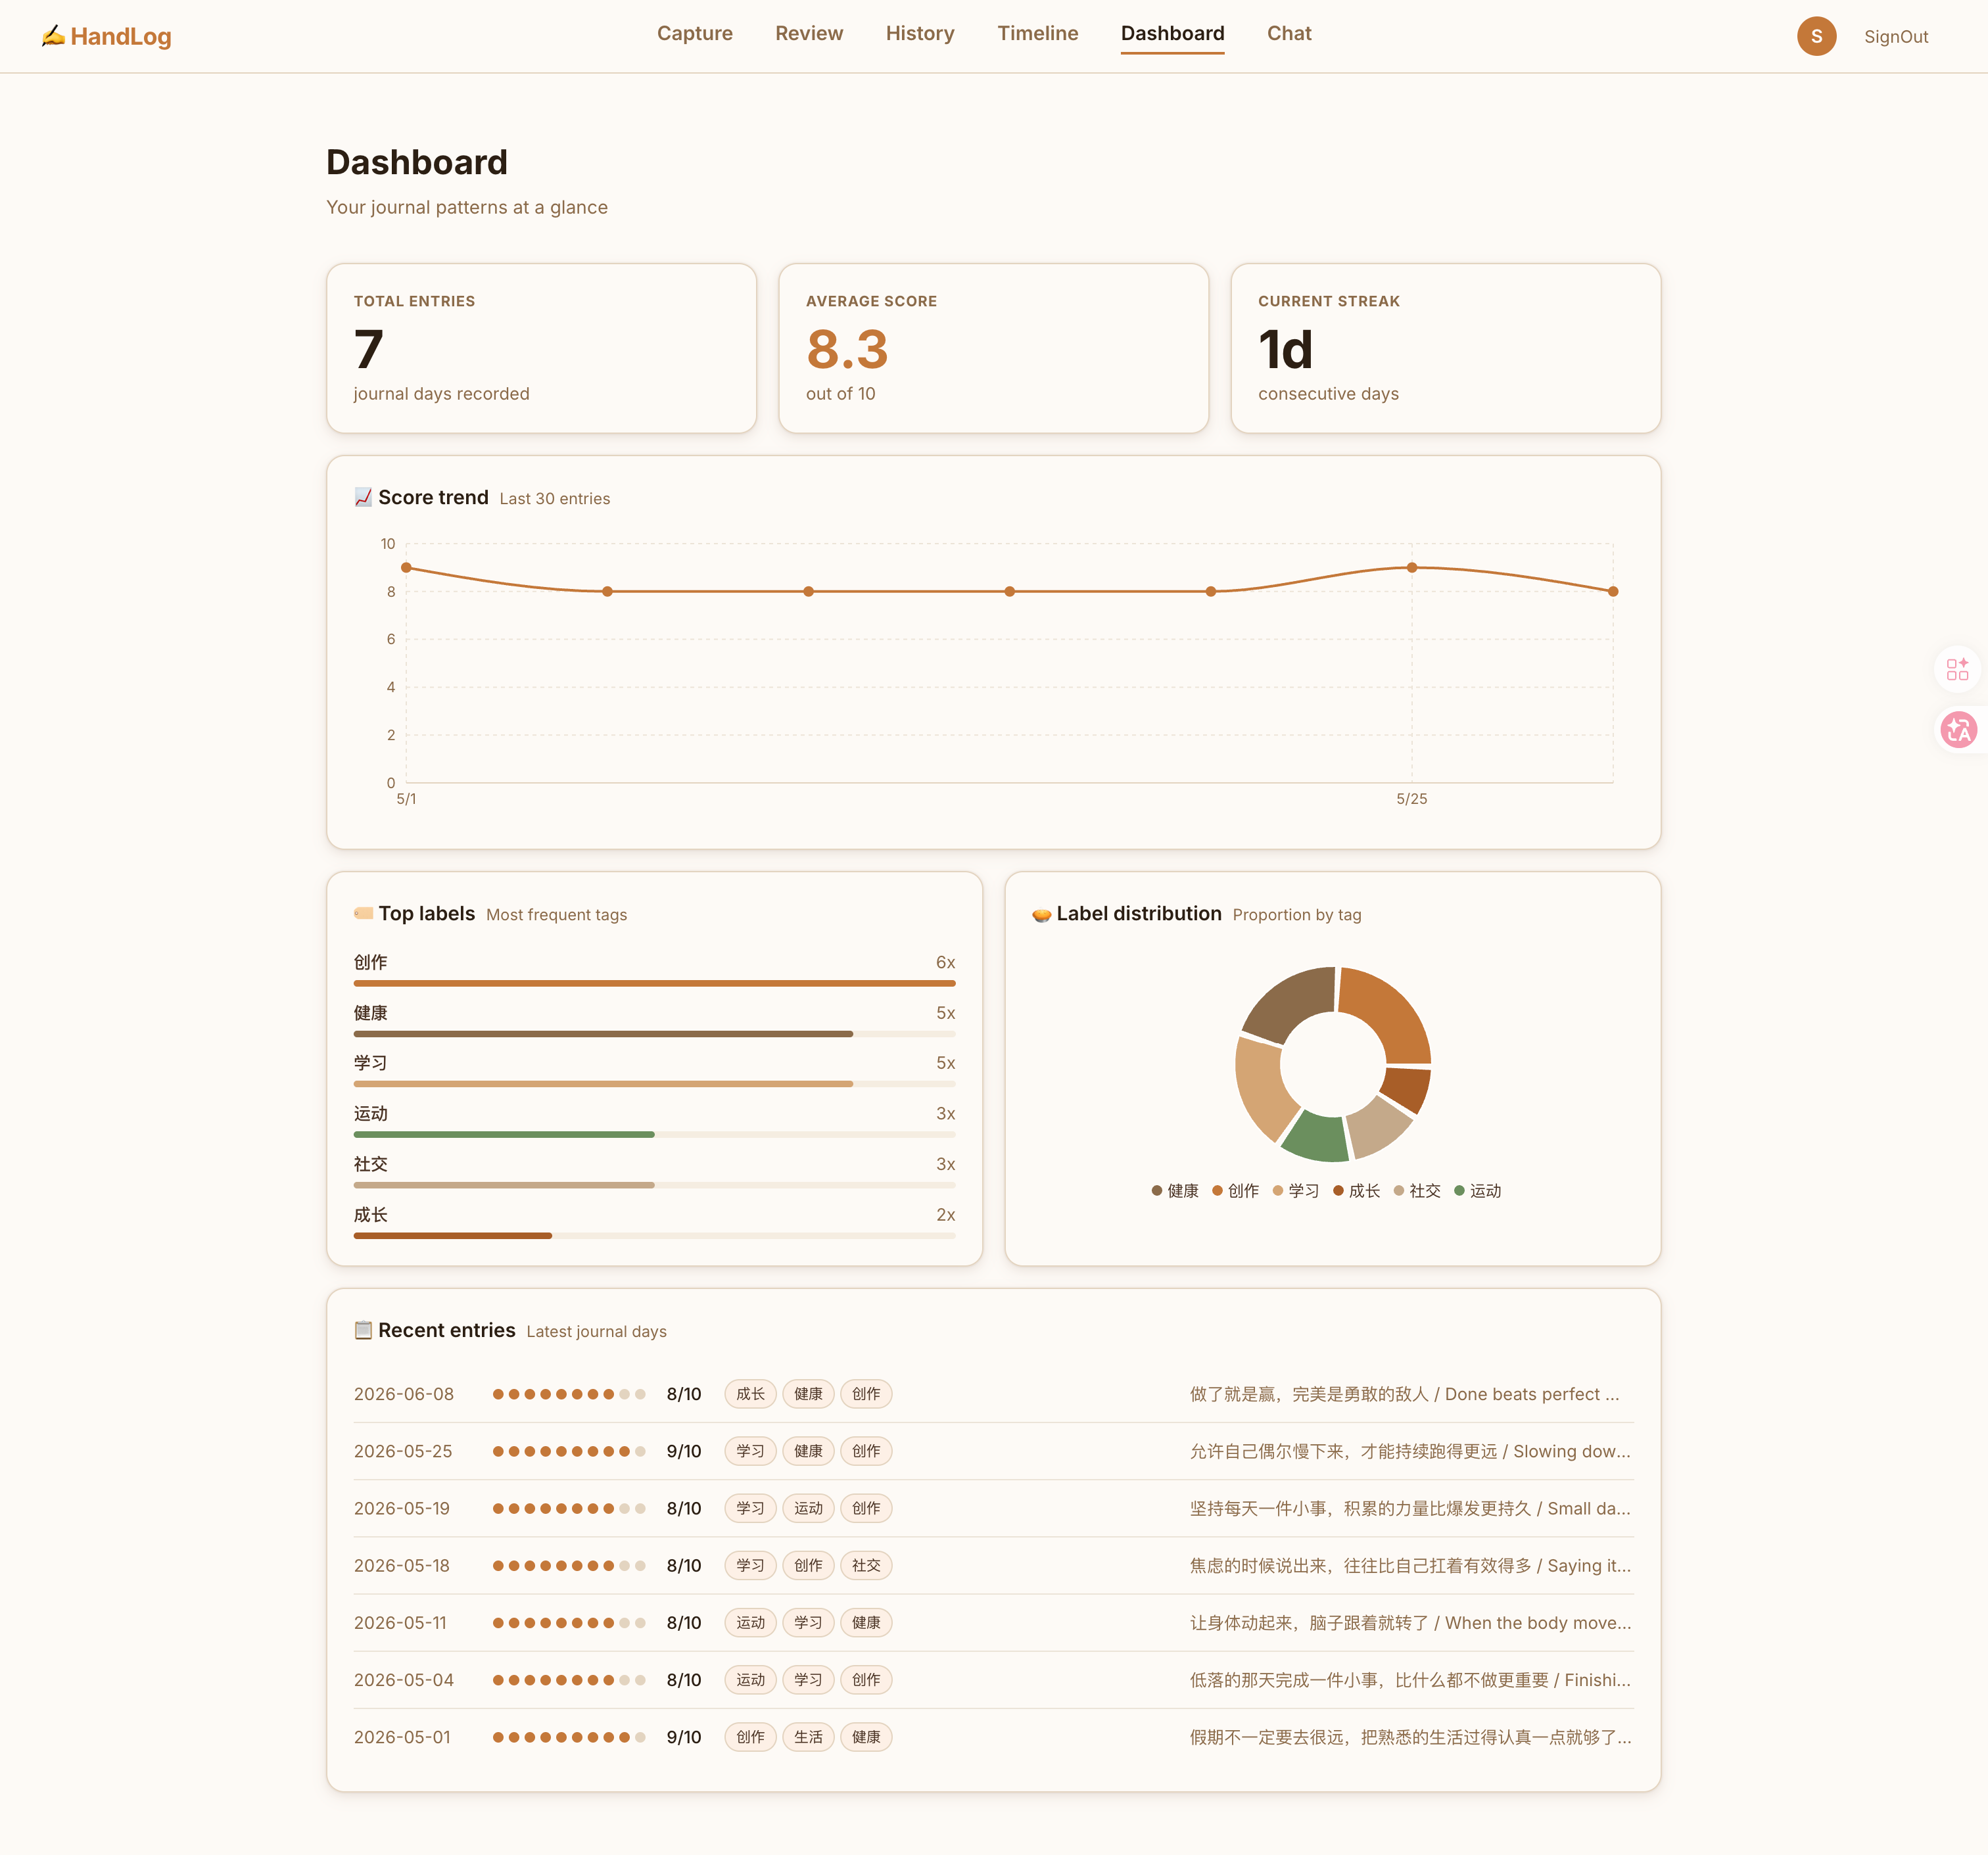
IN ACTION
09
See it
working.
CAPTURE
DAILY REVIEW
Every page has one job — capture, review, reflect, or explore. Daily, weekly & monthly reviews, all AI-generated.
REAL APP
LIVE ON VERCEL
DEEP CHAT
DASHBOARD
✍️ HandLog
handlog.app

Slide 10
BEHIND THE BUILD
10
Built in 7 days.
Shipped to the world.
Claude Code
AI coding assistant — wrote & shipped the app
Claude API
Reviews, mood scores, deep chat
OpenAI Whisper
Solo, from scratch. No prior AI experience — just Claude Code and curiosity. Generates daily, weekly, and monthly reviews automatically. The whole workflow runs on AI-first tools from day one.
Speech-to-text for voice notes
Notion API
Auto-saves entries to your workspace
Vercel
Production hosting, zero-config CI/CD
CLAUDE CODE SKILLS USED
Anthropic Frontend Design Skills
Superpowers
Playwright
UI generation · slide decks · design systems
Persistent memory · cross-session context
Browser automation · end-to-end testing
skills.sh/anthropics/skills
github.com/obra/superpowers
github.com/microsoft/playwright

Slide 11
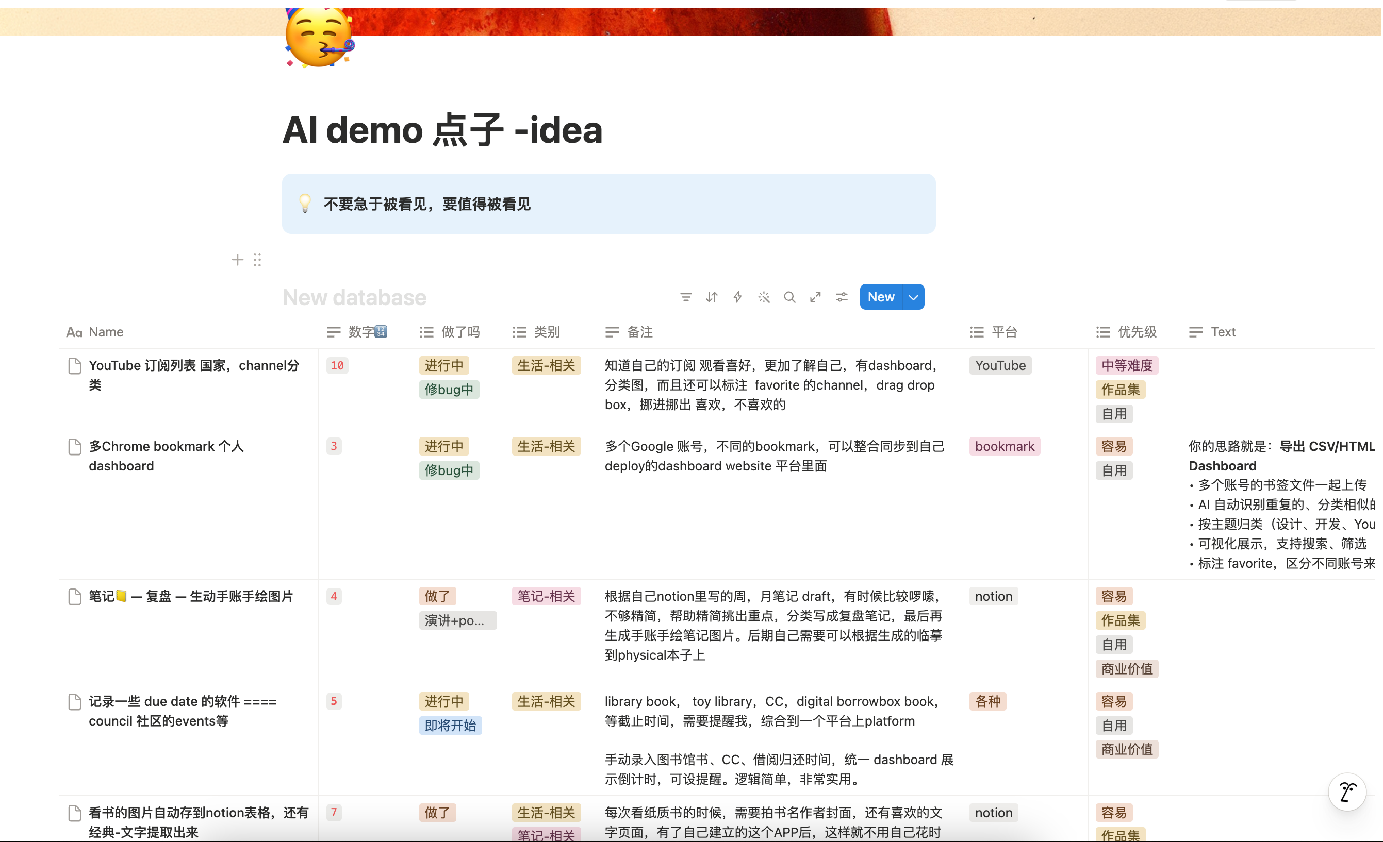
YOU CAN DO THIS TOO
11
Vibe code
your life.
MY AI IDEA TABLE — NOTION
You don't need to be a developer. You just need a problem worth solving and the curiosity to try.
TECHNICAL
NON-TECHNICAL
EVERYONE
Start small
Use AI tools
I keep a Notion table of ideas — problems I notice in my daily life that don't have good solutions yet. When I have time, I pick one and vibe code it into existence.
One problem. One weekend.
Claude Code does the coding.
Ship it
Keep going
"Done is better than perfect — progress comes from action."
Vercel free. Share it.
Next idea. Next weekend.
✍️ HandLog
handlog.app

Slide 12
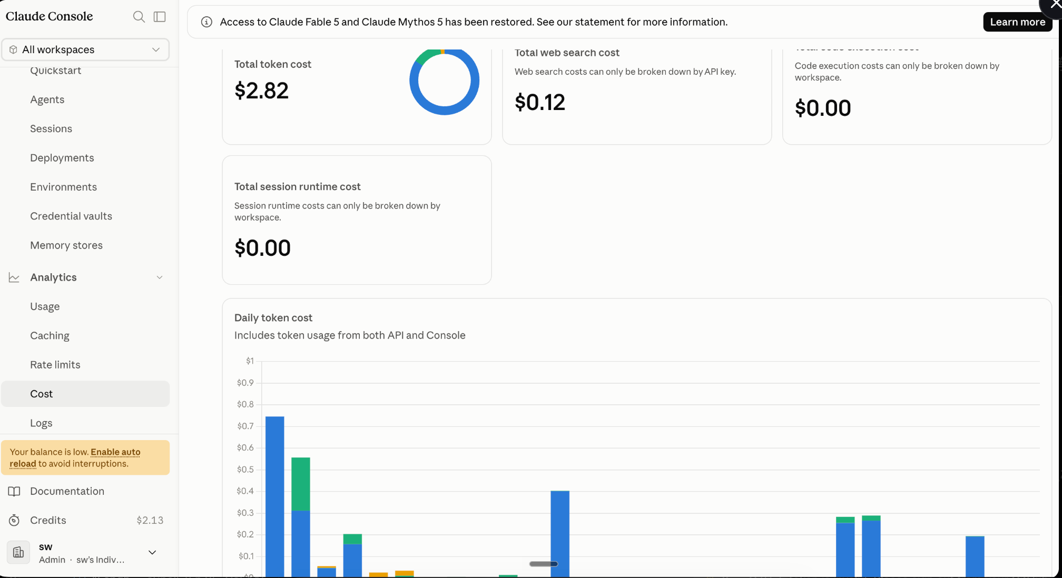
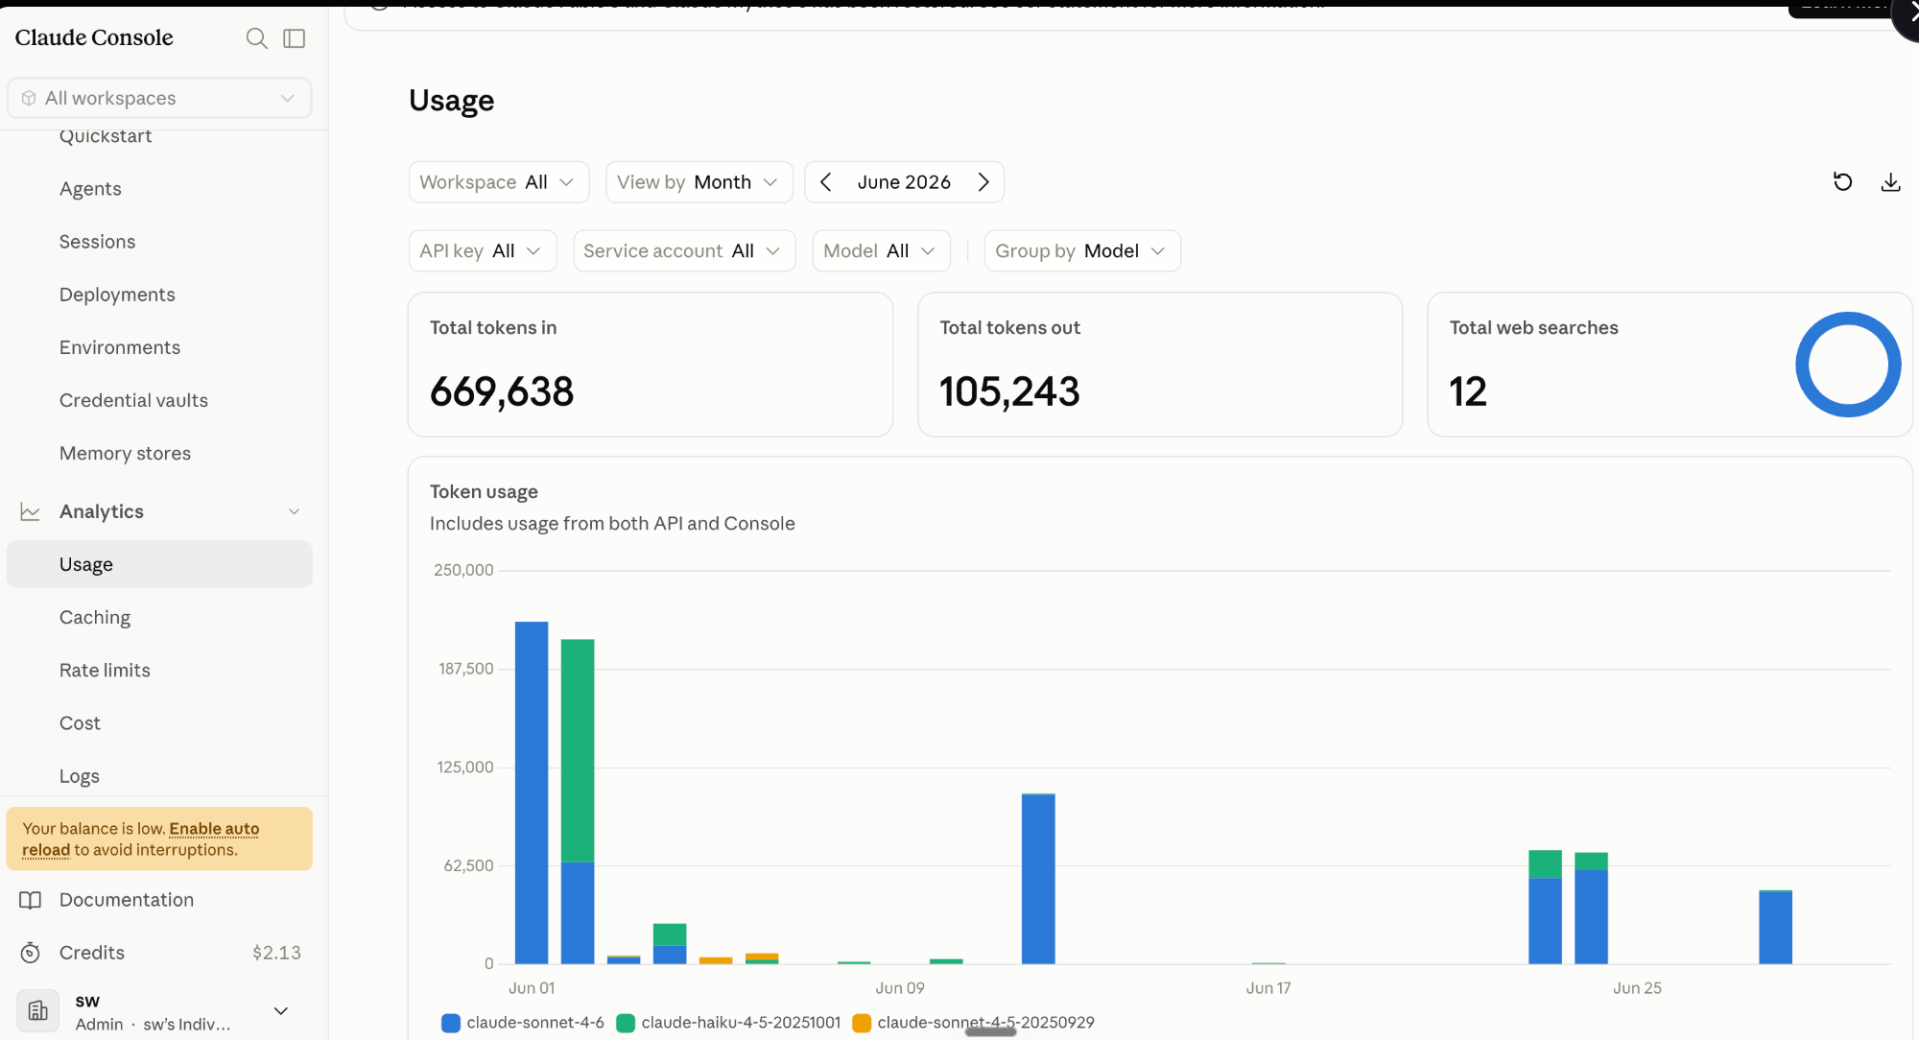
CHEAPER THAN YOU THINK
12
Less than
a cup of coffee.
CLAUDE CONSOLE — USAGE
I topped up $5 on the Claude API.
A month of vibe coding a small project
barely made a dent.
CLAUDE CONSOLE — COST
$2.94
$2.13
Total spent this month (tokens + web search)
Still left on the original $5 top-up
669,638 tokens in · 105,243 tokens out · 12 web searches — and I still have more than half my budget left.
✍️ HandLog
handlog.app

Slide 13
THANK YOU
13
Thank you for being here.
Claude Code + Claude API + Skills + Hooks + Plugins
anthropic.com
OpenAI Whisper API
Michelle ✦
platform.openai.com
For building this community and creating the space for all of us to learn, share, and grow in AI together.
Notion API
developers.notion.com
Doris ✦
For believing in my potential, encouraging me to show up, and recommending Zara Zhang's channel — which inspired this very PPT.
Anthropic Frontend Design Skills
skills.sh/anthropics/skills
This PPT was made with Zara Zhang's frontend-slides.
Try it yourself — it's free and open source.
Superpowers
github.com/obra/superpowers
Playwright
github.com/microsoft/playwright
✍️ HandLog — by Sarah
hand-log.vercel.app

Slide 14
START YOUR JOURNEY
Your story,
remembered.
Capture today. Let AI make sense of your week.
Your memories, structured and searchable — forever.
Try HandLog Free
View on GitHub
✍️ HandLog — AI Journal
hand-log.vercel.app

