Slide 1

Using Python in R with Reticulate
Sarah Murphy
R Working Group
Wednesday, April 14, 2021

Slide 2
Installation
libraries.install(‘reticulate’)

Slide 3
When you install reticulate you are also:
Installing Miniconda
Small Anaconda installer that comes with only the essentials
This is your Python package manager
Creating a new Python environment called r-reticulate
This is where you will install your Python packages
You don’t have to use this environment if you have a different one you’d like to use
Notes:
https://rstudio.github.io/reticulate/
https://www.rstudio.com/resources/webinars/r-python-in-rstudio-1-2-with-reticulate/

Slide 4
Ways to use
Python code blocks in R Markdown
Interactively
Using Python commands directly in an R script
Sourcing Python scripts

Slide 5
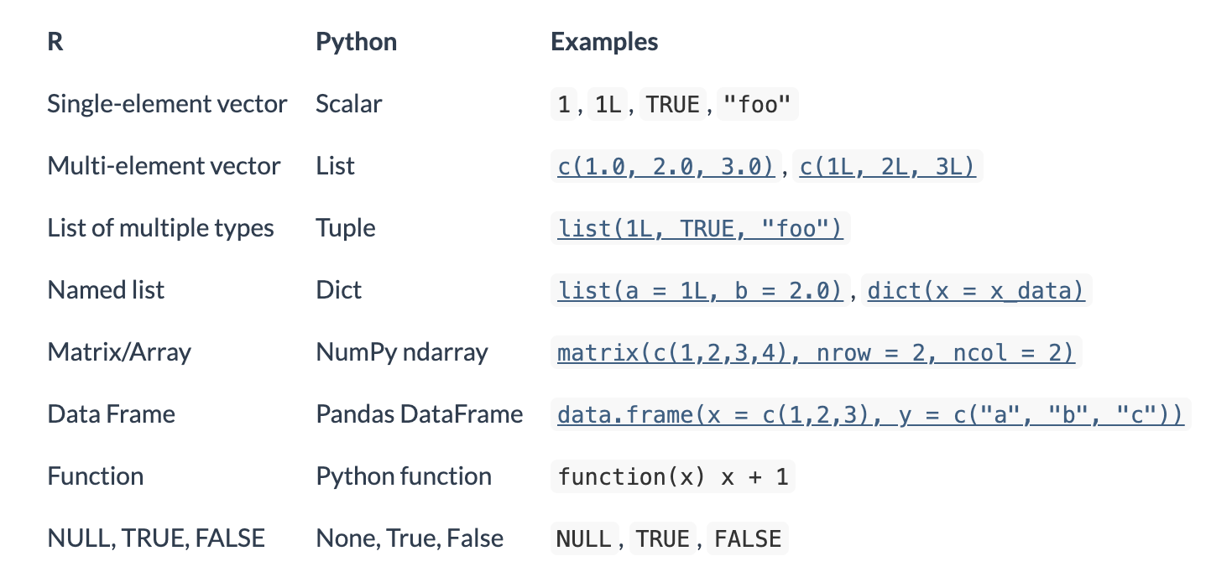
Data type and syntax differences
Python data types will be converted to the equivalent R type
Python commands use ‘$’ in R instead of ‘.’
Python command in Python
plt.plot(data)
Python command in R
plt$plot(data)
Data types table from rstudio.github.io/reticulate

Slide 6
Sources
General reticulate information:
https://rstudio.github.io/reticulate/
Using Python in R
Python example based on examples from:
http://xarray.pydata.org/en/stable/examples/ERA5-GRIB-example.html
http://xarray.pydata.org/en/stable/plotting.html
Cover image from: https://blog.rstudio.com/2018/03/26/reticulate-r-interface-to-python/
Table on slide 5: https://rstudio.github.io/reticulate/index.html#importing-python-modules

Slide 7
Installing Packages for your Python environment on the command line
These commands may not work using the terminal within R studio. They should work anywhere else bash commands work.
source activate r-reticulate
conda install <package name>
Sometimes you need to use conda-forge
conda install -c conda-forge <package name>
You can find the command to install different python packages here: https://anaconda.org/
Notes:
You can find work arounds to the R studio issue on google if you’re determine to make that work

