Slide 1
Sarah Murphy Research Summary
January 15, 2021

Slide 2
Ph.D. Research Questions
What are the important factors that influence the surface energy budget over young, thin sea ice? In particular, what are the contributions from longwave and shortwave radiation, and sensible and latent heat?
How do the boundary-layer and cloud-microphysics schemes in polar WRF perform under the conditions observed during the N-ICE field campaign?
What is the accuracy of polar WRF simulations as compared to the N-ICE measurements?
What modifications can be made to improve polar WRF’s simulation of the surface energy of the Arctic?

Slide 3
Ph.D. Research Questions
What are the important factors that influence the surface energy budget over young, thin sea ice? In particular, what are the contributions from longwave and shortwave radiation, and sensible and latent heat?
Paper currently being edited
How do the boundary-layer and cloud-microphysics schemes in polar WRF perform under the conditions observed during the N-ICE field campaign?
What is the accuracy of polar WRF simulations as compared to the N-ICE measurements?
What modifications can be made to improve polar WRF’s simulation of the surface energy of the Arctic?

Slide 4
Schemes | Microphysics Schemes Details
Goddard (Tao et al. 1989) | Commonly found in both polar and non-polar applications Developed for tropical and midlatitude events Three ice-phase categories (cloud ice, snow, hail)
WRF Single-Moment 5-Class (Hong et al. 2004) | Commonly found in both polar and non-polar applications Has 5 particle classes (vapor, cloud, ice, rain, snow) Accurate representation of cloud-radiation feedback with ice clouds
Morrison Bulk Two-Moment (Morrison et al. 2009) | 5 particle categories: cloud droplets, cloud ice, rain, snow, and graupel. Two moment scheme: size distribution evolves freely from predicted number concentration and mixing ratio Originally created and tested for squall lines
Predicted Particle Properties (P3) (Morrison and Milbrandt 2015) | Advances to Morrison Bulk Two-Moment Removes conversion between cold phase particle categories – one ice phase category Tested in mid-latitude situations – for large cloud particle sizes Can not resolve a variety of types at one locations – dilution problem
Notes:
https://collaboration.cmc.ec.gc.ca/science/rpn/SEM/dossiers/2014/seminaires/2014-11-28/Seminar_2014-11-28_Jason-Milbrandt.pdf
Inappropriate for polar regions

Slide 5
Schemes | Boundary Layer Schemes Details
Yonsei University (Hong et al. 2006) | First-order closure Commonly found in both polar and non-polar applications Important feature: including of explicit treatment of entrainment at the top of the PBL (treated implicitly in other schemes). Was developed for use in hurricane forecasts and over the United States
Mellor-Yamada-Janjic (Janjic 1994) | 1.5-order closure Best for slightly unstable and stable flows.
Mellor-Yamada-Nakanishi-Niino (Nakanishi and Niino 2004) | Second-order closure scheme Modified version of the Mellor-Yamada-Janjic scheme Reevaluated closure constants Improvements based on large-eddy-simulation data for the dry planetary boundary layer Improved condensation physics

Slide 6
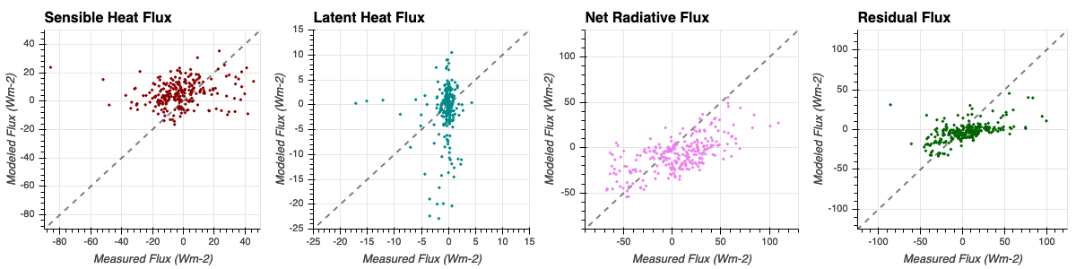
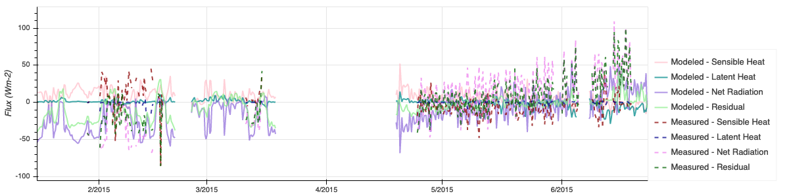
Surface Energy Budget Scatterplots and Timeseries
a Representative Model Run vs the Measurements
(P3 & MYJ)

Slide 7
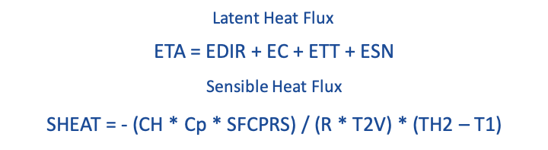
Latent and Sensible Heat Flux Equations Land Surface Model

Slide 8

Latent Heat Equation
ETA = EDIR + EC + ETT + ESN
Soil, vegetation, and canopy do not exist in our situation.
EDIR: Direct soil evaporation
EC: Canopy resistance
ETT: Vegetation transpiration
ESN: Sublimation and deposition from snowpack
E_{p} = Potential evapotranspiration
F_{sn} = Fractional snow coverage
α_{s} = Distribution shape parameter
W = Snow water equivalent
W_{max} = Maximum snow water equivalent dependent on vegetation type
= Constant in all model runs
= Potential source of difference between model runs

Slide 9

Sensible Heat Equation
Differences of up to 0.3
Differences of up to 15 K
SHEAT = - (CH * Cp * SFCPRS) / (R * T2V) * (TH2 – T1)
CH = C_{hs} * wind speed
Cp = 1004.5 J K⁻¹ Kg⁻¹
SFCPRS = Surface Pressure
R = 287.04 J K⁻¹ Kg⁻¹
T2V = SFCTMP * (1.0 + 0.61 * Q2)
SFCTMP = Surface temperature
Q2 = Mixing ratio of first level above ground
TH2 = Potential temperature at first level above ground
T1 = Skin temperature
Stability parameter
to be determined
k = Von Karman constant
u* = Friction velocity
Z = Height above surface
Z₀ = Surface roughness
Ψ_{h} = Stability parameter
= Constant in all model runs
= Potential source of difference between model runs

Slide 10
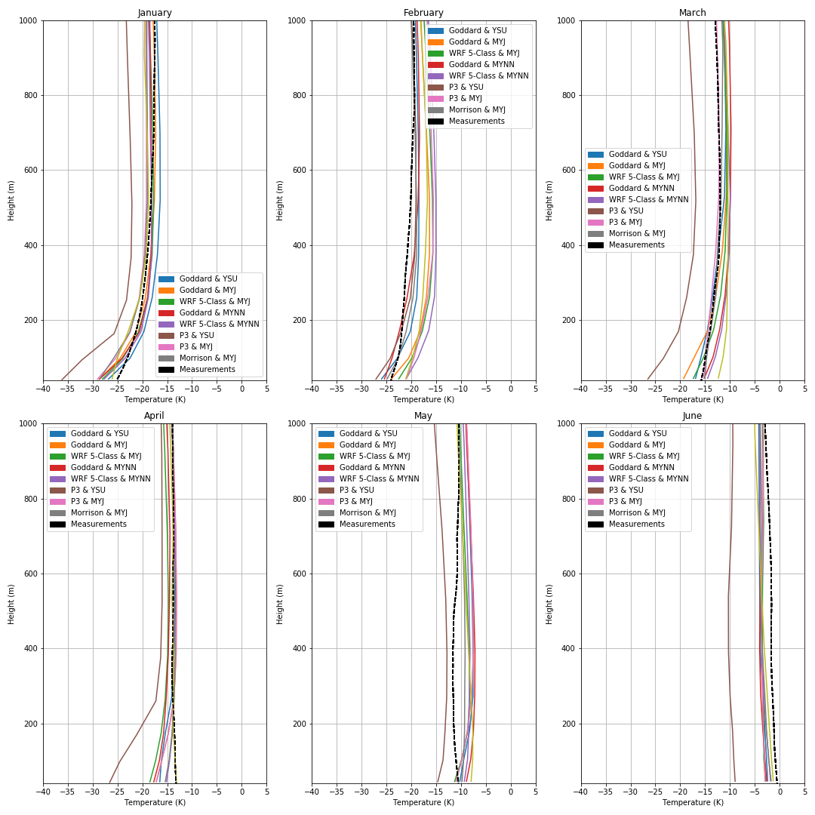
Vertical Temperature Profiles

Slide 11
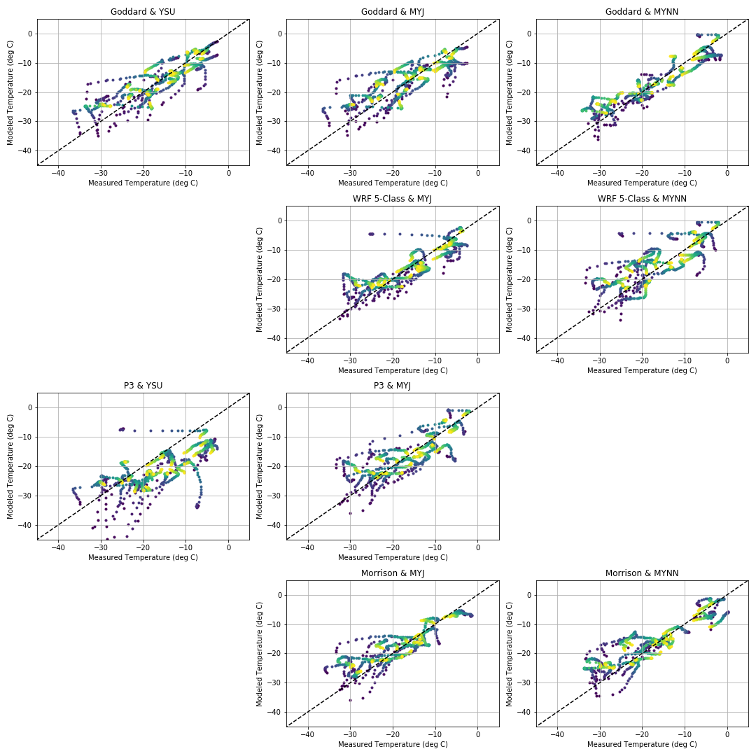
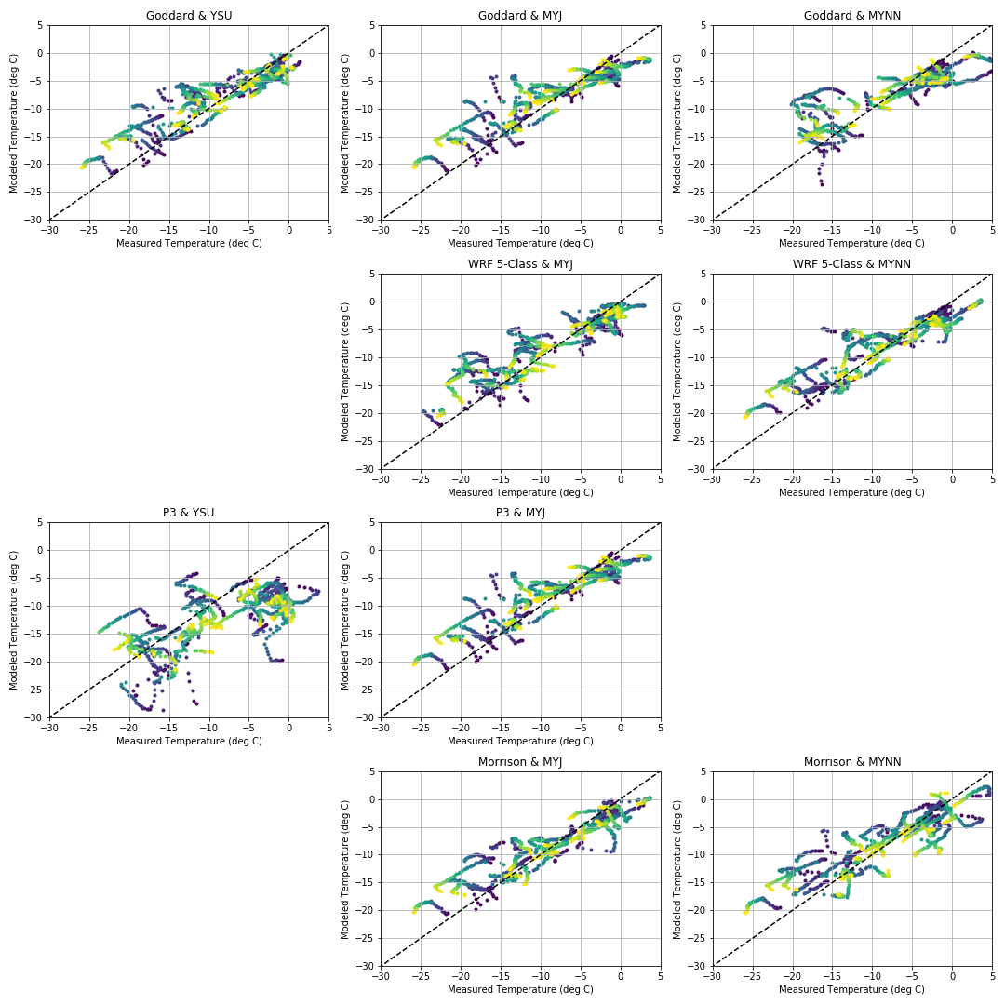
Scatterplots of the lowest 1km
Winter
Spring/Summer

Slide 12
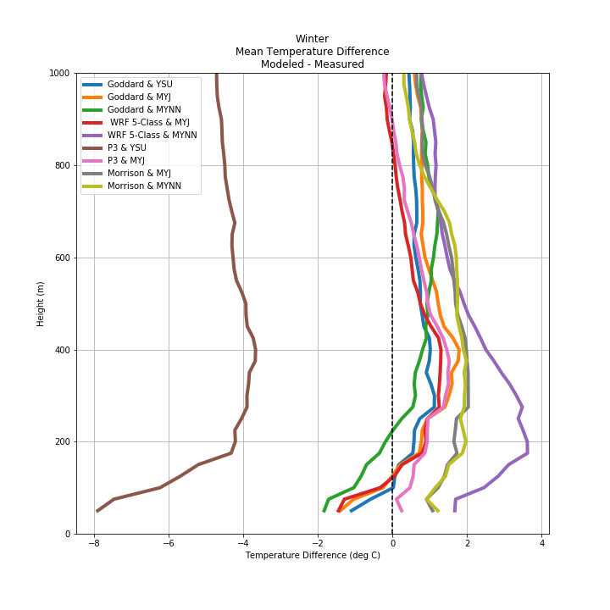
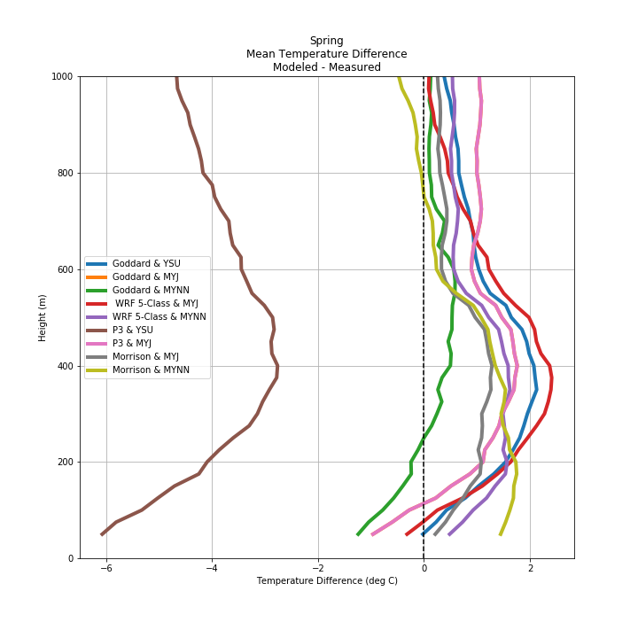
Temperature Differences in the lowest 1km

