Slide 1
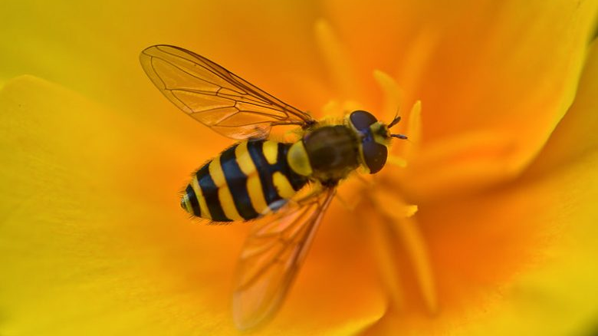
Project Hoverfly
Theoretical Ecology Practical
30.10.2025
Sarai and Charith

Slide 2
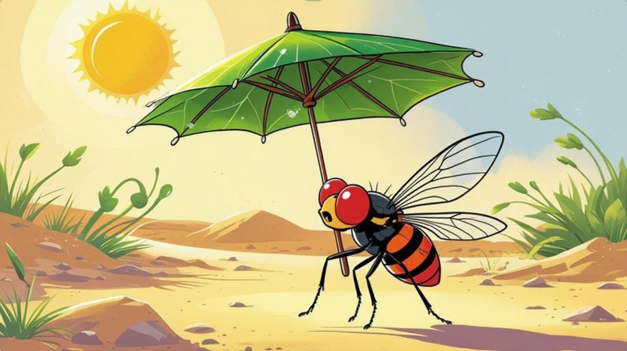
Introduction
Climate change causes more temperature extremes, threatening population survival
Insect, being ectothermic, are highly sensitive to heat stress (Heal et al. 1988)
Egg dormancy helps survive stress but delays reproduction and adult survival drives population growth
Evolutionary rescue happens when adaptive mutations prevent extintion
Mutation affecting specific life stages may determine survival under stress
Notes:
Climate change is driving more frequent temperature extremes, threatening population persistence. Insects, as ectotherms, are highly sensitive to thermal stress especially during developmental stages.
Evolutionary rescue occurs when beneficial mutations spread fast enough to prevent extinction.
Understanding how life-stage-specific mutations (e.g., in egg hatching or adult fecundity) influence rescue is key to predicting survival under temperature stress.

Slide 3
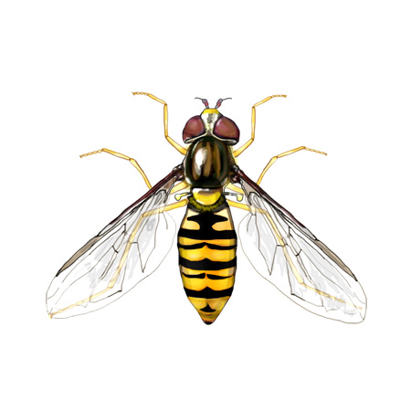
How do new mutations in a species with different life stages influence evolutionary rescue of the population under temperature stress?

Slide 4
Model species - Hoverfly
Important worldwide pollinators and pest control (Doyle et al. 2020)
4 life stages (egg, larva, pupa, adult)
Optimal hatching temperature range 17-23°C
Ambient temperature affects developmental time and adult coloration (Danková et al. 2023)

Slide 5

Model Overview
Stochastic simulation
2 genotypes: wildtype and mutant, Haploid
Wildtype Mutant
Only eggs survive into next generation
Mutation
Parameters | Description | Values
Z_w, Z_m | Initial population of wildtype and mutant eggs | 100w, 50m
f_w, f_m | Fecundity wildtype and mutant (eggs per adult) | 2-3w, 2-4m
hZ_w, hZ_m | Hatching rate | 0.5w, 0.55m
pZ_w, pZ_m | Egg survival probability | 0.4w, 0.55m
mut_rate | Mutation rate | 0-0.05
t_max | Maximum generations simulated | 200
Notes:
Add Values,
Haploid

Slide 6
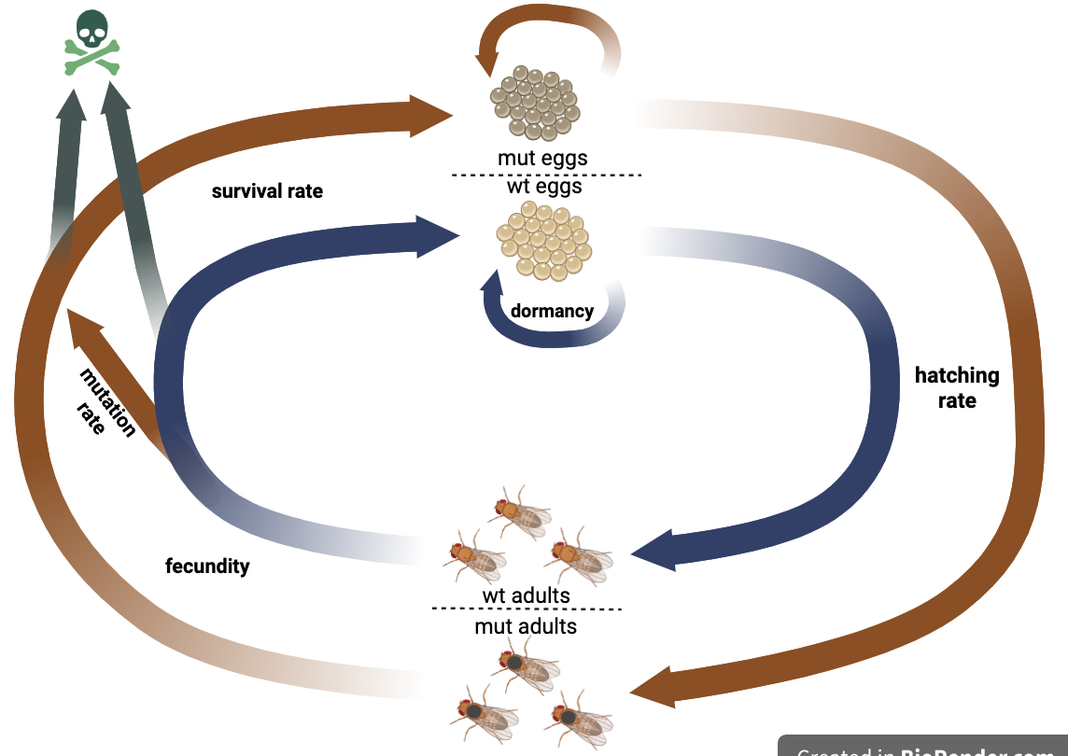
Modeling the Life Cycle
Notes:
Only one death

Slide 7
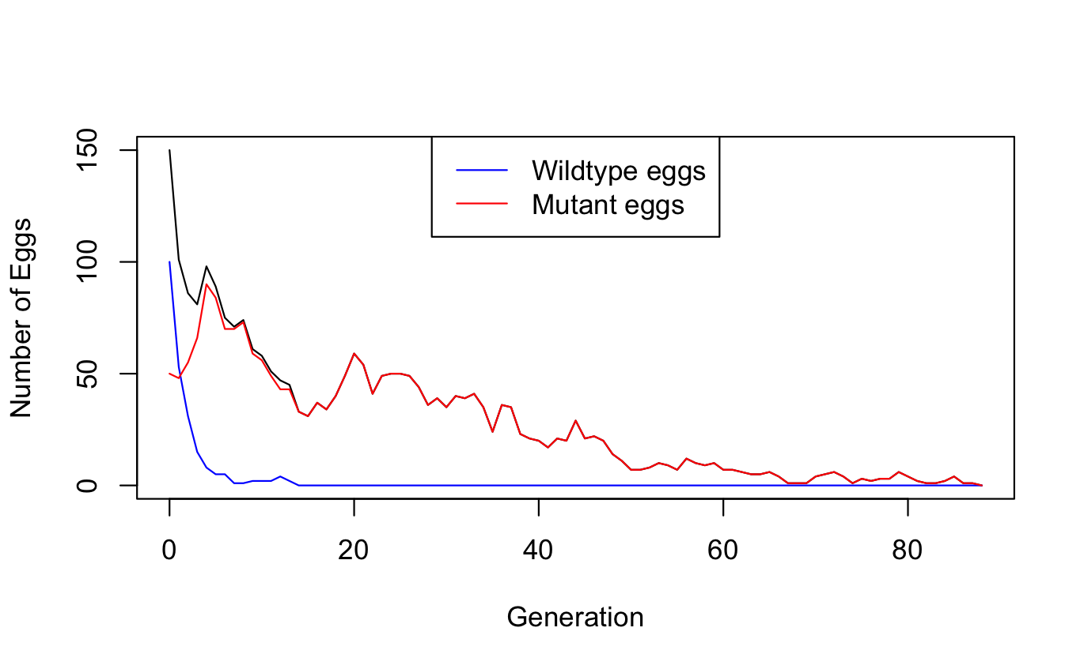
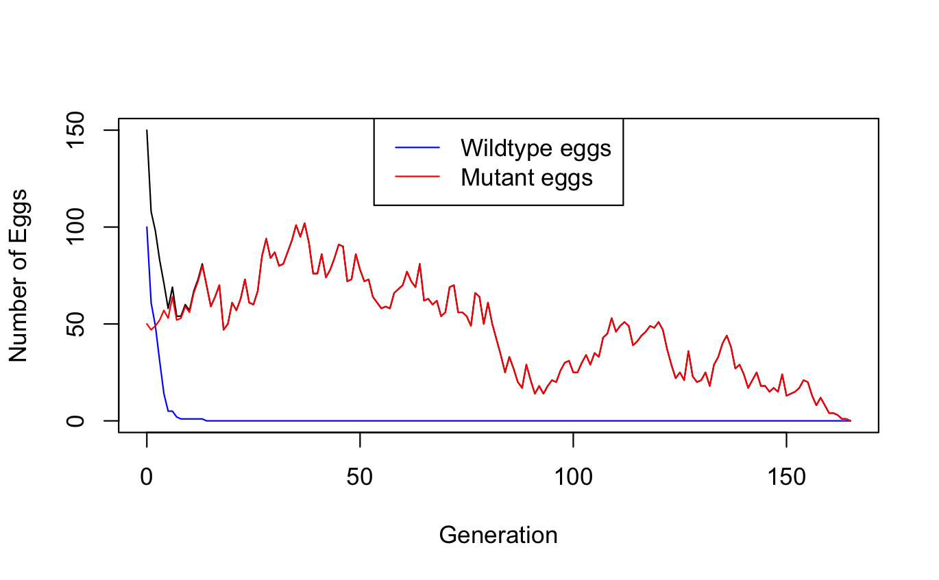
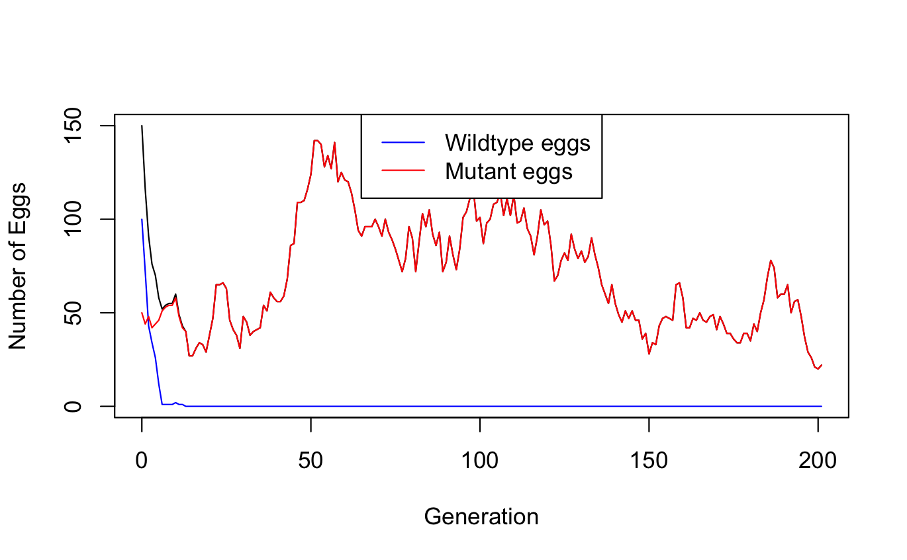
Parameters: | wildtype | mutant
initial population | 100 | 50
fecundity | 2 | 2.5
hatching rate | 0.5 | 0.55
survival rate | 0.4 | 0.55
mutation rate | 0.001
Notes:
Here you can see multiple rounds of our model with the same parameters, you can see that every round is different than the other and that rescue is not always guaranteed with these parameters
And rescue, as you can see here is often provided by the mutant genotype
These many versions of the same model are due to stochasticity, which in our model is even stronger, because to calculate our two life stages we take values from poisson and binomial distributions

Slide 8
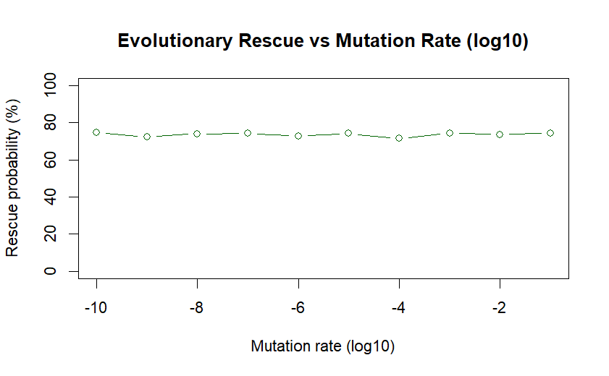
Mutation Rate does not matter!
Parameters: | wildtype | mutant
initial population | 100 | 50
fecundity | 2 | 2.5
hatching rate | 0.5 | 0.55
survival rate | 0.4 | 0.55
mutation rate | 1e-10 – 0.1
Notes:
Firstly we studied how the mutation rate affects the rescue probability in our model and we found that mutation rate doesn’t seem to have an effect on the probability of rescue of the population

Slide 9
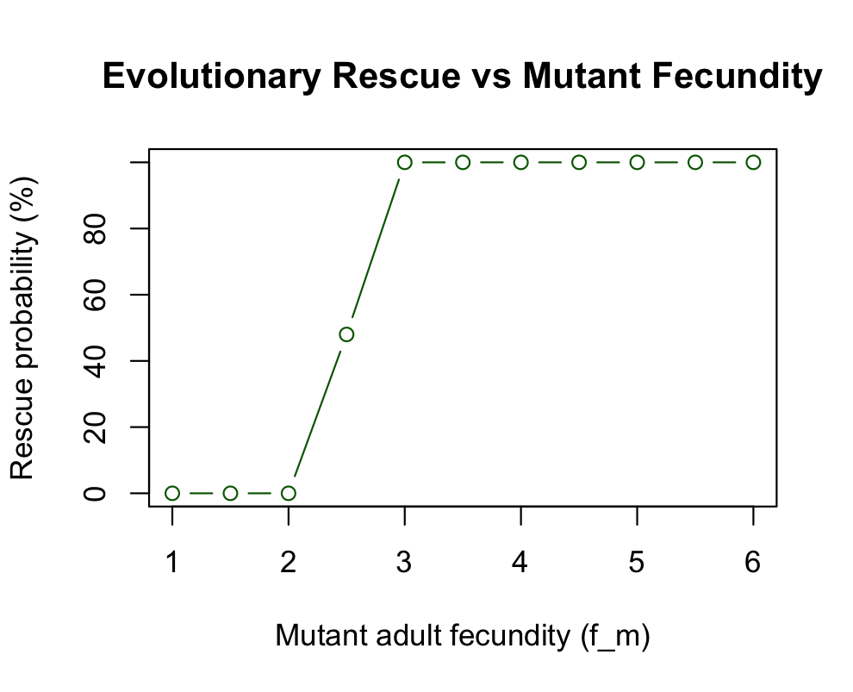
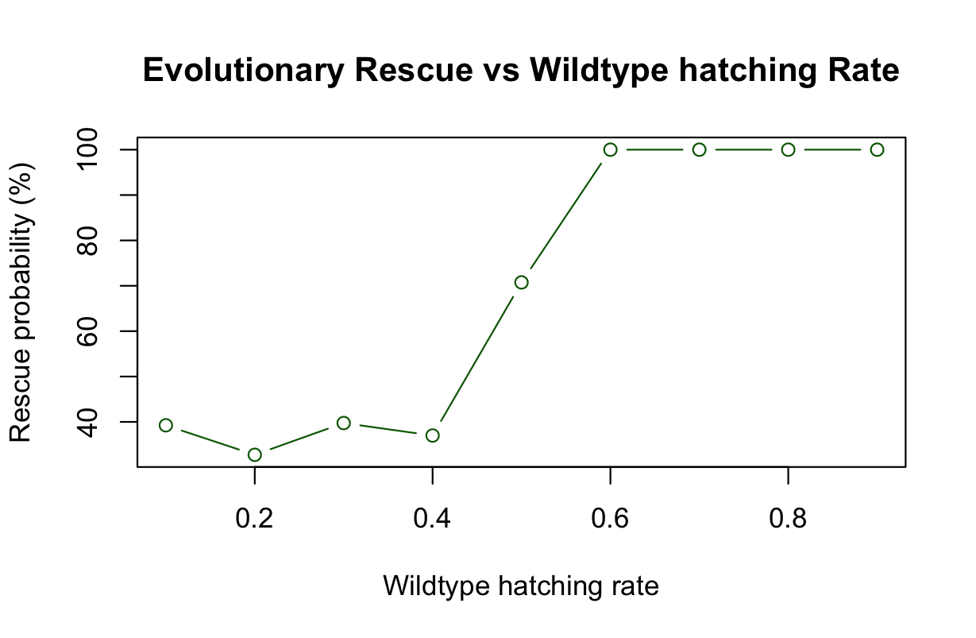
Parameters: | wildtype | mutant
initial pop. | 100 | 50
fecundity | 2 | 0 – 6 or 2.5
hatching rate | 0.5 or 0 - 1 | 0 - 1
survival rate | 0.4 | 0.55
mutation rate | 0.001
Notes:
With this set of parameters we can see that when mutant adult frequency the threshold of 2.5 reaches the rescue probability goes up to a 100%
We computed the same for the wildtype hatching rate for which the same happens from 0.6, above that value, rescue is guaranteed

Slide 10
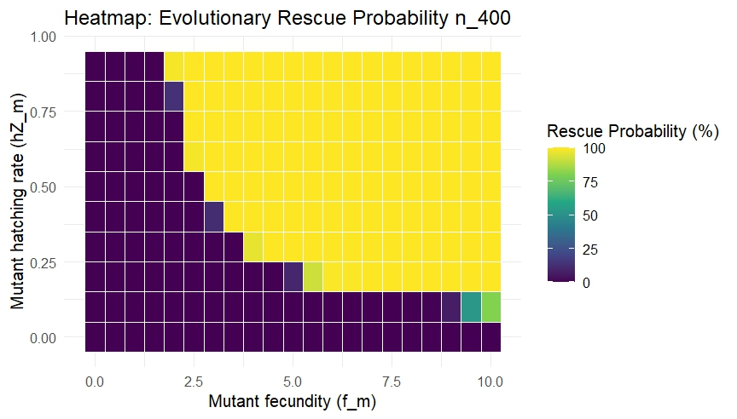
Evolutionary Rescue Probability with Mutant hatching rate vs Mutant fecundity
Parameters: | wildtype | mutant
initial pop. | 100 | 50
fecundity | 2 | 0 - 10
hatching rate | 0.5 | 0 - 1
survival rate | 0.4 | 0.55
mutation rate | 0.001
Notes:
3D heatmap
Here we can see that mutant fecundity and hatching rate dependant are from each other
The fecundity can be very high , but this doesn’t affect rescue probability if the hatching rate is also low, which also makes a lot of biological sense
The same for hatching rate, doesn’t matter how high it is, some fecundity is needed for population rescue

Slide 11
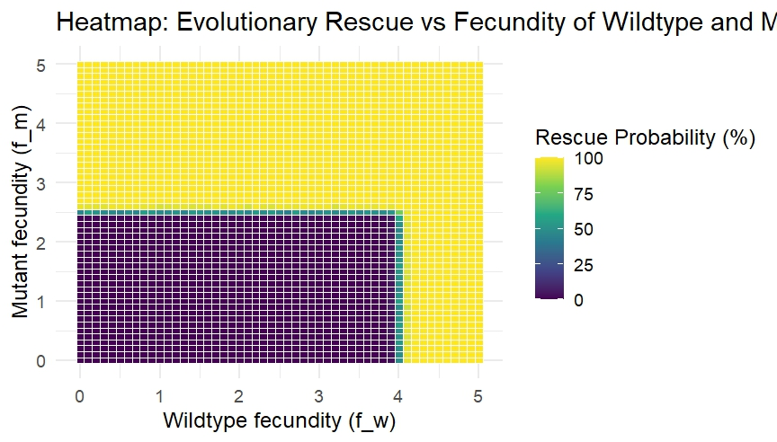
Evolutionary Rescue vs Fecundity of Wildtype and Mutant (Number of round 200)
Parameters: | wildtype | mutant
initial pop. | 100 | 50
fecundity | 0 - 5 | 0 - 5
hatching rate | 0.5 | 0.55
survival rate | 0.4 | 0.55
mutation rate | 0.001
Notes:
Here we can again see codependence of the fitness parameters
Here we look at both fecundities, we see asymmetry, that’s because, since all other parameters for the mutant fitness are higher, already lower levels of fecundity would rescue the population
For the wildtype genotype to save the population it would take a higher fecundity rate with these other parameters

Slide 12

Biological Interpretation
Population survival under stress depends on hatching success and fecundity.
Even rare beneficial mutations can enable rescue.
Low hatching or fecundity leads to extinction despite mutation potential
This highlights how life-stage adaptations can buffer insect populations against climate-driven stress.
Notes:
Population survival under stress hinges on egg hatching success and adult fecundity traits directly shaping recovery potential.
rare beneficial mutations (e.g., improving hatching or reproduction)

Slide 13
Limitations & Future Work
Limitations:
Only two life stages
Constant temperature
Time availability
Future work:
All life stages
Fluctuation or extreme temperature regimes
Add genetic diversity
Notes:
doesn’t capture real environmental fluctuations or extreme heat events.
(egg → larva → pupa → adult) to capture full life-cycle effects.
reflect climate variability.
(multiple loci or mutation types) to better reflect real evolutionary potential.

Slide 14
Summary & Take-home Message
Benificial muatation can rescue population from extinction under environment stress.
Rescue depends more on fitness than on mutation rate alone.
Life stage traits strongly influnce survival
A similar refined model could be used for conservation approaches
Notes:
Our simulations show that even rare beneficial mutations can allow a population to recover under stress, but the strength of that mutation’s advantage matters more than how often it arises. Since hatching and fecundity determine success, this model helps us understand how life stages contribute to population persistence, and similar models could guide conservation strategies under climate change.

Slide 15
References
Daňková K, Nicholas S, Nordström K. 2023 Temperature during pupal development affects hoverfly developmental time, adult life span, and wing length. Ecology and Evolution. https://doi.org/10.1002/ece3.10516
Doyle T, Hawkes WLS, Massy R, Powney GD, Menz MHM, Wotton KR. 2020 Pollination by hoverflies in the Anthropocene. Proc. R. Soc. B 287: 20200508. http://dx.doi.org/10.1098/rspb.2020.0508
Heal J. 1988 Variation and seasonal changes in hoverfly species: interactions between temperature , age and genotype

Slide 16
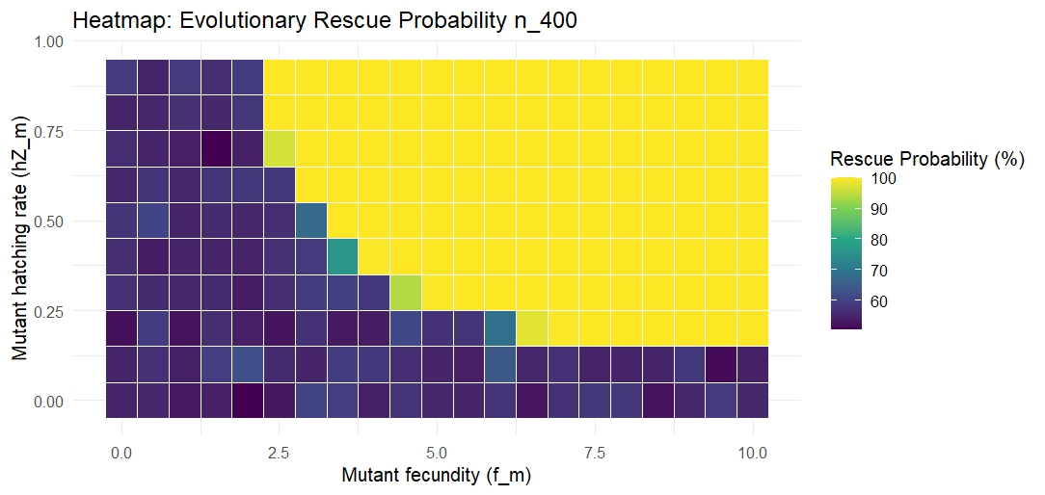
Parameters: | wildtype | mutant
initial pop. | 100 | 50
fecundity | 3 | 0 - 10
hatching rate | 0.5 | 0 - 1
survival rate | 0.5 | 0.5
mutation rate | 0.001

